Slide 1
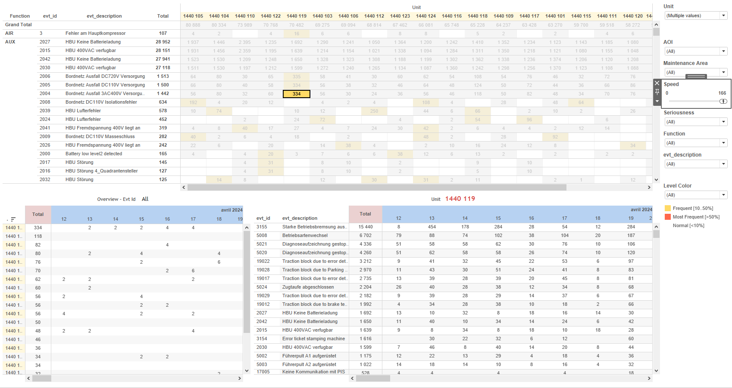
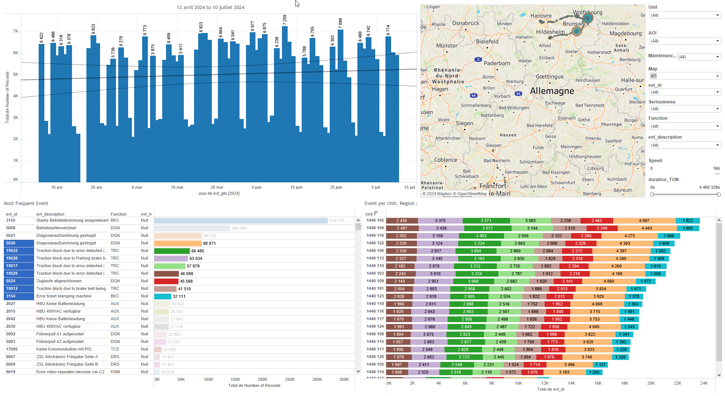
DATA VISUALIZATION REPORT SHEET
HealthHub
HDF_perf
Standard
Event Analysis
Represented By
prj version HDF_url Copy file to minio 21Mb(s) Git pull(s) Create data Table 10millions lignes(s) Copy file locally 21Mb(s) Copy file from minio 21Mb(s) Source AlstomReport Lib 2500 lines Read RDATA file localy 21Mb(s)
GENERAL DESCRIPTION
This report offers a detailed overview of performance data, focusing on metrics such as the time taken to copy files and the number of Git pulls. It includes various tables and visualizations categorized by project and version, allowing for in-depth data exploration and trend identification.
MAIN CHARACTERISTICS | Description
Project | Any project
Domain | Statistics
Type of report | Data Exploration - Operational Time Series (OPDAT)
Report's Objective | Provide a comprehensive analysis of performance data across various projects and versions. Enable users to filter data by project and version. Facilitate interaction with multiple tables to understand the impact of different versions on various performance metrics.

Slide 2
Constitution du rapport 1/3
Peformance Misc. Dashboard
The 'Peformance Misc.' dashboard provides a comprehensive analysis of performance data across various projects and versions. It allows users to filter data by project and version, explore detailed performance metrics, and interact with multiple tables to understand the impact of different versions on various performance metrics.
Position | Exemple de question | Description
top right | What is the average time to copy a 21Mb file locally? | This table visualizes the performance data categorized by project (prj) and version. The x-axis represents the time taken to copy a 21Mb file locally, while the fill axis uses the version to color each cell.
top left | What is the version of the data based on the HDF_url and how is the data table with 10 million lines created? | This table visualizes the performance data by project, with each cell color-coded based on the version (V1, V2, V3). The x-axis represents the time to create a data table with 10 million rows, while the y-axis categorizes the projects.
bottom right | What is the version of the HDF file and how does it affect the reading of the RDATA file locally? | This table displays the project versions categorized by 'prj' and colored based on the version derived from the HDF_url.
bottom left | What is the version of the HDF_url and how does it relate to saving the RDATA file locally? | This table visualizes the performance data by project (prj) and version, where the version is determined based on the HDF_url. The x-axis represents the 'Save RDATA file locally 21Mb(s)' metric.
Principaux Filtres/Paramètres
Filtrage par | Description

Slide 3
Constitution du rapport 2/3
Performance GIT Dashboard
The 'Performance GIT' dashboard provides a comprehensive overview of Git pull activities categorized by project version. It allows for detailed data exploration through a color-coded tabular format, enabling users to quickly identify trends and patterns.
Position | Exemple de question | Description
center | What is the average number of Git pulls? | This plot visualizes the number of Git pulls categorized by project version. The data is represented in a tabular format, with each cell color-coded based on the version.
Principaux Filtres/Paramètres
Filtrage par | Description

Slide 4
Constitution du rapport 3/3
Performance Minio Dashboard
The 'Performance Minio' dashboard provides an in-depth analysis of the performance data by project versions, specifically focusing on the time taken to copy a 21MB file to MinIO. It allows users to explore detailed performance metrics categorized by HDF URL versions and compare them interactively through tables.
Position | Exemple de question | Description
left | How does the version of HDF_url affect the performance of copying a 21Mb file from minio? | This table visualizes the performance data by project, with versions indicated by color.
right | What is the average time taken to copy a 21MB file to MinIO? | This table shows the performance of different project versions based on the time taken to copy a 21Mb file to Minio. The versions are categorized into V1, V2, and V3 based on the HDF URL.
Principaux Filtres/Paramètres
Filtrage par | Description

Slide 5
Liste des variables
GENERAL DESCRIPTION
La liste des variables ci-dessous est necessaire pour la constitution du rapport. Pour le projet [Projet] leur equivalence doit être fournie avec la plage de Valeur associée en cas de demande de rapport.
Variable | Description
Copy file from minio 21Mb(s) | This variable measures the time taken to copy a 21MB file from Minio storage. It is used to evaluate performance in various dashboards.
Copy file locally 21Mb(s) | This variable tracks the time taken to copy a 21MB file locally. It is recorded as operational data.
Copy file to minio 21Mb(s) | This variable tracks the performance of copying files to a Minio server. It is recorded as operational data.
Create data Table 10millions lignes(s) | This variable is used to create a large data table with 10 million rows. It is recorded as operational data.
Git pull(s) | This variable measures the number of Git pull operations. It is recorded as operational data.
HDF_url | This variable is used to identify different versions of the HDF. It is critical for distinguishing between versions in performance tests.
Read RDATA file localy 21Mb(s) | This variable measures the time to read a local RDATA file of 21Mb. It is used in performance analysis dashboards.
Save RDATA file localy 21Mb(s) | This variable tracks the performance of saving a specific file size locally. It is used in various performance dashboards to measure efficiency.
Source AlstomReport Lib 2500 lines | This variable is used to track the performance of file operations in the Alstom dashboards. It provides insights into the efficiency of data handling processes.
prj | The variable 'prj' is used to identify specific projects within the train data. It is a string type and is used in various performance and statistical dashboards.
NOTE
Les illustrations fournissent un aperçu des représentations graphiques et ne préjugent pas des données pouvant être contenues dans le rapport. En effet, les données peuvent évoluer au cours du projet et dépendent entièrement de celui-ci.
Toute reproduction ou distribution non autorisée de ce rapport est interdite. Les informations contenues dans ce document sont confidentielles et destinées uniquement aux parties mentionnées. L'utilisation ou la divulgation non autorisée de ces informations est passible de poursuites judiciaires. Les représentations graphiques sont fournies à titre indicatif et ne sauraient engager la responsabilité de l'émetteur quant à l'exhaustivité ou l'exactitude des données présentées. Les données sont sujettes à des modifications au fil du projet et doivent être interprétées dans ce contexte.

