Slide 1
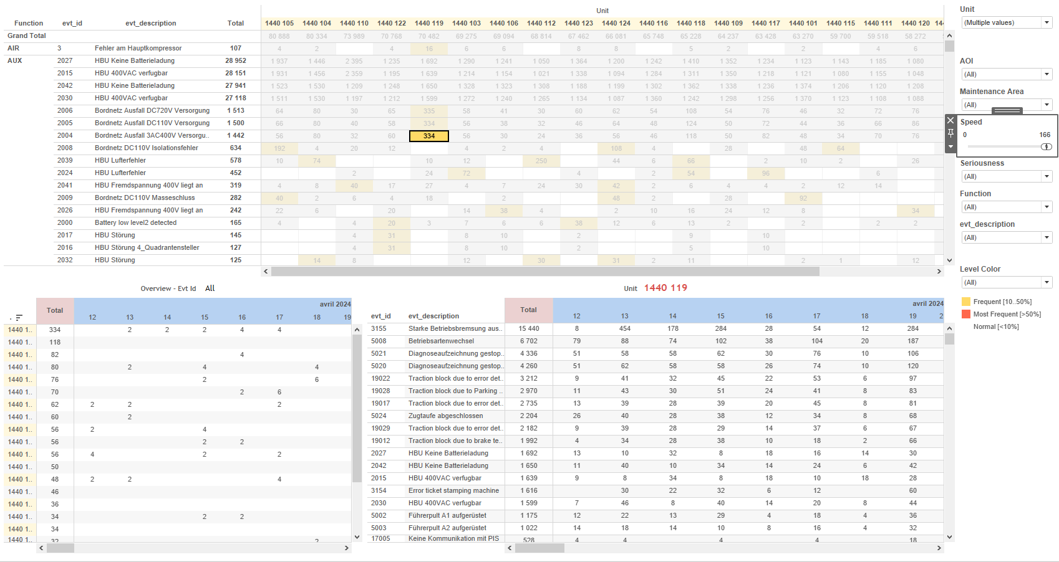
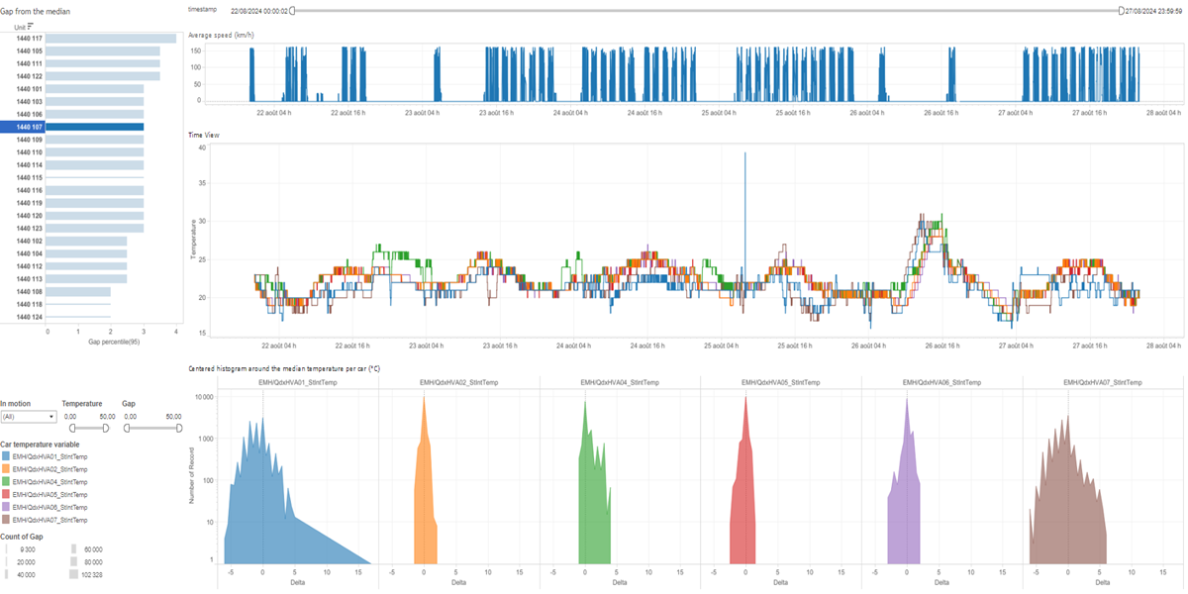
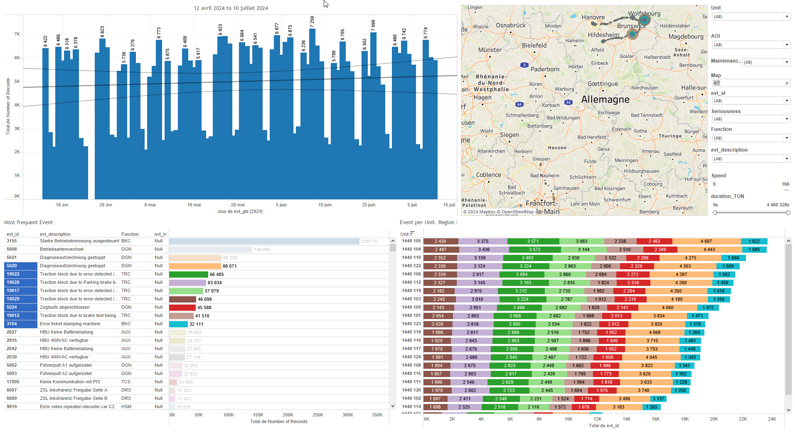
DATA VISUALIZATION REPORT SHEET
HealthHub
HVAC
Standard
Event Analysis
Represented By
timestamp value Gap SpeedAbove0 Unit temp Ecart veh Delta Speed
GENERAL DESCRIPTION
The 'DashBoard' dashboard provides a comprehensive overview of vehicle performance and trends over time. It includes tables and plots that allow for detailed data exploration and interaction between graphs to identify gaps, trends, and distributions in the data.
MAIN CHARACTERISTICS | Description
Project | Any project
Domain | Exploration,Operational Data
Type of report | Data Exploration - Operational Time Series (OPDAT)
Report's Objective | Provide a comprehensive overview of vehicle performance and trends over time. Enable detailed data exploration and interaction between graphs to identify gaps, trends, and distributions in the data. Visualize the relationship between different variables such as speed, timestamp, and temperature.

Slide 2
Constitution du rapport 1/1
DashBoard Dashboard
The 'DashBoard' dashboard provides a comprehensive overview of vehicle performance and trends over time. It includes tables and plots that allow for detailed data exploration and interaction between graphs to identify gaps, trends, and distributions in the data.
Position | Exemple de question | Description
bottom right | What is the gap from the median speed for vehicles in motion? | This plot displays the gap ('Gap') on the x-axis and the unit ('Unit') on the y-axis. Since 'Unit' is a string, this plot is most likely a table. Each cell's color and value are determined by the 'Gap' variable.
top | What trends or patterns can be observed over time using the variables such as timestamp, value, and temperature in a line chart? | This line plot displays the relationship between timestamp and value. The fill axis variable temp is used for additional context.
bottom | What is the distribution of the median temperature per car (°C) visualized using a centered histogram? | This area plot visualizes the relationship between Delta and Delta, with the fill variable 'temp' used to color the values of each cell.
top left | What is the average speed (km/h) over time based on the given data? | This line chart displays the speed over time, where the x-axis represents timestamps and the y-axis represents speed values.
Principaux Filtres/Paramètres
Filtrage par | Description
SpeedAbove0 | Filtering events where speed is above 0, indicating the object is in motion.
timestamp | Filtering applicable to workbooks.
timestamp | Filtering applicable to workbooks.
Temperature | Filtering applicable to workbooks.

Slide 3
Liste des variables
GENERAL DESCRIPTION
La liste des variables ci-dessous est necessaire pour la constitution du rapport. Pour le projet [Projet] leur equivalence doit être fournie avec la plage de Valeur associée en cas de demande de rapport.
Variable | Description
Delta | Delta represents the difference from the median temperature per car. It is used in various dashboards to track temperature variations.
Ecart | This variable represents the deviation from the median value. It is used in several dashboards to analyze train performance.
Speed | Speed is the rate at which a train travels. It is continuously recorded as operational data.
SpeedAbove0 | This variable indicates if the train's speed is above zero. It is used in various dashboards to filter and plot data related to train movement.
median_value | The median value is used to calculate gaps and monitor temperature. It is recorded as operational data.
temp | Temperature data is used to monitor HVAC performance. It is recorded continuously in various dashboards.
timestamp | This variable represents the time at which data is recorded. It is used extensively across various dashboards to track events and operational data.
value | This variable is recorded continuously as operational data. It represents a real-time measurement relevant to train operations.
veh | This variable represents the vehicle identifier. It is used across various dashboards to track train performance.
NOTE
Les illustrations fournissent un aperçu des représentations graphiques et ne préjugent pas des données pouvant être contenues dans le rapport. En effet, les données peuvent évoluer au cours du projet et dépendent entièrement de celui-ci.
Toute reproduction ou distribution non autorisée de ce rapport est interdite. Les informations contenues dans ce document sont confidentielles et destinées uniquement aux parties mentionnées. L'utilisation ou la divulgation non autorisée de ces informations est passible de poursuites judiciaires. Les représentations graphiques sont fournies à titre indicatif et ne sauraient engager la responsabilité de l'émetteur quant à l'exhaustivité ou l'exactitude des données présentées. Les données sont sujettes à des modifications au fil du projet et doivent être interprétées dans ce contexte.

