Slide 1
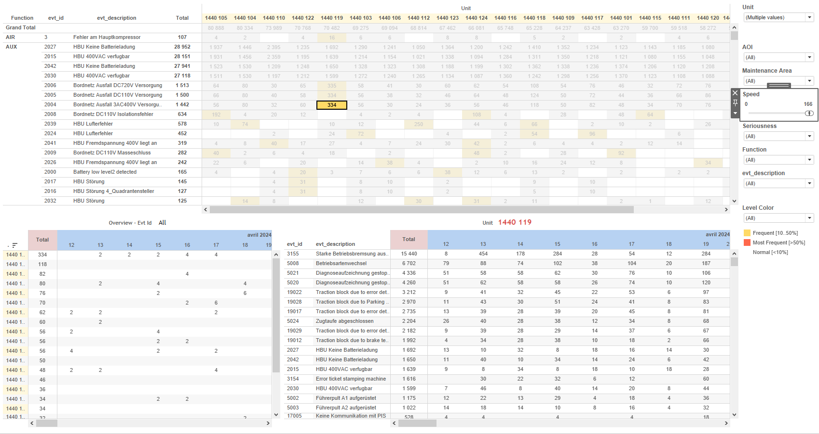
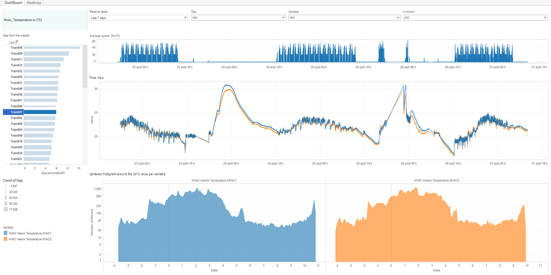
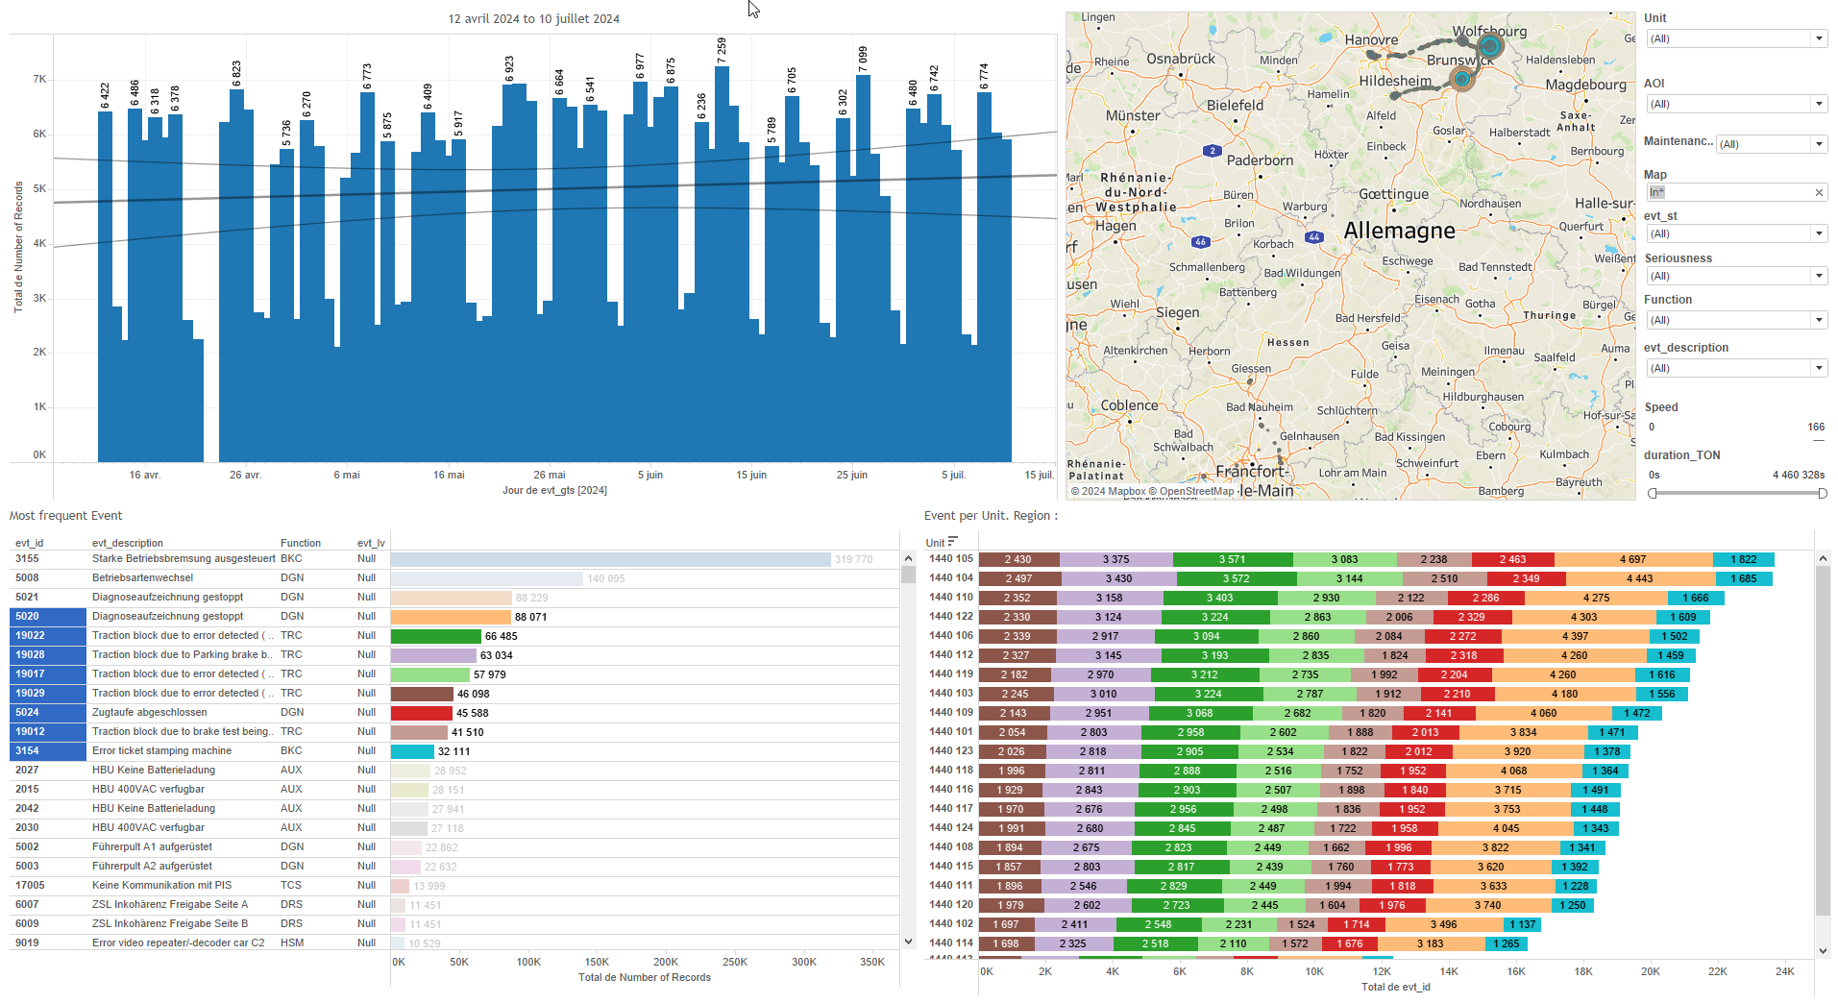
DATA VISUALIZATION REPORT SHEET
HealthHub
HVAC_Analog
Standard
Event Analysis
Represented By
timestamp Variable Speed Unit In Motion value Delta Gap Over hysteresis Name
GENERAL DESCRIPTION
This report provides a comprehensive overview of vehicle motion and speed data, including interactive visualizations such as line charts, area plots, and tables. It also includes a heatmap for analyzing 'Unit' values over time, facilitating detailed data exploration and interaction between visualizations.
MAIN CHARACTERISTICS | Description
Project | Any project
Domain | Exploration,Operational Data
Type of report | Data Exploration - Operational Time Series (OPDAT)
Report's Objective | Provide an interactive and comprehensive view of vehicle motion and speed data. Enable detailed data exploration and interactive analysis. Analyze and visualize 'Unit' values over time. Explore relationships between calculated values and units.

Slide 2
Constitution du rapport 1/2
DashBoard Dashboard
The 'DashBoard' provides an interactive and comprehensive view of vehicle motion and speed data, allowing users to explore the relationship between different variables over time and across categories. It includes various plots such as line charts, area plots, and tables that enable detailed data exploration and interactive analysis.
Position | Exemple de question | Description
bottom left | What is the gap from the median in the context of vehicle motion and speed? | This visualization displays the Gap (calculated using [Ecart]) on the x-axis and Units on the y-axis. The size of the elements is determined by the Gap value. Given that the y-axis variable is categorical, this plot is most likely a table with color and value for each cell.
top right | What is the relationship between timestamp and value in the context of speed and motion? | This line plot visualizes the 'value' over time using the 'timestamp' as the x-axis. The 'Variable' is used for color coding each data point.
bottom right | What is the distribution of Delta values and how do they vary with different Variables? | This area plot visualizes the relationship between Delta (x-axis) and Delta (y-axis) with Variable used for color coding.
top | What is the average speed in km/h when the speed is greater than 5? | This line chart displays the speed measured over time. The x-axis represents the timestamp, while the y-axis represents the speed in real numbers.
Principaux Filtres/Paramètres
Filtrage par | Description
In Motion | Filtering by speed, determining if the speed is greater than 5 to indicate motion.
timestamp | Filtering applicable to workbooks based on relative dates in the datetime format.
Variable | Filtering applicable to workbooks.
timestamp | Filtering by timestamp, a datetime field.
Temperature | Filtering applicable to workbooks based on the real datatype and the context of temperature measurements.
timestamp | Filtering by day for datetime values.

Slide 3
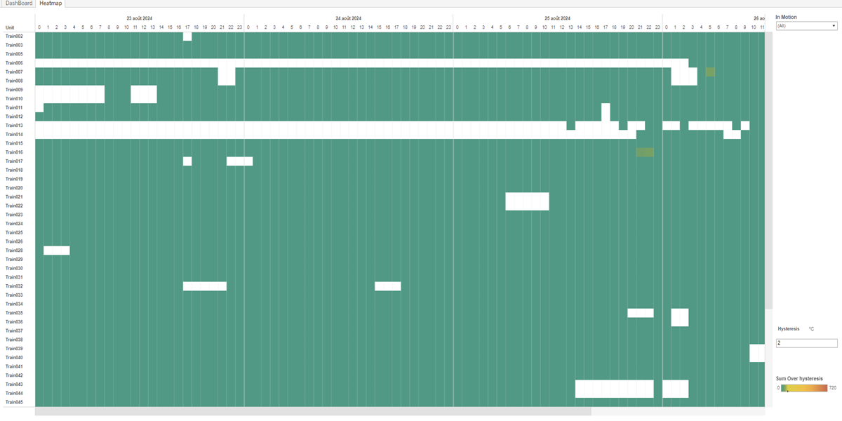
Constitution du rapport 2/2
Heatmap Dashboard
The 'Heatmap' dashboard is designed to analyze and visualize 'Unit' values over time. It includes a table to sum 'Over hysteresis' values and a heatmap to explore relationships between calculated values and units, facilitating detailed data exploration and interaction between visualizations.
Position | Exemple de question | Description
top | What is the sum of 'Over hysteresis' values based on the 'Unit' and 'timestamp'? | This table displays the 'Unit' values over different timestamps, with cells colored based on the 'Over hysteresis' calculation.
bottom | What is the relationship between the calculated values and the unit over time? | This heatmap visualizes the data where the y-axis represents the Calculation_589127144345911297 and the text axis shows unit. The color and value of each cell correspond to the data calculations.
Principaux Filtres/Paramètres
Filtrage par | Description

Slide 4
Liste des variables
GENERAL DESCRIPTION
La liste des variables ci-dessous est necessaire pour la constitution du rapport. Pour le projet [Projet] leur equivalence doit être fournie avec la plage de Valeur associée en cas de demande de rapport.
Variable | Description
Delta | Delta represents the difference from a reference value. It is used to analyze variations in train performance.
DeltaRef | DeltaRef is used to record operational data related to train performance. It is visualized in histograms to analyze deviations from the median.
Ecart | Ecart measures the deviation from the median value in train operations. It is used to monitor and analyze gaps in performance metrics.
Name | This variable represents the name of a specific part of a train. It is used in multiple dashboards to filter and plot data.
Ordering | This variable represents the order in which events are recorded. It is used in various plots and dashboards to sequence data points.
Range | Range measures the span of values, often related to train speed or distance. It is used in various dashboards to track and analyze performance metrics.
Speed | Speed is recorded continuously as operational data. It measures how fast the train is moving.
Unit | This variable identifies parts of a train. It is used in various dashboards to track and analyze operational data.
Variable | This variable is used in various dashboards to provide context for events. It is recorded as operational data.
median_value | This variable represents the median value recorded for operational data. It is used in various dashboards to analyze the gap from the median and other related metrics.
timestamp | This variable records the date and time of events. It is used in multiple dashboards for tracking and analysis.
NOTE
Les illustrations fournissent un aperçu des représentations graphiques et ne préjugent pas des données pouvant être contenues dans le rapport. En effet, les données peuvent évoluer au cours du projet et dépendent entièrement de celui-ci.
Toute reproduction ou distribution non autorisée de ce rapport est interdite. Les informations contenues dans ce document sont confidentielles et destinées uniquement aux parties mentionnées. L'utilisation ou la divulgation non autorisée de ces informations est passible de poursuites judiciaires. Les représentations graphiques sont fournies à titre indicatif et ne sauraient engager la responsabilité de l'émetteur quant à l'exhaustivité ou l'exactitude des données présentées. Les données sont sujettes à des modifications au fil du projet et doivent être interprétées dans ce contexte.

