Slide 1
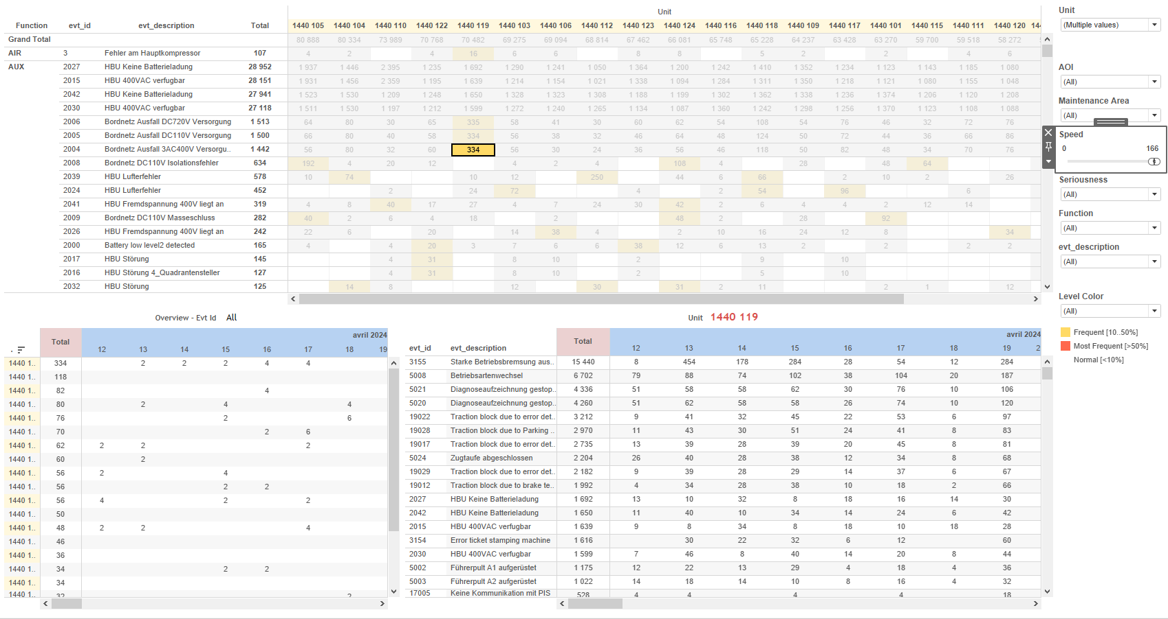
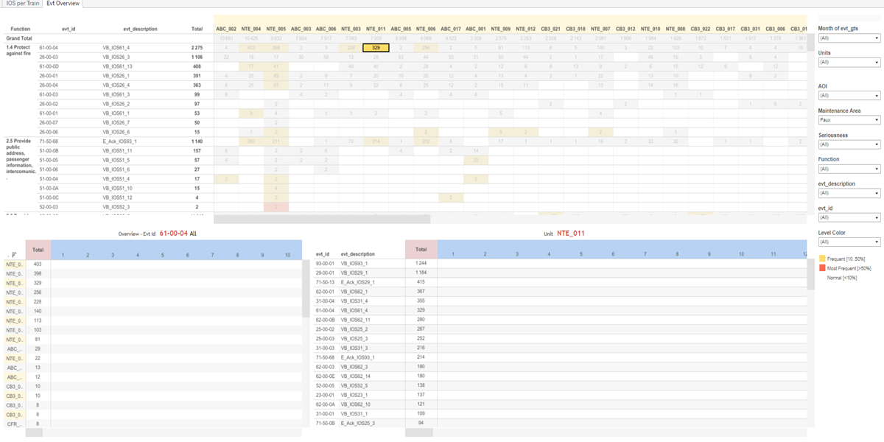
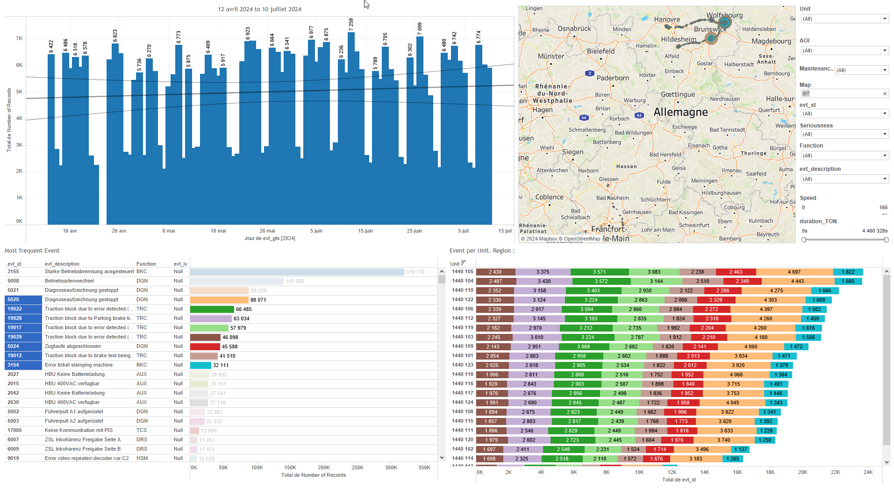
DATA VISUALIZATION REPORT SHEET
HealthHub
IOS_evt
Standard
Event Analysis
Represented By
evt_id evt_gts Number of Records evt_lv Units Maintenance Area evt_description aoi Function Unit
GENERAL DESCRIPTION
This report provides a comprehensive overview of fleet events, allowing users to analyze event seriousness, IDs, and descriptions over time. It includes various visualizations such as tables and bar charts to facilitate detailed data exploration.
MAIN CHARACTERISTICS | Description
Project | Any project
Domain | Event, Exploration
Type of report | Data Exploration - Train Event Data with Contextual Variables
Report's Objective | Provide a comprehensive view of fleet events for detailed analysis. Enable users to explore event seriousness, IDs, and descriptions over time. Facilitate data exploration through interactive tables and visual distinctions based on event frequency and timestamps.

Slide 2
Constitution du rapport 1/2
Evt Overview Dashboard
The 'Evt Overview' dashboard provides a comprehensive view of fleet events, allowing users to analyze event seriousness, IDs, and descriptions over time. It facilitates detailed data exploration through interactive tables and visual distinctions based on event frequency and timestamps.
Position | Exemple de question | Description
top | What is the distribution of event seriousness and areas of interest in the fleet overview? | This visualization displays the total count of events, categorized by units. The color indicates the frequency level of records, with 'Level Color' providing a visual distinction.
bottom left | What is the overview of the event ID in terms of units and records over time? | This plot visualizes the evt_gts against Units. The evt_gts is a datetime variable, and Units is a string. This plot likely represents a table with color and value for each cell.
bottom right | What is the unit description and its relationship with the event description and timestamps? | This visualization displays the event descriptions over time. The x-axis represents the event timestamps (evt_gts), and the y-axis represents the event descriptions (evt_description). The number of records is indicated for each event.
Principaux Filtres/Paramètres
Filtrage par | Description
Seriousness | Filtering the severity of events
aoi | Filtering all or part of the project's 'AOI' (Area Of Interest)

Slide 3
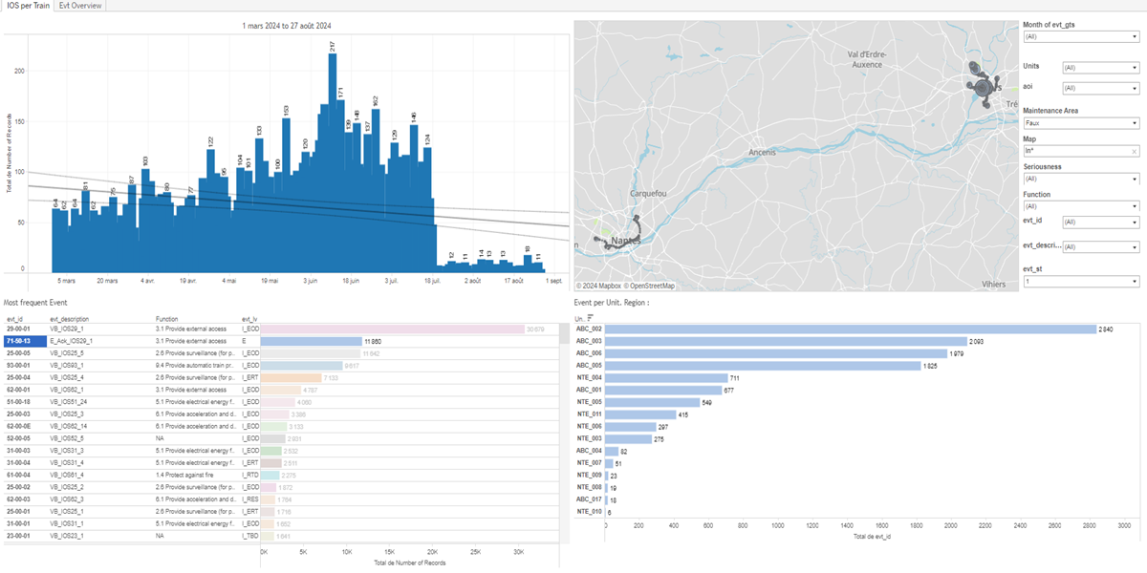
Constitution du rapport 2/2
IOS per Train Dashboard
The 'IOS per Train' dashboard provides an in-depth analysis of records, events, and units over time, allowing users to explore data through various visualizations such as vertical bar charts, tables, and GPS coordinate plots. It enables detailed data exploration by offering interactive graphs and tables that highlight event frequencies, distributions, and geographical locations.
Position | Exemple de question | Description
top left | How many records are there over time? | The plot visualizes the number of records over time, with evt_gts on the x-axis and Number of Records on the y-axis. Each bar represents a count of records for a specific time period.
bottom left | What is the most frequent event and its seriousness? | This plot visualizes the 'Number of Records' on the x-axis and 'evt_lv' on the y-axis. Each cell is colored and valued by 'evt_id'.
bottom right | What is the distribution of events per unit in different maintenance areas? | This visualization shows the number of units per event ID. The data is represented in a tabular format with each cell colored based on the event ID.
top right | What are the GPS coordinates and IDs of events over time? | This plot visualizes GPS coordinates with longitude on the x-axis and latitude on the y-axis. Each point represents an event identified by its unique ID.
Principaux Filtres/Paramètres
Filtrage par | Description
Seriousness | Filtering the severity of events
Maintenance Area | Filtering maintenance-related depot areas
evt_gts | Filtering applicable to workbooks. This filter applies to events based on their datetime, providing a mechanism to filter events by their date and time attributes.

Slide 4
Liste des variables
GENERAL DESCRIPTION
La liste des variables ci-dessous est necessaire pour la constitution du rapport. Pour le projet [Projet] leur equivalence doit être fournie avec la plage de Valeur associée en cas de demande de rapport.
Variable | Description
Function | The variable 'Function' is used to categorize operational data in various dashboards. It helps in identifying specific functions within the train's systems.
Map | This variable represents the map used in various dashboards to visualize location-based data. It is recorded as context data for events.
Unit | Unit is an identifier for parts of a train, used in various operational and event contexts. It helps track and analyze the performance and issues of different train sections.
aoi | This variable is used to identify the area of interest in various contexts. It is crucial for maintenance and operational data analysis.
evt_description | This variable describes events related to train operations. It is used across multiple dashboards to provide context for various operational metrics.
evt_gps_lat | This variable records the latitude of the train's GPS position during events. It is used to map the location of various train events.
evt_gps_lon | This variable represents the longitude coordinate of a GPS event. It is used to track the location of the train during specific events.
evt_gts | This variable represents the timestamp of an event. It is recorded as context data for various analyses.
evt_id | The variable is used to identify specific events in various operational dashboards. It helps in tracking and analyzing event occurrences across different time frames and locations.
evt_lv | The evt_lv variable indicates the seriousness of an event. It is used in multiple dashboards to filter and plot event data.
evt_spd | This variable represents the speed of an event recorded on the train. It is used in various operational dashboards to monitor and analyze train performance.
NOTE
Les illustrations fournissent un aperçu des représentations graphiques et ne préjugent pas des données pouvant être contenues dans le rapport. En effet, les données peuvent évoluer au cours du projet et dépendent entièrement de celui-ci.
Toute reproduction ou distribution non autorisée de ce rapport est interdite. Les informations contenues dans ce document sont confidentielles et destinées uniquement aux parties mentionnées. L'utilisation ou la divulgation non autorisée de ces informations est passible de poursuites judiciaires. Les représentations graphiques sont fournies à titre indicatif et ne sauraient engager la responsabilité de l'émetteur quant à l'exhaustivité ou l'exactitude des données présentées. Les données sont sujettes à des modifications au fil du projet et doivent être interprétées dans ce contexte.

