Slide 1
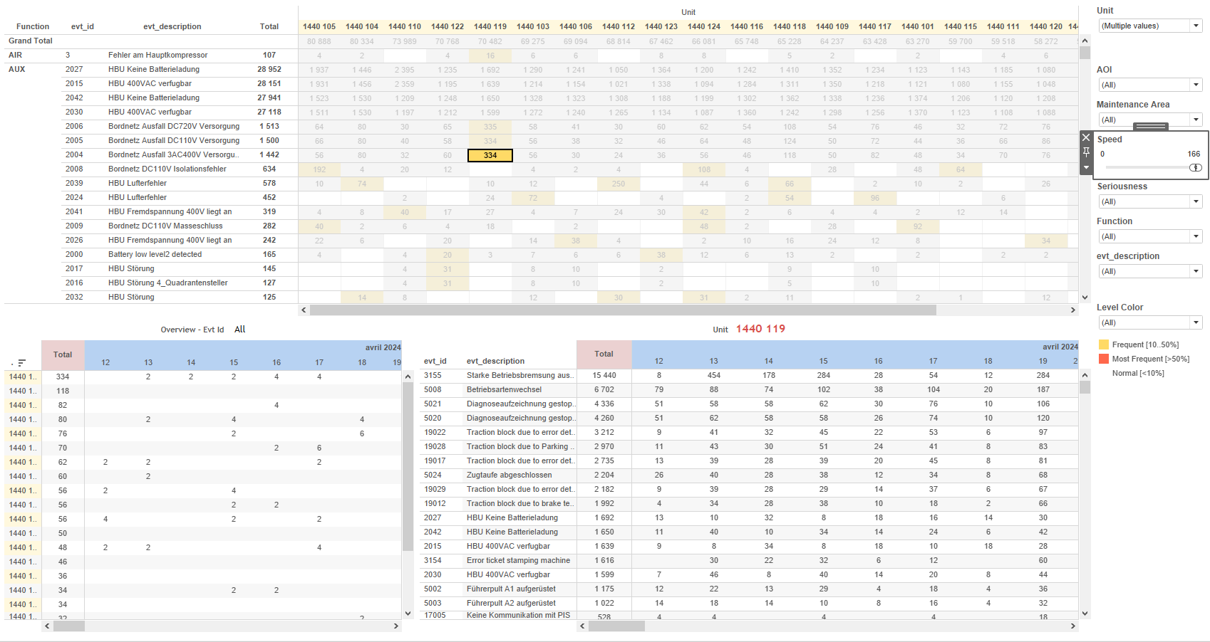
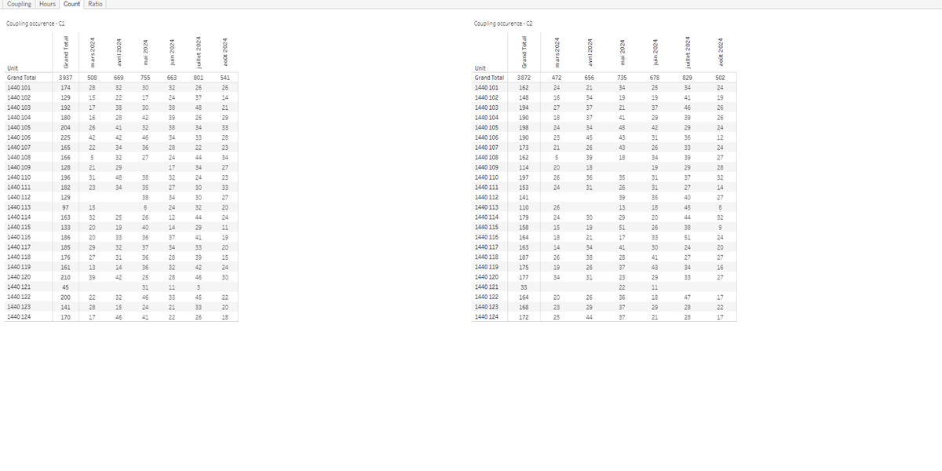
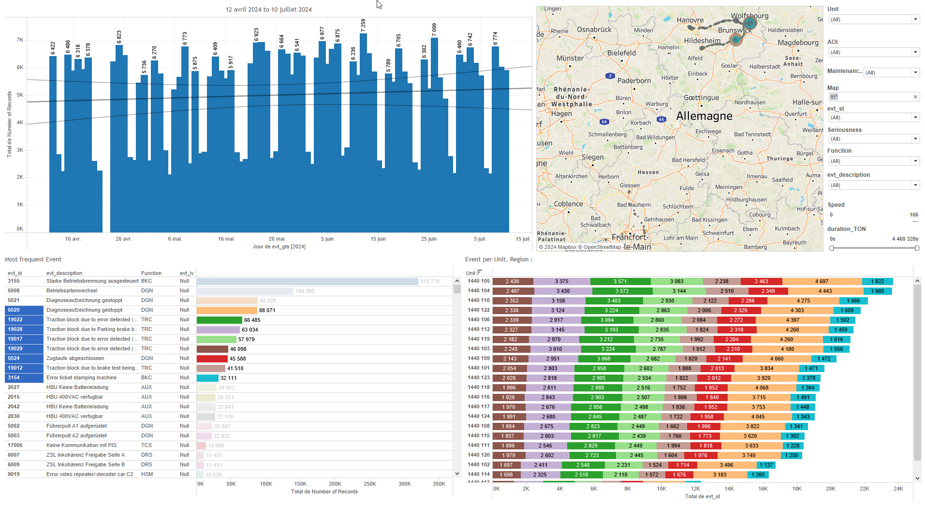
DATA VISUALIZATION REPORT SHEET
HealthHub
KPI_Coupling
Standard
Event Analysis
Represented By
Unit value LocalDate variable Value Side Type Ratio C Ratio TC Type
GENERAL DESCRIPTION
This report provides a comprehensive overview of various coupling metrics for train equipment. It includes visualizations and analyses of unit occurrences, coupling distributions, duration, and ratios, facilitating data exploration and understanding of trends and patterns.
MAIN CHARACTERISTICS | Description
Project | Any project
Domain | Operational Data
Type of report | Key Performance Indicator (KPI) - Operational Time Series (OPDAT)
Report's Objective | Provide an overview of unit occurrences over time categorized by coupling types C1 and C2. Analyze the distribution and trends of coupling units over time. Visualize the coupling duration (in hours) for different units over time. Understand the ratio of Time Coupling (TC) and Occurrence Coupling (OC) across different units.

Slide 2
Constitution du rapport 1/4
Count Dashboard
The 'Count' dashboard provides an overview of unit occurrences over time, categorized by coupling types C1 and C2. It allows for detailed exploration of data through textual visualizations, facilitating easy readability and understanding of trends and variations.
Position | Exemple de question | Description
bottom | What is the occurrence of coupling (C2) over time, categorized by unit? | This plot visualizes the count of units over time. The x-axis represents the LocalDate, while the y-axis shows the Unit values. The data is displayed in a textual format for easy readability.
top | What is the occurrence of coupling (C1) over time, and how does it vary by unit? | This visualization displays the count of Units over LocalDate, represented as text.
Principaux Filtres/Paramètres
Filtrage par | Description

Slide 3
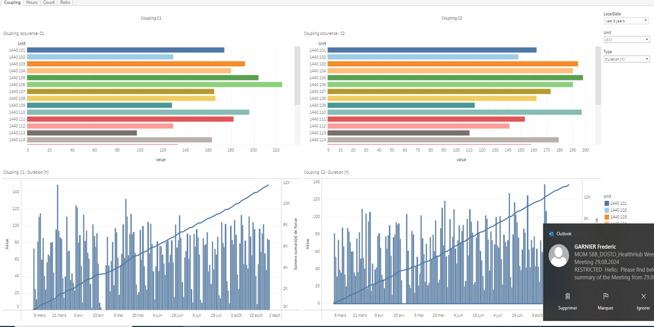
Constitution du rapport 2/4
Coupling Dashboard
The Coupling dashboard provides a comprehensive analysis of the distribution and trends of coupling units over time. It allows users to explore data through detailed tables and interactive vertical bar charts, facilitating a deeper understanding of patterns and trends.
Position | Exemple de question | Description
top left | What are the occurrences and values of the Unit over time? | This visualization shows the distribution of Unit across different values. The 'value' variable is plotted on the x-axis, and the 'Unit' variable is used for the fill color and cell values.
top right | What are the patterns and trends observed in the coupling occurrences for Unit C2 over time? | The plot visualizes the relationship between value and Unit. The x-axis represents 'value' which is a real number, and the y-axis represents 'Unit' which is a string. Since the y-axis is categorical, the plot is displayed as a table where each cell is colored based on the 'Unit' variable.
bottom left | What is the trend of Coupling C1 over time based on the given parameters and variables? | This plot visualizes the 'LocalDate' against 'Value'. The values are computed based on the formula provided.
bottom right | What is the trend of the 'Coupling C2' variable over time? | This visualization displays the trend of values over time, with dates on the x-axis and calculated values on the y-axis. Each bar represents a specific date and its corresponding value.
Principaux Filtres/Paramètres
Filtrage par | Description

Slide 4
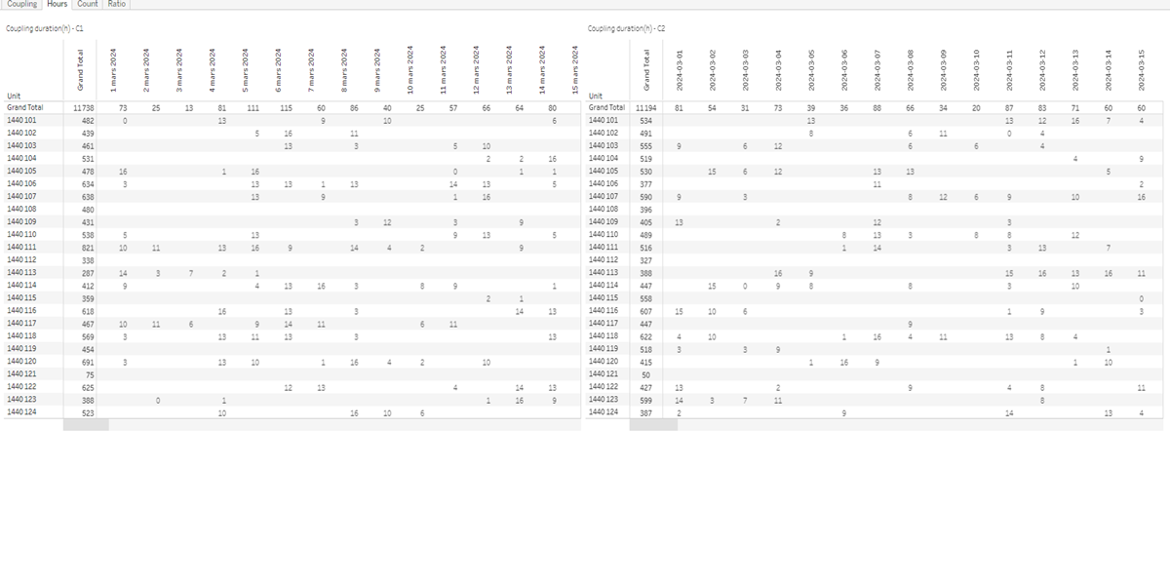
Constitution du rapport 3/4
Hours Dashboard
The 'Hours' dashboard provides a comprehensive overview of the coupling duration (in hours) for different units over time. It allows for detailed data exploration by visualizing the distribution of units by date and enables users to interact with the graphs to gain insights into the unit values over time.
Position | Exemple de question | Description
left | What is the coupling duration (in hours) for different units over time? | This plot visualizes the LocalDate against the Unit. It displays the value of each unit over time, providing insights into the distribution of units by date.
right | What is the coupling duration (in hours) for different units and dates? | This visualization shows the distribution of Unit over LocalDate with values represented as text.
Principaux Filtres/Paramètres
Filtrage par | Description

Slide 5
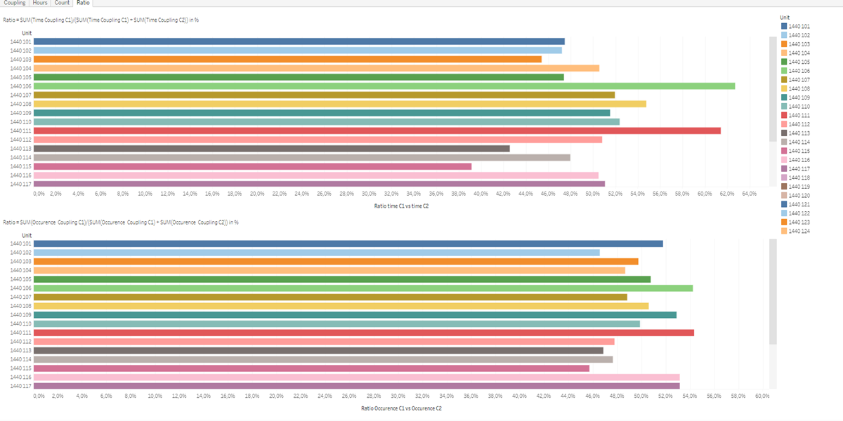
Constitution du rapport 4/4
Ratio Dashboard
The 'Ratio' dashboard provides insights into the ratio of Time Coupling (TC) and Occurrence Coupling (OC) across different units. It includes interactive tables that allow users to explore detailed data and understand the distribution of these ratios, with color-coded cells for easy comparison.
Position | Exemple de question | Description
top | What is the ratio of Time Coupling C1 to the total Time Coupling of C1 and C2? | This visualization shows the ratio of TC across different units. The ratio is calculated using the formula SUM([Calculation_1275081706719453184])/(SUM([Calculation_1275081706719453184])+SUM([TC1 (copy)_1275081706719707137])).
bottom | What is the ratio of Occurrence Coupling C1 to the sum of Occurrence Coupling C1 and Occurrence Coupling C2 in percentage? | This plot visualizes the Ratio C against the Unit. The Ratio C is calculated as the sum of TC1 divided by the sum of TC1 and C1. Since the y-axis is categorical, the plot is displayed as a table where each cell's color and value are determined by the Unit.
Principaux Filtres/Paramètres
Filtrage par | Description

Slide 6
Liste des variables
GENERAL DESCRIPTION
La liste des variables ci-dessous est necessaire pour la constitution du rapport. Pour le projet [Projet] leur equivalence doit être fournie avec la plage de Valeur associée en cas de demande de rapport.
Variable | Description
LocalDate | This variable records the local date for various train-related events. It is used extensively in different dashboards for tracking and analysis.
Unit | This variable identifies different parts of a train. It is used extensively in both context and operational data.
value | This variable represents a real-time measurement used in multiple dashboards for analysis and monitoring. It is crucial for understanding train operations and events.
variable | This variable is recorded as operational data. It is used in various dashboards to analyze train coupling occurrences.
NOTE
Les illustrations fournissent un aperçu des représentations graphiques et ne préjugent pas des données pouvant être contenues dans le rapport. En effet, les données peuvent évoluer au cours du projet et dépendent entièrement de celui-ci.
Toute reproduction ou distribution non autorisée de ce rapport est interdite. Les informations contenues dans ce document sont confidentielles et destinées uniquement aux parties mentionnées. L'utilisation ou la divulgation non autorisée de ces informations est passible de poursuites judiciaires. Les représentations graphiques sont fournies à titre indicatif et ne sauraient engager la responsabilité de l'émetteur quant à l'exhaustivité ou l'exactitude des données présentées. Les données sont sujettes à des modifications au fil du projet et doivent être interprétées dans ce contexte.

