Slide 1
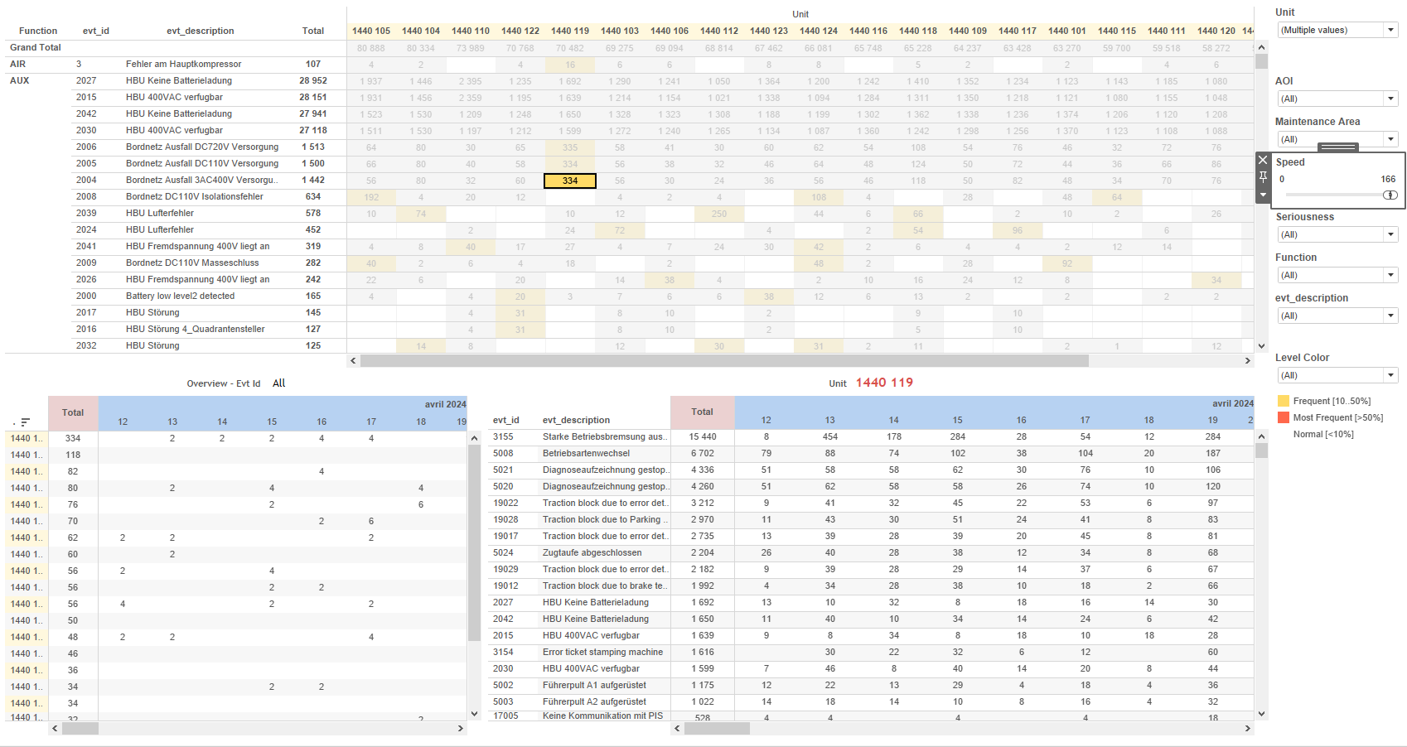
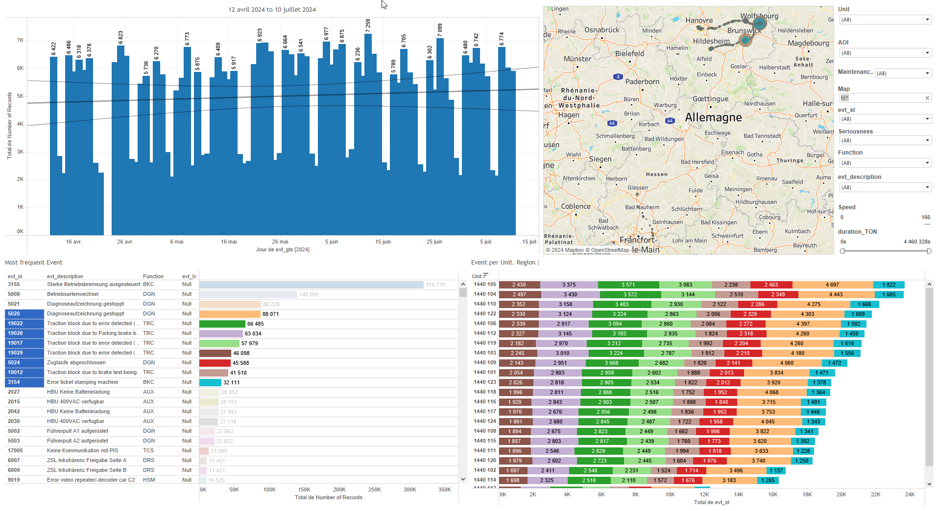
DATA VISUALIZATION REPORT SHEET
HealthHub
KPI_Datalogger
Standard
Event Analysis
Represented By
Type File LocalDate Unit timestamp File_timestamp Date
GENERAL DESCRIPTION
The KPI dashboard provides an interactive exploration of file types based on their timestamps and content, using various visualizations like tables and circle plots to analyze the relationship between file names and their types (500ms or 100ms). It allows for detailed data filtering and interaction between graphs for comprehensive data analysis.
MAIN CHARACTERISTICS | Description
Project | Any project
Domain | Operational Data
Type of report | Key Performance Indicator (KPI) - Operational Time Series (OPDAT)
Report's Objective | Provide an interactive exploration of file types based on their timestamps and content. Analyze the relationship between file names and their types (500ms or 100ms). Allow for detailed data filtering and interaction between graphs for comprehensive data analysis.

Slide 2
Constitution du rapport 1/1
KPI Dashboard
The KPI dashboard provides an interactive exploration of file types based on their timestamps and content, using various visualizations like tables and circle plots to analyze the relationship between file names and their types (500ms or 100ms). It allows for detailed data filtering and interaction between graphs for comprehensive data analysis.
Position | Exemple de question | Description
top left | What is the type of the file based on its content? | This table visualizes the relationship between File names and their corresponding Types, determined by the presence of '500ms' or '100ms' in the file name.
bottom left | What is the relationship between File timestamps and their types (500ms or 100ms) in the Circle chart? | This plot visualizes the 'File' data over time, using circles to represent different 'Type' values based on the content of 'File'.
top right | What is the type of measurement based on the file name containing '500ms' or not? | This plot visualizes the 'Type' of files based on the 'File' variable. The data is categorized and displayed as a table where each cell's color and value are determined by the 'Type' formula.
bottom right | What is the type of the file based on its name containing '500ms' or '100ms'? | Description of a worksheet in a report. A worksheet contains charts (plots) and addresses a specific question.
Principaux Filtres/Paramètres
Filtrage par | Description

Slide 3
Liste des variables
GENERAL DESCRIPTION
La liste des variables ci-dessous est necessaire pour la constitution du rapport. Pour le projet [Projet] leur equivalence doit être fournie avec la plage de Valeur associée en cas de demande de rapport.
Variable | Description
File | This variable is used to determine the sampling rate of data files. It helps differentiate between 500ms and 100ms data recordings.
File_timestamp | This timestamp indicates when the file was created or last modified. It is recorded as context data for events.
LocalDate | This variable represents the local date of the recorded data. It is used in various KPIs and analyses.
Unit | This variable identifies different parts of a train. It is used in various dashboards for operational and event data.
timestamp | This variable records the exact time an event occurs. It is crucial for synchronizing data and analyzing trends.
NOTE
Les illustrations fournissent un aperçu des représentations graphiques et ne préjugent pas des données pouvant être contenues dans le rapport. En effet, les données peuvent évoluer au cours du projet et dépendent entièrement de celui-ci.
Toute reproduction ou distribution non autorisée de ce rapport est interdite. Les informations contenues dans ce document sont confidentielles et destinées uniquement aux parties mentionnées. L'utilisation ou la divulgation non autorisée de ces informations est passible de poursuites judiciaires. Les représentations graphiques sont fournies à titre indicatif et ne sauraient engager la responsabilité de l'émetteur quant à l'exhaustivité ou l'exactitude des données présentées. Les données sont sujettes à des modifications au fil du projet et doivent être interprétées dans ce contexte.

