Slide 1
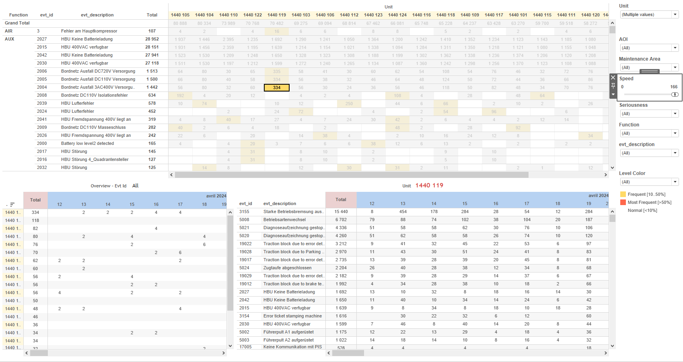
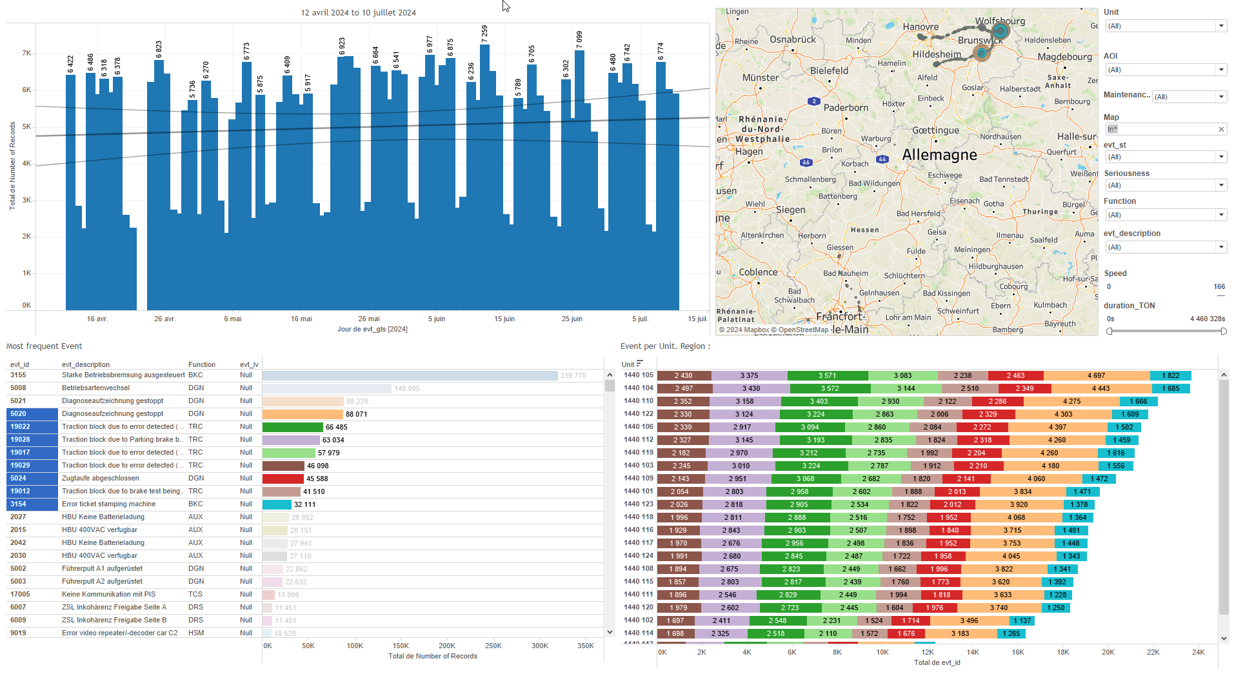
DATA VISUALIZATION REPORT SHEET
HealthHub
KPI_Diesel
Standard
Event Analysis
Represented By
Time Unit Mission date Date Diff
GENERAL DESCRIPTION
The 'Main' dashboard provides an in-depth analysis of time-related trends and distributions across various units and missions. It enables users to explore detailed time differences, mission durations, and unit distributions through interactive tables and line plots.
MAIN CHARACTERISTICS | Description
Project | Any project
Domain | Operational Data
Type of report | Key Performance Indicator (KPI) - Operational Time Series (OPDAT)
Report's Objective | Provide an in-depth analysis of time-related trends and distributions across various units and missions. Enable users to explore detailed time differences, mission durations, and unit distributions through interactive tables and line plots. Visualize the 'Time' values over 'date' to understand the trend of the variable 'Diff' over time. Show the distribution of units over time. Display the relationship between Time and Mission. Analyze the time difference in the mission data based on the given variables.

Slide 2
Constitution du rapport 1/1
Main Dashboard
The 'Main' dashboard provides an in-depth analysis of time-related trends and distributions across various units and missions. It enables users to explore detailed time differences, mission durations, and unit distributions through interactive tables and line plots.
Position | Exemple de question | Description
bottom right | What is the trend of the variable 'Diff' over time? | This line plot visualizes the 'Time' values over 'date'. The x-axis represents dates, and the y-axis shows the time differences.
top left | What is the distribution of units over time? | This plot visualizes the Time on the x-axis and Unit on the y-axis. Since the y-axis is categorical, the plot is represented as a table with cells colored based on the Unit.
top right | What is the time taken for each mission? | This visualization displays the relationship between Time and Mission. Since the y-axis variable is categorical, the resulting plot is presented as a table. Each cell is colored and valued based on the fill variable.
bottom left | What is the time difference in the mission data based on the given variables? | This visualization shows the distribution of missions over time, using the 'Mission' variable for the y-axis and 'Time' for the text axis. Since 'Mission' is a string, the plot is represented as a table where each cell's color and value are determined by the 'fill' variable.
Principaux Filtres/Paramètres
Filtrage par | Description

Slide 3
Liste des variables
GENERAL DESCRIPTION
La liste des variables ci-dessous est necessaire pour la constitution du rapport. Pour le projet [Projet] leur equivalence doit être fournie avec la plage de Valeur associée en cas de demande de rapport.
Variable | Description
Date | This variable records the date and time of events. It is used for trend analysis in various dashboards.
Diff | Diff represents the difference in operational data over time. It is used in multiple dashboards to analyze trends and performance metrics.
Mission | The mission variable tracks the specific task or route assigned to a train. It is used to analyze performance metrics in various dashboards.
Unit | The Unit variable identifies different parts of a train. It is used across various dashboards for both context and operational data.
NOTE
Les illustrations fournissent un aperçu des représentations graphiques et ne préjugent pas des données pouvant être contenues dans le rapport. En effet, les données peuvent évoluer au cours du projet et dépendent entièrement de celui-ci.
Toute reproduction ou distribution non autorisée de ce rapport est interdite. Les informations contenues dans ce document sont confidentielles et destinées uniquement aux parties mentionnées. L'utilisation ou la divulgation non autorisée de ces informations est passible de poursuites judiciaires. Les représentations graphiques sont fournies à titre indicatif et ne sauraient engager la responsabilité de l'émetteur quant à l'exhaustivité ou l'exactitude des données présentées. Les données sont sujettes à des modifications au fil du projet et doivent être interprétées dans ce contexte.

