Slide 1
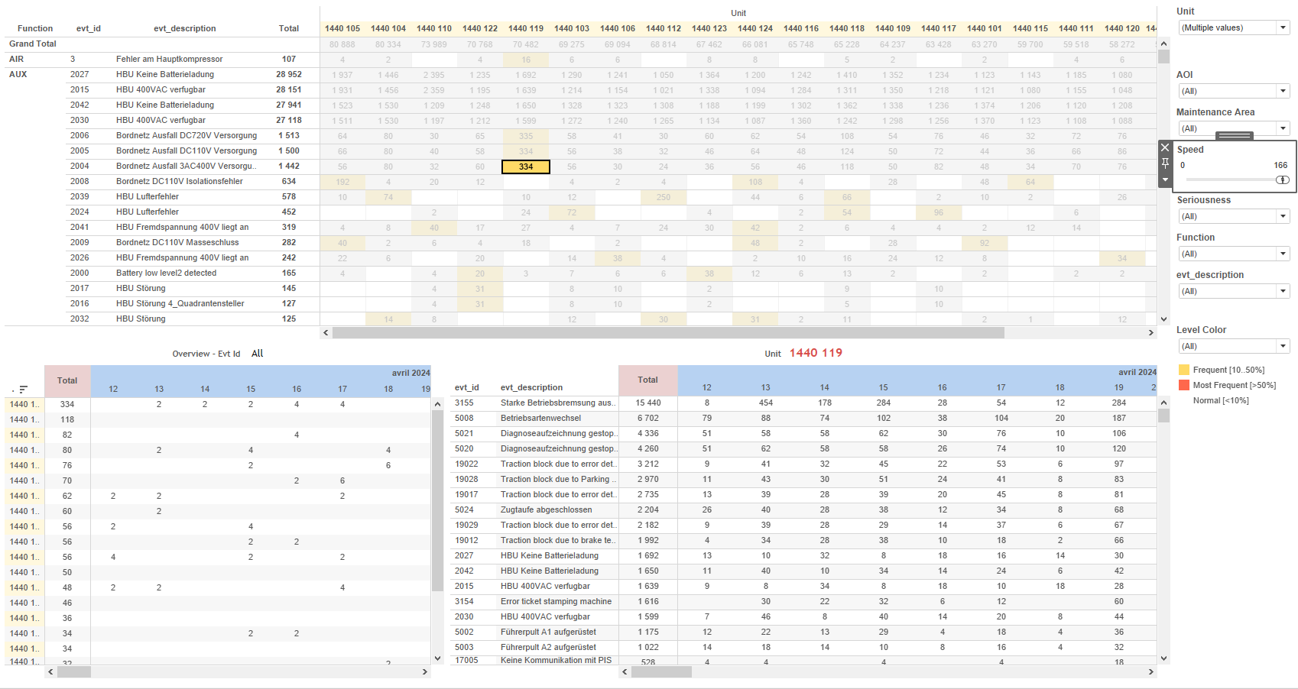
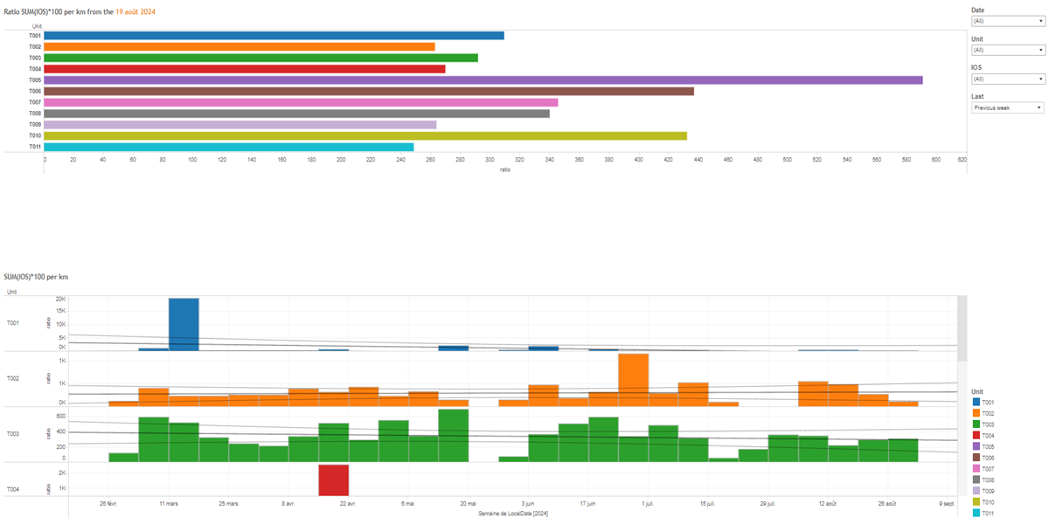
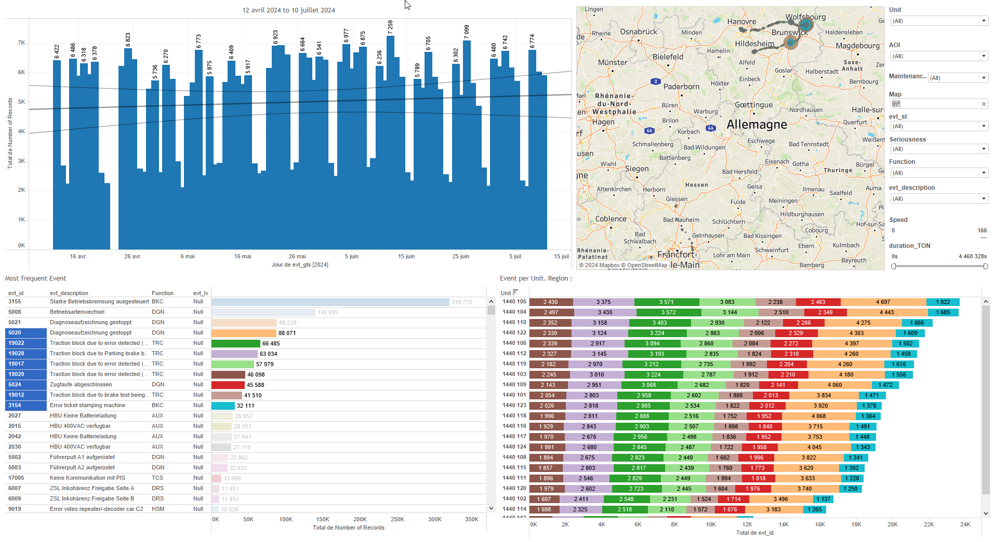
DATA VISUALIZATION REPORT SHEET
HealthHub
KPI_IOS
Standard
Event Analysis
Represented By
Unit LocalDate ratio evt_description N Mileage
GENERAL DESCRIPTION
The 'Main' dashboard provides a comprehensive analysis of ratios related to mileage and unit counts. It allows for detailed exploration of data where mileage exceeds 50, featuring interactive tables that visualize these ratios and facilitate in-depth analysis.
MAIN CHARACTERISTICS | Description
Project | Any project
Domain | Event,Exploration
Type of report | Key Performance Indicator (KPI) - Operational Time Series (OPDAT)
Report's Objective | Provide a comprehensive analysis of ratios related to mileage and unit counts. Facilitate detailed exploration of data where mileage exceeds 50. Visualize ratios using interactive tables.

Slide 2
Constitution du rapport 1/1
Main Dashboard
The 'Main' dashboard provides a comprehensive analysis of ratios related to mileage and unit counts. It allows for detailed exploration of data where mileage exceeds 50, featuring interactive tables that visualize these ratios and facilitate in-depth analysis.
Position | Exemple de question | Description
bottom | What is the ratio of SUM(IOS) to Mileage per kilometer, considering only cases where Mileage exceeds 50? | This plot displays the ratio calculated based on the LocalDate. The fill variable 'Unit' is used for color and value of each cell.
top | What is the ratio of SUM(IOS) * 100 per km based on the provided variables and context? | This visualization represents the ratio of units, calculated using the formula: 'IF MAX([Mileage]) > 50 THEN SUM([N])*100/MAX([Mileage]) ELSE 0 END'. The x-axis shows the ratio, and the y-axis categorizes the data by Unit.
Principaux Filtres/Paramètres
Filtrage par | Description
LocalDate | Filtering by datetime, specifically for the 'Last' caption.
LocalDate | Filtering applicable to workbooks by date.
evt_description | Filtering by event description

Slide 3
Liste des variables
GENERAL DESCRIPTION
La liste des variables ci-dessous est necessaire pour la constitution du rapport. Pour le projet [Projet] leur equivalence doit être fournie avec la plage de Valeur associée en cas de demande de rapport.
Variable | Description
LocalDate | This variable represents the local date in the context of train events. It is used for filtering and plotting in various dashboards.
Mileage | Mileage measures the distance traveled by a train. It is used in various dashboards to calculate performance metrics.
N | This variable is used to calculate the ratio of IOS events per kilometer. It is a real number recorded continuously as operational data.
Unit | This variable identifies different parts of a train. It is used in various dashboards to track operational data.
evt_description | Describes the type of event occurring on the train, such as braking or overspeed incidents.
NOTE
Les illustrations fournissent un aperçu des représentations graphiques et ne préjugent pas des données pouvant être contenues dans le rapport. En effet, les données peuvent évoluer au cours du projet et dépendent entièrement de celui-ci.
Toute reproduction ou distribution non autorisée de ce rapport est interdite. Les informations contenues dans ce document sont confidentielles et destinées uniquement aux parties mentionnées. L'utilisation ou la divulgation non autorisée de ces informations est passible de poursuites judiciaires. Les représentations graphiques sont fournies à titre indicatif et ne sauraient engager la responsabilité de l'émetteur quant à l'exhaustivité ou l'exactitude des données présentées. Les données sont sujettes à des modifications au fil du projet et doivent être interprétées dans ce contexte.

