Slide 1
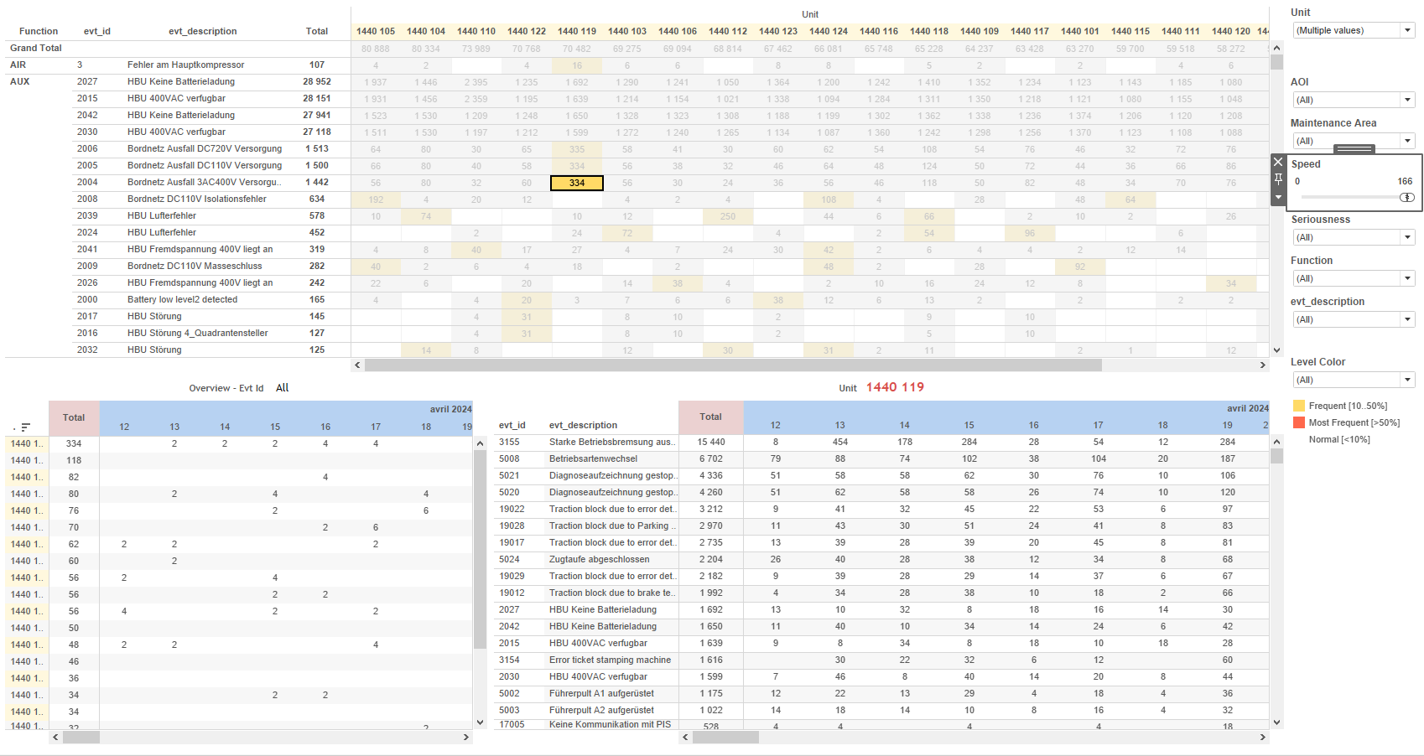
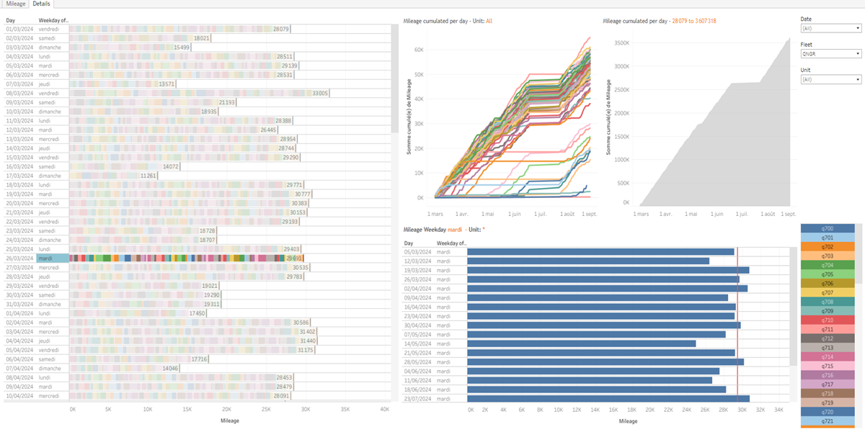
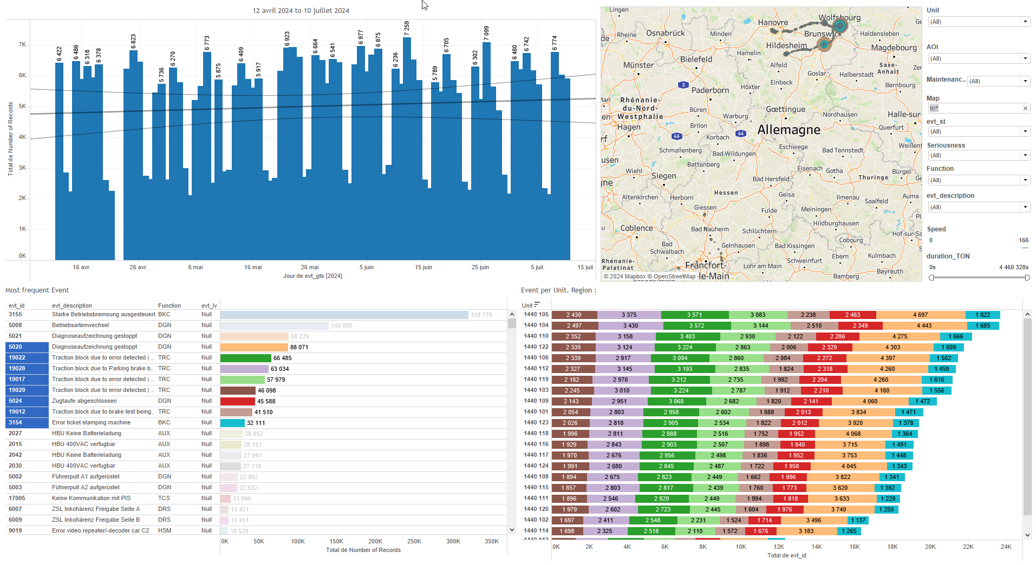
DATA VISUALIZATION REPORT SHEET
HealthHub
KPI_Mileage
Standard
Event Analysis
Represented By
Unit LocalDate Mileage Fleet SubFleet Day One WeekDay
GENERAL DESCRIPTION
The 'KPI_Mileage' report provides comprehensive data visualization and exploration of the fleet's mileage and unit usage over time. It includes interactive dashboards with filters and worksheets that allow users to explore trends, cumulative totals, and distributions across various dates and units. This report is designed to help users analyze and compare performance across different units and sub-fleets, making it a valuable tool for operational decision-making.
MAIN CHARACTERISTICS | Description
Project | Any project
Domain | Exploration
Type of report | Key Performance Indicator (KPI) - Operational Time Series (OPDAT)
Report's Objective | Provide an in-depth analysis of mileage and unit usage over time. Enable detailed data exploration and comparison through interactive tables and charts. Analyze and compare performance across different units and sub-fleets.

Slide 2
Constitution du rapport 1/2
Details Dashboard
The 'Details' dashboard provides an in-depth analysis of mileage and unit usage over time, allowing users to explore trends, cumulative totals, and distributions across various dates and units. It features interactive tables and charts that enable detailed data exploration and comparison.
Position | Exemple de question | Description
bottom left | What are the details and trends of mileage and unit usage over different days? | This plot visualizes the Mileage over time (LocalDate) with different Units as the fill color.
bottom right | What is the total mileage cumulated per day for each sub-fleet? | This area chart visualizes the cumulative mileage over time, with LocalDate on the x-axis and Mileage on the y-axis.
center | What is the mileage cumulated per day? | This visualization shows the Mileage over time, categorized by Unit. The x-axis represents LocalDate, and the y-axis represents Mileage. Each cell is filled based on Unit.
top | What is the mileage distribution on weekdays? | This bar chart displays the mileage data against local dates. Each bar represents the mileage recorded on specific dates, allowing for easy comparison of mileage over time.
Principaux Filtres/Paramètres
Filtrage par | Description
Fleet | Filtering applicable to workbooks. Filtering all or part of the Fleet by identifier.
LocalDate | Filtering applicable to workbooks. Filtering by date and time.

Slide 3
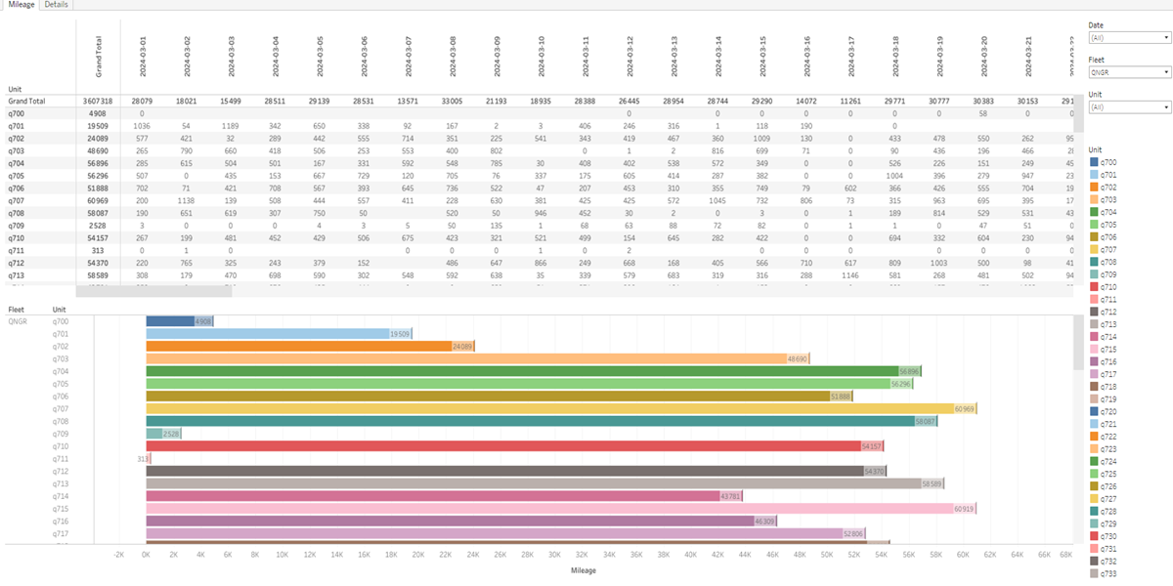
Constitution du rapport 2/2
Mileage Dashboard
The Mileage dashboard provides an overview of the fleet's mileage over time, allowing for detailed exploration of mileage data categorized by units and sub-fleets. It features interactive tables that display relationships and trends in mileage, helping users to analyze and compare performance across different units.
Position | Exemple de question | Description
bottom | What is the mileage in kilometers for the fleet over time? | A table displaying the Unit categorized by LocalDate, with color and value for each cell based on Mileage.
top | How does the mileage vary across different units and sub-fleets over time? | This table visualizes the relationship between Mileage and Unit, using color and value for each cell based on the Unit variable.
Principaux Filtres/Paramètres
Filtrage par | Description
LocalDate | Filtering by datetime values, using the caption 'Date' as a reference for the filter.
Unit | Filtering applicable to workbooks.
Fleet | Filtering all or part of the Fleet by identifier.

Slide 4
Liste des variables
GENERAL DESCRIPTION
La liste des variables ci-dessous est necessaire pour la constitution du rapport. Pour le projet [Projet] leur equivalence doit être fournie avec la plage de Valeur associée en cas de demande de rapport.
Variable | Description
LocalDate | The local date of an event or operation is recorded in this variable. It is used to analyze patterns over time.
Mileage | Mileage indicates the total distance traveled by a train. It is recorded as operational data and used in various dashboards for analysis.
SubFleet | This variable represents a subset of the train fleet. It is used in various analyses such as distribution, mileage, speed, and stabling.
Unit | This variable identifies a specific part of a train. It is used in various operational and event data dashboards.
NOTE
Les illustrations fournissent un aperçu des représentations graphiques et ne préjugent pas des données pouvant être contenues dans le rapport. En effet, les données peuvent évoluer au cours du projet et dépendent entièrement de celui-ci.
Toute reproduction ou distribution non autorisée de ce rapport est interdite. Les informations contenues dans ce document sont confidentielles et destinées uniquement aux parties mentionnées. L'utilisation ou la divulgation non autorisée de ces informations est passible de poursuites judiciaires. Les représentations graphiques sont fournies à titre indicatif et ne sauraient engager la responsabilité de l'émetteur quant à l'exhaustivité ou l'exactitude des données présentées. Les données sont sujettes à des modifications au fil du projet et doivent être interprétées dans ce contexte.

