Slide 1
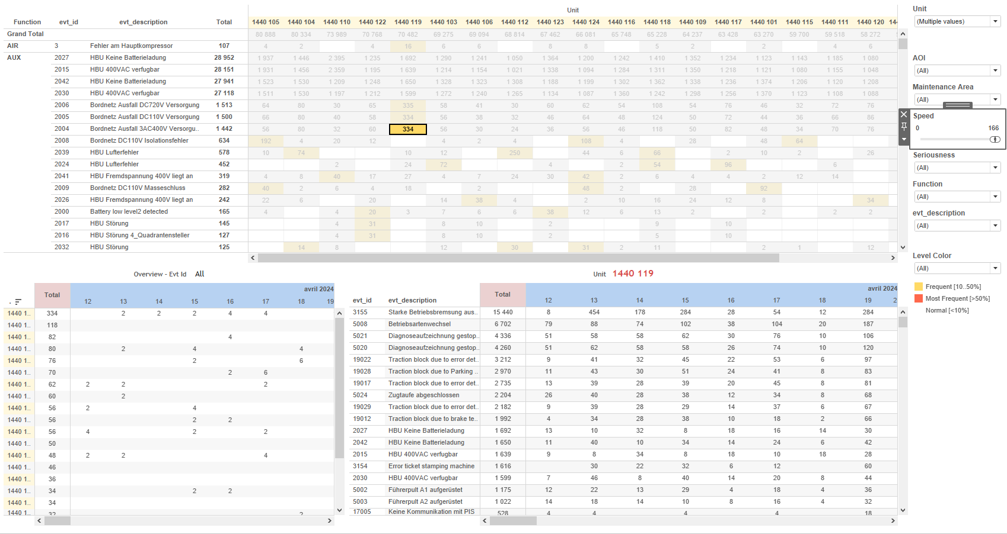
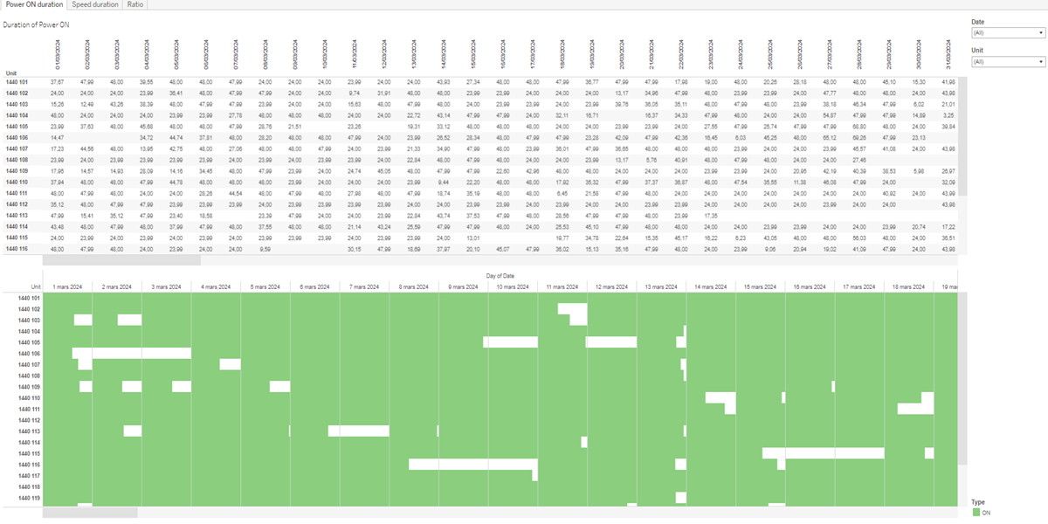
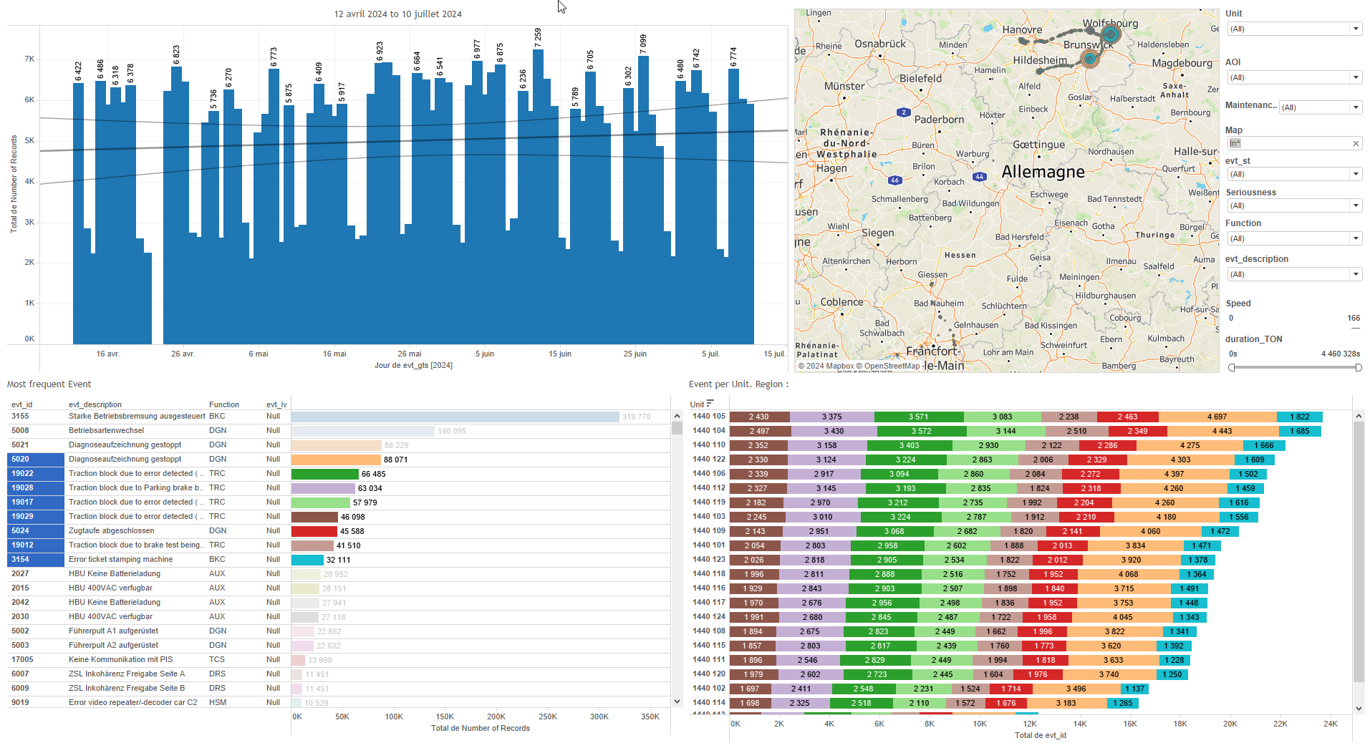
DATA VISUALIZATION REPORT SHEET
HealthHub
KPI_PowerON
Standard
Event Analysis
Represented By
Date Unit Duration Type timestamp Ratio Duration Power ON Duration Speed
GENERAL DESCRIPTION
This report provides a comprehensive overview of the operational time series data for train equipment. It includes detailed visualizations and analyses of power ON duration, the relationship between various operational parameters, and the ratio of time in motion to power on time. The report aims to facilitate data exploration and trend analysis through interactive dashboards and visualizations.
MAIN CHARACTERISTICS | Description
Project | Any project
Domain | Exploration
Type of report | Key Performance Indicator (KPI) - Operational Time Series (OPDAT)
Report's Objective | Provide insights into the duration of power ON over time. Analyze the relationship between Unit, Duration, and Type. Examine the ratio of time in motion to time power on. Facilitate detailed analysis of train motion duration and unit distribution over time.

Slide 2
Constitution du rapport 1/3
Power ON duration Dashboard
The 'Power ON duration' dashboard provides insights into the duration of power ON over time and the relationship between Unit, Duration, and Type. It allows for detailed data exploration through interactive visualizations, enabling users to filter data and analyze specific patterns effectively.
Position | Exemple de question | Description
top | What is the duration of power ON over time? | This visualization displays the Date on the x-axis and Unit on the y-axis. The Duration is included as additional text information.
bottom | What is the relationship between Unit, Duration, and Type? | This plot visualizes the relationship between Duration and Unit, with different Types filling the color and value of each cell.
Principaux Filtres/Paramètres
Filtrage par | Description
Date | Filtering applicable to workbooks.

Slide 3
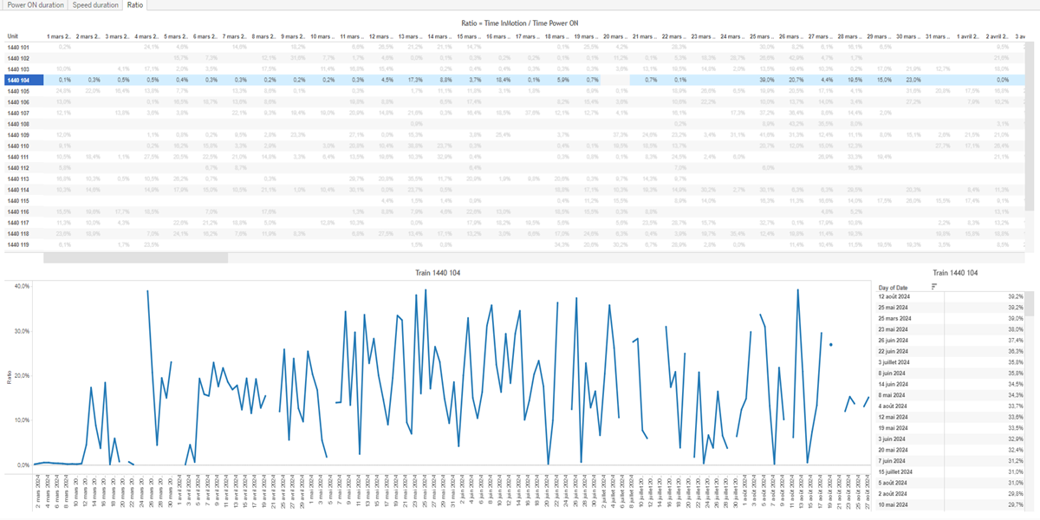
Constitution du rapport 2/3
Ratio Dashboard
The 'Ratio' dashboard provides a comprehensive analysis of the ratio of time in motion to time power on. It allows for detailed data exploration through various visualizations, including tables and line charts, and enables users to interact with the data by filtering and examining trends over time.
Position | Exemple de question | Description
top | What is the ratio of time in motion to time power on? | This plot displays the distribution of 'Unit' over 'Date'. The 'Ratio' is calculated using the formula: MAX([Calculation_1431581736525643777])/SUM([Duration Speed (copy)_1431581736526405634]).
bottom left | What is the ratio of the maximum duration speed to the sum of the duration power on over time? | This visualization shows the ratio over time, calculated as the maximum value of Calculation_1431581736525643777 divided by the sum of Duration Speed (copy)_1431581736526405634. The x-axis represents the date, while the y-axis shows the ratio.
bottom right | How does the duration of the train's speed and power-on time relate to the overall duration and type of operation? | This plot visualizes the 'Date' on the y-axis and 'Ratio' on the text axis. The 'Date' is derived using the formula DATE([timestamp]), and the 'Ratio' is calculated using the formula MAX([Calculation_1431581736525643777])/SUM([Duration Speed (copy)_1431581736526405634]).
Principaux Filtres/Paramètres
Filtrage par | Description

Slide 4
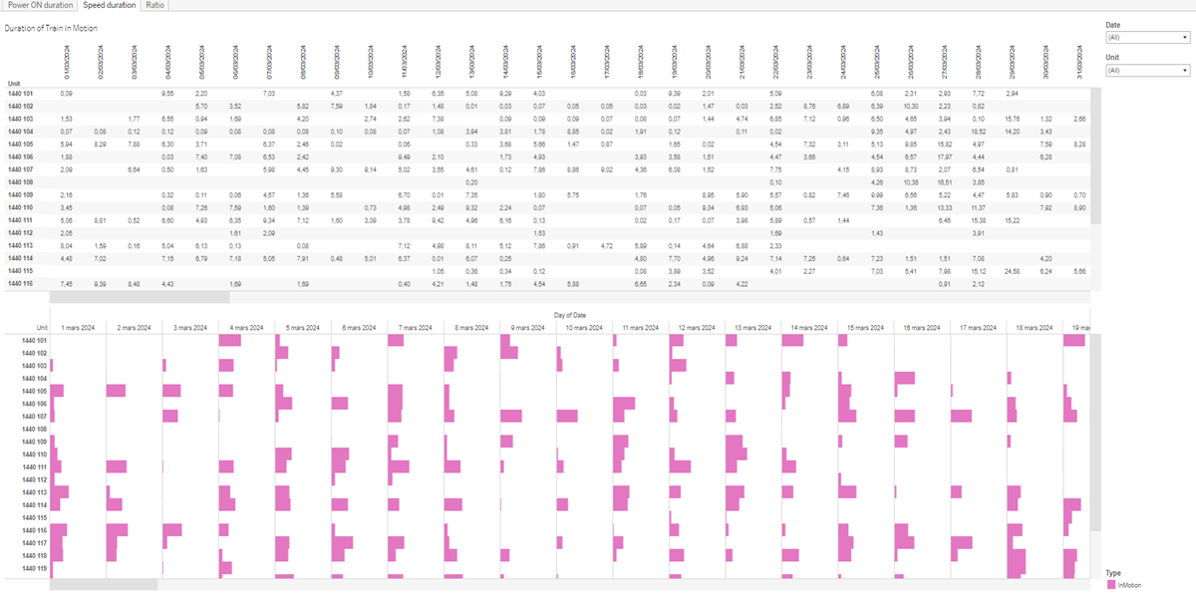
Constitution du rapport 3/3
Speed duration Dashboard
The 'Speed duration' dashboard provides insights into the relationship between Date and Unit, as well as the relationship between Unit, Duration, and Type. It allows users to explore data through interactive tables and charts, facilitating detailed analysis of train motion duration and unit distribution over time.
Position | Exemple de question | Description
top | What is the duration of the train in motion? | This plot visualizes the relationship between Date and Unit. The Date is derived from the timestamp, and the Unit is represented as a string value. The plot provides a clear view of how Units are distributed over different Dates.
bottom | What is the relationship between Unit, Duration, and Type? | Description of a worksheet in a report. A worksheet contains charts (plots) and addresses a specific question.
Principaux Filtres/Paramètres
Filtrage par | Description
Date | Filtering applicable to workbooks.

Slide 5
Liste des variables
GENERAL DESCRIPTION
La liste des variables ci-dessous est necessaire pour la constitution du rapport. Pour le projet [Projet] leur equivalence doit être fournie avec la plage de Valeur associée en cas de demande de rapport.
Variable | Description
Duration | Duration is the time difference between the start and end of an event, measured in minutes. It is used to analyze various train operations like Power ON and Speed duration.
Type | Type indicates the nature of the recorded data, such as 'InMotion' or 'Power ON'. It helps categorize the data for analysis.
Unit | The unit is a unique identifier for a part of a train. It is used in various dashboards to track operational and event data.
timestamp | This variable represents the date and time when data was recorded. It is used across multiple dashboards to timestamp events and operational data.
NOTE
Les illustrations fournissent un aperçu des représentations graphiques et ne préjugent pas des données pouvant être contenues dans le rapport. En effet, les données peuvent évoluer au cours du projet et dépendent entièrement de celui-ci.
Toute reproduction ou distribution non autorisée de ce rapport est interdite. Les informations contenues dans ce document sont confidentielles et destinées uniquement aux parties mentionnées. L'utilisation ou la divulgation non autorisée de ces informations est passible de poursuites judiciaires. Les représentations graphiques sont fournies à titre indicatif et ne sauraient engager la responsabilité de l'émetteur quant à l'exhaustivité ou l'exactitude des données présentées. Les données sont sujettes à des modifications au fil du projet et doivent être interprétées dans ce contexte.

