Slide 1
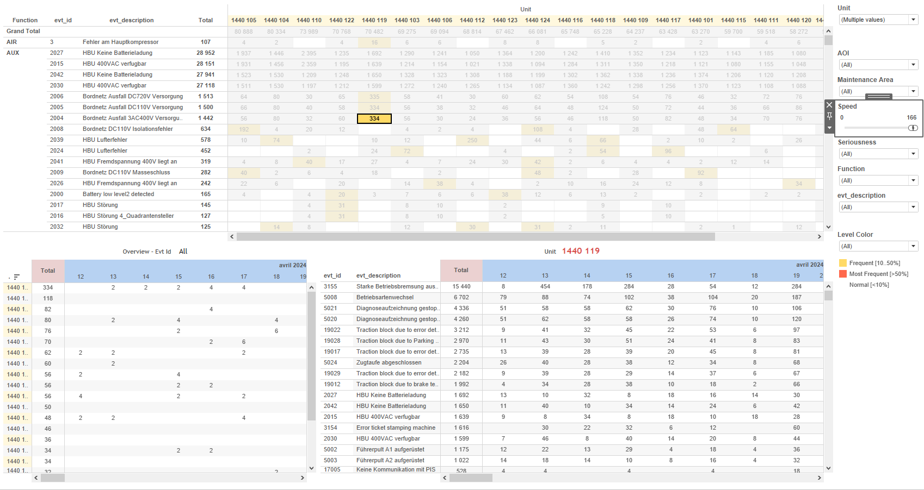
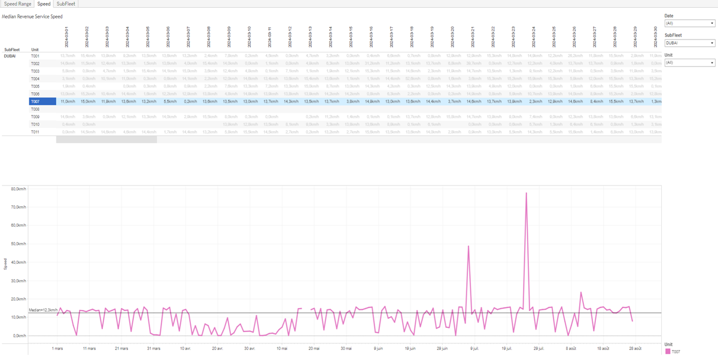
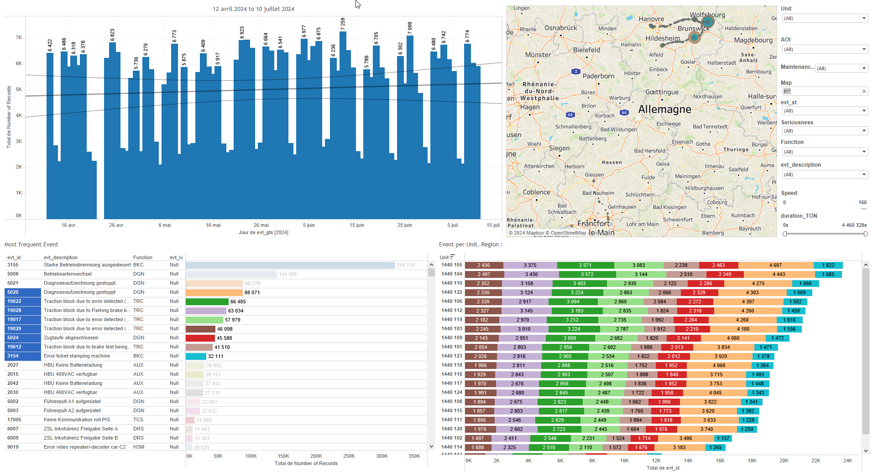
DATA VISUALIZATION REPORT SHEET
HealthHub
KPI_Speed
Standard
Event Analysis
Represented By
LocalDate Range Unit Duration SubFleet rangeSpeedDuration Speed Mileage RevenueServiceDuration One
GENERAL DESCRIPTION
This report provides data visualization and exploration about Train equipments, focusing on key performance indicators related to speed metrics, speed ranges, and subfleet durations. It includes various dashboards with tables, line charts, and bar charts to facilitate detailed data analysis and interaction.
MAIN CHARACTERISTICS | Description
Project | Any project
Domain | Exploration
Type of report | Key Performance Indicator (KPI) - Operational Time Series (OPDAT)
Report's Objective | Provide a comprehensive analysis of speed metrics over time. Visualize data distribution and trends for speed ranges. Offer detailed data exploration through interactive graphs. Understand subfleet durations and their ranges over specified periods.

Slide 2
Constitution du rapport 1/3
Speed Dashboard
The 'Speed' dashboard provides a comprehensive analysis of speed metrics over time. It includes a table and a line chart to explore the median revenue service speed and its trend over different units and dates, allowing for detailed data exploration and interaction between the graphs.
Position | Exemple de question | Description
top | What is the median revenue service speed over time? | This visualization shows the speed calculated as Mileage divided by Revenue Service Duration over different Local Dates. The Unit is represented as a categorical variable.
bottom | What is the trend of speed over time for different units? | This line chart displays the trend of Speed over time, measured by the 'LocalDate' variable. The Speed is calculated using the formula '[Mileage]/[RevenueServiceDuration]'. The chart is color-coded by the 'Unit' variable for better differentiation.
Principaux Filtres/Paramètres
Filtrage par | Description
LocalDate | Filtering by date using datetime data type. Applicable for filtering events or records based on date.
LocalDate | Filtering applicable to workbooks. Filtering by datetime with caption 'Date'.

Slide 3
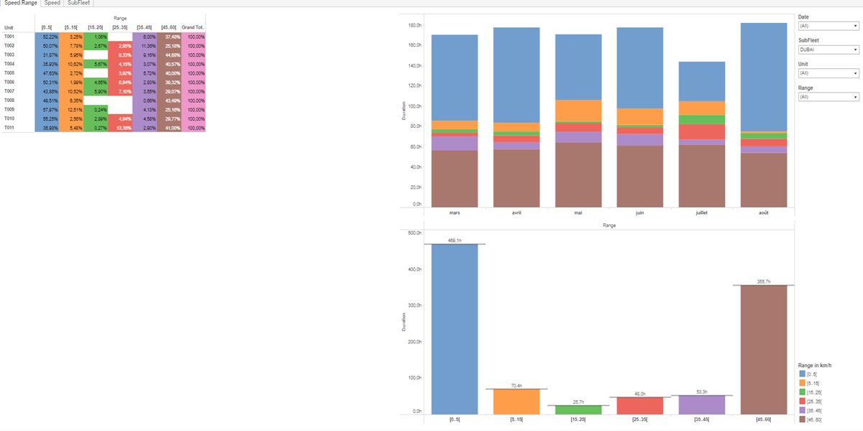
Constitution du rapport 2/3
Speed Range Dashboard
The 'Speed Range' dashboard provides a comprehensive analysis of speed ranges over time, utilizing tables and bar charts to visualize data distribution and trends. It allows for detailed data exploration through interactive graphs and color-coded cells, facilitating an in-depth understanding of speed duration across different ranges.
Position | Exemple de question | Description
top | What is the duration of different speed ranges over time? | This table visualizes the Range against Unit. Each cell is colored based on the Range values, providing a clear view of the data distribution.
bottom left | What is the duration of speed ranges over time? | This visualization displays the Duration against LocalDate with color fill based on Range. The plot type is a vertical bar chart.
bottom right | What is the duration of different speed ranges in the given dataset? | This visualization displays the duration of different speed ranges. The x-axis represents various speed ranges, while the y-axis shows the duration for each range.
Principaux Filtres/Paramètres
Filtrage par | Description
LocalDate | Filtering applicable to workbooks. Filtering by datetime, specifically related to the date aspect.

Slide 4
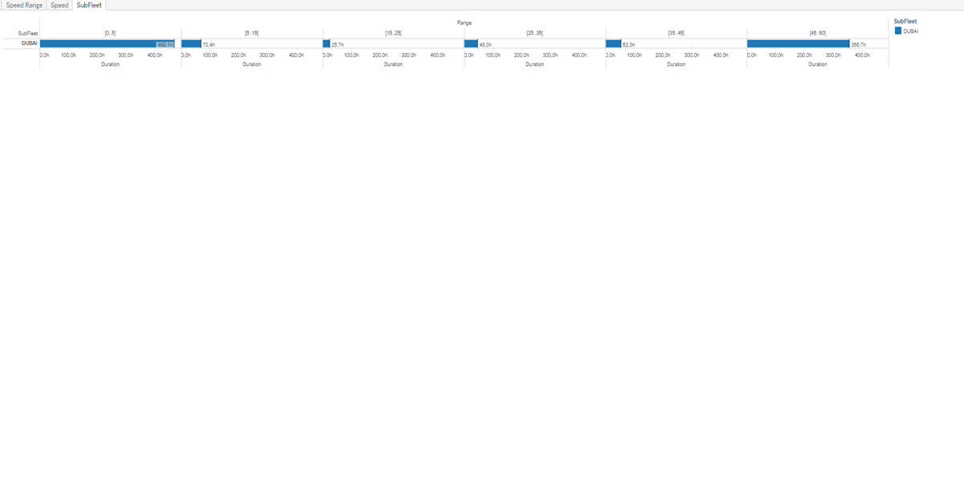
Constitution du rapport 3/3
SubFleet Dashboard
The 'SubFleet' dashboard provides a comprehensive overview of the duration of different subfleets. It allows users to explore detailed data through interactive tables, enabling a clear understanding of subfleet durations and their ranges over specified periods.
Position | Exemple de question | Description
center | What is the duration and range of the SubFleet over the specified period? | This table visualizes the duration of different subfleets. The x-axis represents the duration in real numbers, while the y-axis categorizes different subfleets. Each cell is filled with a value corresponding to the subfleet's duration.
Principaux Filtres/Paramètres
Filtrage par | Description

Slide 5
Liste des variables
GENERAL DESCRIPTION
La liste des variables ci-dessous est necessaire pour la constitution du rapport. Pour le projet [Projet] leur equivalence doit être fournie avec la plage de Valeur associée en cas de demande de rapport.
Variable | Description
LocalDate | This variable represents the local date on which events or operational data are recorded. It is used to filter and plot data across multiple dashboards.
Mileage | Mileage is the total distance traveled by the train. It is recorded continuously as operational data.
Range | Range refers to the range of speeds recorded during operations. It is used in various plots to analyze speed trends and distributions.
RevenueServiceDuration | This variable represents the duration of revenue service for a train. It is used to calculate the median revenue service speed.
SubFleet | The SubFleet variable categorizes parts of the train for analysis. It is used in various dashboards to filter and plot data.
Unit | This variable identifies parts of a train. It is used across various dashboards to track and analyze train performance.
rangeSpeedDuration | This variable represents the duration at various speed ranges. It is used to calculate operational performance metrics.
NOTE
Les illustrations fournissent un aperçu des représentations graphiques et ne préjugent pas des données pouvant être contenues dans le rapport. En effet, les données peuvent évoluer au cours du projet et dépendent entièrement de celui-ci.
Toute reproduction ou distribution non autorisée de ce rapport est interdite. Les informations contenues dans ce document sont confidentielles et destinées uniquement aux parties mentionnées. L'utilisation ou la divulgation non autorisée de ces informations est passible de poursuites judiciaires. Les représentations graphiques sont fournies à titre indicatif et ne sauraient engager la responsabilité de l'émetteur quant à l'exhaustivité ou l'exactitude des données présentées. Les données sont sujettes à des modifications au fil du projet et doivent être interprétées dans ce contexte.

