Slide 1
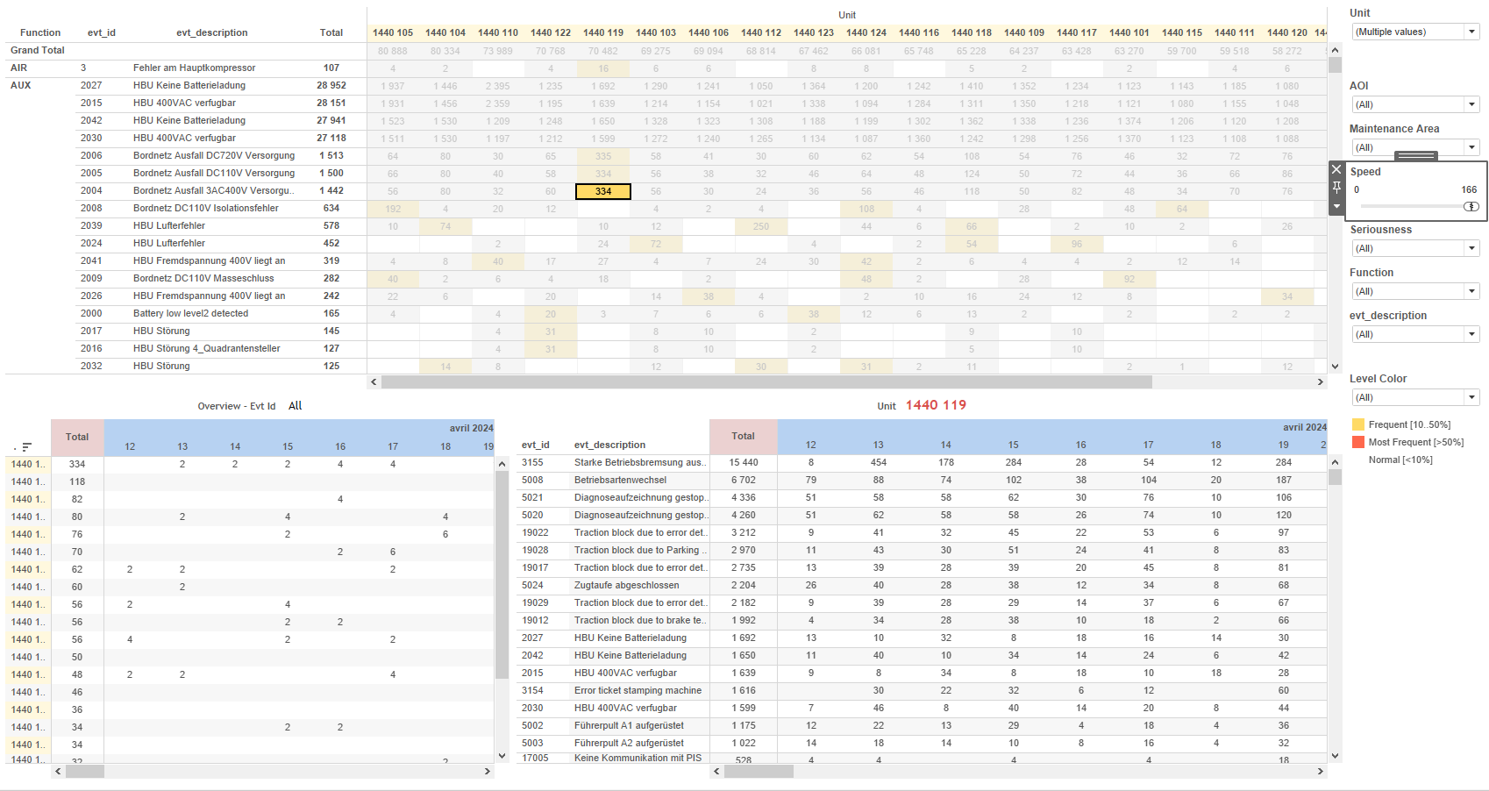
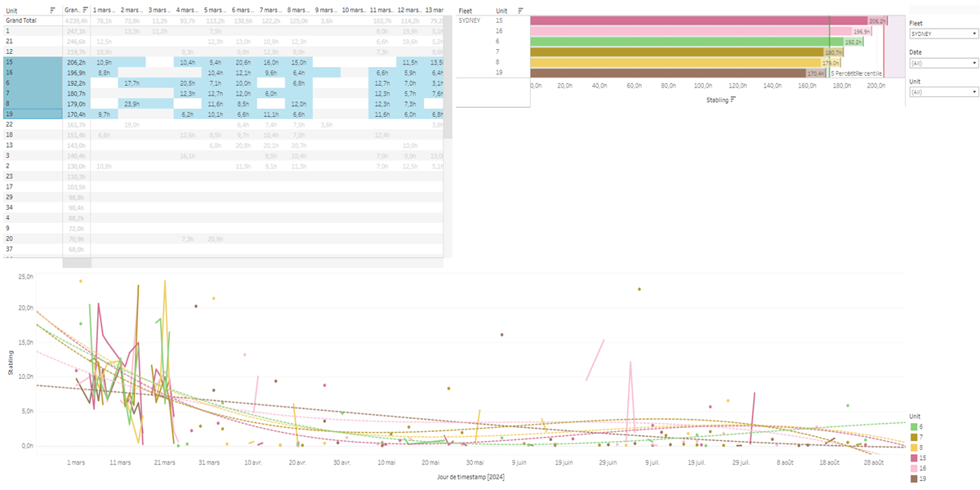
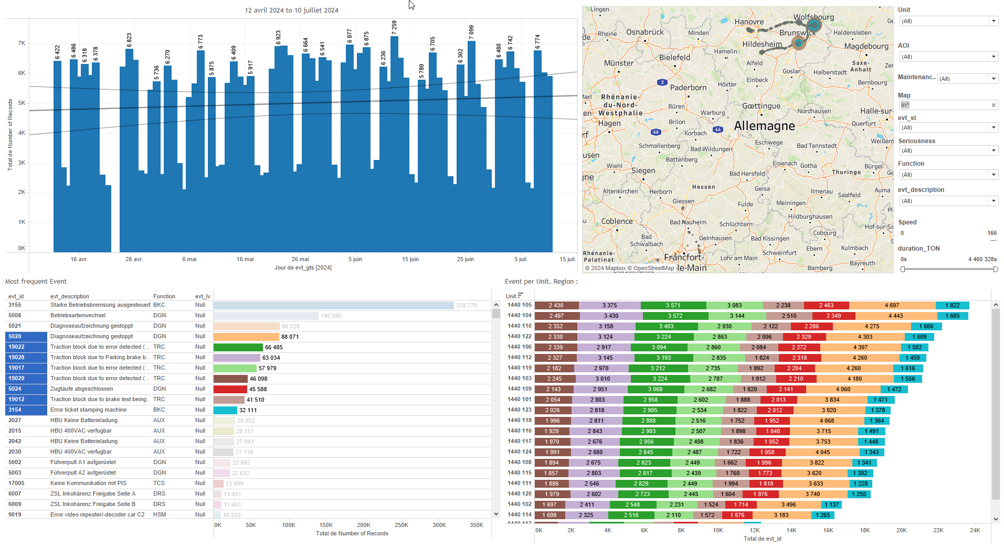
DATA VISUALIZATION REPORT SHEET
HealthHub
KPI_Stabling
Standard
Event Analysis
Represented By
Unit timestamp Stabling Fleet SubFleet st Duration LocalDate
GENERAL DESCRIPTION
The 'Stabling' dashboard offers a detailed view of unit distribution and stabling duration over time. It allows users to analyze data through various visualizations such as tables and line charts, providing insights into the relationship between timestamp, stabling, and unit values.
MAIN CHARACTERISTICS | Description
Project | Any project
Domain | Exploration
Type of report | Key Performance Indicator (KPI) - Operational Time Series (OPDAT)
Report's Objective | Provide a comprehensive overview of unit distribution and stabling duration over time. Facilitate detailed analysis of the relationship between timestamp, stabling, and unit values. Enable users to explore data through tables and line charts.

Slide 2
Constitution du rapport 1/1
Stabling Dashboard
The 'Stabling' dashboard provides a comprehensive overview of unit distribution and stabling duration over time. It allows users to explore data through tables and line charts, facilitating detailed analysis of the relationship between timestamp, stabling, and unit values.
Position | Exemple de question | Description
top | What is the mileage in km based on the given variables and context? | This table visualizes the distribution of Units over time. Each cell is colored based on the calculated duration.
top right | How does the stabling duration vary across different units? | This plot shows the relationship between Stabling and Unit. The data is represented in a table format where each cell is filled based on the Unit values.
bottom | What is the relationship between Stabling duration and timestamp, represented as a Line chart? | This line plot visualizes the 'Stabling' over time, using 'timestamp' on the x-axis and 'Stabling' on the y-axis. The color and value of each cell are determined by the 'Unit'.
Principaux Filtres/Paramètres
Filtrage par | Description
LocalDate | Filtering by date using string datatype
Unit | Filtering applicable to workbooks.
Fleet | Filtering all or part of the Fleet by identifier
timestamp | Filtering applicable to workbooks. Filtering by timestamp, using datetime data type.

Slide 3
Liste des variables
GENERAL DESCRIPTION
La liste des variables ci-dessous est necessaire pour la constitution du rapport. Pour le projet [Projet] leur equivalence doit être fournie avec la plage de Valeur associée en cas de demande de rapport.
Variable | Description
Duration | This variable represents the time difference between two events in minutes. It is used in various KPIs and operational dashboards to track train performance.
LocalDate | The variable represents the local date when data was recorded. It is used in various analyses and filters.
SubFleet | This variable identifies sub-groups within a fleet of trains. It is used to categorize operational data.
Unit | This variable identifies different parts of a train. It is used in various dashboards to track operational data and events.
st | This variable represents the stabling status of a train. It is used in various plots and dashboards for operational analysis.
timestamp | The timestamp records the exact time an event occurs. It is crucial for tracking and analyzing operational data.
NOTE
Les illustrations fournissent un aperçu des représentations graphiques et ne préjugent pas des données pouvant être contenues dans le rapport. En effet, les données peuvent évoluer au cours du projet et dépendent entièrement de celui-ci.
Toute reproduction ou distribution non autorisée de ce rapport est interdite. Les informations contenues dans ce document sont confidentielles et destinées uniquement aux parties mentionnées. L'utilisation ou la divulgation non autorisée de ces informations est passible de poursuites judiciaires. Les représentations graphiques sont fournies à titre indicatif et ne sauraient engager la responsabilité de l'émetteur quant à l'exhaustivité ou l'exactitude des données présentées. Les données sont sujettes à des modifications au fil du projet et doivent être interprétées dans ce contexte.

