Slide 1
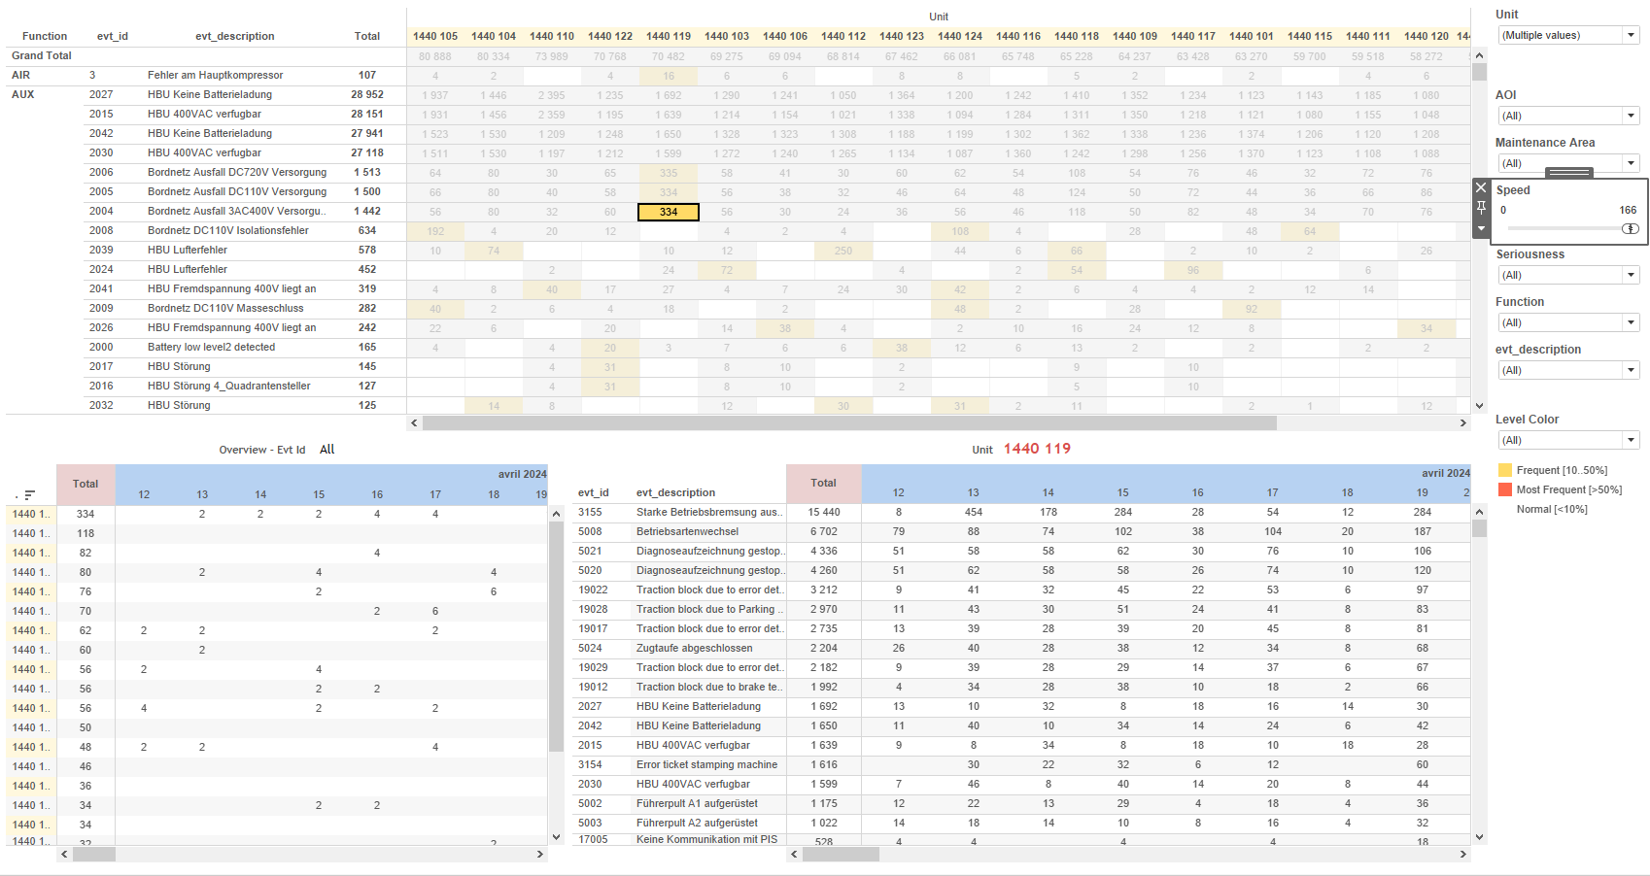
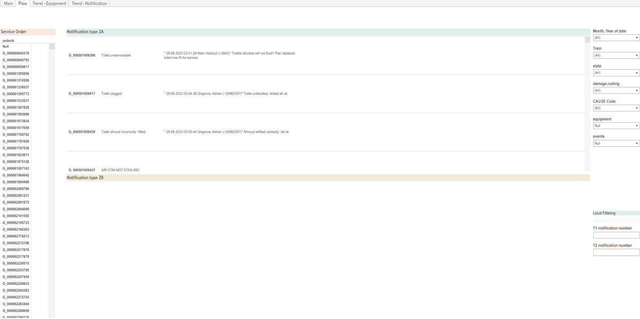
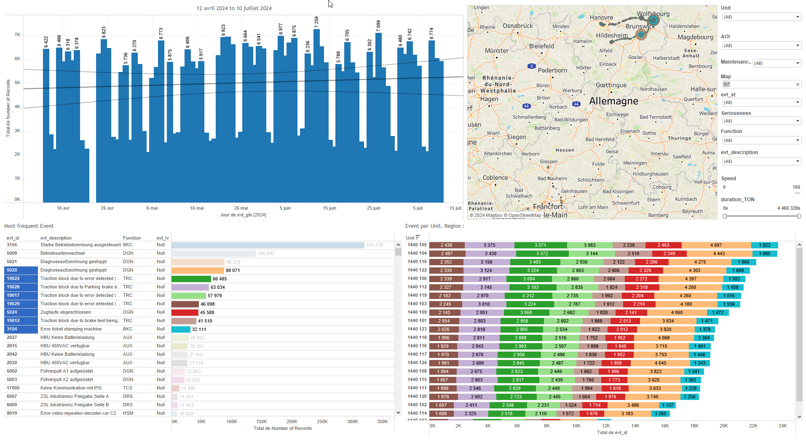
DATA VISUALIZATION REPORT SHEET
HealthHub
MMS_Maintenance
Standard
Event Analysis
Represented By
notificationId date cause.coding equipment events state Train Region taskText REGION
GENERAL DESCRIPTION
This report provides data visualization and exploration about Train equipments, focusing on service order details, notification numbers, task texts, and equipment performance over time. It includes interactive charts and tables that facilitate in-depth analysis and understanding of various notification attributes and trends.
MAIN CHARACTERISTICS | Description
Project | Any project
Domain | Event,Operational Data
Type of report | Data Exploration - Train Event Data with Contextual Variables
Report's Objective | Provide a comprehensive view of service order details and task texts. Facilitate in-depth data analysis and understanding. Enable users to explore distributions and relationships between various notification attributes. Analyze equipment performance over time using moving average calculations. Detail the trends in notifications over time based on notification ID and type.

Slide 2
Constitution du rapport 1/4
Flow Dashboard
The 'Flow' dashboard provides a comprehensive view of service order details, notification numbers, and task texts through interactive Polygon charts. It allows users to explore order IDs, cause codes, and detailed tasks associated with notifications, facilitating in-depth data analysis and understanding.
Position | Exemple de question | Description
top | What is the order ID for the service order? | This plot visualizes the orderId variable, which is a string data type, using a Polygon chart type.
bottom left | What are the cause codes and T1 notification numbers associated with each task text in the Polygon chart? | This plot visualizes the variable 'taskText' which is of type string.
bottom right | What are the details and tasks related to the T2 notification number? | This plot visualizes the taskText variable using a Polygon chart. The taskText variable is a string, and its caption is 'taskText'.
Principaux Filtres/Paramètres
Filtrage par | Description
cause.coding | Filtering applicable to workbooks by CAUSE Code.
notificationId | Filtering applicable to workbooks. This filter is used to identify notifications by their unique notification number, which is of datatype string.
notificationId | Filtering by T2 notification number

Slide 3
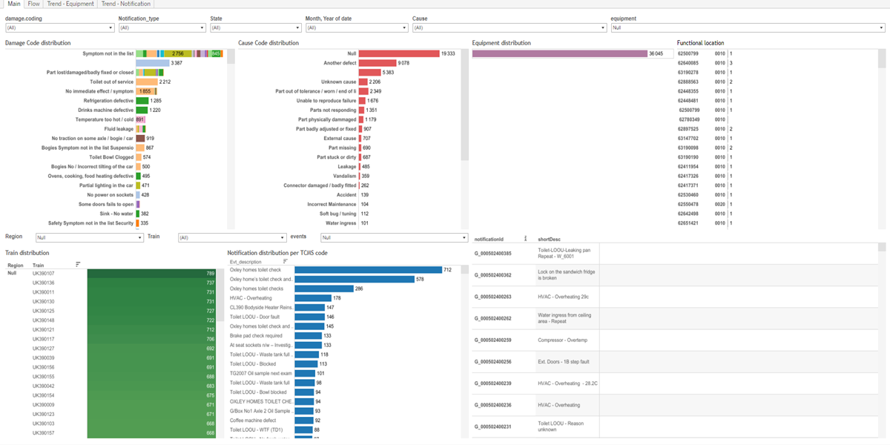
Constitution du rapport 2/4
Main Dashboard
The 'Main' dashboard provides a comprehensive overview of notification data, enabling users to explore distributions and relationships between various notification attributes such as TCMS codes, damage codes, equipment, trains, causes, and functional locations. It facilitates detailed data exploration through interactive tables and textual representations, allowing for in-depth analysis of the dataset.
Position | Exemple de question | Description
bottom right | What is the distribution of notifications per TCMS code? | This plot visualizes the notification data with notificationId on the x-axis and Evt_description on the y-axis. The color and value of each cell are determined by the events variable.
top right | What are the different types of notifications and their associated states, descriptions, and tasks? | The plot visualizes the relationship between shortDesc and taskText. Both axes contain string data, making this a textual representation.
top left | What is the distribution of damage codes based on the notification IDs and damage groups? | This visualization displays the damage.label categorized by notificationId with each cell filled by damage.group.
top right | How is the equipment distributed across different notifications? | This plot displays the notificationId on the x-axis and equipment on the y-axis. Since the y-axis is a boolean, the plot likely represents a table where the fill variable is used for color and value of each cell.
Principaux Filtres/Paramètres
Filtrage par | Description
notificationType | Filtering applicable to workbooks based on the notification type.
state | Filtering by state
cause.coding | Filtering by cause coding

Slide 4
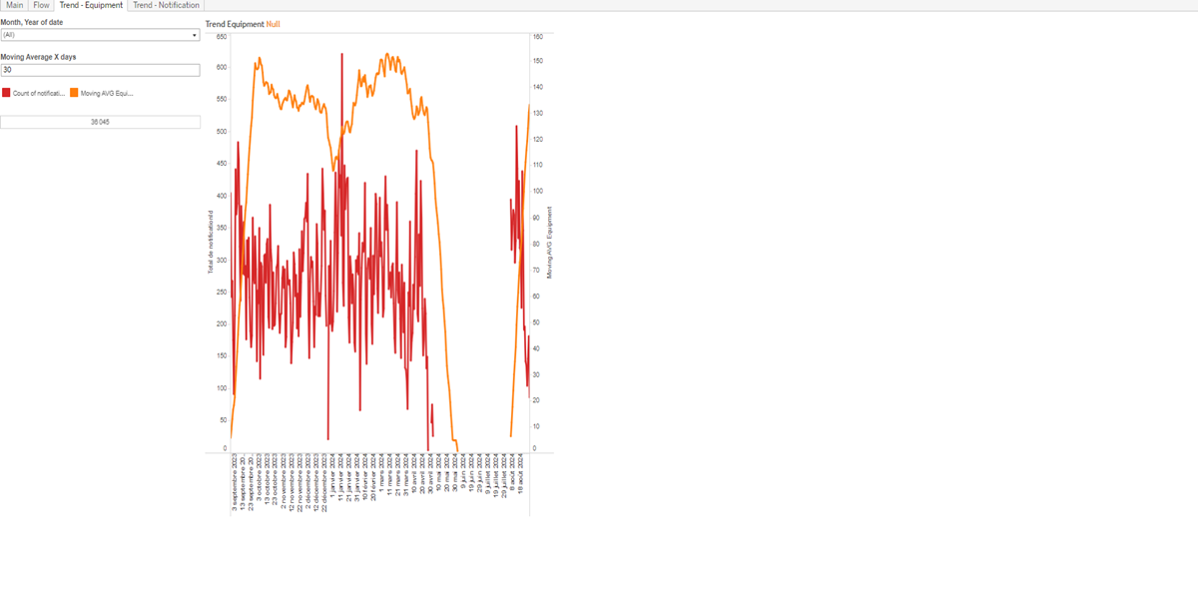
Constitution du rapport 3/4
Trend - Equipment Dashboard
The 'Trend - Equipment' dashboard provides a comprehensive overview of equipment performance over time, utilizing moving average calculations and detailed tables to explore relationships between equipment and notifications. It allows for interactive data exploration and comparison through its line charts and tabular data, facilitating in-depth analysis.
Position | Exemple de question | Description
top | What is the trend of equipment performance over time based on moving average calculations? | This visualization displays the Moving AVG Equipment over time using a line chart. The x-axis represents dates, while the y-axis shows the calculated moving average of equipment notifications.
bottom | What is the relationship between equipment and notificationId over the given period? | Description of a worksheet in a report. A worksheet contains charts (plots) and addresses a specific question.
Principaux Filtres/Paramètres
Filtrage par | Description

Slide 5
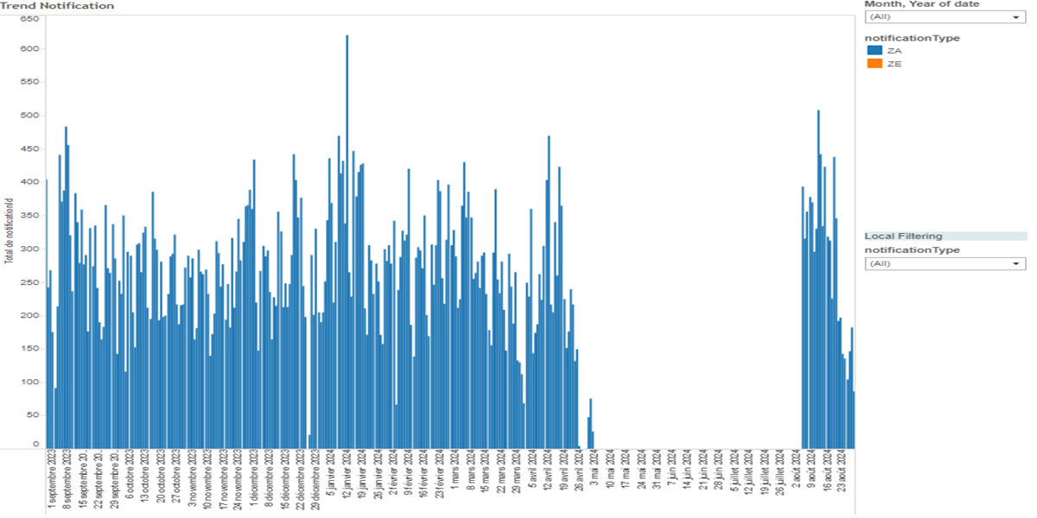
Constitution du rapport 4/4
Trend - Notification Dashboard
The 'Trend - Notification' dashboard provides a detailed analysis of notification trends over time, categorized by notification type. It allows users to filter data based on notification ID and type, facilitating in-depth exploration and interaction between various graphs for comprehensive insights.
Position | Exemple de question | Description
center | What is the trend in notifications over time based on notification ID and type? | This visualization shows the count of notificationId over time, categorized by notificationType.
Principaux Filtres/Paramètres
Filtrage par | Description

Slide 6
Liste des variables
GENERAL DESCRIPTION
La liste des variables ci-dessous est necessaire pour la constitution du rapport. Pour le projet [Projet] leur equivalence doit être fournie avec la plage de Valeur associée en cas de demande de rapport.
Variable | Description
REGION | Region represents the geographical area associated with a train's operation. It is used in various dashboards for analyzing trends and notifications.
affectation.train | This variable represents the train assigned to a specific task or event. It is used in operational data for tracking purposes.
cause.coding | This variable encodes the cause of an event in the maintenance system. It is used to classify and analyze different types of issues that occur.
cause.group | This variable categorizes the cause of events for maintenance purposes. It is used in various plots to analyze event distributions.
cause.label | The variable 'cause.label' is used to categorize causes in the dashboard. It helps in identifying the reasons for specific events.
damage.coding | This variable categorizes the type of damage for maintenance purposes. It is used in various dashboards to analyze and filter damage-related notifications.
damage.group | This variable categorizes the type of damage reported. It is used for maintenance and operational analysis.
damage.label | This variable represents the label for a type of damage recorded in the system. It is used in various dashboards to categorize and identify damage events.
date | This variable represents the date when data was recorded. It is used in various dashboards for event correlation and historical analysis.
equipment | Indicates whether a specific piece of equipment is in use or not. Used across various dashboards for maintenance and operational tracking.
events | Events data is recorded as context data for various operational events. It helps in identifying and tracking specific incidents or notifications.
NOTE
Les illustrations fournissent un aperçu des représentations graphiques et ne préjugent pas des données pouvant être contenues dans le rapport. En effet, les données peuvent évoluer au cours du projet et dépendent entièrement de celui-ci.
Toute reproduction ou distribution non autorisée de ce rapport est interdite. Les informations contenues dans ce document sont confidentielles et destinées uniquement aux parties mentionnées. L'utilisation ou la divulgation non autorisée de ces informations est passible de poursuites judiciaires. Les représentations graphiques sont fournies à titre indicatif et ne sauraient engager la responsabilité de l'émetteur quant à l'exhaustivité ou l'exactitude des données présentées. Les données sont sujettes à des modifications au fil du projet et doivent être interprétées dans ce contexte.

