Slide 1
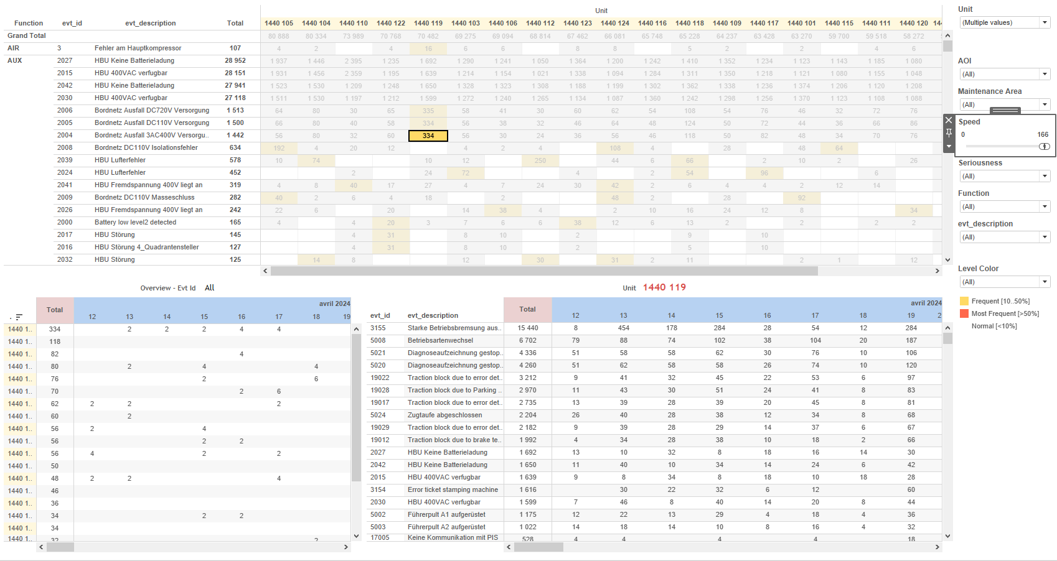
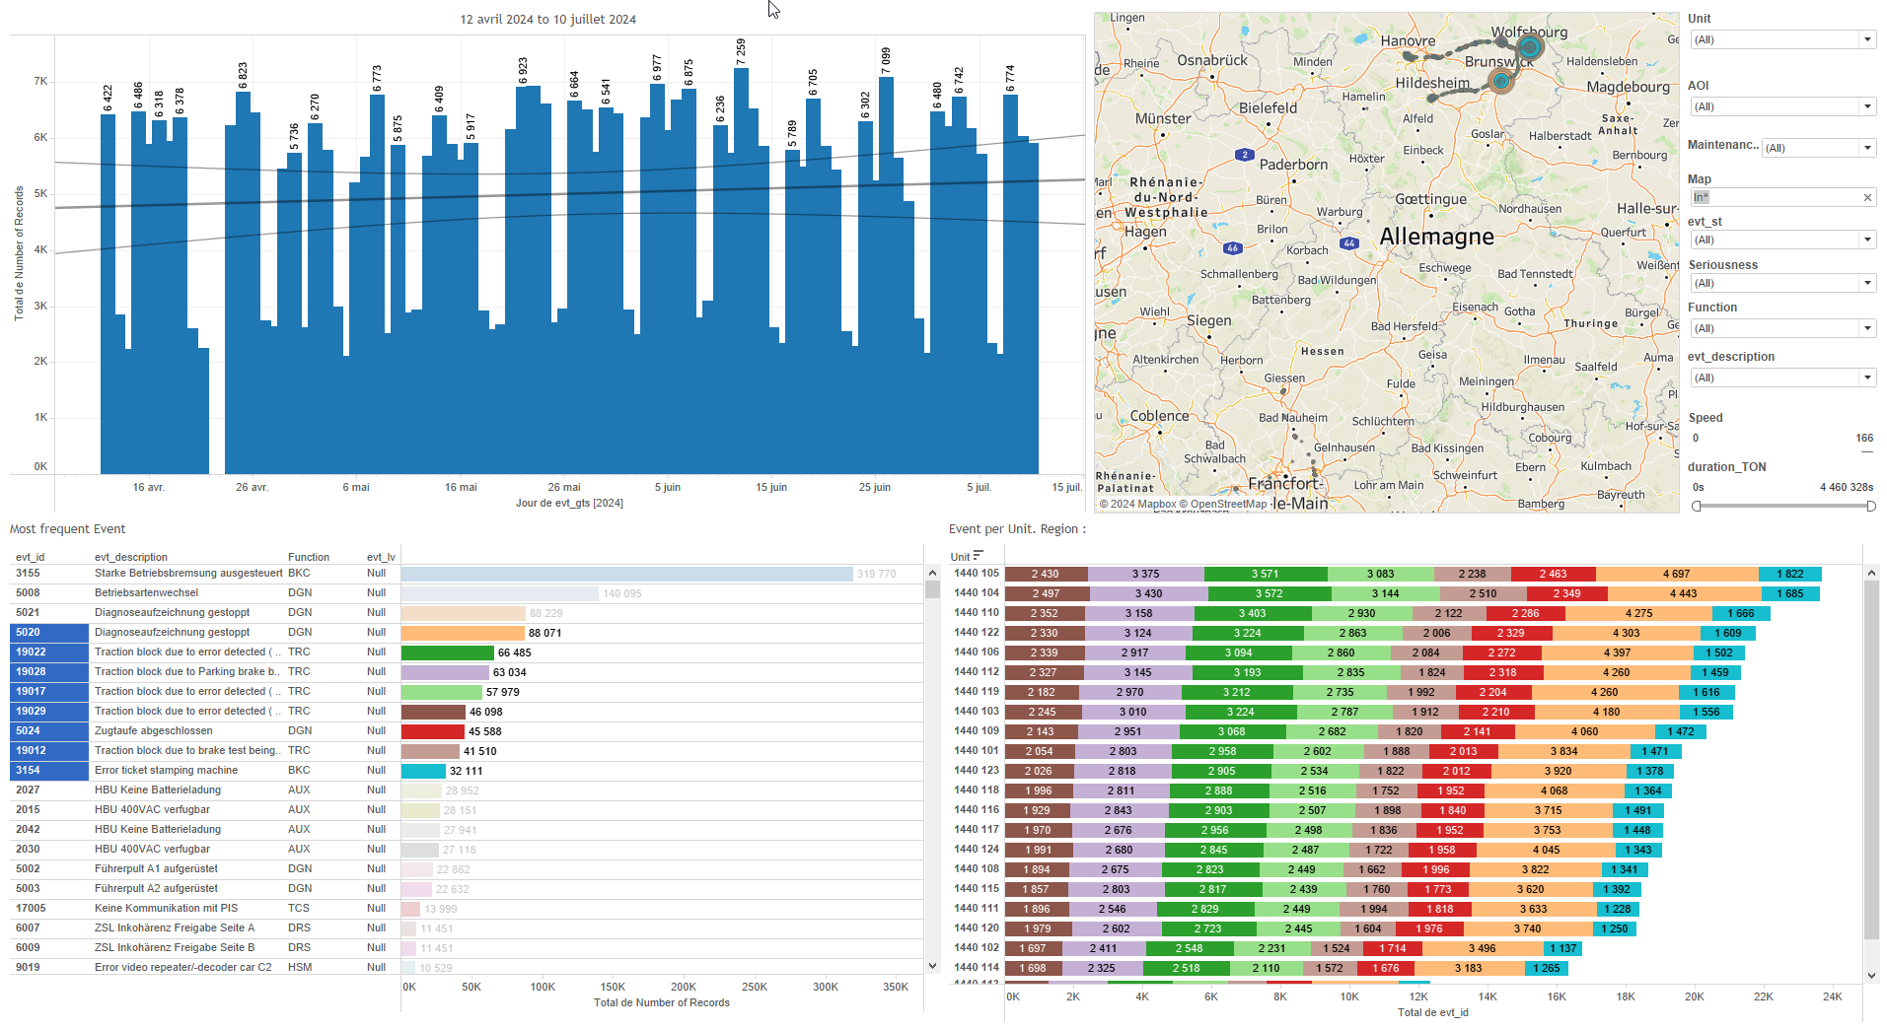
DATA VISUALIZATION REPORT SHEET
HealthHub
Minio
Standard
Event Analysis
Represented By
project size Bucket key Total Dir Ratio Dir level Total size Available in %
GENERAL DESCRIPTION
This report provides a comprehensive overview of the number of files per project and bucket, as well as the size distributions across various categories, buckets, and directories. It includes interactive tables and visualizations that facilitate detailed data exploration.
MAIN CHARACTERISTICS | Description
Project | Any project
Domain | Operational Data
Type of report | Data Exploration - Operational Time Series (OPDAT)
Report's Objective | Provide a comprehensive overview of the number of files per project and bucket. Facilitate detailed data exploration through interactive tables and visualizations. Analyze project size distributions across various categories, buckets, and directories.

Slide 2
Constitution du rapport 1/2
Minio Nb Dashboard
The 'Minio Nb' dashboard provides a comprehensive overview of the number of files per project and bucket, categorized by various criteria such as backup, datawarehouse, upload, download, production, and other. It allows for detailed data exploration through interactive tables that highlight the size and distribution of files across different projects and buckets.
Position | Exemple de question | Description
top | What is the number of files per project based on different categories such as backup, datawarehouse, upload, download, production, and other? | This plot displays the size against the project. Since the y-axis variable is categorical, the plot is displayed as a table. Each cell is filled with the project data.
bottom | What is the number of files per bucket based on different categories? | This visualization displays the size of buckets categorized by project. The categories include 'backup/', 'datawarehouse/', 'upload/', 'download/', 'production/', and 'other'. Each cell in the table is colored based on the project associated with the bucket.
Principaux Filtres/Paramètres
Filtrage par | Description

Slide 3
Constitution du rapport 2/2
Minio Size Dashboard
The 'Minio Size' dashboard provides a comprehensive analysis of project size distributions across various categories, buckets, and directories. It allows for detailed data exploration through interactive tables and pie charts, facilitating insights into the size ratios and distributions within the Minio system.
Position | Exemple de question | Description
top left | What is the size distribution per project based on different key categories? | This visualization represents the project distribution across different sizes. The color and value of each cell correspond to the project categories.
bottom left | What is the ratio percentage of different categories in the total size? | This pie chart visualizes the ratio of project sizes, calculated as SUM(size) divided by a parameter.
top | What is the size distribution per bucket in the dataset? | This visualization displays the size distribution across different buckets. The x-axis represents the size, while the y-axis categorizes the data into buckets based on the provided formula. The fill axis variable 'project' is used to color and value each cell.
top right | What is the size distribution per project and per bucket? | This visualization displays the size of various buckets categorized by project. The x-axis represents the size, while the y-axis categorizes the buckets into 'backup/', 'datawarehouse/', 'upload/', 'download/', 'production/', and 'other'. The fill axis uses the 'project' variable to color and value each cell.
Principaux Filtres/Paramètres
Filtrage par | Description

Slide 4
Liste des variables
GENERAL DESCRIPTION
La liste des variables ci-dessous est necessaire pour la constitution du rapport. Pour le projet [Projet] leur equivalence doit être fournie avec la plage de Valeur associée en cas de demande de rapport.
Variable | Description
key | This variable is recorded continuously as operational data. It is used to categorize files into different buckets based on their path.
project | The project variable categorizes data by project names, aiding in the organization and analysis of project-specific information. It is used in multiple dashboards to filter and plot data.
size | The size variable represents the amount of space occupied by files. It is measured in bytes.
NOTE
Les illustrations fournissent un aperçu des représentations graphiques et ne préjugent pas des données pouvant être contenues dans le rapport. En effet, les données peuvent évoluer au cours du projet et dépendent entièrement de celui-ci.
Toute reproduction ou distribution non autorisée de ce rapport est interdite. Les informations contenues dans ce document sont confidentielles et destinées uniquement aux parties mentionnées. L'utilisation ou la divulgation non autorisée de ces informations est passible de poursuites judiciaires. Les représentations graphiques sont fournies à titre indicatif et ne sauraient engager la responsabilité de l'émetteur quant à l'exhaustivité ou l'exactitude des données présentées. Les données sont sujettes à des modifications au fil du projet et doivent être interprétées dans ce contexte.

