Slide 1
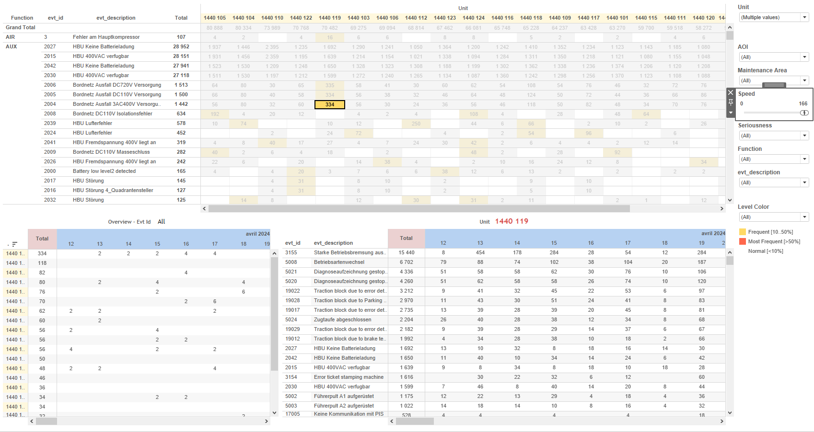
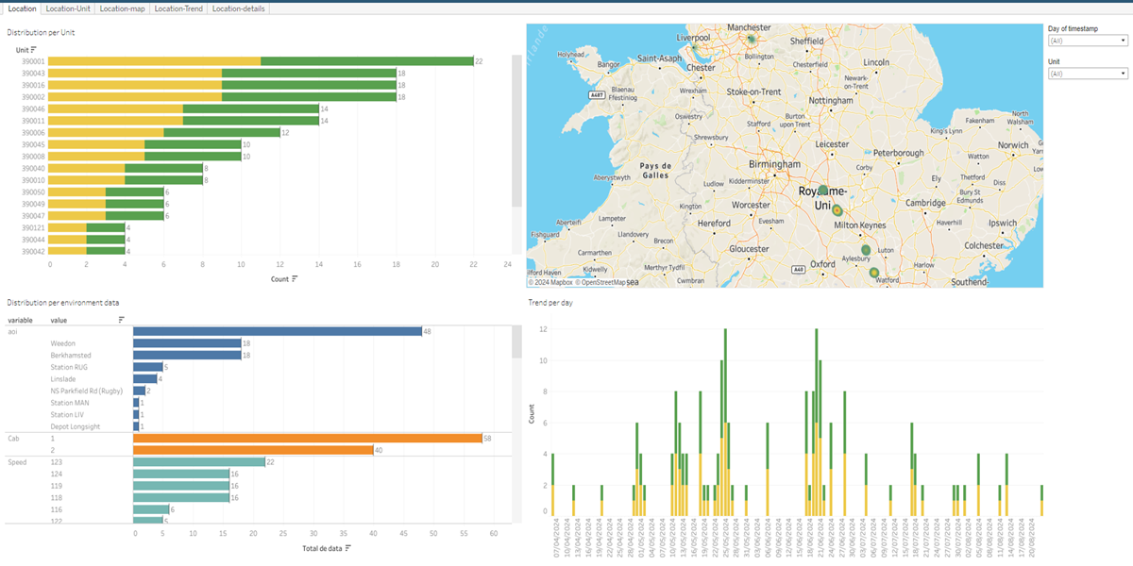
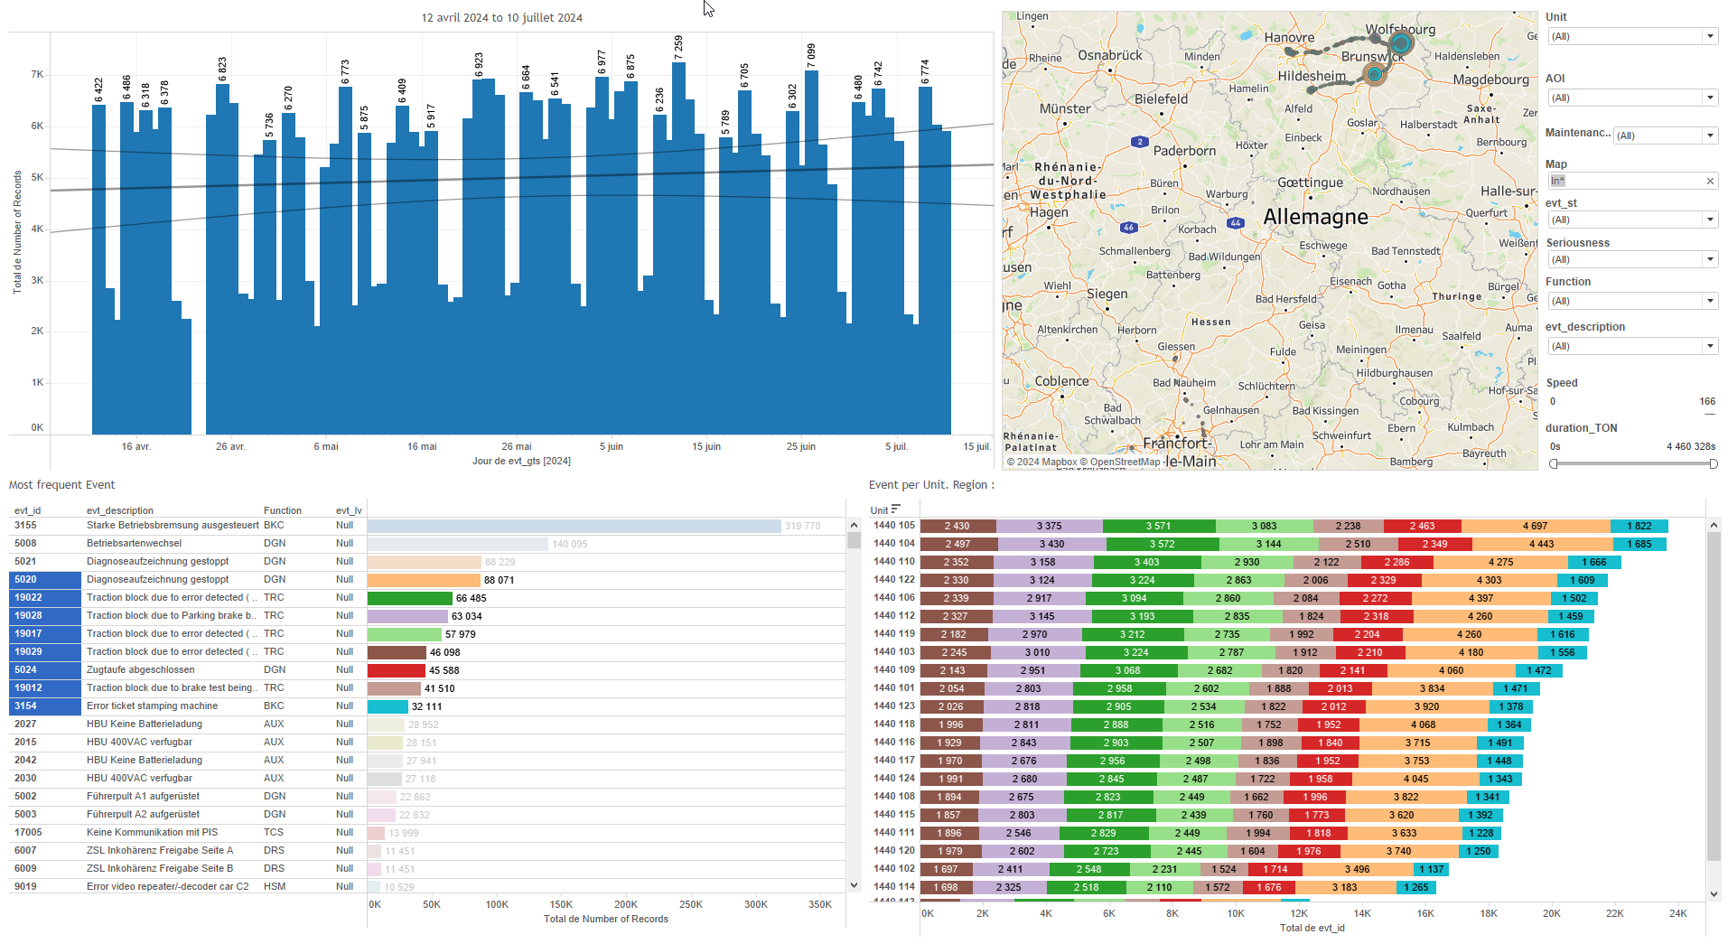
DATA VISUALIZATION REPORT SHEET
HealthHub
Opdat_HeatMap
Standard
Event Analysis
Represented By
variable Unit timestamp Type lat lon value
GENERAL DESCRIPTION
The 'Location' dashboard provides an overview of data distribution per unit, spatial patterns on a map, daily trends, and detailed data distribution. It allows for comprehensive data exploration through interactive tables and heatmaps, enabling users to identify trends and patterns effectively.
MAIN CHARACTERISTICS | Description
Project | Any project
Domain | Exploration,Operational Data
Type of report | Data Exploration - Operational Time Series (OPDAT)
Report's Objective | Provide an overview of data distribution per unit. Identify spatial patterns on a map. Analyze daily trends. Enable comprehensive data exploration through interactive tables and heatmaps.

Slide 2
Constitution du rapport 1/1
Location Dashboard
The 'Location' dashboard provides an overview of data distribution per unit, spatial patterns on a map, daily trends, and detailed data distribution. It allows for comprehensive data exploration through interactive tables and heatmaps, enabling users to identify trends and patterns effectively.
Position | Exemple de question | Description
top left | What is the distribution per unit? | This visualization shows data (Extract.data)_5E2A4E7065DE4CF89DED893D1476C0B5 on the x-axis and Unit on the y-axis. Each cell is filled with variable values.
top right | What patterns can be observed in the spatial distribution of the data points based on latitude and longitude in the heatmap? | This heatmap visualization displays the longitude (lon) and latitude (lat) data points on a map. The colors represent the density or intensity of the data points.
bottom right | What are the daily trends shown in the bar chart based on the variable data? | This visualization shows the trend of data (Extract.data)_5E2A4E7065DE4CF89DED893D1476C0B5 over time, using the variable for color and value of each cell.
bottom left | What is the distribution of data per environment? | This table displays the value categorized by variable, providing a detailed view of the data distribution.
Principaux Filtres/Paramètres
Filtrage par | Description

Slide 3
Liste des variables
GENERAL DESCRIPTION
La liste des variables ci-dessous est necessaire pour la constitution du rapport. Pour le projet [Projet] leur equivalence doit être fournie avec la plage de Valeur associée en cas de demande de rapport.
Variable | Description
Type | The variable indicates the type of data being recorded, which can be either duration in hours or occurrence. It is used in various KPIs and operational data plots.
Unit | This variable identifies parts of a train. It is used across various dashboards for both context and operational data.
lat | Latitude is used to map the location of train units. It is recorded as operational data.
lon | Longitude is recorded continuously as operational data and is used in location heatmaps.
timestamp | Timestamp is recorded as context data for events and operational data. It is used to track when events occur and to monitor train operations.
value | This variable is continuously recorded operational data. It is used in multiple dashboards for analysis.
variable | This variable is recorded as context data for events and is used in multiple dashboards. It helps in analyzing train performance and operational conditions.
NOTE
Les illustrations fournissent un aperçu des représentations graphiques et ne préjugent pas des données pouvant être contenues dans le rapport. En effet, les données peuvent évoluer au cours du projet et dépendent entièrement de celui-ci.
Toute reproduction ou distribution non autorisée de ce rapport est interdite. Les informations contenues dans ce document sont confidentielles et destinées uniquement aux parties mentionnées. L'utilisation ou la divulgation non autorisée de ces informations est passible de poursuites judiciaires. Les représentations graphiques sont fournies à titre indicatif et ne sauraient engager la responsabilité de l'émetteur quant à l'exhaustivité ou l'exactitude des données présentées. Les données sont sujettes à des modifications au fil du projet et doivent être interprétées dans ce contexte.

