Slide 1
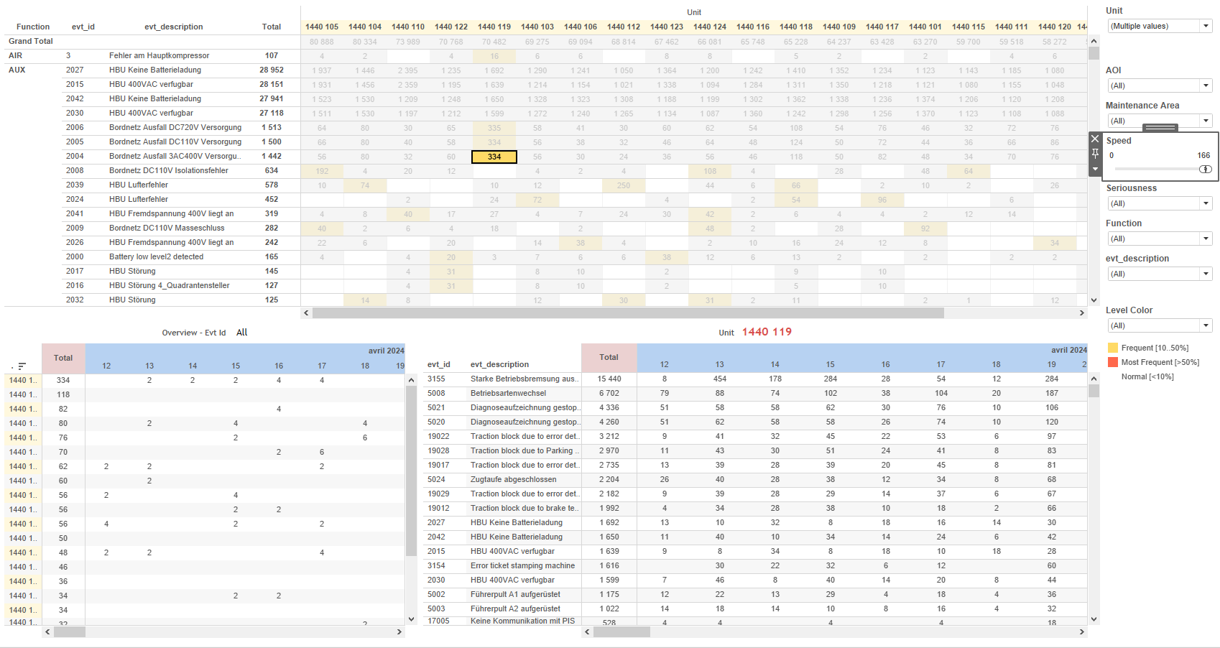
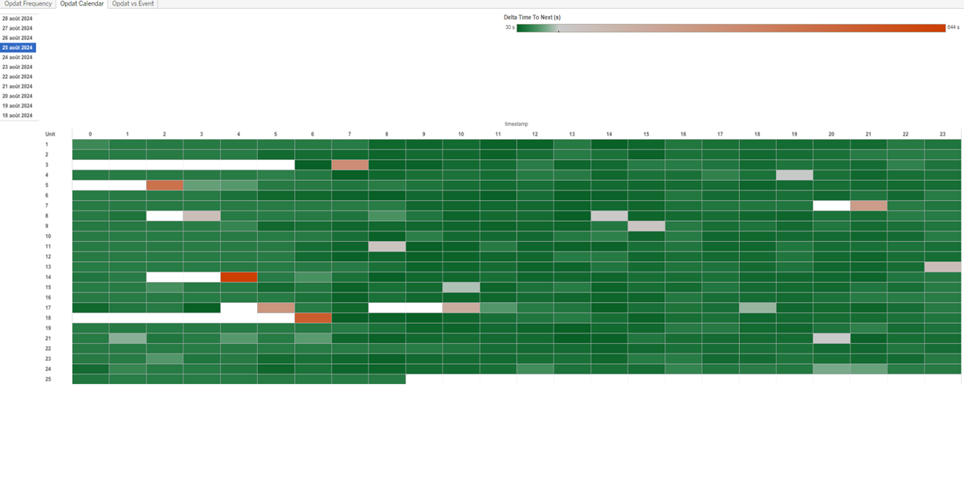
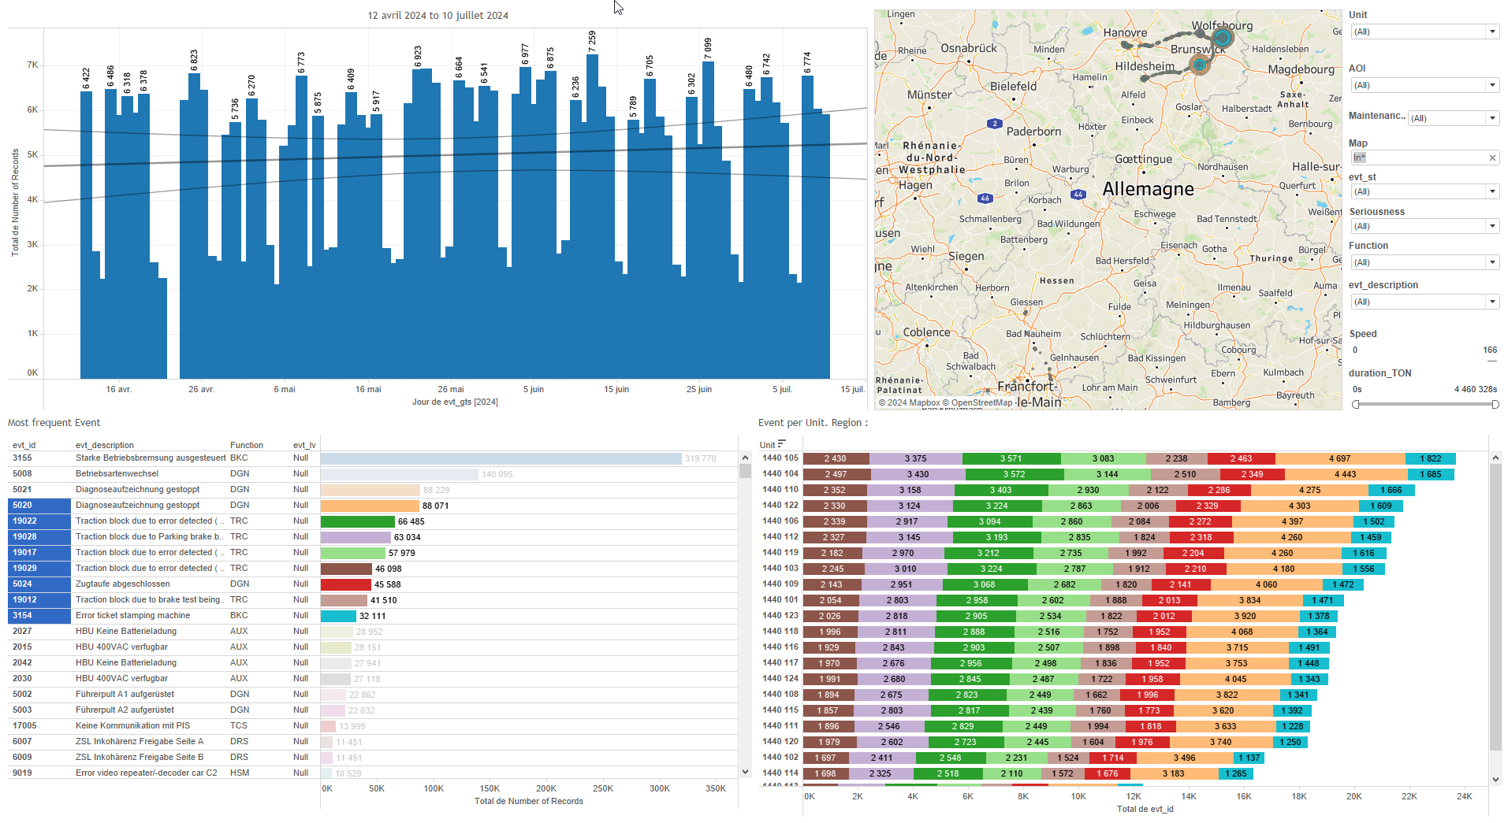
DATA VISUALIZATION REPORT SHEET
HealthHub
Opdat_Quality
Standard
Event Analysis
Represented By
Unit timestamp One Delta Time To Next Filter delT_opdat Type Color Conditionning typeEvt Upper Limit Lower Limit
GENERAL DESCRIPTION
This report provides a comprehensive overview of the Opdat Quality project, including detailed analyses of daily and hourly activities, operation frequencies, and the relationship between operational data and events. It facilitates data-driven decision-making through interactive visualizations and tables.
MAIN CHARACTERISTICS | Description
Project | Any project
Domain | Event,Operational Data
Type of report | Data Exploration - Operational Time Series (OPDAT)
Report's Objective | Provide a comprehensive overview of the daily and hourly activities within the Opdat Calendar. Facilitate data-driven decision-making through detailed exploration of daily lists and Delta Time To Next Filter distribution. Enable detailed analysis of operation frequencies over time. Allow users to explore median periods, delta times, and frequency ranges through interactive tables. Provide comprehensive analysis of the relationship between operational data and events over time. Enable understanding of patterns and correlations through interactive visualizations.

Slide 2
Constitution du rapport 1/3
Opdat Calendar Dashboard
The 'Opdat Calendar' dashboard provides a comprehensive overview of the daily and hourly activities within the Opdat Calendar. It allows for detailed exploration of daily lists and the distribution of Delta Time To Next Filter over different timestamps and units, facilitating data-driven decision-making.
Position | Exemple de question | Description
left | What is the daily list of the Opdat Calendar? | Description of a worksheet in a report. A worksheet contains charts (plots) and addresses a specific question.
right | What is the distribution of Delta Time To Next Filter over different timestamps and units? | This plot visualizes the timestamp against the Unit, with Delta Time To Next Filter used for cell color and value. The data is presented in a tabular format due to the categorical nature of the y-axis variable.
Principaux Filtres/Paramètres
Filtrage par | Description

Slide 3
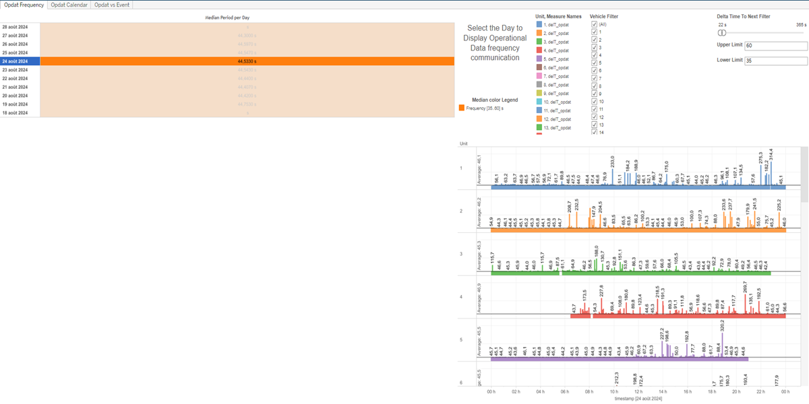
Constitution du rapport 2/3
Opdat Frequency Dashboard
The 'Opdat Frequency' dashboard provides a detailed analysis of operation frequencies over time, allowing users to explore median periods, delta times, and frequency ranges through interactive tables with color-coded cells based on calculated values and unit differentiation.
Position | Exemple de question | Description
bottom | What is the median period per day and how does it relate to the upper and lower limits for frequency? | This visualization represents the frequency of operations over time. The y-axis shows the timestamp, and the fill axis uses color conditioning based on calculated values to highlight different frequency ranges.
top | What is the delta time to the next filter for the given data? | This visualization shows the frequency of operations over time with delT_opdat values represented. Each cell is colored based on the Unit.
Principaux Filtres/Paramètres
Filtrage par | Description
Unit | Filtering applicable to workbooks. Filtering events by location on the GPS map, Filtering all or part of the Trains by identifier, Filtering by speed, Duration (hour/day/week), Filtering the duration of the train service, Time window size for event counting, Filtering all or part of the project's 'AOI' (Area Of Interest), Filtering maintenance-related depot areas, Filtering by operational mode of the Train, Event reference, Filtering by event description, Filtering event edges, Filtering by equipment that generated the event report, Filtering the severity of events
Delta Time To Next Filter | Filtering applicable to workbooks. This filter is used to determine the delta time to the next filter. It uses a formula to check if the absolute value of delT_opdat is greater than 24*3600*3, in which case it returns NULL, otherwise it returns delT_opdat.

Slide 4
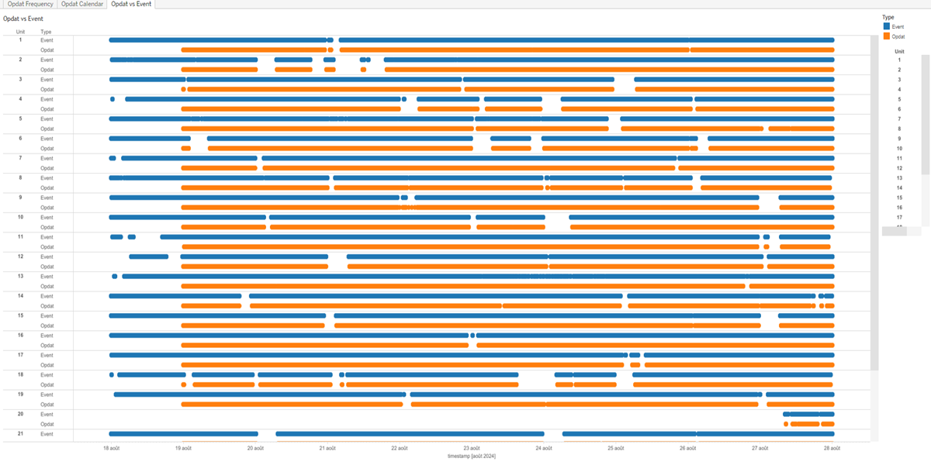
Constitution du rapport 3/3
Opdat vs Event Dashboard
The 'Opdat vs Event' dashboard provides a comprehensive analysis of the relationship between operational data and events over time. It allows for detailed data exploration through interactive visualizations, such as circle and polygon charts, enabling users to understand patterns and correlations effectively.
Position | Exemple de question | Description
bottom | What is the relationship between Opdat and Event over time? | This visualization displays the 'Type' categorized by 'timestamp'. The 'Type' is derived from a calculation based on 'typeOpdat' and 'typeEvt'.
top | What is the relationship between the operational data and the event unit represented as a polygon chart? | Description of a worksheet in a report. A worksheet contains charts (plots) and addresses a specific question.
Principaux Filtres/Paramètres
Filtrage par | Description

Slide 5
Liste des variables
GENERAL DESCRIPTION
La liste des variables ci-dessous est necessaire pour la constitution du rapport. Pour le projet [Projet] leur equivalence doit être fournie avec la plage de Valeur associée en cas de demande de rapport.
Variable | Description
Unit | This variable identifies different parts of a train. It is used in both event context data and operational data.
delT_opdat | This variable represents the delta time recorded as operational data. It is used to measure time intervals between events in train operations.
timestamp | This variable records the exact time of an event or operation. It is crucial for tracking and analyzing data over time.
typeEvt | This variable indicates the type of event recorded in the system. It is used to distinguish between operational data and event data.
typeOpdat | This variable records operational data continuously. It is used in quality analysis plots.
NOTE
Les illustrations fournissent un aperçu des représentations graphiques et ne préjugent pas des données pouvant être contenues dans le rapport. En effet, les données peuvent évoluer au cours du projet et dépendent entièrement de celui-ci.
Toute reproduction ou distribution non autorisée de ce rapport est interdite. Les informations contenues dans ce document sont confidentielles et destinées uniquement aux parties mentionnées. L'utilisation ou la divulgation non autorisée de ces informations est passible de poursuites judiciaires. Les représentations graphiques sont fournies à titre indicatif et ne sauraient engager la responsabilité de l'émetteur quant à l'exhaustivité ou l'exactitude des données présentées. Les données sont sujettes à des modifications au fil du projet et doivent être interprétées dans ce contexte.

