Slide 1
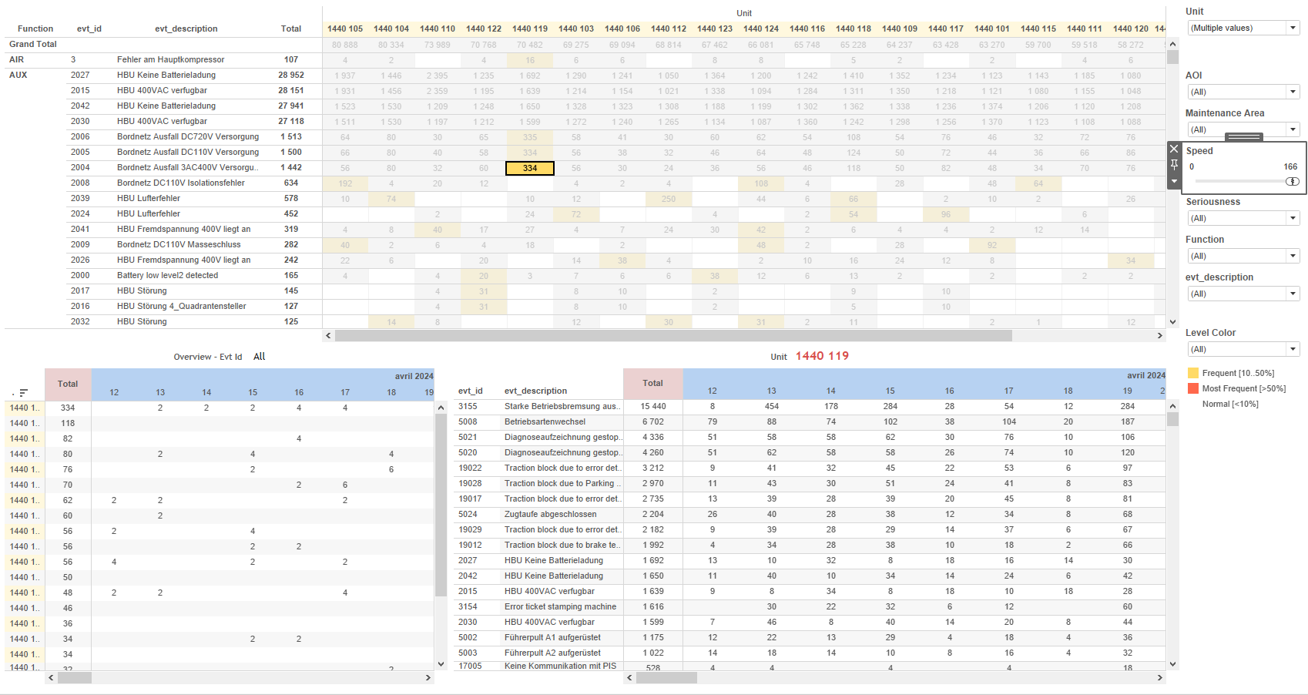
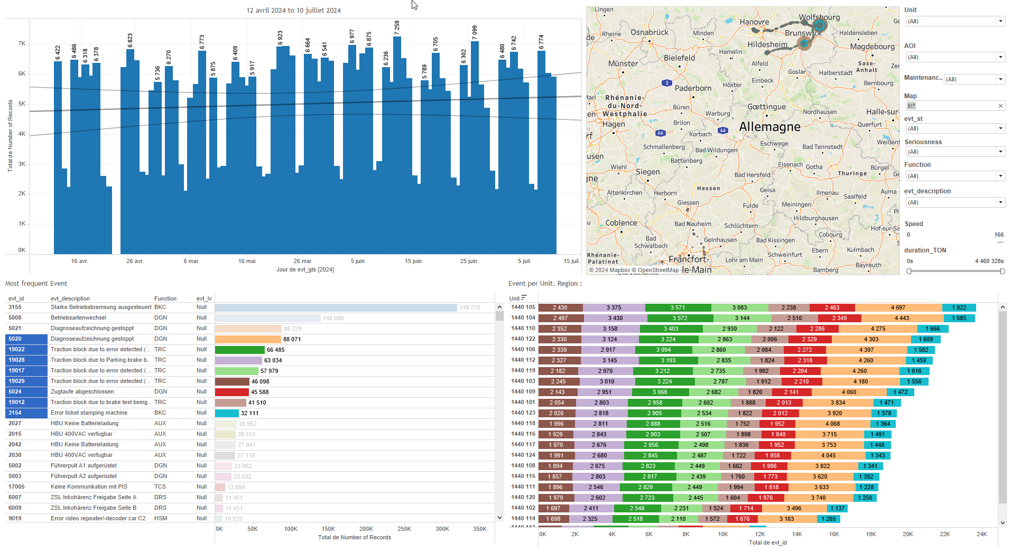
DATA VISUALIZATION REPORT SHEET
HealthHub
OverSpeed
Standard
Event Analysis
Represented By
aoi value idx Unit evt_gts evt_description Environment Data evt_id evt_gps_lat evt_gps_lon
GENERAL DESCRIPTION
The 'Location' dashboard provides a comprehensive analysis of geographical and categorical data, enabling detailed exploration through various plots such as tables, heatmaps, and line charts. It facilitates understanding of distribution, relationships, and trends in the dataset, with interactive features for in-depth data analysis.
MAIN CHARACTERISTICS | Description
Project | Any project
Domain | Event, Operational Data
Type of report | Data Exploration - Train Event Data with Contextual Variables
Report's Objective | Provide a comprehensive analysis of geographical and categorical data. Enable detailed exploration through various plots such as tables, heatmaps, and line charts. Facilitate understanding of distribution, relationships, and trends in the dataset. Offer interactive features for in-depth data analysis.

Slide 2
Constitution du rapport 1/1
Location Dashboard
The 'Location' dashboard provides a comprehensive analysis of geographical and categorical data, enabling detailed exploration through various plots such as tables, heatmaps, and line charts. It facilitates understanding of distribution, relationships, and trends in the dataset, with interactive features for in-depth data analysis.
Position | Exemple de question | Description
top left | What is the distribution of the area of interest (aoi) over the given indices? | This plot visualizes the 'aoi' variable categorized by 'idx'. The 'aoi' variable is displayed using colors in each cell.
bottom left | What is the relationship between the Unit and the index (idx) in the given dataset? | This plot displays the 'Unit' values categorized by 'idx'. Since 'Unit' is a string, the resulting plot is represented as a table. Each cell is colored and valued based on the 'Unit' variable.
top right | What is the geographical distribution of the event data based on GPS coordinates? | This heatmap visualizes the distribution of events based on their GPS coordinates. The x-axis represents the longitude (evt_gps_lon) and the y-axis represents the latitude (evt_gps_lat).
bottom right | What is the relationship between the environment data values? | This plot visualizes the relationship between 'value' and 'value' using real number data types. The x-axis represents 'value' and the y-axis represents 'value'.
Principaux Filtres/Paramètres
Filtrage par | Description

Slide 3
Liste des variables
GENERAL DESCRIPTION
La liste des variables ci-dessous est necessaire pour la constitution du rapport. Pour le projet [Projet] leur equivalence doit être fournie avec la plage de Valeur associée en cas de demande de rapport.
Variable | Description
Environment Data | This variable represents environmental data relevant to train operations. It is used in various plots to analyze trends and locations.
Map | The map variable is used to plot the location of events on a heatmap. It helps in visualizing the geographical distribution of incidents.
Unit | This variable identifies a specific part of a train. It is recorded as context data for events.
aoi | The variable 'aoi' is recorded as operational data and used in various dashboards for tracking train locations. It provides context data for events and helps in visualizing trends and patterns.
evt_description | This variable records event descriptions. It is used in multiple dashboards for event analysis.
evt_gps_lat | This variable represents the latitude of a GPS event recorded for a train. It is used in various dashboards to plot the train's location.
evt_gps_lon | This variable represents the GPS longitude of an event. It is used in various dashboards to map the location of events.
evt_gts | This variable records the timestamp of events. It is used in multiple dashboards for event tracking and analysis.
evt_id | This variable is used to uniquely identify events in the system. It is essential for tracking and analyzing event-related data.
idx | This variable is used to track the location and events of train units. It is recorded continuously as operational data.
value | This variable is used to represent real-time data points. It is utilized in multiple dashboards for various analyses.
NOTE
Les illustrations fournissent un aperçu des représentations graphiques et ne préjugent pas des données pouvant être contenues dans le rapport. En effet, les données peuvent évoluer au cours du projet et dépendent entièrement de celui-ci.
Toute reproduction ou distribution non autorisée de ce rapport est interdite. Les informations contenues dans ce document sont confidentielles et destinées uniquement aux parties mentionnées. L'utilisation ou la divulgation non autorisée de ces informations est passible de poursuites judiciaires. Les représentations graphiques sont fournies à titre indicatif et ne sauraient engager la responsabilité de l'émetteur quant à l'exhaustivité ou l'exactitude des données présentées. Les données sont sujettes à des modifications au fil du projet et doivent être interprétées dans ce contexte.

