Slide 1
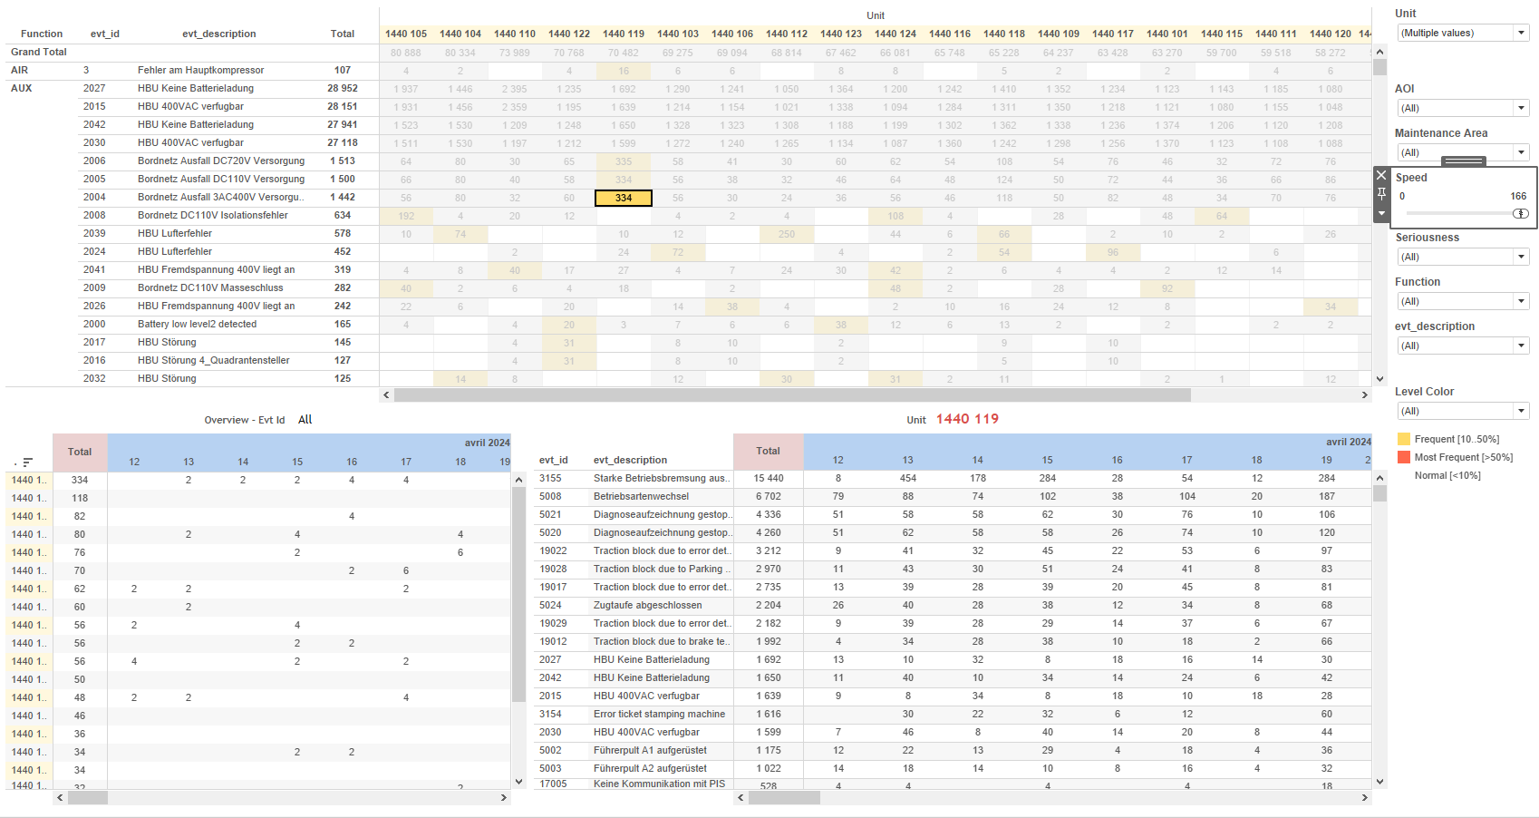
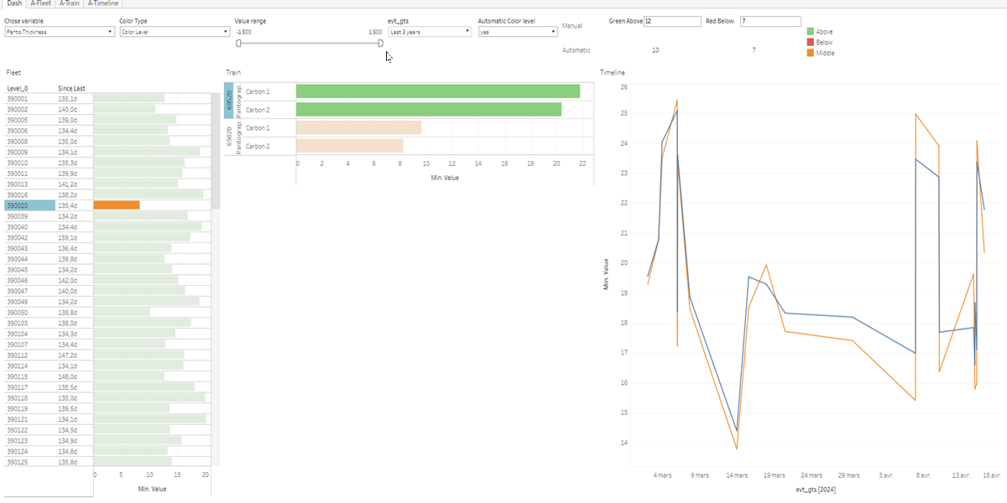
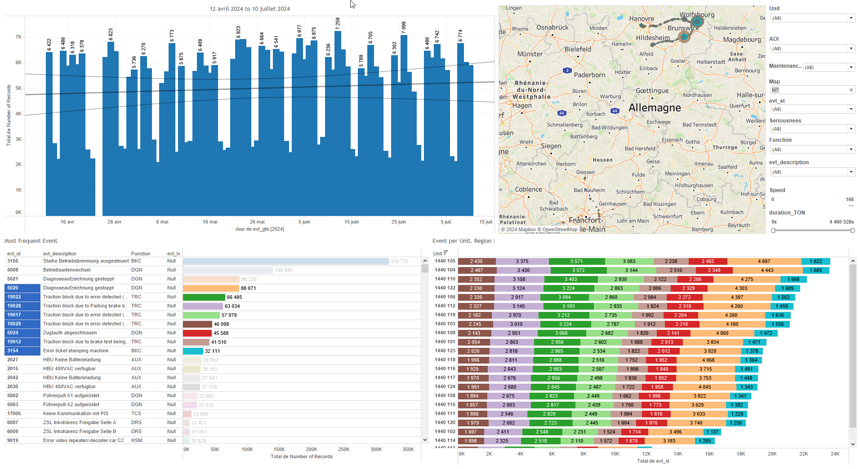
DATA VISUALIZATION REPORT SHEET
HealthHub
PantoInspect_Level3
Standard
Event Analysis
Represented By
Value evt_gts Colouring all Colouring GreeAbove RedBelow variable Automatic Color level ColorTypeCtrl Level_6
GENERAL DESCRIPTION
The 'Dash' dashboard provides a comprehensive view of data distributions and color classifications over time. It allows for detailed data exploration through various visualizations, including tables, line plots, and vertical bar charts, facilitating the understanding of relationships and conditions among different parameters.
MAIN CHARACTERISTICS | Description
Project | Any project
Domain | Event, Operational Data
Type of report | Data Exploration - Train Event Data with Contextual Variables
Report's Objective | Provide a comprehensive view of data distributions and color classifications over time. Facilitate detailed data exploration through various visualizations, including tables, line plots, and vertical bar charts. Help understand relationships and conditions among different parameters.

Slide 2
Constitution du rapport 1/1
Dash Dashboard
The 'Dash' dashboard provides a comprehensive view of data distributions and color classifications over time. It allows for detailed data exploration through various visualizations, including tables, line plots, and vertical bar charts, facilitating the understanding of relationships and conditions among different parameters.
Position | Exemple de question | Description
bottom left | What is the distribution of values over time and how does it correlate with color levels? | This visualization displays the Value against evt_gts, using Colouring all for cell coloring. The x-axis represents real values calculated by a formula, while the y-axis represents datetime values.
bottom | What is the color classification based on the provided parameters and data? | This plot visualizes the 'Value' against 'evt_gts' with 'Colouring' used for color coding. It provides a detailed view of the data distribution over time.
bottom right | What is the timeline of events and their corresponding values? | This visualization shows the values of 'Value' over time, categorized by '_Location_string'.
top left | How does the color level vary based on different parameters and conditions? | This plot visualizes the GreeAbove data from the source [data]. The plot type is determined automatically based on the data characteristics.
Principaux Filtres/Paramètres
Filtrage par | Description
Value | Filtering applicable to workbooks based on the real datatype and a specific formula that checks if a variable matches a parameter, then returns a value.

Slide 3
Liste des variables
GENERAL DESCRIPTION
La liste des variables ci-dessous est necessaire pour la constitution du rapport. Pour le projet [Projet] leur equivalence doit être fournie avec la plage de Valeur associée en cas de demande de rapport.
Variable | Description
ColorTypeCtrl | This variable indicates the type of color control used in the train's operational data. It is used in various dashboards for visualizing train performance metrics.
GreeAbove | This variable represents the operational data for a specific part of the train. It is used to monitor the condition above a certain threshold.
Image | Image data is used in the dashboards to visualize operational conditions of train components. It is recorded as context data for specific events.
Level_0 | Level 0 represents the initial level of the train's hierarchy. It is used across various dashboards for operational data analysis.
Level_1 | This variable represents the first level of some hierarchical structure within the train's operational data. It is used extensively across multiple dashboards to filter and plot data.
Level_2 | Level 2 indicates the hierarchical position within the train's operational data. It is used for filtering and plotting various dashboard metrics.
Level_3 | This variable is used to classify the train levels. It is recorded as operational data.
Level_4 | This variable is recorded continuously as operational data. It is used to monitor train operations across multiple dashboards.
Level_5 | This variable is recorded continuously as operational data. It is used in various dashboards to monitor train performance.
Level_6 | Level 6 is a continuously recorded operational data variable. It is used to monitor various performance metrics of the train fleet.
RedBelow | This variable represents a threshold level for a specific measurement in the train's operational data. It is used to determine if a value is below a critical limit.
NOTE
Les illustrations fournissent un aperçu des représentations graphiques et ne préjugent pas des données pouvant être contenues dans le rapport. En effet, les données peuvent évoluer au cours du projet et dépendent entièrement de celui-ci.
Toute reproduction ou distribution non autorisée de ce rapport est interdite. Les informations contenues dans ce document sont confidentielles et destinées uniquement aux parties mentionnées. L'utilisation ou la divulgation non autorisée de ces informations est passible de poursuites judiciaires. Les représentations graphiques sont fournies à titre indicatif et ne sauraient engager la responsabilité de l'émetteur quant à l'exhaustivité ou l'exactitude des données présentées. Les données sont sujettes à des modifications au fil du projet et doivent être interprétées dans ce contexte.

