Slide 1
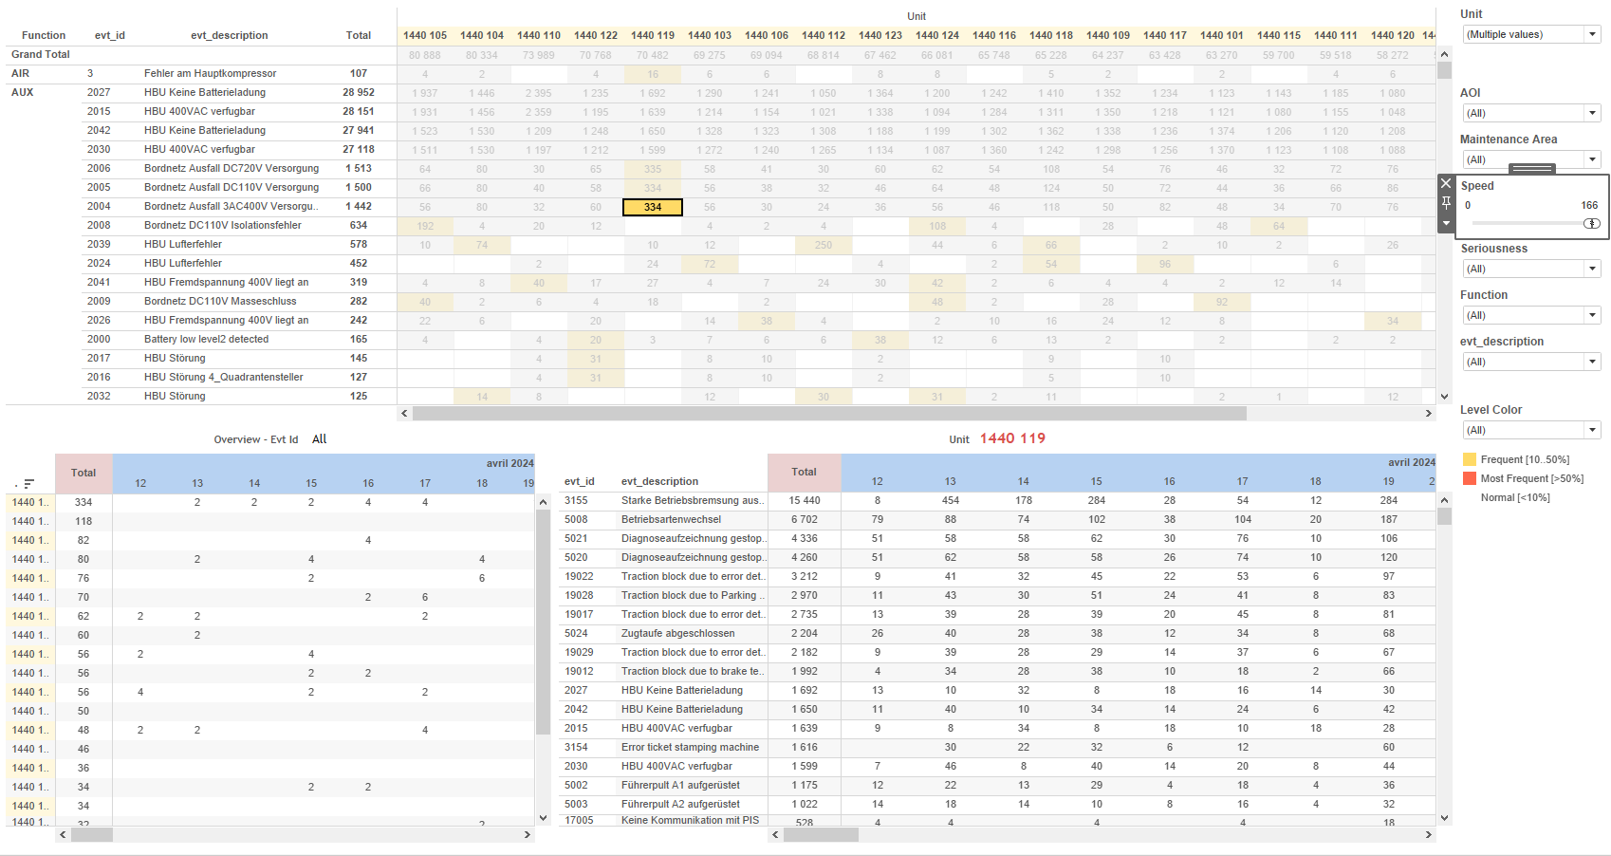
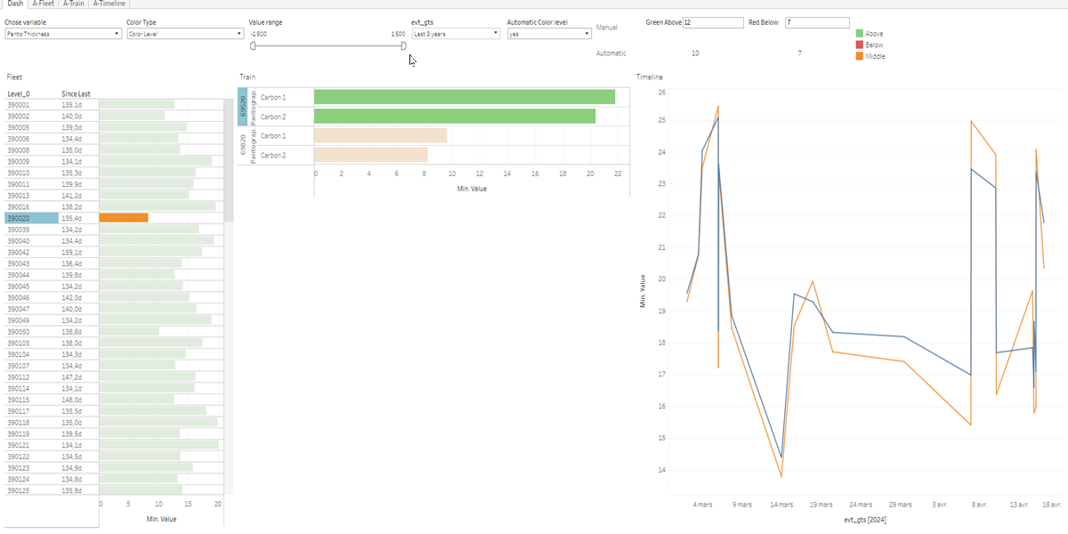
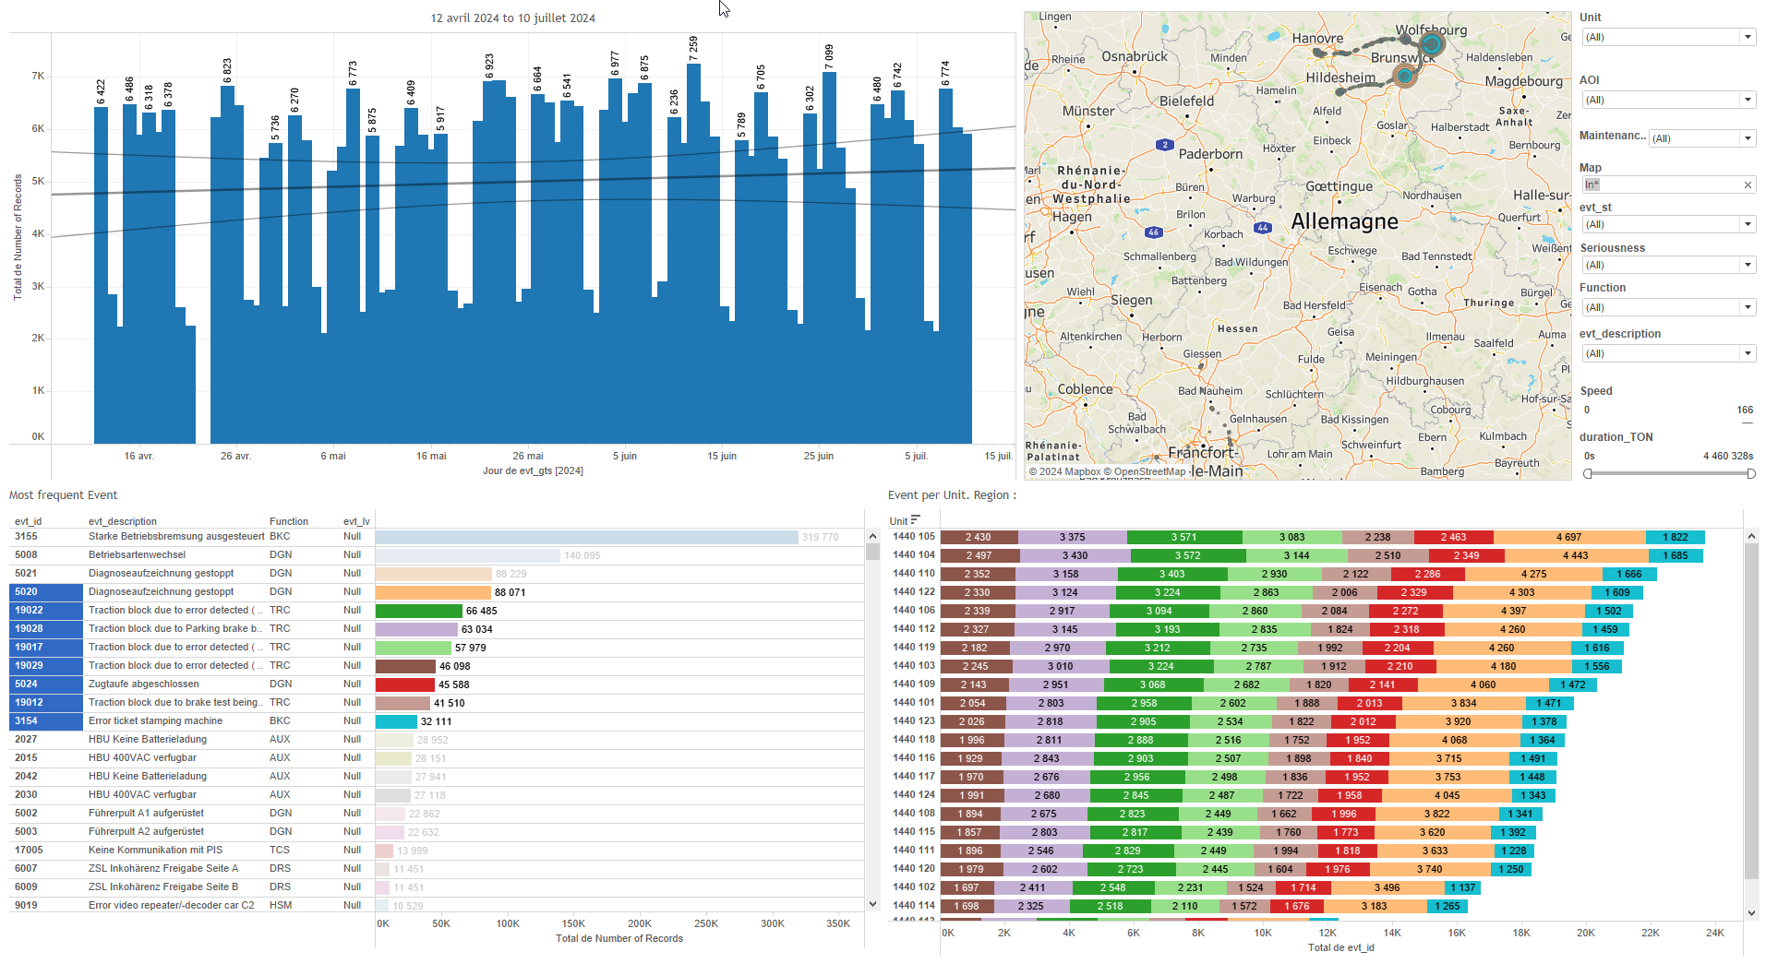
DATA VISUALIZATION REPORT SHEET
HealthHub
PantoInspect_Level4
Standard
Event Analysis
Represented By
Value evt_gts RedBelow Colouring all GreeAbove Colouring Red Below Since last Level_2 Level_3
GENERAL DESCRIPTION
The 'Dash' dashboard provides comprehensive visualizations to analyze the distribution of values and color levels over time across different parameters. It allows detailed data exploration through interactive tables, line charts, and vertical bar charts, enabling users to understand the relationships between various variables and their impact on the fleet's performance.
MAIN CHARACTERISTICS | Description
Project | Any project
Domain | Event,Operational Data
Type of report | Data Exploration - Train Event Data with Contextual Variables
Report's Objective | Provide comprehensive visualizations to analyze the distribution of values and color levels over time across different parameters. Enable detailed data exploration through interactive tables, line charts, and vertical bar charts. Understand the relationships between various variables and their impact on the fleet's performance.

Slide 2
Constitution du rapport 1/1
Dash Dashboard
The 'Dash' dashboard provides comprehensive visualizations to analyze the distribution of values and color levels over time across different parameters. It allows detailed data exploration through interactive tables, line charts, and vertical bar charts, enabling users to understand the relationships between various variables and their impact on the fleet's performance.
Position | Exemple de question | Description
bottom left | What is the distribution of values for different color levels over time in the fleet? | This visualization represents the 'Value' on the x-axis and 'evt_gts' on the y-axis. The color and value of each cell are determined by 'Colouring all'.
bottom right | What is the distribution of values over time for the given parameters? | This visualization shows the 'Value' on the x-axis and 'evt_gts' on the y-axis. The 'Colouring' axis is used to fill each cell with a color based on the provided conditions.
center | How does the color type and levels affect the timeline of events? | This visualization shows the 'evt_gts' on the x-axis as datetime values and 'Value' on the y-axis, categorized by '_Location_string'.
top left | How do different parameters influence the color levels and values over time? | This visualization presents the data for GreeAbove. The chart type is automatically selected based on the data characteristics.
Principaux Filtres/Paramètres
Filtrage par | Description
Value | Filtering applicable to workbooks. This filter is based on the real datatype and uses a Tableau formula to determine if the variable equals Parameter 2, then returns the value. It is used for filtering within a specified value range.

Slide 3
Liste des variables
GENERAL DESCRIPTION
La liste des variables ci-dessous est necessaire pour la constitution du rapport. Pour le projet [Projet] leur equivalence doit être fournie avec la plage de Valeur associée en cas de demande de rapport.
Variable | Description
ColorTypeCtrl | This variable controls the color type in the dashboards. It is used in multiple visualizations to differentiate data points.
GreeAbove | The variable is used to monitor the operational status of the train. It is recorded continuously.
Image | This variable is used to display images in the dashboard. It is recorded as context data.
Level_0 | This variable indicates the first level of the train hierarchy. It is used to track and analyze operational data across various dashboards.
Level_1 | This variable is used to classify the operational data of train components. It helps in tracking the performance and maintenance needs.
Level_2 | Level 2 indicates a specific context within the operational data for the train. It is used to categorize events at this level for detailed analysis.
Level_3 | This variable represents the operational state of a train component. It is used in various dashboards for monitoring and analysis.
Level_4 | This variable is a real number used in various plots and dashboards to monitor train operations. It is recorded continuously as operational data.
Level_5 | Level 5 indicates the height of a specific component in the train. It is continuously recorded as operational data.
Level_6 | This variable is used to record operational data at different levels of a train. It is utilized in various dashboards for monitoring and analysis.
RedBelow | RedBelow indicates when a measurement falls below a specified threshold. It is used for monitoring operational data in train dashboards.
NOTE
Les illustrations fournissent un aperçu des représentations graphiques et ne préjugent pas des données pouvant être contenues dans le rapport. En effet, les données peuvent évoluer au cours du projet et dépendent entièrement de celui-ci.
Toute reproduction ou distribution non autorisée de ce rapport est interdite. Les informations contenues dans ce document sont confidentielles et destinées uniquement aux parties mentionnées. L'utilisation ou la divulgation non autorisée de ces informations est passible de poursuites judiciaires. Les représentations graphiques sont fournies à titre indicatif et ne sauraient engager la responsabilité de l'émetteur quant à l'exhaustivité ou l'exactitude des données présentées. Les données sont sujettes à des modifications au fil du projet et doivent être interprétées dans ce contexte.

