Slide 1
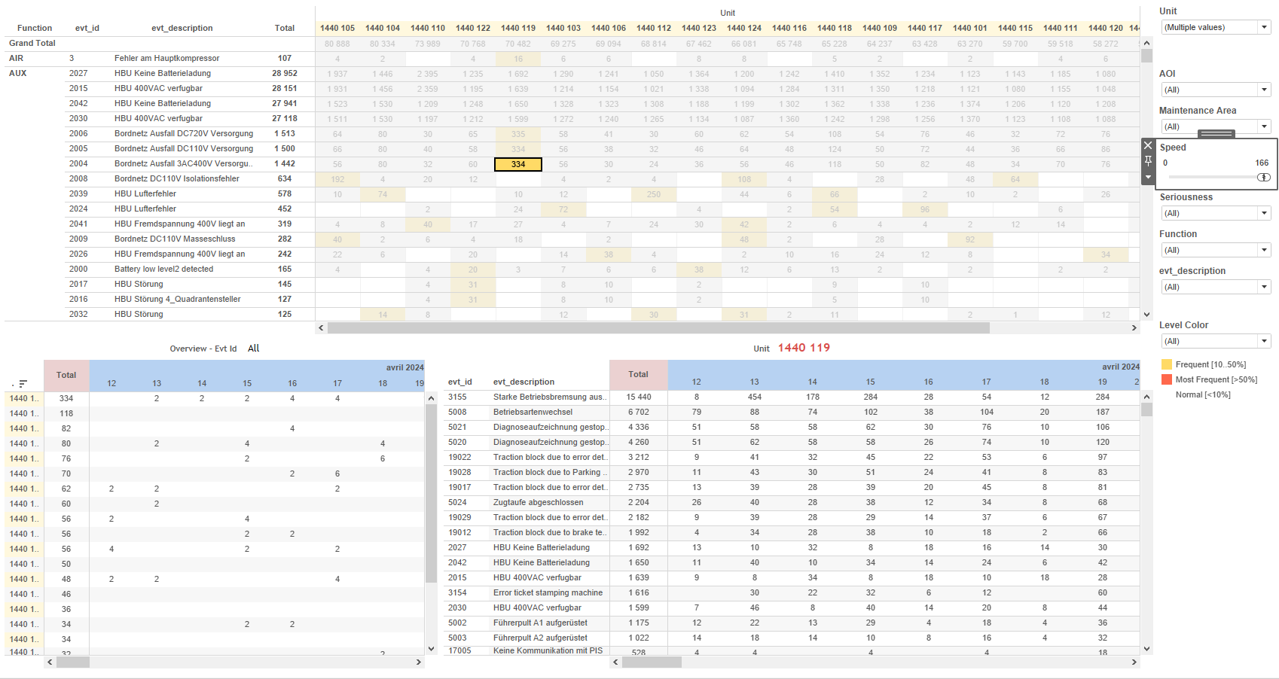
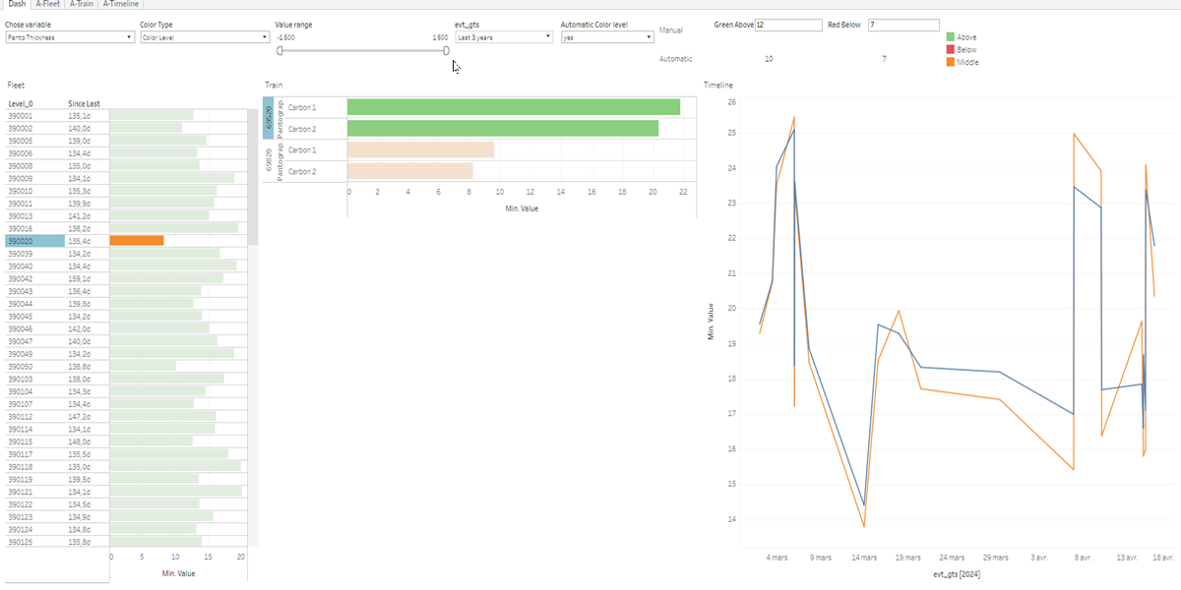
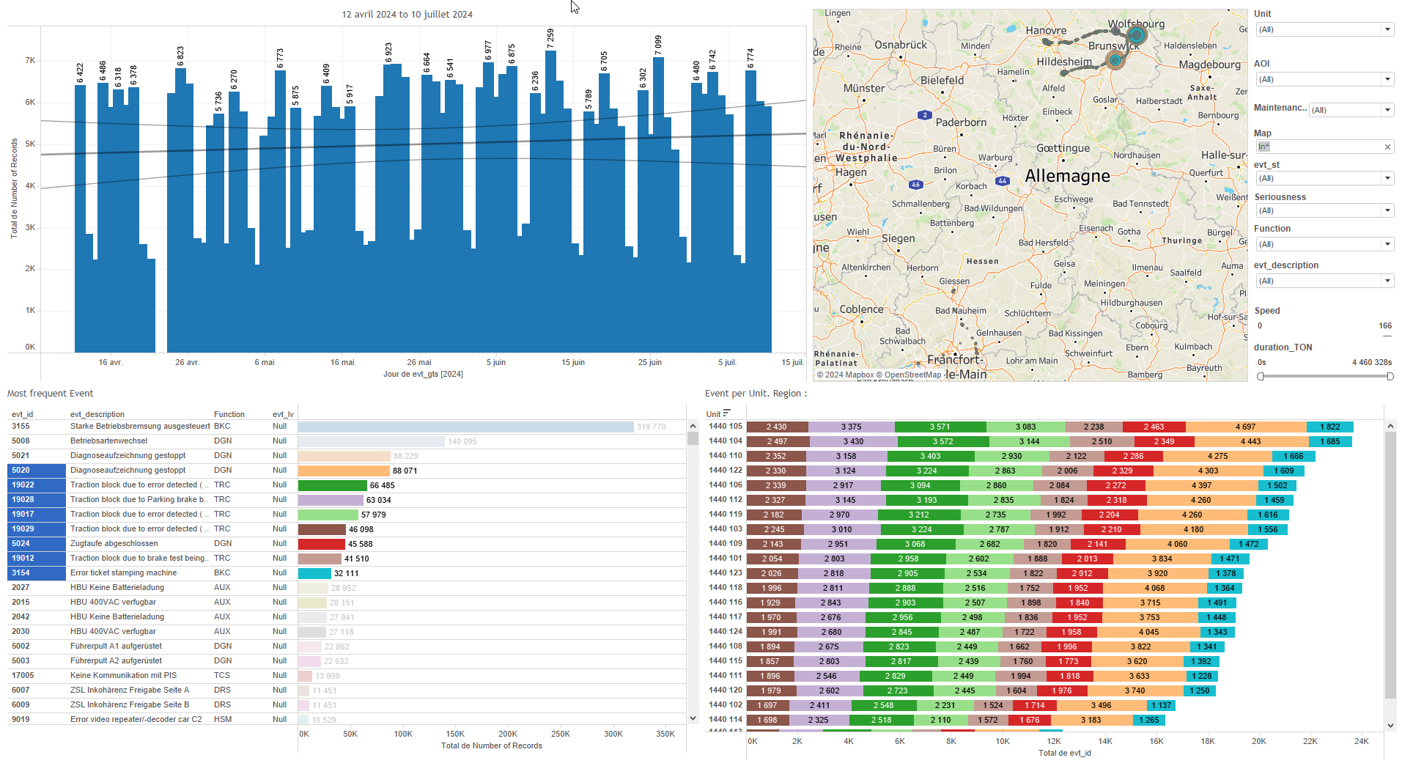
DATA VISUALIZATION REPORT SHEET
HealthHub
PantoInspect_Level5
Standard
Event Analysis
Represented By
Value evt_gts Colouring all GreeAbove Colouring RedBelow variable Level_0 Variable value
GENERAL DESCRIPTION
The 'Dash' dashboard provides a comprehensive analysis of color parameters and their relationships with various values and time-based events. It enables detailed data exploration through interactive visualizations, allowing users to filter data and compare different parameters effectively.
MAIN CHARACTERISTICS | Description
Project | Any project
Domain | Event,Operational Data
Type of report | Data Exploration - Train Event Data with Contextual Variables
Report's Objective | Provide comprehensive analysis of color parameters and their relationships with various values and time-based events. Enable detailed data exploration through interactive visualizations. Allow users to filter data and compare different parameters effectively.

Slide 2
Constitution du rapport 1/1
Dash Dashboard
The 'Dash' dashboard provides a comprehensive analysis of color parameters and their relationships with various values and time-based events. It enables detailed data exploration through interactive visualizations, allowing users to filter data and compare different parameters effectively.
Position | Exemple de question | Description
bottom left | What is the relationship between different color parameters and their respective values in the dataset? | This visualization displays a bar chart where the x-axis represents 'Value' and the y-axis represents 'evt_gts'. The color of each cell is determined by the 'Colouring all' variable.
bottom right | What is the relationship between event timestamps and calculated values, and how are these values categorized based on various parameters? | This visualization displays a bar chart where the x-axis represents 'Value' and the y-axis represents 'evt_gts'. The colors of the bars are determined by the 'Colouring' variable based on the given formula.
bottom right | What is the distribution and comparison of various color levels and time-based parameters in the given dataset? | This visualization displays the 'evt_gts' over time, showing the calculated 'Value' for each event, colored by '_Location_string'.
top right | What is the relationship between different color levels and their corresponding values? | This plot visualizes the variable 'GreeAbove' from the dataset '[Extract (Extract.Extract)]' as a real number. The axis and other elements are automatically determined based on the dataset schema.
Principaux Filtres/Paramètres
Filtrage par | Description
Value | Filtering applicable to workbooks. Filtering by value based on the condition specified in the formula.

Slide 3
Liste des variables
GENERAL DESCRIPTION
La liste des variables ci-dessous est necessaire pour la constitution du rapport. Pour le projet [Projet] leur equivalence doit être fournie avec la plage de Valeur associée en cas de demande de rapport.
Variable | Description
ColorTypeCtrl | This variable is used to control the color type in various dashboards. It is crucial for visualizing different operational states of the train.
GreeAbove | This variable is used to monitor the upper part of the pantograph. It is critical for ensuring safe operation.
Image | This variable is used to display images in various dashboards. It is a string datatype sourced from the data.
Level_0 | This variable is used to categorize different levels in train data analysis. It helps in segmenting operational data for better insights.
Level_1 | This variable is used to track the operational status of train components. It is recorded continuously as operational data.
Level_2 | This variable indicates the second level of the train hierarchy. It is used across multiple dashboards to categorize operational data.
Level_3 | This variable is used in multiple dashboards to track operational data. It helps in analyzing the train's performance over time.
Level_4 | This variable is used to monitor operational data related to train levels. It is crucial for maintaining and inspecting pantographs.
Level_5 | Level 5 indicates the fifth level of a train component, monitored continuously as operational data.
Level_6 | Level 6 represents a specific operational parameter recorded continuously. It is used across multiple dashboards for various inspections and monitoring purposes.
RedBelow | This variable indicates when a parameter falls below a certain threshold. It is used to monitor train performance and safety.
NOTE
Les illustrations fournissent un aperçu des représentations graphiques et ne préjugent pas des données pouvant être contenues dans le rapport. En effet, les données peuvent évoluer au cours du projet et dépendent entièrement de celui-ci.
Toute reproduction ou distribution non autorisée de ce rapport est interdite. Les informations contenues dans ce document sont confidentielles et destinées uniquement aux parties mentionnées. L'utilisation ou la divulgation non autorisée de ces informations est passible de poursuites judiciaires. Les représentations graphiques sont fournies à titre indicatif et ne sauraient engager la responsabilité de l'émetteur quant à l'exhaustivité ou l'exactitude des données présentées. Les données sont sujettes à des modifications au fil du projet et doivent être interprétées dans ce contexte.

