Slide 1
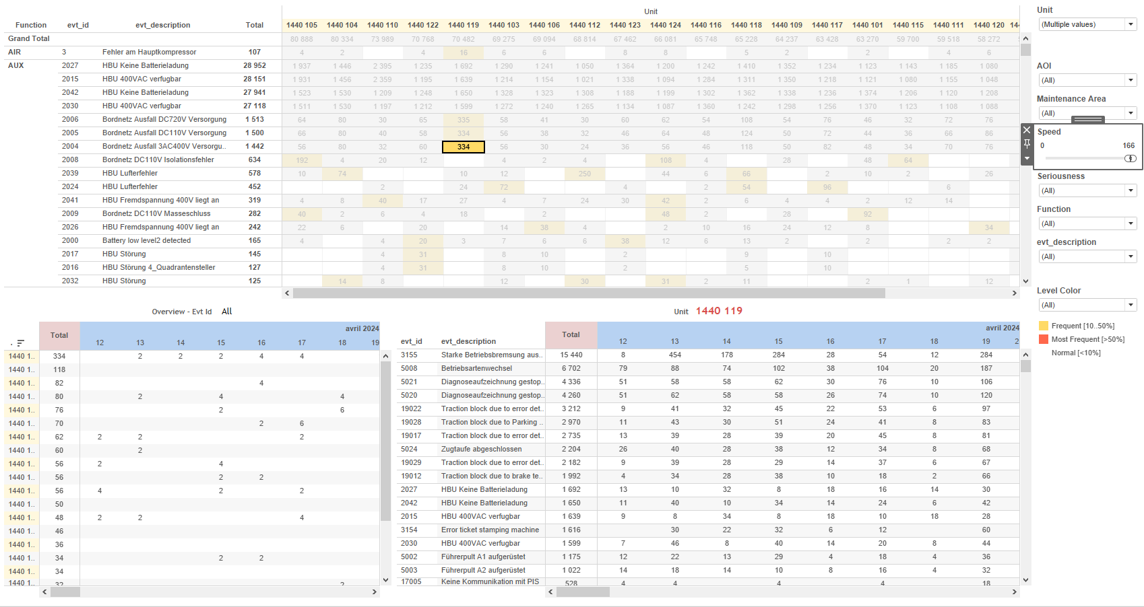
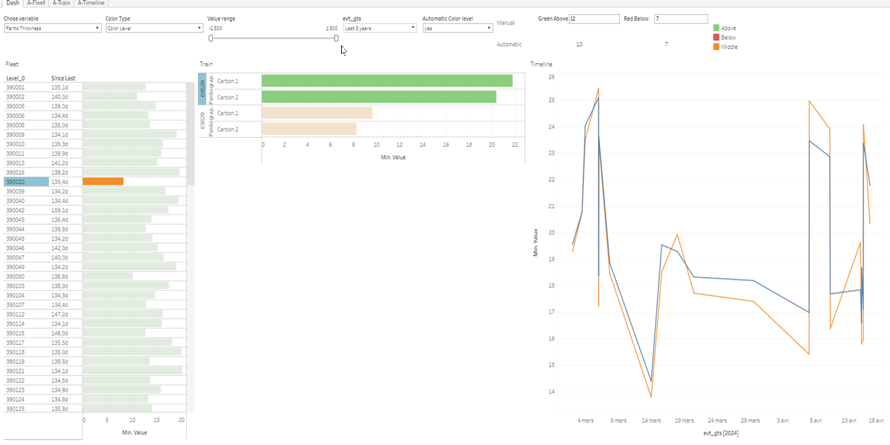
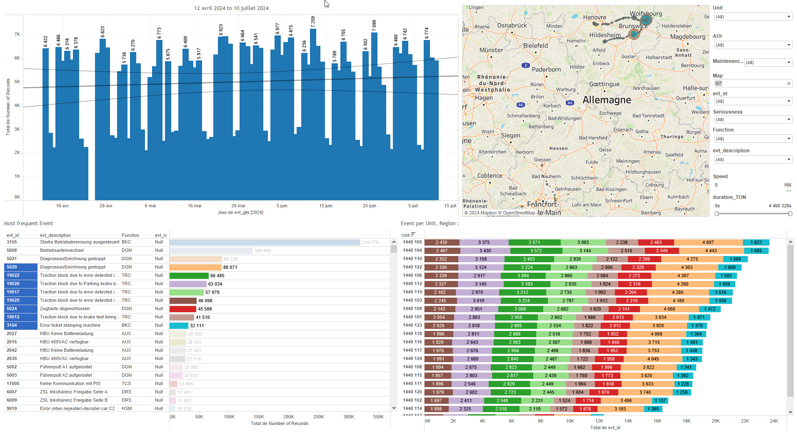
DATA VISUALIZATION REPORT SHEET
HealthHub
PantoInspect_Level6
Standard
Event Analysis
Represented By
Value evt_gts Colouring RedBelow Colouring all GreeAbove Colouring Days since last Green Above value Color Type
GENERAL DESCRIPTION
The report provides a comprehensive overview of fleet performance and status over time, facilitating detailed data exploration through various visualizations, including tables, line charts, and histograms. It aims to analyze key factors and variables influencing the fleet, as well as color levels and event timelines.
MAIN CHARACTERISTICS | Description
Project | Any project
Domain | Event,Operational Data
Type of report | Data Exploration - Operational Time Series (OPDAT)
Report's Objective | Provide a comprehensive visualization of fleet performance and status over time. Facilitate detailed data exploration through various plots, including tables, line charts, and histograms. Analyze key factors and variables influencing the fleet. Examine color levels and event timelines.

Slide 2
Constitution du rapport 1/1
Dash Dashboard
The dashboard 'Dash' provides a comprehensive visualization of fleet performance and status over time. It allows detailed data exploration through various plots, including tables, line charts, and histograms, facilitating the analysis of key factors and variables influencing the fleet, as well as color levels and event timelines.
Position | Exemple de question | Description
left | What are the key factors and variables influencing the performance and status of the fleet as represented in the chart? | This visualization displays the 'Value' over time. Each cell is colored based on 'Colouring all'.
center | What are the color levels and values over time for the given parameters? | This visualization shows the values of 'Value' over time, colored by 'Colouring'. The x-axis represents 'Value' and the y-axis represents 'evt_gts'. The plot uses a bar chart to display the data.
right | What is the timeline of events based on various parameters and calculations? | This visualization plots 'evt_gts' over time with 'Value' as the y-axis variable. Each cell is filled with '_Location_string' values.
top left | What is the color level based on the given parameters and calculations? | This plot visualizes the variable 'GreeAbove' from the source '[Extract (Extract.Extract)]'. The variable is of type 'real'.
Principaux Filtres/Paramètres
Filtrage par | Description
Value | Filtering applicable to workbooks. This filter uses a formula in Tableau to compare a variable to a parameter and return a value if they match.

Slide 3
Liste des variables
GENERAL DESCRIPTION
La liste des variables ci-dessous est necessaire pour la constitution du rapport. Pour le projet [Projet] leur equivalence doit être fournie avec la plage de Valeur associée en cas de demande de rapport.
Variable | Description
ColorTypeCtrl | This variable is used to control color settings in various dashboards. It helps in visual differentiation of operational data.
GreeAbove | It indicates the maximum value recorded above a certain threshold. This value is used to determine the operational status of train components.
Image | This variable represents an image related to the train's operational data. It is used in various dashboards for visual analysis.
Level_0 | This variable is used in multiple dashboards to monitor the operational status of train components. It is essential for tracking and analyzing train performance metrics.
Level_1 | Level 1 is a string data type used in various dashboards. It helps in differentiating levels in the context of train operations.
Level_2 | This variable represents the second level of a hierarchical structure in the train system. It is used in multiple dashboards to analyze operational data.
Level_3 | This variable is used to categorize the operational levels of train components. It is recorded as context data for events.
Level_4 | This variable represents the fourth level of a train unit. It is used in various dashboards for fleet and operational analysis.
Level_5 | Level 5 is recorded as operational data and used in various dashboards for monitoring train performance.
Level_6 | This variable represents a level measurement in a train component. It is used for continuous operational data recording.
RedBelow | The RedBelow variable indicates the lower threshold for a red signal in the train's operational data. It is used to determine if a value falls below a critical level.
NOTE
Les illustrations fournissent un aperçu des représentations graphiques et ne préjugent pas des données pouvant être contenues dans le rapport. En effet, les données peuvent évoluer au cours du projet et dépendent entièrement de celui-ci.
Toute reproduction ou distribution non autorisée de ce rapport est interdite. Les informations contenues dans ce document sont confidentielles et destinées uniquement aux parties mentionnées. L'utilisation ou la divulgation non autorisée de ces informations est passible de poursuites judiciaires. Les représentations graphiques sont fournies à titre indicatif et ne sauraient engager la responsabilité de l'émetteur quant à l'exhaustivité ou l'exactitude des données présentées. Les données sont sujettes à des modifications au fil du projet et doivent être interprétées dans ce contexte.

