Slide 1
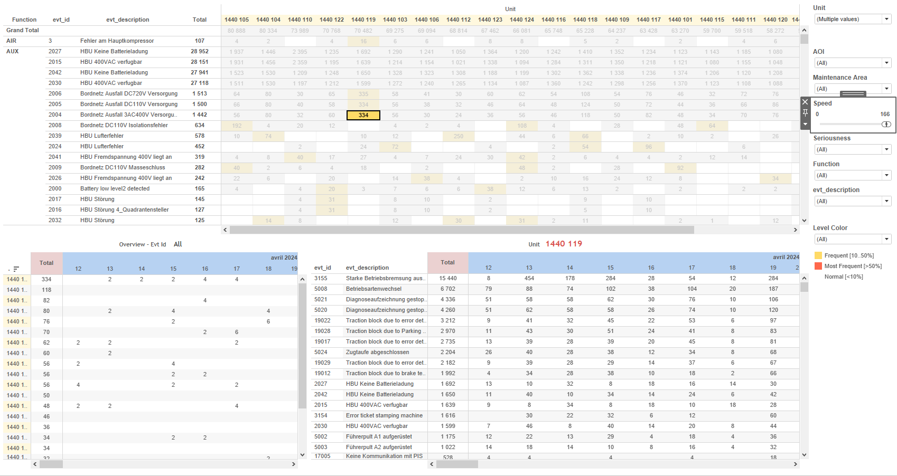
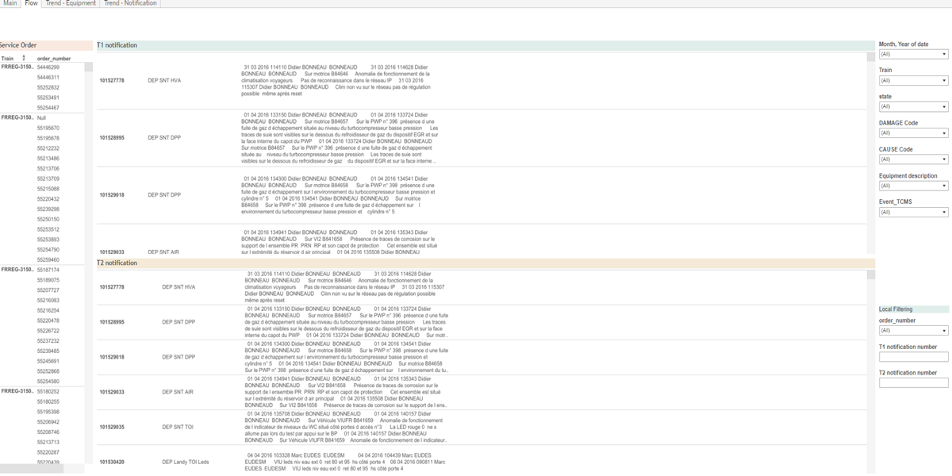
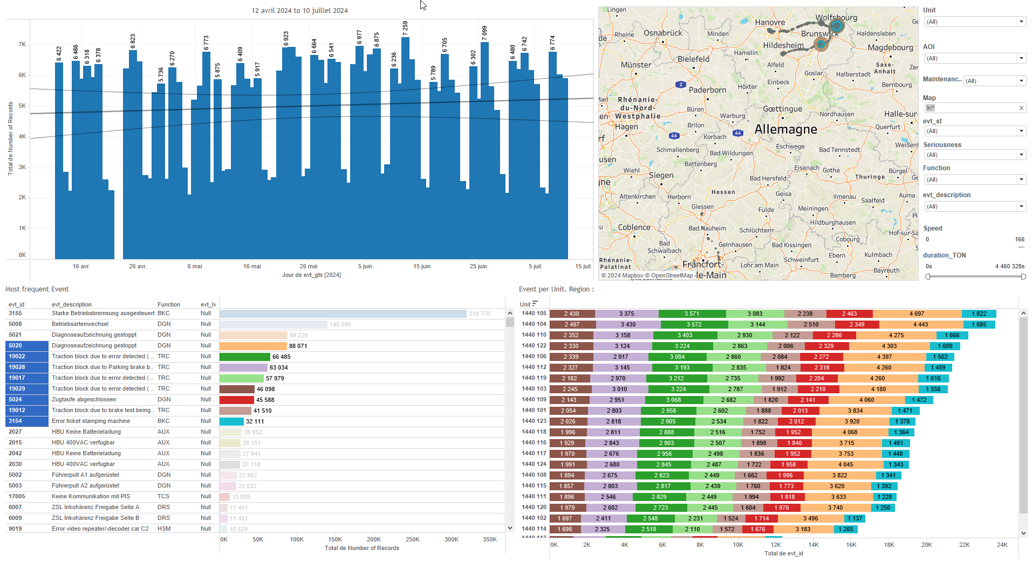
DATA VISUALIZATION REPORT SHEET
HealthHub
RAILSYS_Correlation_Evt_Notification
Standard
Event Analysis
Represented By
id CAUSE.second_key Equipment description date Event_TCMS Train state assembly Equipment_description.F Project
GENERAL DESCRIPTION
This report provides a comprehensive overview of train equipment data, including visualizations and detailed analyses of service orders, notifications, damage codes, equipment trends, and cause codes. It facilitates data exploration and interaction between various visualizations, allowing users to understand the distribution and relationships of different variables within the dataset.
MAIN CHARACTERISTICS | Description
Project | Any project
Domain | Event,Operational Data
Type of report | Data Exploration - Train Event Data with Contextual Variables
Report's Objective | Provide a comprehensive visualization of service order information and notification details. Facilitate detailed data exploration and interaction between graphs. Analyze trends in notifications and equipment usage over time. Enable understanding of the distribution and relationships of different variables within the dataset.

Slide 2
Constitution du rapport 1/4
Flow Dashboard
The 'Flow' dashboard provides a comprehensive visualization of service order information and notification details. It allows users to explore the main causes and damages associated with T1 and T2 notifications through interactive polygon charts, facilitating detailed data exploration and interaction between graphs.
Position | Exemple de question | Description
top | What is the service order information based on the provided variables and context? | This visualization displays the order_number data in a Polygon chart. The order_number is represented as a string, indicating categorical data.
bottom left | What are the main causes and damages associated with T1 notifications and their corresponding order numbers? | This visualization represents the data for 'text' from the source '[Extract (Extract.Extract)]'. The chart type is a polygon which displays the categorical data from the y-axis.
bottom right | What are the T2 notifications and their details? | This visualization represents the text data from the source [Extract (Extract.Extract)]. The y-axis displays the text values categorized accordingly.
Principaux Filtres/Paramètres
Filtrage par | Description
CAUSE Code | Filtering by the CAUSE Code, which is a string identifier for various causes in the dataset.
DAMAGE.second_key | Filtering the severity of events
order_number | Filtering by order number in the context of T1 orders.
notification_number | Filtering applicable to workbooks. Filtering the notification number from source '[Extract (Extract.Extract)]'.
notification_number | Filtering by notification number in the context of the data source '[Extract (Extract.Extract)]'. This filter is currently not used.

Slide 3
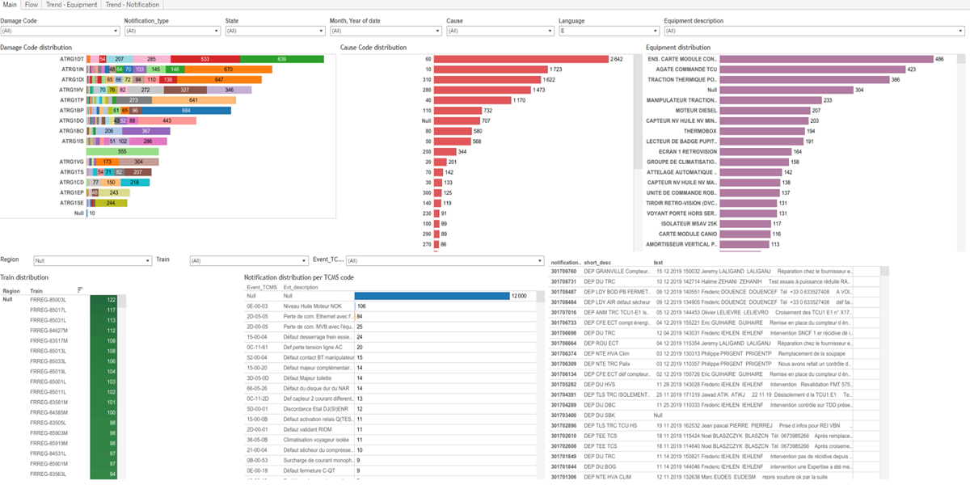
Constitution du rapport 2/4
Main Dashboard
The 'Main' dashboard provides a comprehensive analysis of notifications, damage codes, equipment, train events, and cause codes. It allows for detailed data exploration through various visualizations and interactions between graphs, enabling users to understand the distribution and relationships of different variables within the dataset.
Position | Exemple de question | Description
bottom right | What is the distribution of notifications per TCMS code? | This table visualizes the 'Evt_description' categorized by 'id'. Each cell is filled with 'Event_TCMS'.
bottom left | What are the different types of notifications and their associated states and texts in the dataset? | This plot visualizes text data from the source [Extract (Extract.Extract)] using a Polygon chart type.
top left | What is the distribution of Damage Codes based on the provided variables and context? | This plot displays data with id on the x-axis and DAMAGE.first_key on the y-axis. Each cell is colored and valued based on DAMAGE.second_key.
top right | What is the distribution of equipment based on different projects and regions? | This visualization shows the Equipment description based on various calculations and conditions. The y-axis represents different equipment descriptions depending on the calculation results, while the x-axis is the ID.
Principaux Filtres/Paramètres
Filtrage par | Description
notification_type | Filtering applicable to workbooks. Example: Filtering by notification type in the dataset, which is a string value extracted from the source '[Extract (Extract.Extract)]'.
state | Filtering by the state, which is a string datatype. This filter allows the user to select specific states from the dataset based on the 'State' filter caption.
DAMAGE.second_key | Filtering by damage code based on the provided caption and context.
CAUSE.second_key | Filtering by event description

Slide 4
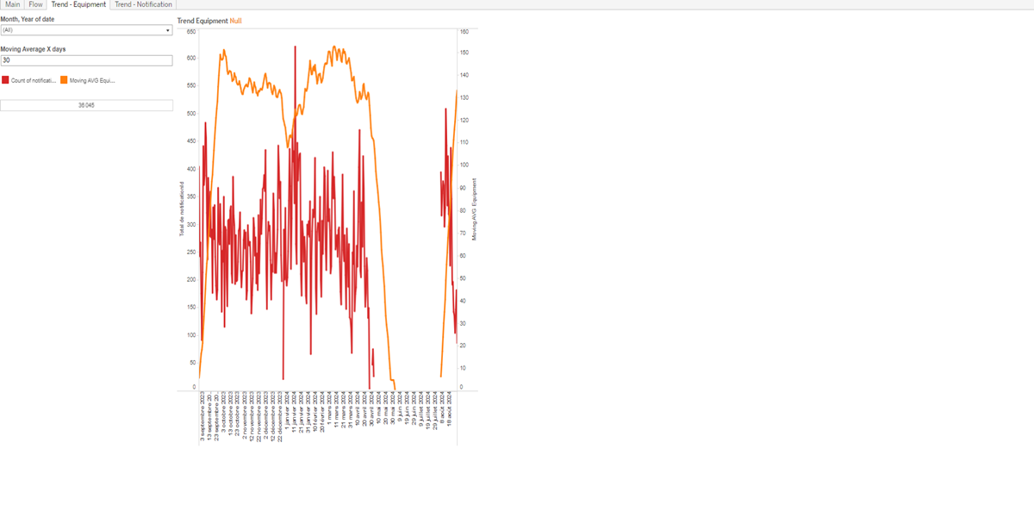
Constitution du rapport 3/4
Trend - Equipment Dashboard
The 'Trend - Equipment' dashboard provides an overview of equipment usage trends over time through a line plot and detailed descriptions categorized by ID. It allows for detailed data exploration by visualizing moving averages and categorizing equipment descriptions, facilitating a comprehensive analysis of equipment trends.
Position | Exemple de question | Description
right | What is the trend of equipment usage over time based on the provided parameters and calculations? | This line plot visualizes the moving average of equipment over time. The x-axis represents dates, while the y-axis shows the calculated moving average of equipment. The moving average is computed using a window sum of distinct counts of IDs divided by a parameter value.
left | What is the description and analysis of the equipment trends in the provided dataset? | This visualization shows the Equipment description categorized by id. The data is derived from multiple calculations and conditions applied to the equipment description fields based on the type of equipment.
Principaux Filtres/Paramètres
Filtrage par | Description

Slide 5
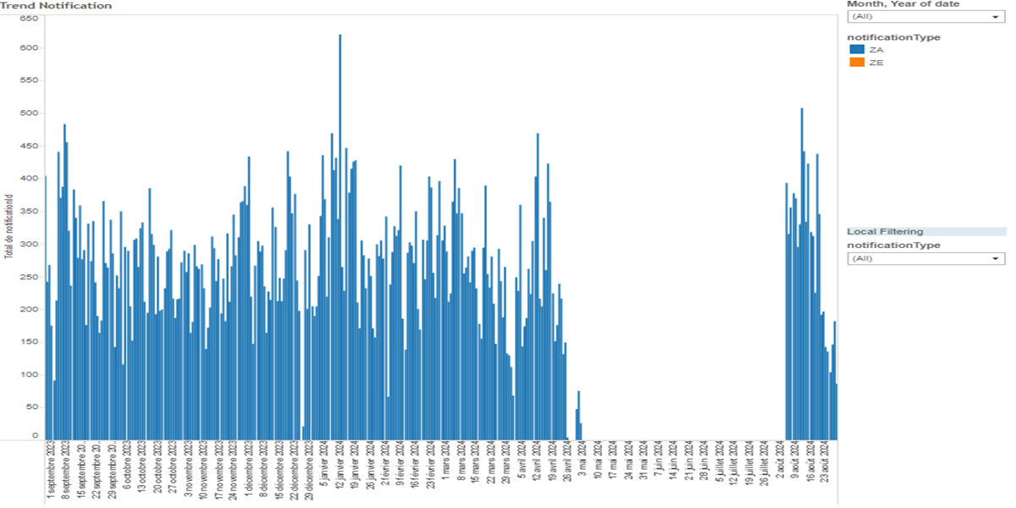
Constitution du rapport 4/4
Trend - Notification Dashboard
The 'Trend - Notification' dashboard is designed to analyze trends in notifications based on various variables and conditions. It features a table visualization where notifications are categorized and colored by type, with detailed exploration facilitated by date-based filtering.
Position | Exemple de question | Description
center | What are the trends in notifications based on different variables and their conditions? | This visualization displays a table where the 'id' is categorized and colored based on 'notification_type'. The x-axis represents the 'date'.
Principaux Filtres/Paramètres
Filtrage par | Description

Slide 6
Liste des variables
GENERAL DESCRIPTION
La liste des variables ci-dessous est necessaire pour la constitution du rapport. Pour le projet [Projet] leur equivalence doit être fournie avec la plage de Valeur associée en cas de demande de rapport.
Variable | Description
CAUSE.second_key | This variable is used to identify the cause of events in the train's operational data. It is recorded as context data for specific events.
DAMAGE.first_key | This variable is used to identify the primary key for damage events in the system. It helps correlate damage reports with specific equipment.
DAMAGE.second_key | This variable represents a specific type of damage recorded in the system. It is used for event correlation and notification in the dashboard.
EVENT_TCMS_CODE | This code identifies specific events in the train's TCMS. It helps in tracking and analyzing operational issues.
Equipment_description.E | This variable describes the equipment in the train. It is used in various dashboards to track and analyze equipment-related data.
Equipment_description.F | Describes the equipment used in various train projects. Used for notifications and operational data.
Equipment_description.I | This variable describes the equipment affected during an event. It helps in identifying the specific parts of the train involved.
Material_description.E | This variable provides a description of the materials used in train equipment. It is used in various plots to analyze equipment and notification trends.
REGION | This variable is used to identify the region associated with train events. It is crucial for operational data analysis.
assembly | The assembly variable refers to the process of putting together various parts of a train. It is recorded as context data for specific events.
date | The date variable is used to timestamp events and track operational data over time.
NOTE
Les illustrations fournissent un aperçu des représentations graphiques et ne préjugent pas des données pouvant être contenues dans le rapport. En effet, les données peuvent évoluer au cours du projet et dépendent entièrement de celui-ci.
Toute reproduction ou distribution non autorisée de ce rapport est interdite. Les informations contenues dans ce document sont confidentielles et destinées uniquement aux parties mentionnées. L'utilisation ou la divulgation non autorisée de ces informations est passible de poursuites judiciaires. Les représentations graphiques sont fournies à titre indicatif et ne sauraient engager la responsabilité de l'émetteur quant à l'exhaustivité ou l'exactitude des données présentées. Les données sont sujettes à des modifications au fil du projet et doivent être interprétées dans ce contexte.

