Slide 1
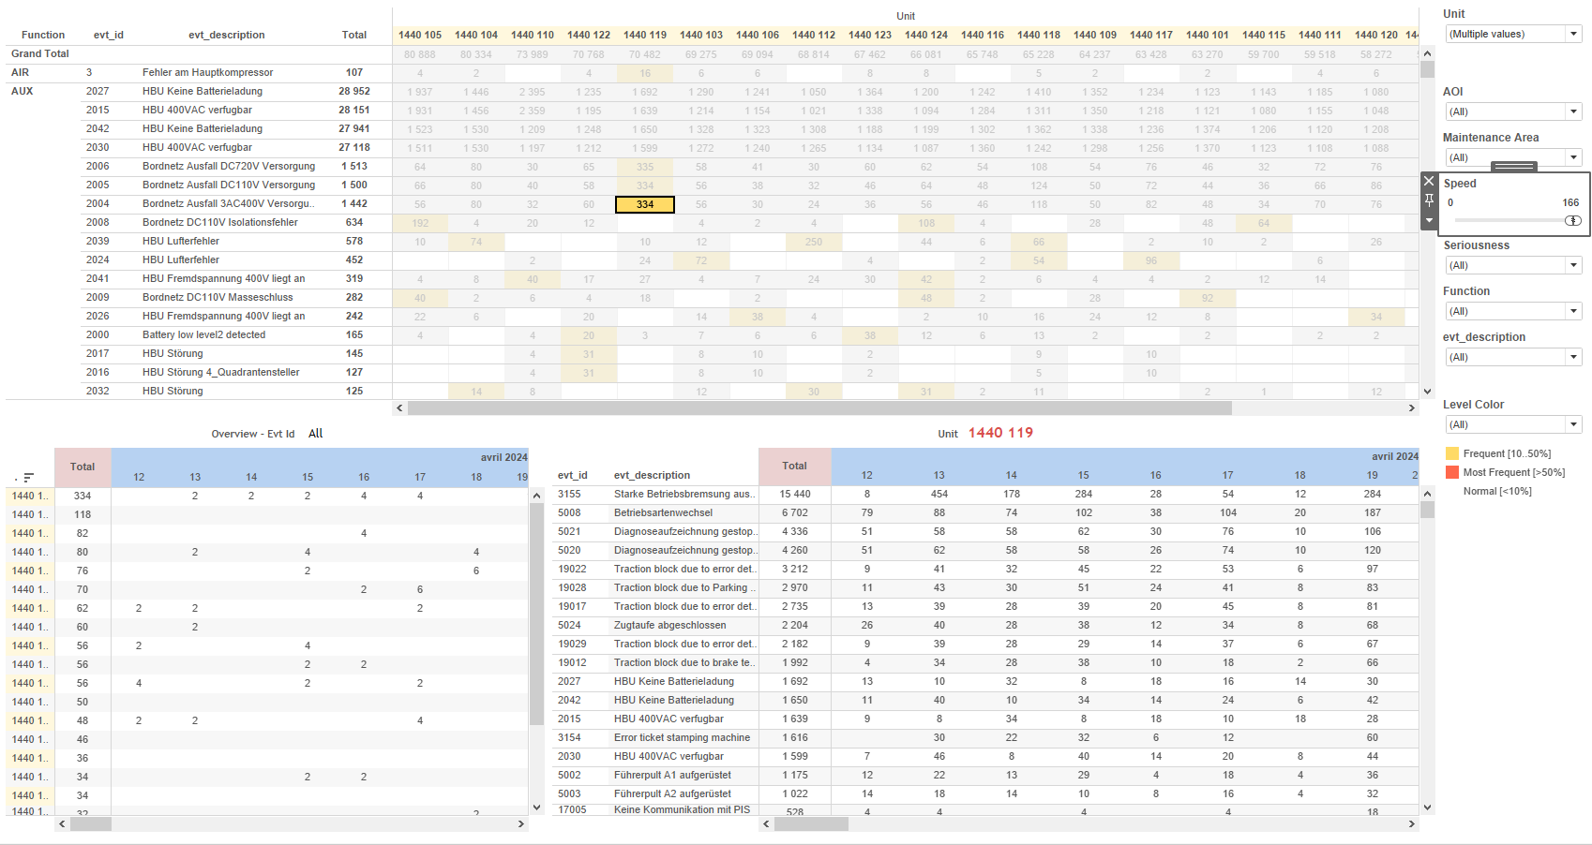
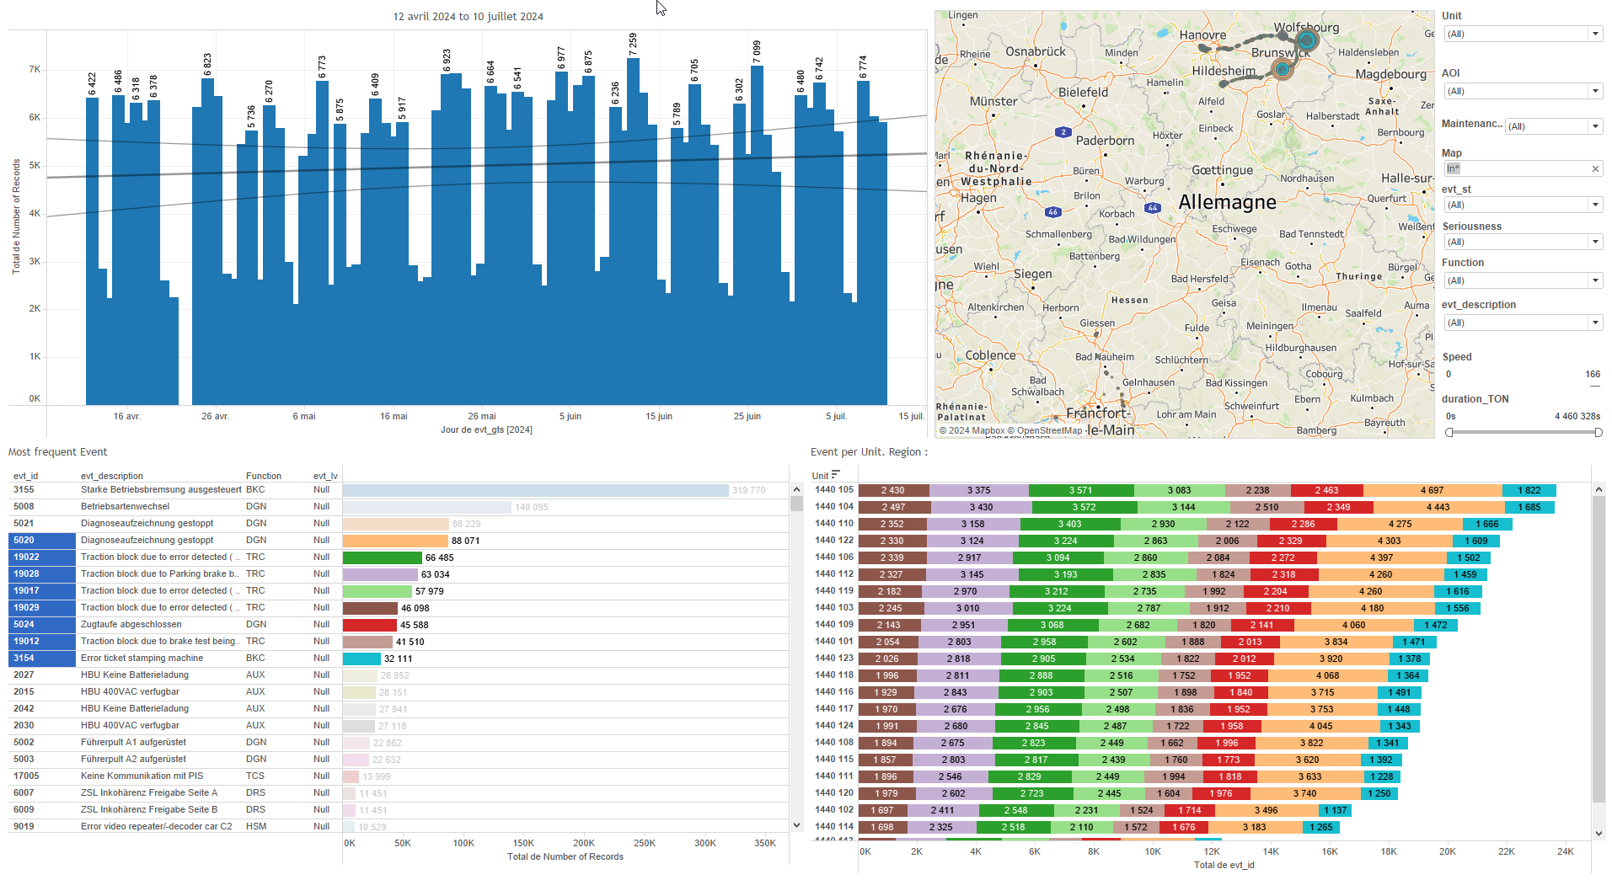
DATA VISUALIZATION REPORT SHEET
HealthHub
SLA
Standard
Event Analysis
Represented By
Date One Report Name SLA Project Name Existing project_name Color Project Name Color SLA Missing
GENERAL DESCRIPTION
The 'SLA' dashboard provides an overview of Service-Level Agreement (SLA) performance, categorizing data by date and project. It includes various visualizations like tables and bar charts that allow for detailed exploration of key performance indicators and SLA metrics, with interactive elements to compare different SLA percentages and performance thresholds.
MAIN CHARACTERISTICS | Description
Project | Any project
Domain | Operational Data
Type of report | Key Performance Indicator (KPI) - Operational Time Series (OPDAT)
Report's Objective | Provide a comprehensive overview of Service-Level Agreement (SLA) performance. Categorize data by date and project for detailed exploration. Visualize key performance indicators and SLA metrics. Enable interactive comparisons of different SLA percentages and performance thresholds.

Slide 2
Constitution du rapport 1/1
SLA Dashboard
The 'SLA' dashboard provides an overview of Service-Level Agreement (SLA) performance, categorizing data by date and project. It includes various visualizations like tables and bar charts that allow for detailed exploration of key performance indicators and SLA metrics, with interactive elements to compare different SLA percentages and performance thresholds.
Position | Exemple de question | Description
bottom right | What are the key performance indicators and their values for the given time period in the report? | This visualization displays the 'Report Name' categorized by 'Date'. The color fill represents different ranges of SLA percentages, indicating performance thresholds.
bottom left | What is the service level agreement (SLA) performance based on the provided data? | This bar chart displays the 'Date' on the x-axis and 'Existing' values on the y-axis. The size of each bar is represented by 'One'.
top right | What is the Service-Level Agreement (SLA) performance based on the provided variables and calculations? | This plot displays the data with 'Date' on the x-axis and 'Report Name' on the y-axis. Since 'Report Name' is a string, the plot is represented as a table where each cell is colored based on the 'fill' variable.
top left | What is the Service-Level Agreement (SLA) performance over time for different projects? | This table visualizes the project data categorized by date. Each cell is color-coded based on the SLA percentage ranges.
Principaux Filtres/Paramètres
Filtrage par | Description

Slide 3
Liste des variables
GENERAL DESCRIPTION
La liste des variables ci-dessous est necessaire pour la constitution du rapport. Pour le projet [Projet] leur equivalence doit être fournie avec la plage de Valeur associée en cas de demande de rapport.
Variable | Description
Existing | This variable measures existing operational data of train units. It is used to calculate SLA performance.
Freshness | This variable indicates the freshness of the data. It is used to ensure that the data is up-to-date and reliable.
Missing | The variable represents missing data points in the train's operational records. It is used to calculate the Service-Level Agreement (SLA).
name | This variable is used for identifying events and operational data in train dashboards. It helps in tracking and correlating various metrics for maintenance and service-level agreements.
project_name | This variable is used to identify projects in the SLA dashboard. It is a string datatype used in several plots.
NOTE
Les illustrations fournissent un aperçu des représentations graphiques et ne préjugent pas des données pouvant être contenues dans le rapport. En effet, les données peuvent évoluer au cours du projet et dépendent entièrement de celui-ci.
Toute reproduction ou distribution non autorisée de ce rapport est interdite. Les informations contenues dans ce document sont confidentielles et destinées uniquement aux parties mentionnées. L'utilisation ou la divulgation non autorisée de ces informations est passible de poursuites judiciaires. Les représentations graphiques sont fournies à titre indicatif et ne sauraient engager la responsabilité de l'émetteur quant à l'exhaustivité ou l'exactitude des données présentées. Les données sont sujettes à des modifications au fil du projet et doivent être interprétées dans ce contexte.

