Slide 1
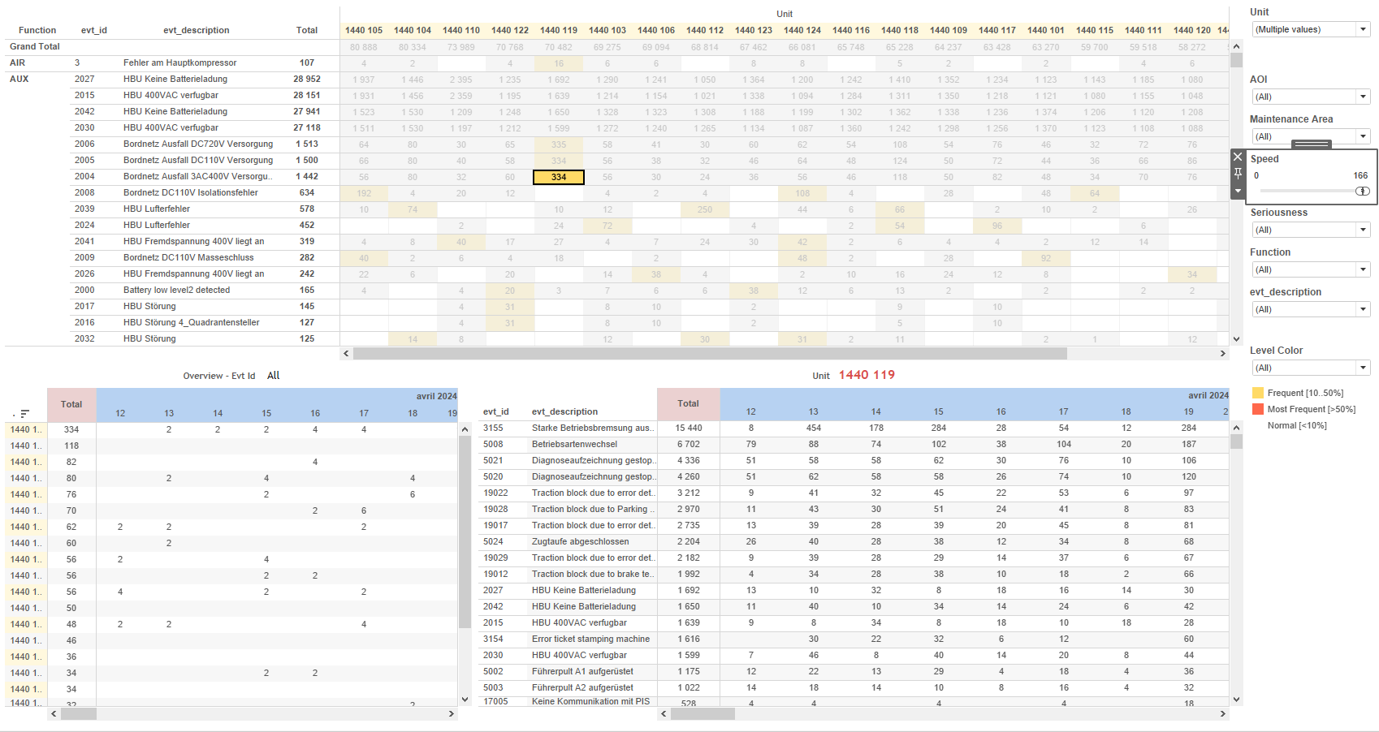
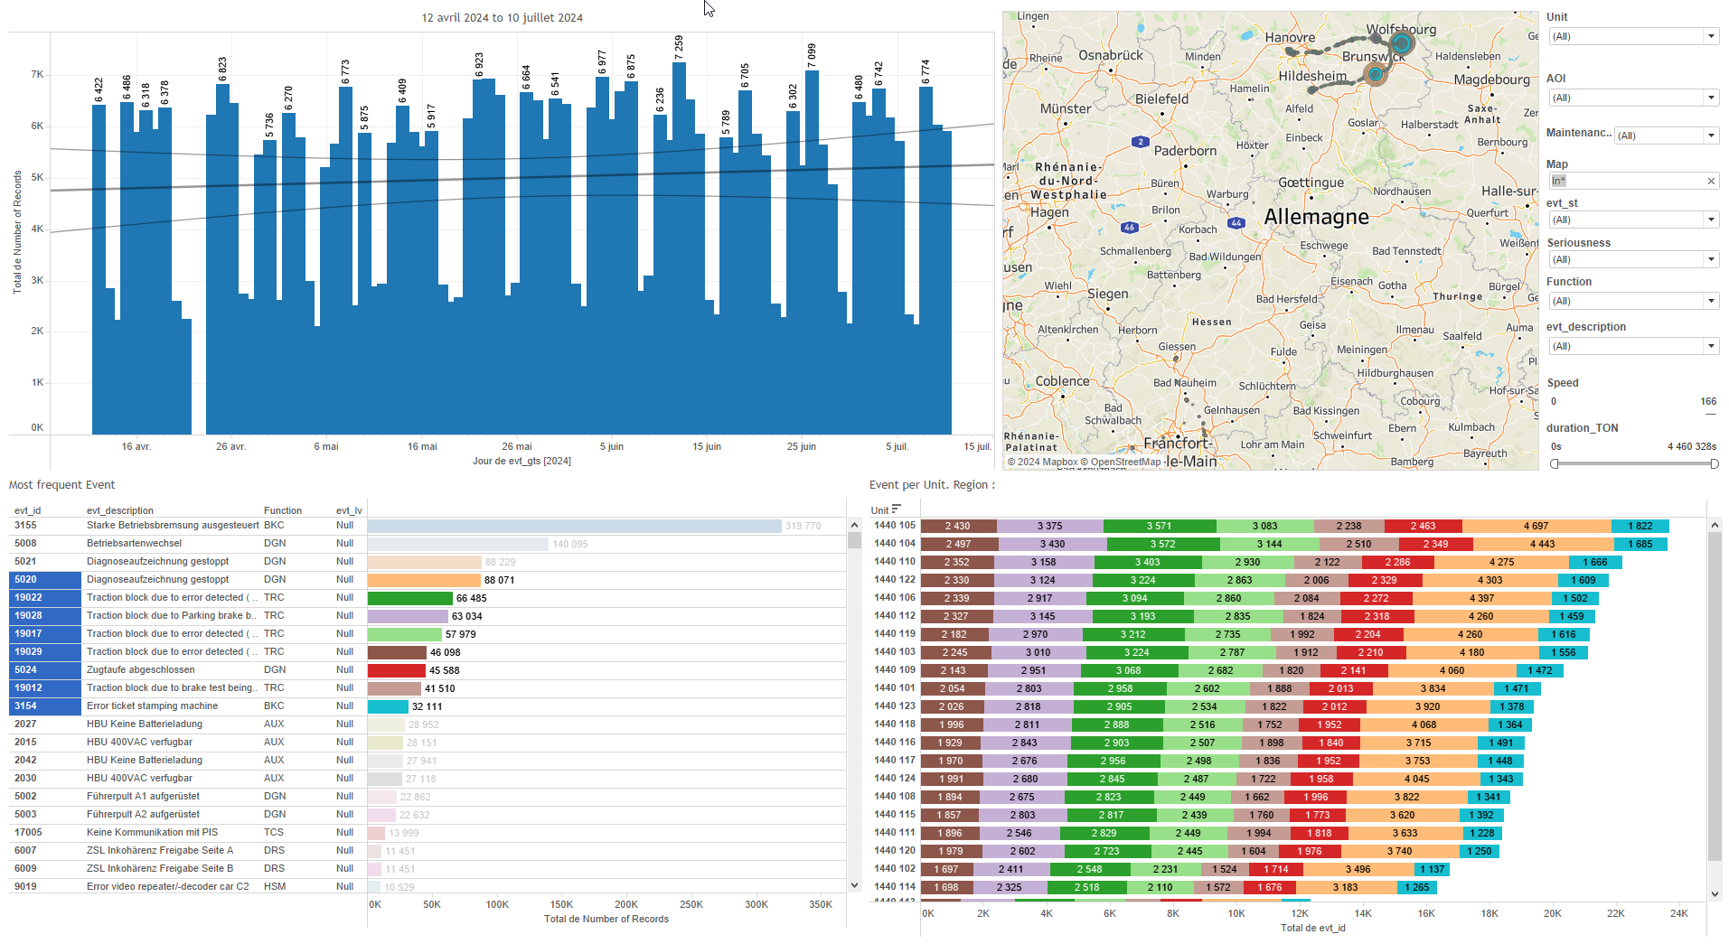
DATA VISUALIZATION REPORT SHEET
HealthHub
SLA_All_Project
Standard
Event Analysis
Represented By
date One Color Month project Min_date Min_Date SLA Month SLA Range Date Max_Date
GENERAL DESCRIPTION
The 'SLA' dashboard provides a comprehensive overview of service-level agreements (SLAs) over time. It includes detailed tables for project performance metrics and overall SLA performance, allowing users to easily identify trends and anomalies.
MAIN CHARACTERISTICS | Description
Project | Any project
Domain | Exploration
Type of report | Data Exploration - Operational Time Series (OPDAT)
Report's Objective | Provide an in-depth analysis of service-level agreements (SLAs) over time. Identify trends and anomalies in SLA performance metrics. Offer a detailed view of projects over time, categorized by date. Show overall performance of the Service-Level Agreement (SLA) based on provided variables and calculations.

Slide 2
Constitution du rapport 1/1
SLA Dashboard
The 'SLA' dashboard provides an in-depth analysis of service-level agreements (SLAs) over time. It includes detailed tables for project performance metrics and overall SLA performance, allowing users to identify trends and anomalies easily.
Position | Exemple de question | Description
top | What are the service-level agreements (SLA) metrics and how do they vary over time and projects? | This table provides a detailed view of projects over time, categorized by date. Each cell is color-coded based on performance metrics, making it easy to identify trends and anomalies.
bottom | What is the overall performance of the Service-Level Agreement (SLA) based on the provided variables and calculations? | This visualization shows the TOTAL (avg) values over time, categorized by Color Month Total. The data is represented in a tabular format as the y-axis variable is a string.
Principaux Filtres/Paramètres
Filtrage par | Description

Slide 3
Liste des variables
GENERAL DESCRIPTION
La liste des variables ci-dessous est necessaire pour la constitution du rapport. Pour le projet [Projet] leur equivalence doit être fournie avec la plage de Valeur associée en cas de demande de rapport.
Variable | Description
Min_date | This variable represents the earliest date recorded in the dataset. It is used to filter and calculate date ranges for service-level agreements.
Report name | This variable indicates the name of the report used in the dashboard. It is essential for identifying and differentiating various reports in SLA calculations.
date | This variable represents the date on which events or operations are recorded. It is used across multiple dashboards to track and analyze time-based data.
project | This variable is used to track project-related data. It is crucial for service-level agreement calculations.
NOTE
Les illustrations fournissent un aperçu des représentations graphiques et ne préjugent pas des données pouvant être contenues dans le rapport. En effet, les données peuvent évoluer au cours du projet et dépendent entièrement de celui-ci.
Toute reproduction ou distribution non autorisée de ce rapport est interdite. Les informations contenues dans ce document sont confidentielles et destinées uniquement aux parties mentionnées. L'utilisation ou la divulgation non autorisée de ces informations est passible de poursuites judiciaires. Les représentations graphiques sont fournies à titre indicatif et ne sauraient engager la responsabilité de l'émetteur quant à l'exhaustivité ou l'exactitude des données présentées. Les données sont sujettes à des modifications au fil du projet et doivent être interprétées dans ce contexte.

