Slide 1
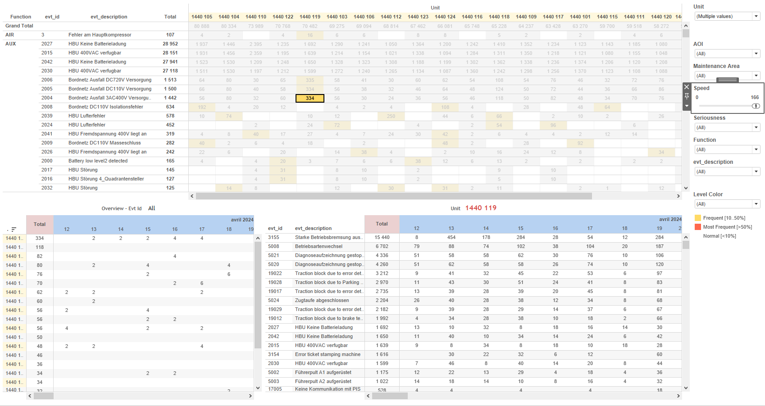
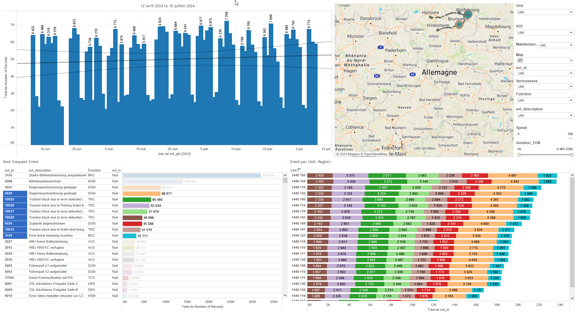
DATA VISUALIZATION REPORT SHEET
HealthHub
Statistic_HealthHub
Standard
Event Analysis
Represented By
TimeScale Filt timestamp prj evtDiscardedPast opDatDiscardedPastOrRepeat Time scale opDatTotal evtInserted evtTotal opDatInserted
GENERAL DESCRIPTION
The 'Stats_Evt_OpDat' dashboard provides a comprehensive overview of operational data and event statistics, allowing users to filter data based on various time scales and explore detailed visualizations through interactive area and bar charts. It facilitates in-depth analysis of data trends and event occurrences over time.
MAIN CHARACTERISTICS | Description
Project | Any project
Domain | Event,Statistics
Type of report | Data Exploration - Operational Time Series (OPDAT)
Report's Objective | Provide a comprehensive overview of operational data and event statistics. Enable users to filter data based on various time scales. Facilitate in-depth analysis of data trends and event occurrences over time.

Slide 2
Constitution du rapport 1/1
Stats_Evt_OpDat Dashboard
The 'Stats_Evt_OpDat' dashboard provides a comprehensive overview of operational data and event statistics, allowing users to filter data based on various time scales and explore detailed visualizations through interactive area and bar charts. It facilitates in-depth analysis of data trends and event occurrences over time.
Position | Exemple de question | Description
bottom right | What are the statistics and ratios related to the operational data and events in the system? | This plot visualizes the data for opDatTotal. The data type is integer.
top | What is the total number of operational data entries over different time scales? | This area chart visualizes the 'opDatTotal' over different time scales, filtered based on user-selected parameters. The x-axis represents the time scale, which can be displayed as a string, day, week, month, quarter, or year depending on the parameter settings. The y-axis shows the 'opDatTotal' as an integer value.
bottom | How does the number of events vary over different time scales? | This area plot visualizes the 'evtInserted' values over different time scales filtered based on the parameter settings. The x-axis represents the 'TimeScale Filt' which can vary from timestamp to year depending on the parameter values.
bottom left | What is the number of OpDatas discarded over different time scales? | This area chart visualizes the discarded past operational data over a time scale. The x-axis represents the time scale filtered by the selected parameter, while the y-axis shows the count of discarded past operational data.
Principaux Filtres/Paramètres
Filtrage par | Description
timestamp | Filtering applicable to workbooks. Filtering by time scale, specifically for datetime data types.

Slide 3
Liste des variables
GENERAL DESCRIPTION
La liste des variables ci-dessous est necessaire pour la constitution du rapport. Pour le projet [Projet] leur equivalence doit être fournie avec la plage de Valeur associée en cas de demande de rapport.
Variable | Description
evtDiscardedPast | This variable tracks the number of past events that were discarded. It is used to calculate the ratio of discarded events to total events.
evtInserted | This variable tracks the number of events inserted. It is recorded as context data for events.
evtTotal | The total number of events recorded in the system. It includes all events regardless of their status.
opDatDiscardedPastOrRepeat | This variable represents the count of operational data points that were discarded due to being past or repeated. It helps in analyzing data quality and operational efficiency.
opDatInserted | This variable tracks the number of operational data entries inserted. It is recorded continuously as operational data.
opDatTotal | This variable represents the total operational data recorded continuously for a train unit. It is used in multiple dashboards to monitor and analyze train performance.
prj | This variable represents the project identifier used in various dashboards. It is recorded as context data for events and operational data.
timestamp | The timestamp variable records the date and time of events. It is used to filter and plot data across various dashboards.
upTime | The upTime variable represents the total operational time of the train engine. It is recorded continuously as operational data.
NOTE
Les illustrations fournissent un aperçu des représentations graphiques et ne préjugent pas des données pouvant être contenues dans le rapport. En effet, les données peuvent évoluer au cours du projet et dépendent entièrement de celui-ci.
Toute reproduction ou distribution non autorisée de ce rapport est interdite. Les informations contenues dans ce document sont confidentielles et destinées uniquement aux parties mentionnées. L'utilisation ou la divulgation non autorisée de ces informations est passible de poursuites judiciaires. Les représentations graphiques sont fournies à titre indicatif et ne sauraient engager la responsabilité de l'émetteur quant à l'exhaustivité ou l'exactitude des données présentées. Les données sont sujettes à des modifications au fil du projet et doivent être interprétées dans ce contexte.

