Slide 1
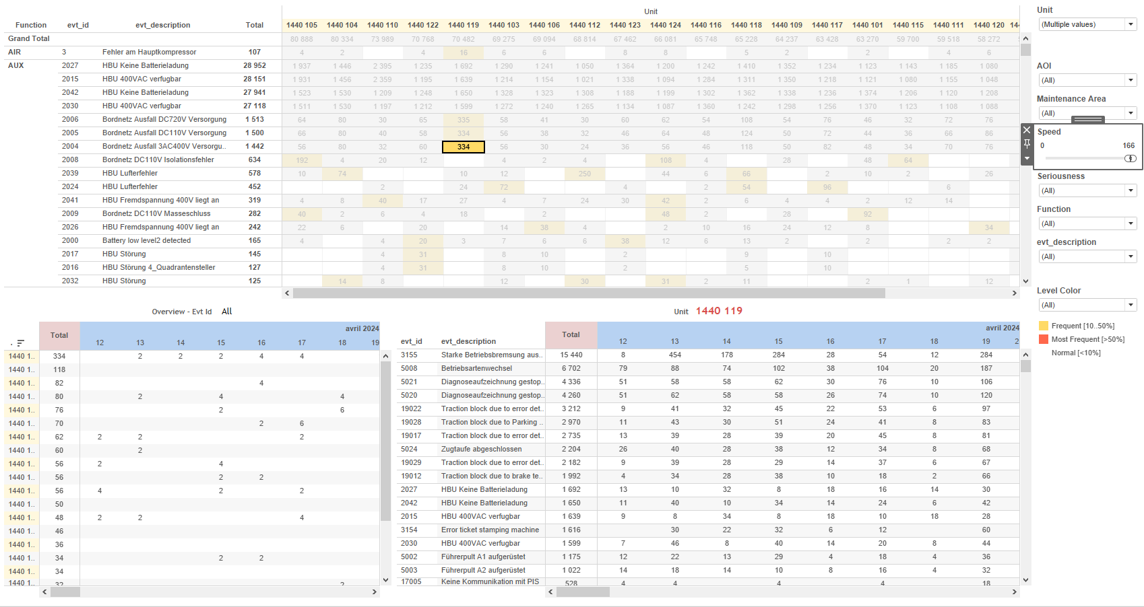
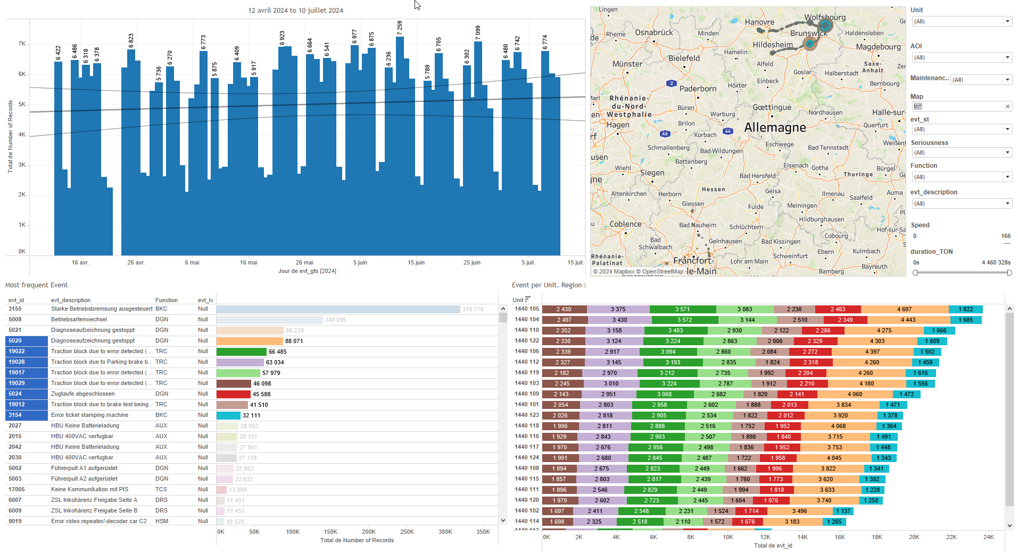
DATA VISUALIZATION REPORT SHEET
HealthHub
Uturn_time
Standard
Event Analysis
Represented By
Delay AOI Train Mission Arriving Date Previous_Mission One Uturn threshold limit Over Limit Delay (bin)
GENERAL DESCRIPTION
The report provides a comprehensive overview of delay distributions and their relationship with various factors such as AOI and Train Mission. It allows for detailed data exploration through interactive visualizations, facilitating insights into median delays and distribution patterns.
MAIN CHARACTERISTICS | Description
Project | Any project
Domain | Exploration
Type of report | Data Exploration - Train Event Data with Contextual Variables
Report's Objective | Provide a comprehensive overview of delay distributions and their relationship with various factors. Enable detailed data exploration through interactive visualizations. Facilitate insights into median delays and distribution patterns.

Slide 2
Constitution du rapport 1/2
Note Dashboard
The dashboard 'Note' provides a comprehensive overview of the data with detailed exploration capabilities. It allows for interactive filtering and analysis through various graphs and charts, enabling users to gain insights and make data-driven decisions.
Position | Exemple de question | Description
Principaux Filtres/Paramètres
Filtrage par | Description

Slide 3
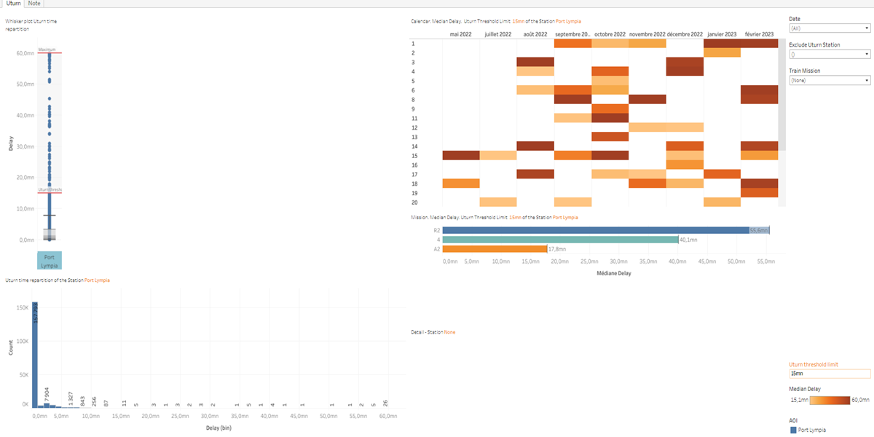
Constitution du rapport 2/2
Uturn Dashboard
The 'Uturn' dashboard provides a comprehensive analysis of delay distributions and their relationship with various factors such as AOI and Train Mission. It allows for detailed data exploration through interactive visualizations, facilitating insights into median delays and distribution patterns.
Position | Exemple de question | Description
bottom left | What is the distribution of U-turn times at the station? | This plot visualizes the delay distribution (binned) against the delay values, with AOI used for coloring each cell. The x-axis represents the delay in bins, while the y-axis shows the actual delay values.
top right | What is the median delay based on the Uturn threshold limit? | This plot visualizes the relationship between arriving times, with delays represented by color intensity.
bottom right | What is the median delay for missions given the Uturn threshold limit? | This visualization shows the distribution of Train Mission values across different Delay intervals. Each cell in the table is colored based on the Train Mission value.
top left | What is the distribution of Uturn times represented in a whisker plot for different Areas of Interest (AOI)? | This visualization displays the relationship between AOI and Delay using a circle plot. AOI is represented on the x-axis, and Delay is represented on the y-axis. The fill color is based on the AOI values.
Principaux Filtres/Paramètres
Filtrage par | Description
AOI | Filtering all or part of the project's 'AOI' (Area Of Interest)

Slide 4
Liste des variables
GENERAL DESCRIPTION
La liste des variables ci-dessous est necessaire pour la constitution du rapport. Pour le projet [Projet] leur equivalence doit être fournie avec la plage de Valeur associée en cas de demande de rapport.
Variable | Description
AOI | The Area Of Interest (AOI) indicates specific sections of the train. It is used in various analyses to determine operational metrics.
Arriving | This variable records the time a train arrives at a station. It is used to calculate Uturn times and delays.
Delay | Delay represents the time difference between scheduled and actual events. It is a key operational metric for train performance.
Leaving | This variable records the time when a train leaves a station. It is used to calculate U-turn time.
Previous_Mission | This variable records the mission that the train completed previously. It is used in various plots to analyze U-turn times and delays.
Unit | This variable represents a specific part of the train. It is used across multiple operational and event dashboards.
NOTE
Les illustrations fournissent un aperçu des représentations graphiques et ne préjugent pas des données pouvant être contenues dans le rapport. En effet, les données peuvent évoluer au cours du projet et dépendent entièrement de celui-ci.
Toute reproduction ou distribution non autorisée de ce rapport est interdite. Les informations contenues dans ce document sont confidentielles et destinées uniquement aux parties mentionnées. L'utilisation ou la divulgation non autorisée de ces informations est passible de poursuites judiciaires. Les représentations graphiques sont fournies à titre indicatif et ne sauraient engager la responsabilité de l'émetteur quant à l'exhaustivité ou l'exactitude des données présentées. Les données sont sujettes à des modifications au fil du projet et doivent être interprétées dans ce contexte.

