Slide 1
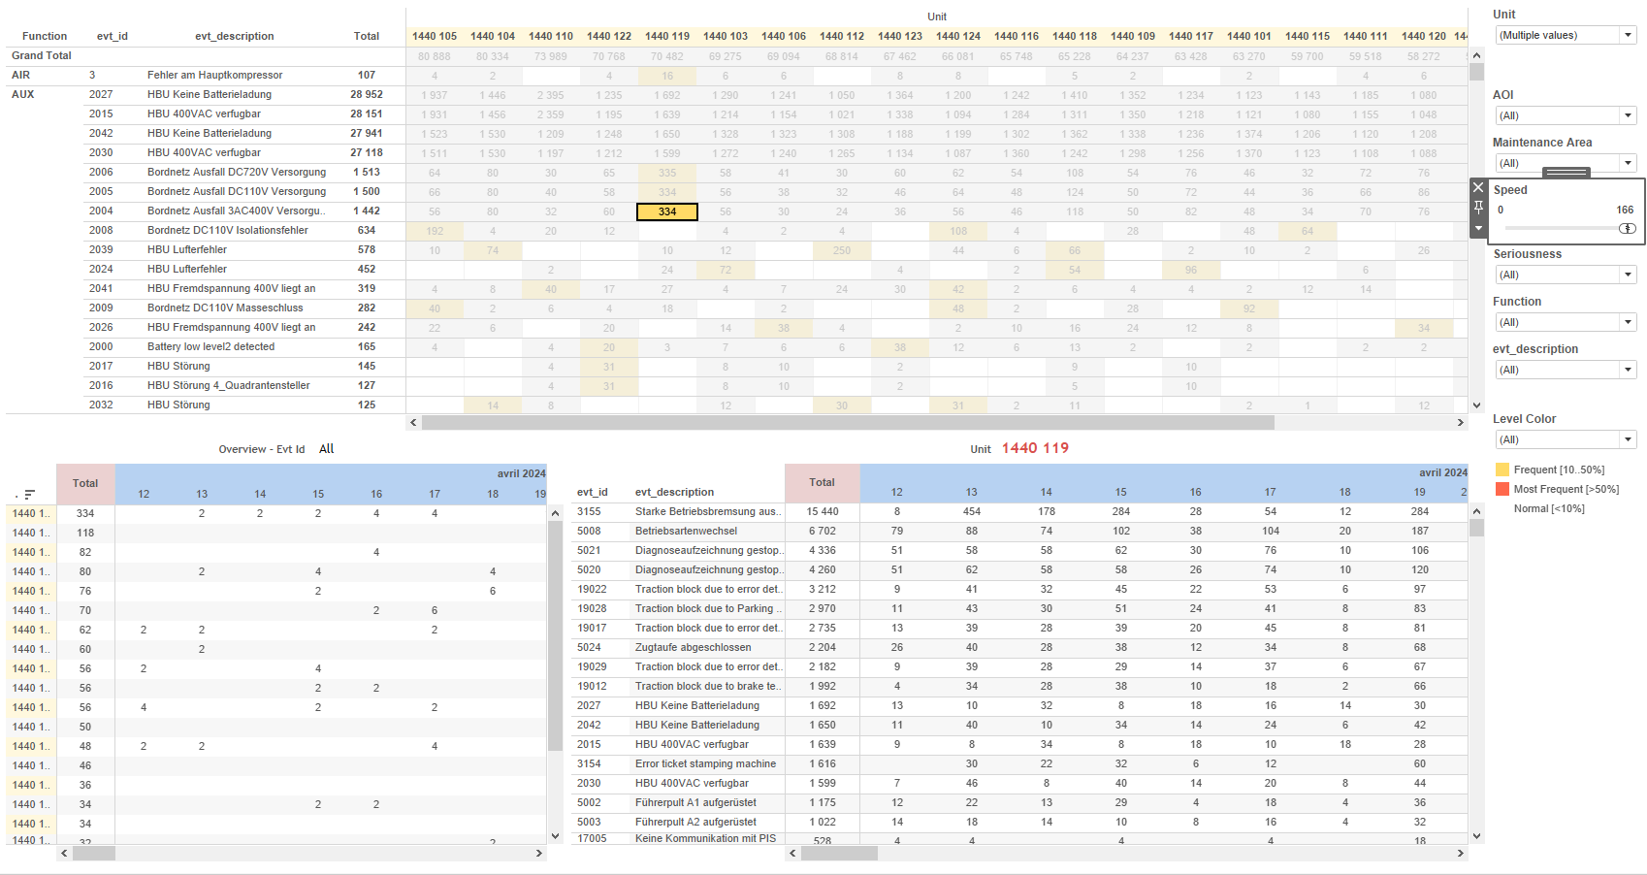
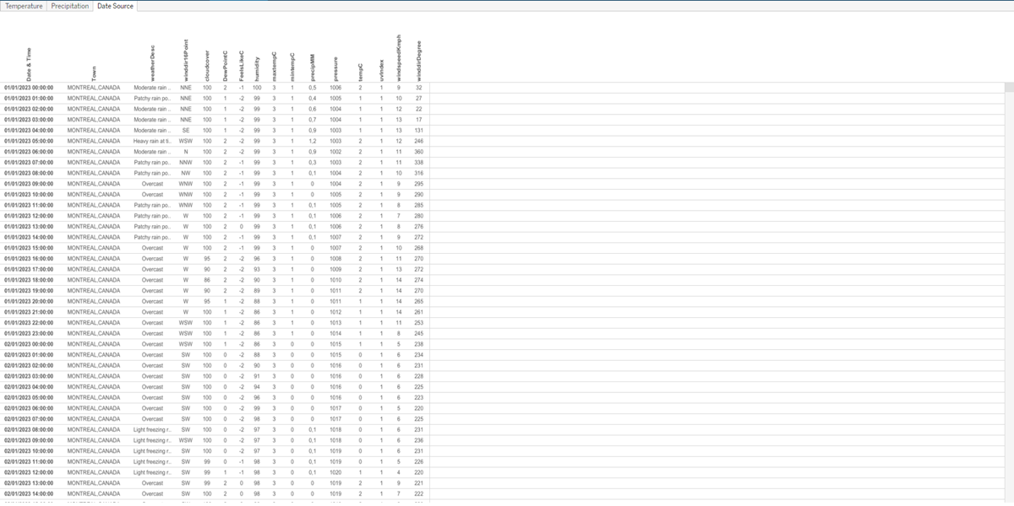
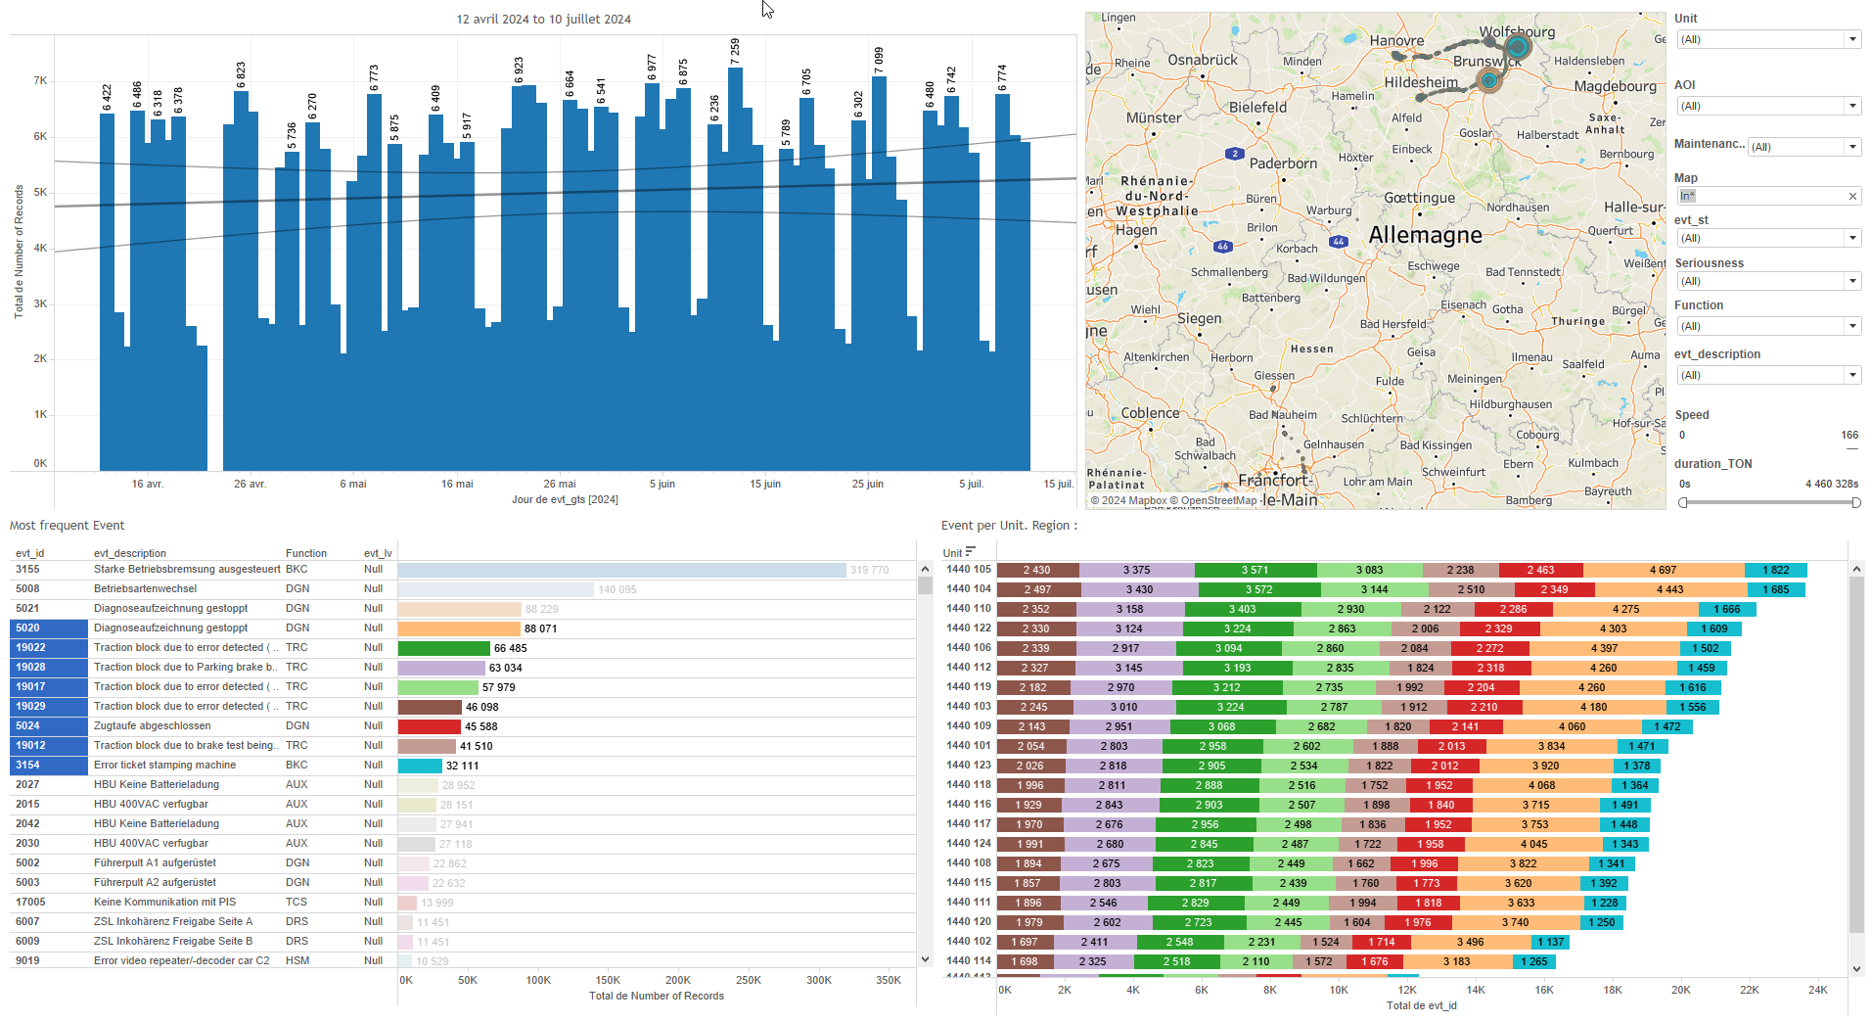
DATA VISUALIZATION REPORT SHEET
HealthHub
Weather_History
Standard
Event Analysis
Represented By
Date & Time Date tempC date precipMM time Town Number of Records humidity winddirDegree
GENERAL DESCRIPTION
The 'Weather_History' report provides a detailed overview of weather data including wind direction, precipitation, and temperature. The report includes interactive visualizations and tables that allow users to explore data trends and distributions over time.
MAIN CHARACTERISTICS | Description
Project | Any project
Domain | Exploration
Type of report | Data Exploration - Operational Time Series (OPDAT)
Report's Objective | Provide comprehensive visualization of wind direction degrees using a polygon chart. Analyze daily and monthly precipitation trends, and distribution of precipitation values over time. Explore daily, monthly, and distribution trends of temperature data across various towns.

Slide 2
Constitution du rapport 1/3
Date Source Dashboard
The 'Date Source' dashboard provides a comprehensive visualization of wind direction degrees using a polygon chart. It allows users to explore the continuous representation of wind direction data in detail, enhancing the understanding of wind patterns.
Position | Exemple de question | Description
center | What is the direction of the wind in degrees as represented by the wind direction degree variable? | This plot visualizes the wind direction degrees using a polygon chart. The data type for wind direction is real, providing a continuous representation of the values.
Principaux Filtres/Paramètres
Filtrage par | Description

Slide 3
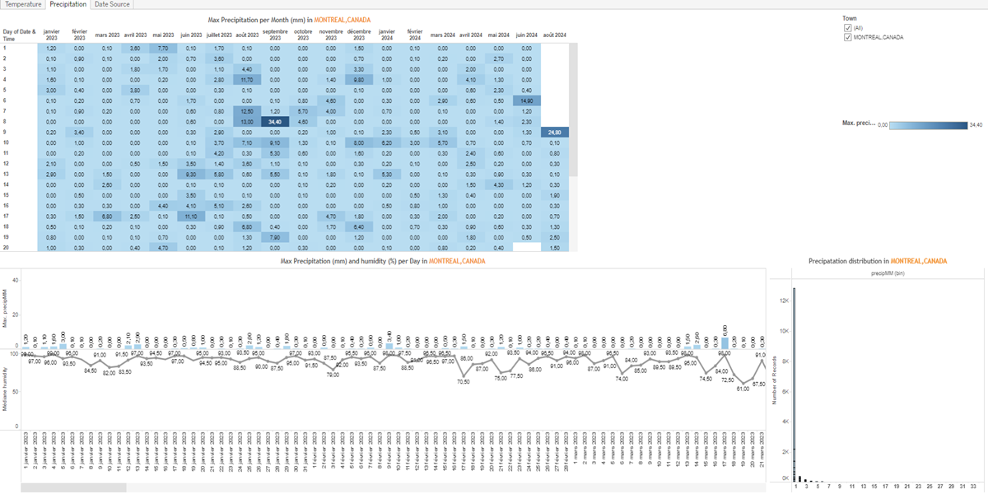
Constitution du rapport 2/3
Precipitation Dashboard
The 'Precipitation' dashboard provides a comprehensive overview of precipitation data, enabling users to analyze daily and monthly precipitation trends, as well as the distribution of precipitation values over time. It facilitates detailed data exploration through interactive graphs and tables, allowing users to identify maximum precipitation and humidity levels, and understand precipitation distribution.
Position | Exemple de question | Description
bottom left | What is the maximum precipitation (mm) and humidity (%) per day? | This visualization displays the Date on the x-axis and humidity on the y-axis. The fill axis variable is precipMM, representing the precipitation in millimeters.
top | What is the maximum precipitation per month in the given dataset? | This visualization displays the precipitation data over time. The x-axis represents the Date & Time, while the y-axis also represents the Date & Time. The fill axis variable is used to color the cells based on the precipitation values (precipMM).
bottom right | What is the distribution of precipitation over time? | This visualization shows the distribution of precipitation in millimeters (binned) against the number of records. Each cell is colored based on the precipitation value.
Principaux Filtres/Paramètres
Filtrage par | Description

Slide 4
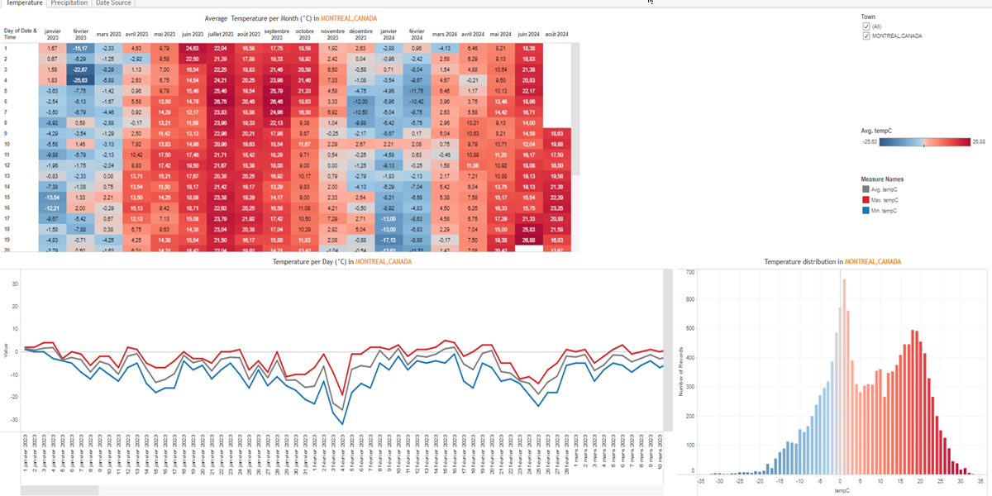
Constitution du rapport 3/3
Temperature Dashboard
The 'Temperature' dashboard provides a comprehensive overview of temperature data, allowing users to explore daily, monthly, and distribution trends across various towns. Users can filter data by date and location, and interact with different visualizations to gain detailed insights.
Position | Exemple de question | Description
bottom left | What is the temperature per day (°C) in the given town? | This visualization shows the date on the x-axis and multiple values on the y-axis. The data is represented in a table format.
top | What is the average temperature per month (°C) in various towns? | This plot visualizes Date & Time against Date & Time with temperature (tempC) used for the fill axis. The data is displayed in a square chart type.
bottom right | What is the temperature distribution over time in different towns? | This vertical bar chart displays the distribution of temperature (tempC) with the number of records as the y-axis. The color and value of each cell are filled based on tempC.
Principaux Filtres/Paramètres
Filtrage par | Description

Slide 5
Liste des variables
GENERAL DESCRIPTION
La liste des variables ci-dessous est necessaire pour la constitution du rapport. Pour le projet [Projet] leur equivalence doit être fournie avec la plage de Valeur associée en cas de demande de rapport.
Variable | Description
DewPointC | This variable measures the dew point temperature in Celsius. It is used to indicate the temperature at which air becomes saturated with moisture.
DewPointF | Dew point in Fahrenheit, used in weather history data. It is recorded as operational data.
FeelsLikeC | This variable represents the perceived temperature, considering factors like humidity and wind. It is recorded as operational data.
FeelsLikeF | FeelsLikeF is the perceived temperature, taking into account wind chill and humidity. It is recorded as operational data.
HeatIndexC | HeatIndexC represents the perceived temperature due to humidity. It is recorded continuously as operational data.
HeatIndexF | HeatIndexF measures the perceived temperature accounting for humidity. It is continuously recorded as operational data.
Town | Town is a context data variable used in weather-related dashboards. It represents the name of the town where the weather data is recorded.
WindChillC | WindChillC represents the perceived decrease in air temperature felt by the body due to wind. It is used in weather history data to provide context on the impact of wind on temperature readings.
WindChillF | WindChillF is a measure of how cold it feels when wind is factored in with the actual air temperature. It is recorded continuously as operational data.
WindGustKmph | WindGustKmph represents the maximum wind speed recorded in kilometers per hour. It is used in the Weather_History dashboard to analyze historical weather data.
WindGustMiles | Wind gusts are recorded as part of the operational data for weather history. They measure the maximum wind speed in miles per hour.
NOTE
Les illustrations fournissent un aperçu des représentations graphiques et ne préjugent pas des données pouvant être contenues dans le rapport. En effet, les données peuvent évoluer au cours du projet et dépendent entièrement de celui-ci.
Toute reproduction ou distribution non autorisée de ce rapport est interdite. Les informations contenues dans ce document sont confidentielles et destinées uniquement aux parties mentionnées. L'utilisation ou la divulgation non autorisée de ces informations est passible de poursuites judiciaires. Les représentations graphiques sont fournies à titre indicatif et ne sauraient engager la responsabilité de l'émetteur quant à l'exhaustivité ou l'exactitude des données présentées. Les données sont sujettes à des modifications au fil du projet et doivent être interprétées dans ce contexte.

