Slide 1
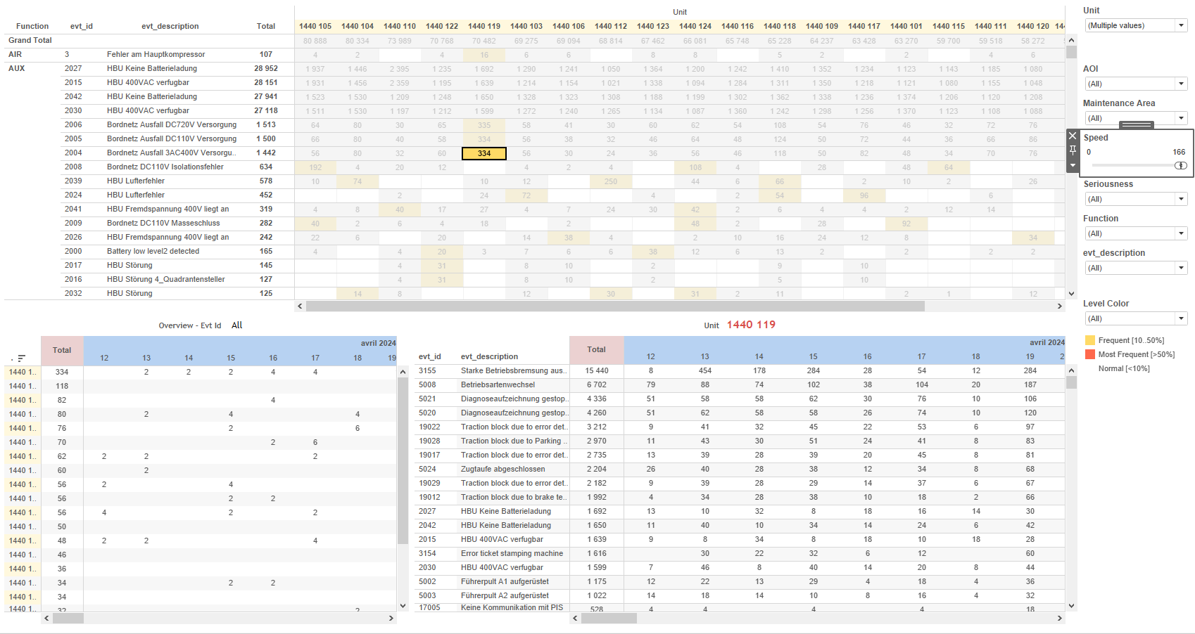
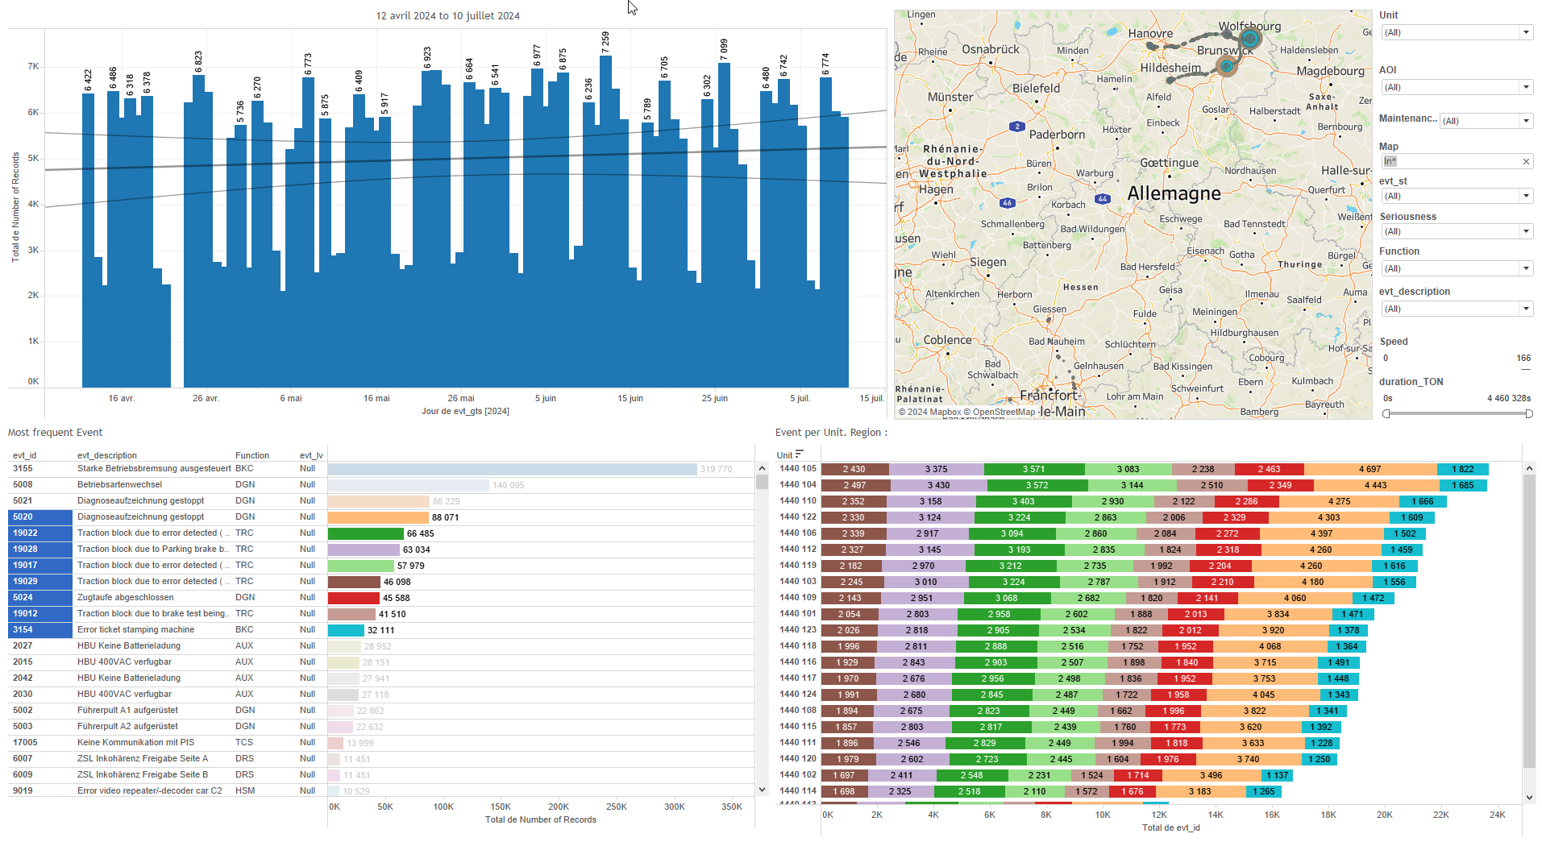
DATA VISUALIZATION REPORT SHEET
HealthHub
version
Standard
Event Analysis
Represented By
Unit Color Version value One Color Type version_id version_val_max Last Type OI
GENERAL DESCRIPTION
This report provides a comprehensive overview of the version status of various devices and software/hardware components, offering detailed insights and data exploration capabilities. It includes multiple dashboards with visualizations and textual representations to facilitate understanding and interaction with the data.
MAIN CHARACTERISTICS | Description
Project | Any project
Domain | Statistics,Event
Type of report | Data Exploration - Train Event Data with Contextual Variables
Report's Objective | Provide an in-depth analysis of device distribution and version status based on the 'Color Type' parameter. Offer a comprehensive overview of software and hardware versions. Facilitate detailed data exploration and interaction between different version statuses. Provide insights into hardware versions and their statuses based on various parameters. Offer an overview of the current software versions and their statuses.

Slide 2
Constitution du rapport 1/4
Diagnostic Dashboard
The 'Diagnostic' dashboard provides an in-depth analysis of device distribution and version status based on the 'Color Type' parameter. It allows users to filter data, explore detailed visualizations, and interact with various charts for comprehensive data insights.
Position | Exemple de question | Description
center | What is the distribution of devices and their version status based on the 'Color Type' parameter? | Description of a worksheet in a report. A worksheet contains charts (plots) and addresses a specific question.
Principaux Filtres/Paramètres
Filtrage par | Description

Slide 3
Constitution du rapport 2/4
Version Dashboard
The 'Version' dashboard aims to provide a comprehensive overview of software and hardware versions. It includes a table to visualize the relationship between Version Id Sw and Unit, and a text plot to overview hardware versions, facilitating detailed data exploration and interaction between different version statuses.
Position | Exemple de question | Description
top | What is the current status of the software version based on various parameters and calculations? | This table visualizes the relationship between Version Id Sw and Unit, with cells colored based on different version statuses.
bottom | What is the hardware version overview based on the given parameters and calculations? | This plot provides an overview of hardware versions. The X-axis represents Calculation_1522779654613307393, while the Y-axis shows Unit. The plot type is text, displaying categorical data from OI.
Principaux Filtres/Paramètres
Filtrage par | Description

Slide 4
Constitution du rapport 3/4
Version Hw Dashboard
The 'Version Hw' dashboard provides an overview and detailed insights into hardware versions and their statuses based on various parameters. It allows for data exploration through textual representations and specific categorizations, facilitating a comprehensive understanding of hardware and software statuses.
Position | Exemple de question | Description
top | What is the hardware version and its status based on various parameters? | This plot displays the 'Calculation_1522779654613307393' against 'Unit' and 'OI'. It is a textual representation of the data where 'Unit' and 'OI' are string variables.
bottom | What is the color type and version status of the hardware or software based on the given parameters? | This plot displays data related to PC, sourced from [Extract (Extract.Extract)]. The y-axis variable is categorized as a string.
Principaux Filtres/Paramètres
Filtrage par | Description

Slide 5
Constitution du rapport 4/4
Version Sw Dashboard
The 'Version Sw' dashboard provides an overview of the current software versions and their statuses, with data filtered by unit and visualized in a table format. It allows for detailed exploration of version information with color-coded cells for easy status identification.
Position | Exemple de question | Description
center | What is the current software version and its status? | This plot visualizes the Version Id Sw against Unit, with each cell colored based on the Color variable. The data is displayed in a table format, suitable for categorical y-axis values.
Principaux Filtres/Paramètres
Filtrage par | Description

Slide 6
Liste des variables
GENERAL DESCRIPTION
La liste des variables ci-dessous est necessaire pour la constitution du rapport. Pour le projet [Projet] leur equivalence doit être fournie avec la plage de Valeur associée en cas de demande de rapport.
Variable | Description
OI | OI is an identifier used to distinguish different versions of hardware and software in train diagnostics. It helps track updates and versions across various components.
OR | Operational data for train parts, used in diagnostic dashboards.
PC | PC is a physical identifier used in operational data for train parts. It is recorded continuously.
PN | PN is recorded as operational data and used to identify specific parts of a train.
SN | Serial Number is a unique identifier for a part of a train. It is recorded as context data for events.
Unit | This variable identifies different parts of a train. It is used across various operational and diagnostic dashboards.
evt_subloc | The variable represents a specific sub-location event within the train system. It is used in diagnostic dashboards to track operational data.
last | This variable represents the most recent recorded value. It is used in both software and hardware version dashboards.
ref_version_val | The reference version value is used to identify the target version of software or hardware. It helps in distinguishing between up-to-date and other versions.
unit | This variable identifies a part of the train. It is used in various dashboards for diagnostics and version tracking.
ver | This variable represents the version of the software or hardware component. It is used to determine if the component is up-to-date.
NOTE
Les illustrations fournissent un aperçu des représentations graphiques et ne préjugent pas des données pouvant être contenues dans le rapport. En effet, les données peuvent évoluer au cours du projet et dépendent entièrement de celui-ci.
Toute reproduction ou distribution non autorisée de ce rapport est interdite. Les informations contenues dans ce document sont confidentielles et destinées uniquement aux parties mentionnées. L'utilisation ou la divulgation non autorisée de ces informations est passible de poursuites judiciaires. Les représentations graphiques sont fournies à titre indicatif et ne sauraient engager la responsabilité de l'émetteur quant à l'exhaustivité ou l'exactitude des données présentées. Les données sont sujettes à des modifications au fil du projet et doivent être interprétées dans ce contexte.

