Slide 1
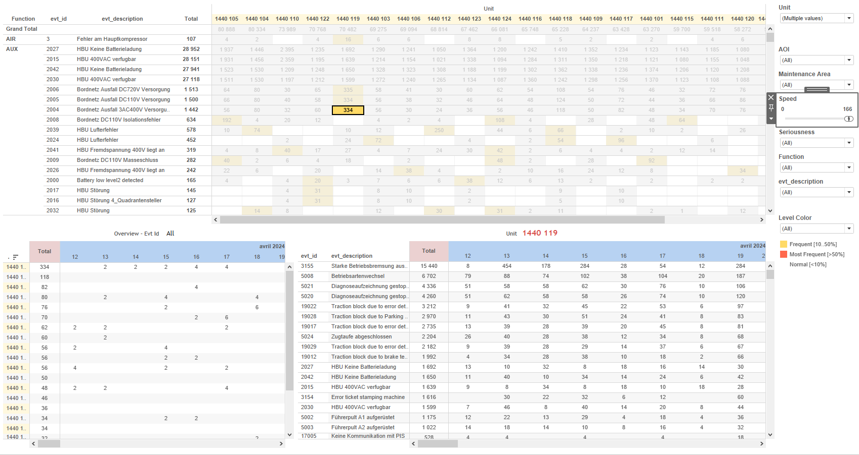
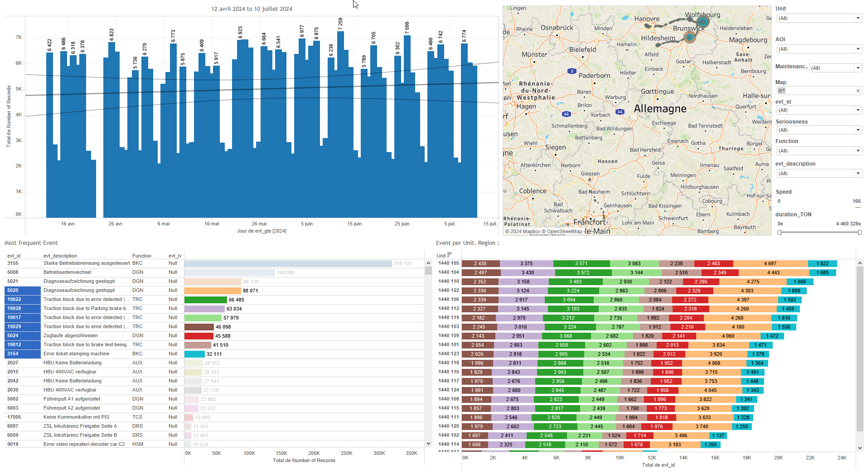
DATA VISUALIZATION REPORT SHEET
HealthHub
ADMIN_version_Report_v10.4
Standard
Event Analysis
Represented By
One version_val Unit Version Id Sw Upper version Type version_id version_tp version_val_max version_uTs
GENERAL DESCRIPTION
The 'Version' report provides a comprehensive overview of software and hardware versions, allowing users to filter data based on specific conditions and explore detailed version statuses through interactive tables. It includes multiple worksheets that visualize the data in a tabular format, with cell colors indicating specific values.
MAIN CHARACTERISTICS | Description
Project | Any project
Domain | Statistics,Operational Data
Type of report | Data Exploration - Operational Time Series (OPDAT)
Report's Objective | Provide a comprehensive overview of software and hardware versions. Allow users to filter data based on specific conditions. Enable detailed exploration of version statuses through interactive tables.

Slide 2
Constitution du rapport 1/3
Version Dashboard
The 'Version' dashboard provides a comprehensive overview of software and hardware versions, allowing users to filter data based on specific conditions and explore detailed version statuses through interactive tables.
Position | Exemple de question | Description
top | What are the different versions of software and hardware based on the given data? | Description of a worksheet in a report. A worksheet contains charts (plots) and addresses a specific question.
bottom | What is the version status of the items based on the given conditions? | This table visualizes the version_val data, categorizing it into a tabular format. Each cell is color-coded and displays the corresponding value.
Principaux Filtres/Paramètres
Filtrage par | Description

Slide 3
Constitution du rapport 2/3
Version Hw Dashboard
The 'Version Hw' dashboard provides a comprehensive overview of the different hardware and software versions and their respective statuses. It allows users to filter and explore data in detail through a table format, with cell colors indicating specific values.
Position | Exemple de question | Description
center | What are the different versions of the hardware and software and their respective statuses? | This plot visualizes the 'version_val' in a table format, with the 'One' variable used for cell color and value.
Principaux Filtres/Paramètres
Filtrage par | Description

Slide 4
Constitution du rapport 3/3
Version Sw Dashboard
The 'Version Sw' dashboard is designed to analyze and visualize the distribution of version types and their values in the software version data. It allows for detailed data exploration through interactive tables and charts, enabling users to filter and drill down into specific version-related questions.
Position | Exemple de question | Description
center | What is the distribution of version types and their values in the software version data? | Description of a worksheet in a report. A worksheet contains charts (plots) and addresses a specific question.
Principaux Filtres/Paramètres
Filtrage par | Description

Slide 5
Liste des variables
GENERAL DESCRIPTION
La liste des variables ci-dessous est necessaire pour la constitution du rapport. Pour le projet [Projet] leur equivalence doit être fournie avec la plage de Valeur associée en cas de demande de rapport.
Variable | Description
Unit | This variable represents an identifier for a part of a train. It is used extensively in both context data for events and operational data.
last | The variable indicates the last recorded value for a specific train component. It is used to determine the most recent operational status.
version_id | This variable identifies different versions of software or hardware used in the trains. It is used in various dashboards to distinguish between software and hardware versions.
version_loc | This variable represents the location version of a train component. It is used in both software and hardware version reports.
version_subLoc | This variable indicates the sub-location version of a train unit. It is used in various operational dashboards to distinguish between different hardware and software versions.
version_tp | This variable distinguishes between software and hardware versions of train components. It is crucial for tracking updates and maintenance.
version_uTs | The variable represents the timestamp of the version recorded. It is crucial for tracking changes over time.
version_val | The version value is used to identify software and hardware versions. It helps distinguish between the upper and lower versions.
version_val_max | This variable represents the maximum version value for a software or hardware component. It helps in identifying the highest version recorded.
NOTE
Les illustrations fournissent un aperçu des représentations graphiques et ne préjugent pas des données pouvant être contenues dans le rapport. En effet, les données peuvent évoluer au cours du projet et dépendent entièrement de celui-ci.
Toute reproduction ou distribution non autorisée de ce rapport est interdite. Les informations contenues dans ce document sont confidentielles et destinées uniquement aux parties mentionnées. L'utilisation ou la divulgation non autorisée de ces informations est passible de poursuites judiciaires. Les représentations graphiques sont fournies à titre indicatif et ne sauraient engager la responsabilité de l'émetteur quant à l'exhaustivité ou l'exactitude des données présentées. Les données sont sujettes à des modifications au fil du projet et doivent être interprétées dans ce contexte.

