Slide 1

CAN WE INSURE OUR HAPPINESS?
Han Da Eun BEK184
Moscow, 2022

Slide 2

OUTLINE
Introduction
Literature Review
Methods
Results Anticipated
Conclusions

Slide 3
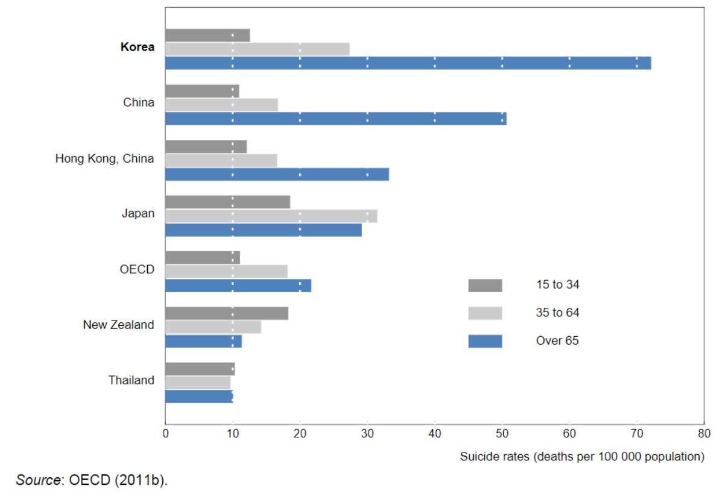
Introduction: background (1)
The suicide rate of the elderly in south korea is the highest in the oecd area In 2010 or later year

Slide 4
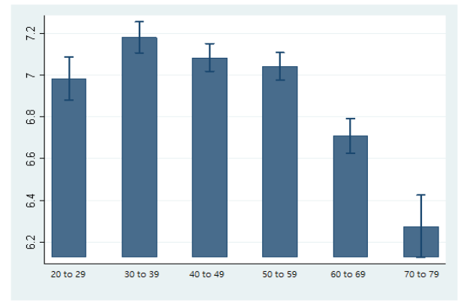
Introduction: background (2)
Korean’s life satisfaction by age in 2019 (Likert scale ranging from 0 to 10)

Slide 5
Introduction: background (3)
July 1, 2018 - Mental health insurance coverage
 | Before 2018 | After 2018
Individual counseling | 11400 won ($9.37 USD) | 7,700 won ($6.33 USD)
Cognitive behavioral therapy costs required for panic disorder and post-traumatic stress disorder | 50,000 ($41.09 USD) to 260,000 won ($213.68 USD) | 16,500 won ($13.56 USD)

Slide 6
Introduction: PROBLEM STATEMENT
AIM: To study the effects of health insurance expansion on the happiness of older adults
OBJECTIVES:
1) To define factors affecting older people depression and life satisfaction;
2) To study the relevant methodology (DID) and build the model;
3) To explain the relations between the health insurance expansion and happiness of older adults.

Slide 7
Introduction: DELIMITATIONS OF THE STUDY
Korean data (not for other countries);
Measure of happiness;
Survey problem.

Slide 8
Introduction: key terms (1)
Happiness or subjective well-being:
life satisfaction,
positive experiences and feelings,
absence of negative experiences and feelings.

Slide 9
Introduction: key terms (2)
Center for Epidemiologic Studies Depression Scale (CESD-10):
One of the most commonly used self-report depression screening scales;
A screening instrument for symptoms of depressed mood in older adults;
8, 9, 10 – positive to depressive symptoms.

Slide 10
Literature review (1)
Programmes
Author(s) | Title | Year | Valuable insights
Pak | What are the effects of expanding social pension on health? Evidence from the Basic Pension in South Korea. | 2021 | Positive effect of social pension growth on the mental health of older adults by increasing financial satisfaction; No effect on physical health.
Kim and Kwon | The effect of extension of benefit coverage for cancer patients on health care utilization across different income groups in South Korea | 2014 | Expanding the benefit coverage of public health insurance reduces the impact of private insurance; improves equity in health care utilization.
Ruger and Kim | Out-of-pocket healthcare spending by the poor and chronically ill in the Republic of Korea. | 2007 | Small amount of Basic Pension benefits for improving physical strength or self-rated general health due to expensive treatments.
Goodman-Bacon | Public insurance and mortality: evidence from Medicaid implementation | 1999 | Medicaid program reduced mortality rates among infants and children.

Slide 11
Literature review (2)
Reasons
Author(s) | Title | Year | Valuable insights
Park et al. | High Prevalence of depression diagnosis among medical aid beneficiaries: a Korean health insurance database study. | 2017 | Medical Aid recipients are more likely to be diagnosed with depression than health insurance recipients ; Variables like being a woman and living in a rural area linked to a higher risk of depression diagnosis.
Jones and Urasawa | Reducing the high rate of poverty among the elderly in Korea. | 2014 | 1) First most common reason for older people considering suicide - disease and incapacity, second reason - economic hardship; 2) High poverty rate linked to a drop in family assistance.
Yun | NMHC jeongsingeongang donghyang vol.26 [NMHC Mental Health Trends vol.26] | 2022 | Causes of the high suicide rate among the elderly: rapid aging of the Korean population; the deterioration of family culture; a lack of welfare infrastructure for the elderly.

Slide 12
Methods: Data
The Korean Longitudinal Study of Aging (KLoSA)
Year | 2006-2020, biannual
Age | Over 45
Sample size | 10 000

Slide 13
Descriptive Statistics
Methods: Descriptive statistics (2)
Dependent variables
 | Variable | Definition | Obs | Mean | Std. Dev. | Min | Max
Measures of happiness | Life satisfaction | (Continuous) Totally satisfied (100), totally unsatisfied (0) | 63215 | 61.2 | 18.2 | 0 | 100
 | Depression | Depressed (1), nondepressed (0) | 47776 | 0.07 | 0.26 | 0 | 1
 | CESD-10 | (Continuous) | 63215 | 1.73 | 1.94 | 0 | 10

Slide 14
Descriptive Statistics
Methods: Descriptive statistics (3)
TREAtment variable
 | Variable | Definition | Obs | Mean | Std. Dev. | Min | Max
Insurance | National Health Insurance | Enrolled (1), not enrolled and covered by the Medical Aid program (0) | 63185 | 0.055 | 0.227 | 0 | 1

Slide 15
Methods: Descriptive statistics (3)
CoVariates
 | Variable | Definition | Obs | Mean | Std. Dev. | Min | Max
Socio-demographic characteristics | Gender | Male (1), Female (0) | 63215 | 0.429 | 0.495 | 0 | 1
 | Age | (Continuous) | 63215 | 66.2 | 10.888 | 45 | 107
 | Marital status | Married (1), divorced/ widowed or afflicted/ separated/ never married (0) | 63214 | 0.764 | 0.425 | 0 | 1
 | Education | Primary school or below (1), junior high school (2), senior high school (3), university or above (4) | 63203 | 2.081 | 1.08 | 1 | 4
 | Frequency of meeting close people | More than four times a week (1), twice or three times a week (2), once a week (3), once in two weeks (4), once a month (5), once in two months (6), once in three – four months (7), once or twice a year (8), rarely seen in a year (9), absence of close people (10) | 63213 | 3.665 | 2.662 | 1 | 10

Slide 16
Methods: Descriptive statistics (4)
Covariates
 | Variable | Definition | Obs | Mean | Std. Dev. | Min | Max
Socio-demographic characteristics | Region | Big cities | 63215 | 0.24 | 0.43 | 0 | 1
 |  | Small and medium-sized cities | 63215 | 0.43 | 0.5 | 0 | 1
 |  | Towns | 63215 | 0.33 | 0.47 | 0 | 1
 | Health status | Perfect (1), very good (2), good (3), average (4), bad (5) | 63215 | 3.7 | 0.93 | 1 | 5
 | Number of children | (Continuous) | 60629 | 2.92 | 1.49 | 0 | 10
Economic status | Income satisfaction | (Continuous) | 63215 | 52.8 | 21.4 | 0 | 100
 | Employment | Employed (1), unemployed (0) | 63215 | 0.4 | 0.49 | 0 | 1

Slide 17

Methods
Formula:
Difference-in-difference
Treatment group | Control group
National Health Insurance beneficiaries | Medical Aid beneficiaries

Slide 18
RESULTS anticipated
 | (1) | (2) | (3)
 | Depression | CESD-10 | Life satisfaction
National Health Insurance | 0.0652*** | -0.114 | -5.013***
Year | 0.00308 | -0.553*** | 0.667***
National Health Insurance #Year | 0.0599** | 0.867*** | -0.844
Marital | -0.0138** | -0.110* | 1.803***
Age | -0.000522* | 0.00873*** | 0.00506
Frequency of meeting close people | 0.00357*** | 0.125*** | -0.441***
Region | 0.00234 | 0.188*** | -0.308
Income satisfaction | -0.000588*** | -0.0121*** | 0.459***
Education | -0.00120 | 0.0144 | 0.480***
Health status | 0.0227*** | 0.185*** | -1.445***
Work | -0.00778 | -0.130*** | 0.424
_cons | 0.0148 | 0.632** | 41.61***

Slide 19
Thank You for Your Attention!

Slide 20
CAN WE INSURE OUR HAPPINESS?
Han Da Eun BEK184
Moscow, 2022

Slide 21
REfERENCES
Callaway, B. & Pedro H. C. (2021). Difference-in-differences with multiple time periods. Journal of Econometrics, Vol. 225, No.2, pp. 200-230.
Jung H. & Kim S. (2020). How happy are Koreans? Measuring happiness and quality of life in Korea. Korea Institute for Health and Social Affairs.
NHIS (2022). About the Social Security System of Korea. Retrieved March 21, 2022, from https://www.nhis.or.kr/english/wbheaa02200m01.do.
OECD. (2011). Society at a Glance: Asia/Pacific 2011. OECD Publishing, Paris.

Slide 22
REfERENCES
Gruber, J., & Yelowitz, A. (1999). Public health insurance and private savings. Journal of Political Economy, 107(6), 1249-1274.
Jones, R. S., & Urasawa, S. (2014). Reducing the high rate of poverty among the elderly in Korea.
Kim, S., & Kwon, S. (2014). The effect of extension of benefit coverage for cancer patients on health care utilization across different income groups in South Korea. International journal of health care finance and economics, 14(2), 161-177.
Pak, T. Y. (2021). What are the effects of expanding social pension on health? Evidence from the Basic Pension in South Korea. The Journal of the Economics of Ageing, 18, 100287.
Park, H., Song, I., & Shin, J. Y. (2017). High Prevalence of depression diagnosis among medical aid beneficiaries: a Korean health insurance database study. Asia Pacific Journal of Public Health, 29(8), 692-697.
Ruger, J. P., & Kim, H. J. (2007). Out-of-pocket healthcare spending by the poor and chronically ill in the Republic of Korea. American Journal of Public Health, 97(5), 804-811.
Yun, S. J. (2022). NMHC jeongsingeongang donghyang vol.26 [NMHC Mental Health Trends vol.26]. The National Mental Health and Welfare Commission.

Slide 23
Literature review (3)
Happiness
Author(s) | Title | Year | Valuable insights
Easterlin | The Economics of Happiness | 2004 | Happiness and life satisfaction - interchangeable measures of overall feelings of well-being
Besser-Jones | The Pursuit and Nature of Happiness | 2013 | 1)‘Happiness' refers to a state of subjective well-being marked by positive affect; 2) Psycological health -> subjective well-being
Mantilla | The Politics of Happiness | 2007 | Long-term unhappiness or depression is seen as a mental health issue
Uusitalo-Malmivaara & Lehto | Social Factors Explaining Children's Subjective Happiness and Depressive Symptoms | 1999 | Happiness - positive and negative affect and life satisfaction

