Slide 1
William Stallings
Data and Computer Communications
Chapter 2
Protocols and Architecture

Slide 2
Characteristics
Direct or indirect
Monolithic or structured
Symmetric or asymmetric
Standard or nonstandard

Slide 3
Direct or Indirect
Direct
  Systems share a point to point link or
  Systems share a multi-point link
  Data can pass without intervening active agent
Indirect
  Switched networks or
  Internetworks or internets
  Data transfer depend on other entities

Slide 4
Monolithic or Structured
Communications is a complex task
To complex for single unit
Structured design breaks down problem into smaller units
Layered structure

Slide 5
Symmetric or Asymmetric
Symmetric
  Communication between peer entities
Asymmetric
  Client/server

Slide 6
Standard or Nonstandard
Nonstandard protocols built for specific computers and tasks
K sources and L receivers leads to K*L protocols and 2*K*L implementations
If common protocol used, K + L implementations needed

Slide 7
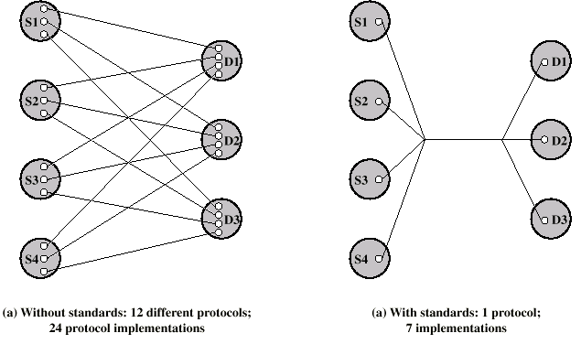
Use of Standard Protocols

Slide 8
Functions
Encapsulation
Segmentation and reassembly
Connection control
Ordered delivery
Flow control
Error control
Addressing
Multiplexing
Transmission services

Slide 9
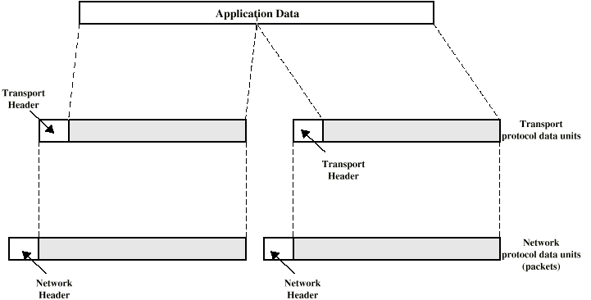
Encapsulation
Addition of control information to data
  Address information
  Error-detecting code
  Protocol control

Slide 10
Segmentation (Fragmentation)
Data blocks are of bounded size
Application layer messages may be large
Network packets may be smaller
Splitting larger blocks into smaller ones is segmentation (or fragmentation in TCP/IP)
  ATM blocks (cells) are 53 octets long
  Ethernet blocks (frames) are up to 1526 octets long
Checkpoints and restart/recovery

Slide 11
Why Fragment?
Advantages
  More efficient error control
  More equitable access to network facilities
  Shorter delays
  Smaller buffers needed
Disadvantages
  Overheads
  Increased interrupts at receiver
  More processing time

Slide 12
Connection Control
Connection Establishment
Data transfer
Connection termination
May be connection interruption and recovery
Sequence numbers used for
  Ordered delivery
  Flow control
  Error control
  Congestion control

Slide 13
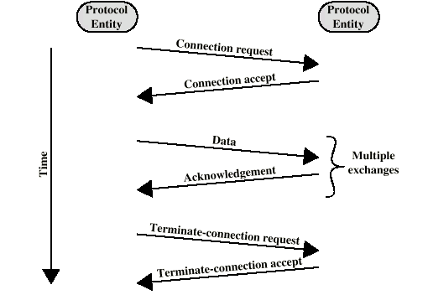
Connection Oriented Data Transfer

Slide 14
Ordered Delivery
PDUs may traverse different paths through network
PDUs may arrive out of order
Sequentially number PDUs to allow for ordering

Slide 15
Flow Control
Done by receiving entity
Limit amount or rate of data
Stop and wait
Credit systems
  Sliding window
Needed at application as well as network layers

Slide 16
Error Control
Guard against loss or damage
Error detection
  Sender inserts error detecting bits
  Receiver checks these bits
  If OK, acknowledge
  If error, discard packet
Retransmission
  If no acknowledge in given time, re-transmit
Performed at various levels

Slide 17
Addressing
Addressing level
Addressing scope
Connection identifiers
Addressing mode

Slide 18
Addressing level
Level in architecture at which entity is named
Unique address for each end system (computer) and router
Network level address
  IP or internet address (TCP/IP)
  Network service access point or NSAP (OSI)
Process within the system
  Port number (TCP/IP)
  Service access point or SAP (OSI)

Slide 19
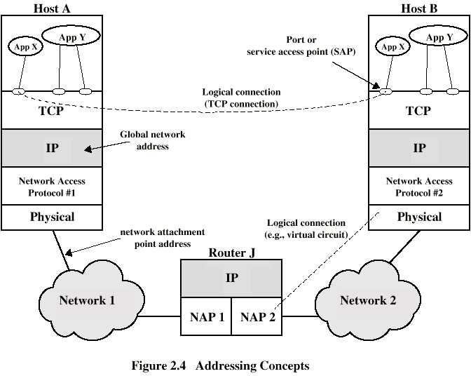
Address Concepts

Slide 20
Addressing Scope
Global non-ambiguity
  Global address identifies unique system
  There is only one system with address X
Global applicability
  It is possible at any system (any address) to identify any other system (address) by the global address of the other system
  Address X identifies that system from anywhere on the network
e.g. MAC address on IEEE 802 networks

Slide 21
Connection Identifiers
Connection oriented data transfer (virtual circuits)
Allocate a connection name during the transfer phase
  Reduced overhead as connection identifiers are shorter than global addresses
  Routing may be fixed and identified by connection name
  Entities may want multiple connections - multiplexing
  State information

Slide 22
Addressing Mode
Usually an address refers to a single system
  Unicast address
  Sent to one machine or person
May address all entities within a domain
  Broadcast
  Sent to all machines or users
May address a subset of the entities in a domain
  Multicast
  Sent to some machines or a group of users

Slide 23
Multiplexing
Supporting multiple connections on one machine
Mapping of multiple connections at one level to a single connection at another
  Carrying a number of connections on one fiber optic cable
  Aggregating or bonding ISDN lines to gain bandwidth

Slide 24
Transmission Services
Priority
  e.g. control messages
Quality of service
  Minimum acceptable throughput
  Maximum acceptable delay
  Jitter
Security
  Access restrictions

Slide 25
OSI - The Model
A layer model
Each layer performs a subset of the required communication functions
Each layer relies on the next lower layer to perform more primitive functions
Each layer provides services to the next higher layer
Changes in one layer should not require changes in other layers

Slide 26
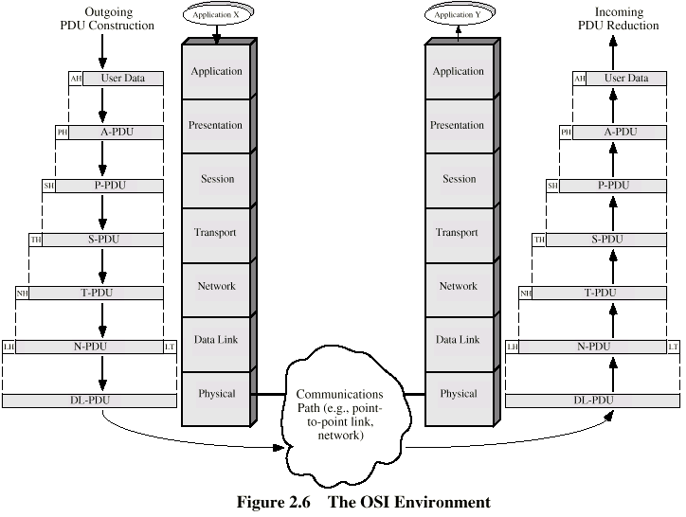
The OSI Environment

Slide 27
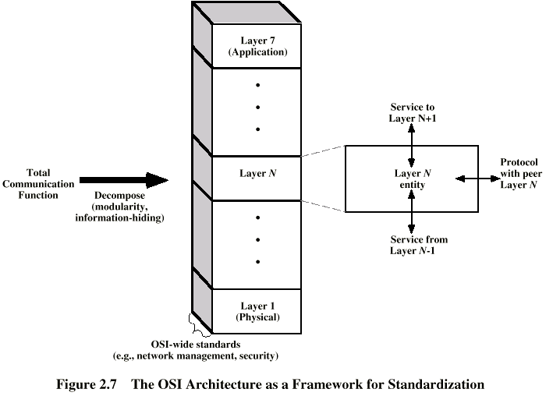
OSI as Framework for Standardization

Slide 28
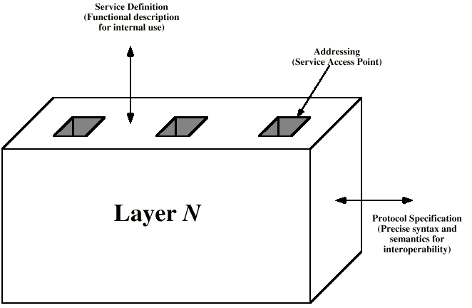
Layer Specific Standards

Slide 29
Elements of Standardization
Protocol specification
  Operates between the same layer on two systems
  May involve different operating system
  Protocol specification must be precise
    Format of data units
    Semantics of all fields
    allowable sequence of PCUs
Service definition
  Functional description of what is provided
Addressing
  Referenced by SAPs

Slide 30
OSI Layers (1)
Physical
  Physical interface between devices
    Mechanical
    Electrical
    Functional
    Procedural
Data Link
  Means of activating, maintaining and deactivating a reliable link
  Error detection and control
  Higher layers may assume error free transmission

Slide 31
OSI Layers (2)
Network
  Transport of information
  Higher layers do not need to know about underlying technology
  Not needed on direct links
Transport
  Exchange of data between end systems
  Error free
  In sequence
  No losses
  No duplicates
  Quality of service

Slide 32
OSI Layers (3)
Session
  Control of dialogues between applications
  Dialogue discipline
  Grouping
  Recovery
Presentation
  Data formats and coding
  Data compression
  Encryption
Application
  Means for applications to access OSI environment

Slide 33
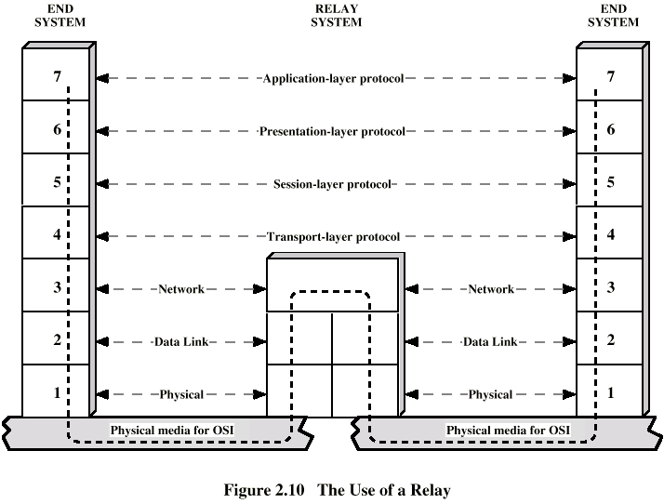
Use of a Relay

Slide 34
TCP/IP Protocol Suite
Dominant commercial protocol architecture
Specified and extensively used before OSI
Developed by research funded US Department of Defense
Used by the Internet

Slide 35
TCP/IP Protocol Architecture(1)
Application Layer
  Communication between processes or applications
End to end or transport layer (TCP/UDP/…)
  End to end transfer of data
  May include reliability mechanism (TCP)
  Hides detail of underlying network
Internet Layer (IP)
  Routing of data

Slide 36
TCP/IP Protocol Architecture(2)
Network Access Layer
  Logical interface between end system and network
Physical Layer
  Transmission medium
  Signal rate and encoding

Slide 37
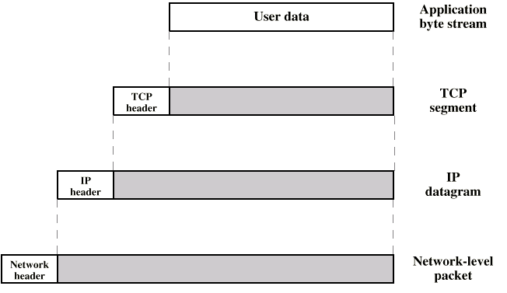
PDUs in TCP/IP

Slide 38
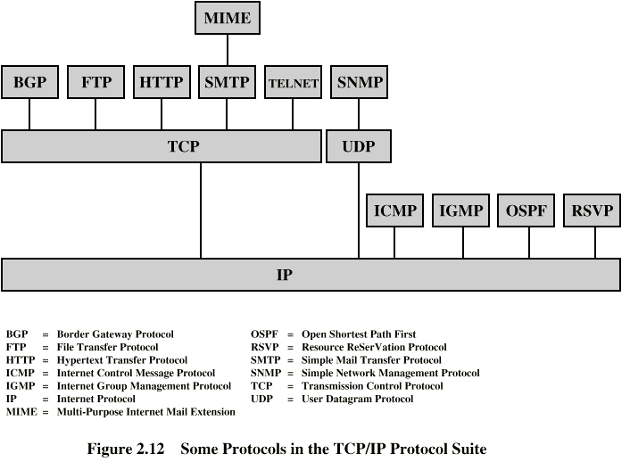
Some Protocols in TCP/IP Suite

Slide 39
Required Reading
Stallings chapter 2
Comer,D. Internetworking with TCP/IP volume I
Comer,D. and Stevens,D. Internetworking with TCP/IP volume II and volume III, Prentice Hall
Halsall, F> Data Communications, Computer Networks and Open Systems, Addison Wesley
RFCs

