Slide 1
Chapter 1: Computer Network Fundamentals
Guide to Computer Network Security

Slide 2
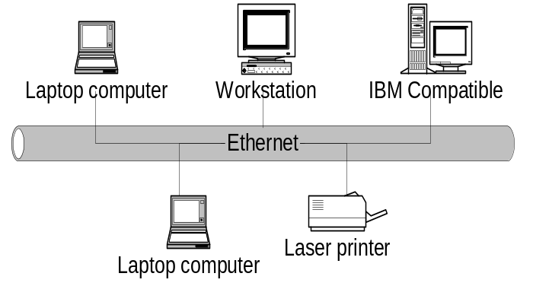
Computer communication networks
A Computer network is a distributed system consisting of loosely coupled computers and other devices.
To form a network, there are communicating rules or protocols each device in the network must follow to communicate with another.

Slide 3
Internetworking technology enables multiple, diverse underlying hardware technologies, and different software regimes to interconnect heterogeneous networks and bring them to communicate smoothly
The network elements (computing elements), network software(operating systems and browsers), and users all work together exchanging information and utilizing the resources in the network
The network elements may be of diverse technologies and software may be as different as possible but the whole combo works in unison.

Slide 4
Computer Networks Types
There are several types of networks:
    LAN – Local Area networks
    WAN – Wide Area networks
    MAN – Metropolitan Area Network

Slide 5
Data Communication Media Technology
Data movement in computer networks is either analog or digital
  In analog format data is sent as a continuous electromagnetic wave with a constant frequency signal called a carrier.
  The carrier signal has three characteristics:
    Amplitude modulation –each bit is represented by a different amplitude of the carrier wave.
    Frequency modulation- each bit is represented by a different frequency of the carrier wave
    Phase Shift modulation – shifts in the wave encode binary information.
  In digital encoding binary data is represented as electrical voltage.

Slide 6
Transmission Media
This is a physical medium between two transmitting elements
The quality, dependability, and overall performance of a computer network depends on the transmission medium
These media fall into the following types:
  Wired Transmission consisting of:
    Copper wire – insulated copper wires. Traditionally used because copper has low resistance to electrical currents.
    Twisted pair - a pair of wires of insulated copper wires each wrapped around the other.

Slide 7
    Coaxial cables – insulated dual conductor cables with inner conductor in the core.
    Optical fiber – small medium made of glass and plastics and conducts optical rays
  Wireless networks fall one of the following three categories depending on distance as follows:
    Restricted proximity network: this network involves local area networks (LANs) with a mixture of fixed and wireless devices.
    Intermediate/Extended network: this wireless network is actually made up of two fixed LANS components joined together by a wireless component. The bridge may be connecting LANS in two nearby buildings or even further.
    Mobile network. This is a fully wireless network connecting two network elements. One of these elements is usually a mobile unit which connects to the home network (fixed) using cellular or satellite technology.

Slide 8
  The three types of wireless communication are connected using the following basic technologies:
    Infrared - uses pulses of infrared light to carry coded instructions to the receiving network element.
    High-Frequency Radio – using electromagnetic radio waves or radio frequencies (RF transmission)
    Microwave – This is a higher frequency version of radio communication. It is capable of being focused in a single direction
    Others include Laser waves

Slide 9
Network Topologies
Computer networks, whether LANs, MANs, or WANs are constructed based on a topology. There are several topologies including:
  (i ) Mesh – allows multiple access links to a network element
  (ii) Tree – except the root, every element in the network can only be accessed through its predecessors
  (iii) Bus – all elements are on a shared line
  (iv) Star – communication between any two elements in the network must go through central node
  (v) Ring – each element in the network is directly connected to two neighbors forming a ring.

Slide 10
Network Connectivity and Protocols
These are operational modalities/procedures for moving packets between network transmitting elements
There are two widely used of protocol suites:
  OSI – open systems interconnection of the international standards organization (ISO)
  TCP/IP – most widely used.
Both of these proposed suites are based on layered tacks of services

Slide 11
Network Services
Network work effectively when network services move data in the network. These services fall into two categories:
  Connection services to facilitate the exchange of data between the two network communicating end-systems with as little data loss as possible and in as little time as possible.
  Switching services to facilitate the movement of data from host to host across the length and width of the network mesh of hosts, hubs, bridges, routers and gateways

Slide 12
Two connection services are provided by most digital networks:
  connected oriented services – offer prior connection controls in a form of three-way handshake
  Connectionless service – no handshake is needed no prior information and no warnings.
Two switching services are provided :
  Circuit switching – The network must reserve all resources needed for the communication session before any communication begins. Example: telecommunications sessions.
  Packet switching networks are referred to as Packet networks. There are two types of these networks.
      Virtual circuit networks – logical connection is needed before a packet is sent
      Datagram and networks -

Slide 13
Network Connecting devices
The computing elements in a network (LAN, WAN) are interconnected using connecting devices commonly referred to as nodes
There are several types:
  Hub – the simplest connecting devices. It takes in inputs and retransmits them verbatim.
  Bridge – it is similar to the hub, however, bridges filter incoming data packets for addresses before the packets/ frames are re-transmitted

Slide 14
  Switch - this a newer version of a bridge with high a performance capacity and can accommodate higher numbers of interfaces
  Router – general purpose nodes that interconnect two or more heterogeneous networks. They are dedicated special purpose computers with their own Address Resolution Protocol (ARP) and IP addresses
  Gateway – this is a more versatile device that can provide translation of and between networking technologies such as OSI and TCP/IP.
    Because of this, Gateways can connect two or more autonomous networks.
    They perform all functions of a router and more.

Slide 15
Network Technologies
Network technologies in each network category.
  LAN Technologies
    Star-based Ethernet (IEEE 802.3) LAN
    Token Ring/IEEE 805.2
    Other LAN technologies
      Asynchronous Transfer Mode (ATM) with the goal to transport real time voice, video, text, email, and graphic data. ATM offers a full array of network services that make it a rival of the Internet network.
      Fiber Distributed Data Interface (FDDI) is a dual-ring network which uses a token ring scheme with many similarities to the original token ring technology.
      AppleTalk, the popular Mac users’ LAN.

Slide 16
  WAN Technologies:
    Integrated Services Digital Network (ISDN)
    X.25
    Other WAN Technologies
      Frame Relay is a packet switched network with the ability to multiplex many logical data conversions over a single connection. It provides flexible efficient channel bandwidth using digital and fiber optics transmission. It has many similar characteristics to X.25 network except in format and functionality.
      Point-to-point Protocol (PPP) is the Internet Standard for transmission of IP packets over serial lines. The point-to-point link provides a single, pre-established communications path from the ending element through a carrier network, such as a telephone company, to a remote network. These links can carry datagram or data-stream transmissions.
      xDirect Service Line (xDSL) is a technology that provides an inexpensive, yet very fast connection to the Internet.
      Switched Multi-megabit Data Service (SMDS) is a connectionless service operating in the range of 1.5-100Mbps; any SMDS station can send a frame to any other station on the same network.
      Asynchronous Transfer Mode (ATM) is already discussed as a LAN technology.

