Slide 1
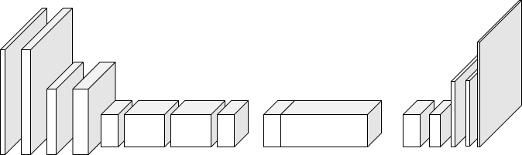
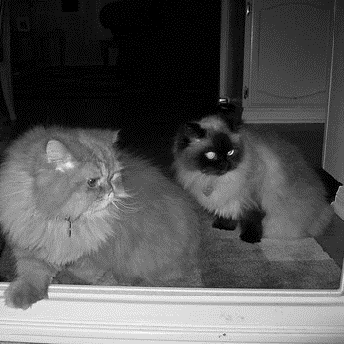
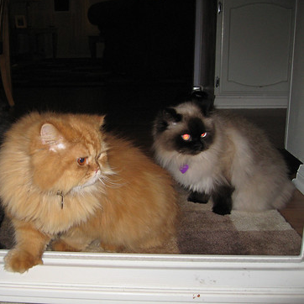

Encoder
Fusion
Decoder
Resize 128x128
Upsample 2x2
512
1256
256
128
64
2
64
64
128
128
256
256
512
256
32
Feature Extractor
Resize 299x299
1000

