Slide 1
CONTENTS
Observations of Maser Emissions in Planetary Atmospheric Plasma
A REVIEW by
Peter H. Handel and Glenn A. Carlson
Dept. of Physics and Astronomy, Univ. of Missouri St. Louis, MO 63121, USA
handel@umsl.edu
Cristiano B. Cosmovich, Stelio Montebugnoli, Alessandro Orfei, Sergej Pogrebenko and Pierre Collom, Planetary and Space Sci. 44, 735-739, 1996.

Slide 2
INTRODUCTION
Introduction
Cristiano B. Cosmovich et. al. fron “Istituto Fisica Spatio Interplanetario,” Via Galilei, 00044 Frascati, Italy, observed MA-SER emissions coming from the plasma created in the atmos-phere of the planet Jupiter by the impact of the comet Shoema-ker-Levy 9, July 19, 1994: Planet. Space Sci. 44, 735-739, 1996.
By using a new fast multichannel spectrometer (up to 128,000 channels) coupled with the 32 m dish of the Medicina Radiotelescope, 18:55-20:20 three molecular lines were studied:
-- Water at 22.235 GHz, the 6₁₆ -5₂₃ 1.35 cm Rot. Trans.
-- Formaldehyde at 4.830 GHz, and
-- Ammonia at 23.694 GHz

Slide 3
INTRODUCTION
The water emission came from “Blob E” and had a very high brightness temperature of 20,000 ºK and an extremely narrow linewidth of only 40 KHz. This can not be explained by thermal emission due to the presence of collisional and thermal (Doppler) broadening in the dense atmosphere of Jupiter. The only possible explanation of the observations is a MASER effect.
So far, OH and H₂O masers have been observed only in cosmos, in nebulae present in the vicinity of UV emitting stars. This represents the first observation of a Water Maser in the solar system, and the first observation of Maser effects in catastrophic planetary events.

Slide 4
OBSERVATIONS
Observations
-- 32 m VLBI Medicina Bologna antenna, with 22 GHz receiver and standard MK-III-A VLBI IF video converter track.
-- New, very high frequency and time resolution, direct Fourier transform spectrometer was designed and constructed for the comet/Jupiter collision event.
The line profiles for the E-impact point are shown in Fig. 1. The earth-Jupiter Doppler shift was removed.

Slide 5
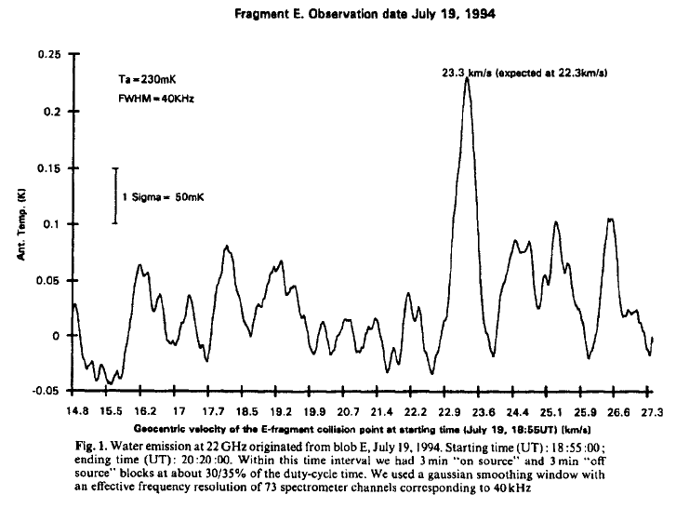

Slide 6
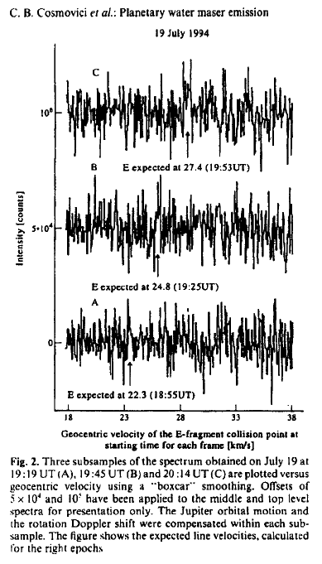

Slide 7
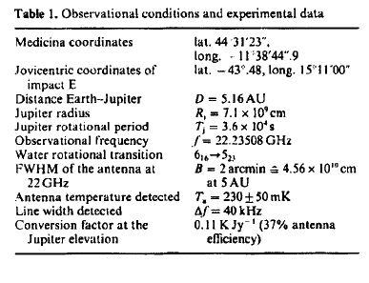

Slide 8
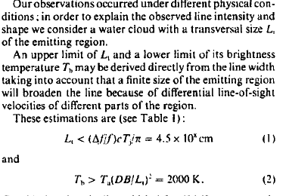
OBSERVATIONS

Slide 9
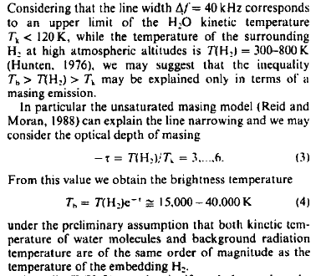
OBSERVATIONS

Slide 10
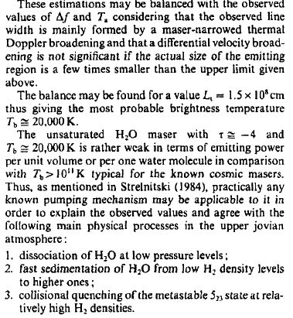
OBSERVATIONS

Slide 11
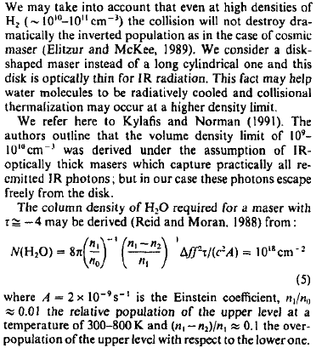
OBSERVATIONS

Slide 12
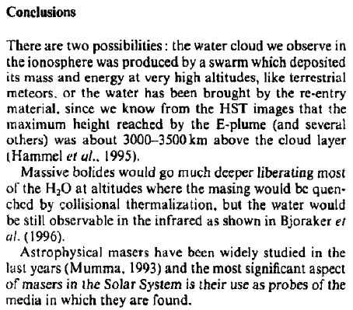
CONCLUSIONS

Slide 13
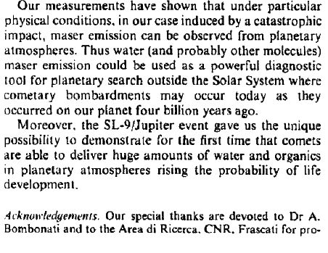
CONCLUSIONS

Slide 14
