Slide 1
Capstone Project
Telecom Churn Analysis
Team members
Tushar Hande Akshay Ambevadkar

Slide 2

Introduction
Churn is biggest problem for telecom companies because it is more expensive to acquire new customer than to keep your existing one free from leaving.

Slide 3
Objective
From customer historical data identify how many customers cancelled subscription.
Identify the factors that are responsible for churn using varies techniques in python.
Support the claim using data visualization techniques.

Slide 4
About Dataset
Given dataset is in the csv format.
Dataset has 3333 rows and 20 columns.
Dataset has no null values.
Target column is churn which notifies whether a particular
customer is churned or not.

Slide 5
More about data
Dataset
Churn
State
Voice mail plan
International plan
Number vmail messages
Total day minutes
Total day calls
Total day charge
Total eve minutes
Total eve charge
Total night minutes
Total night calls
Total night charge
Total intl minutes
Total intl calls
Total intl charge
Customer service calls
Boolean
Numerical
Categorical

Slide 6
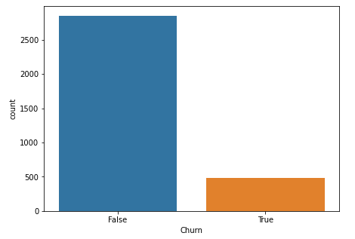
Target variable
From total observations
14.49 % are churned
and 85.51 % are not
churned

Slide 7
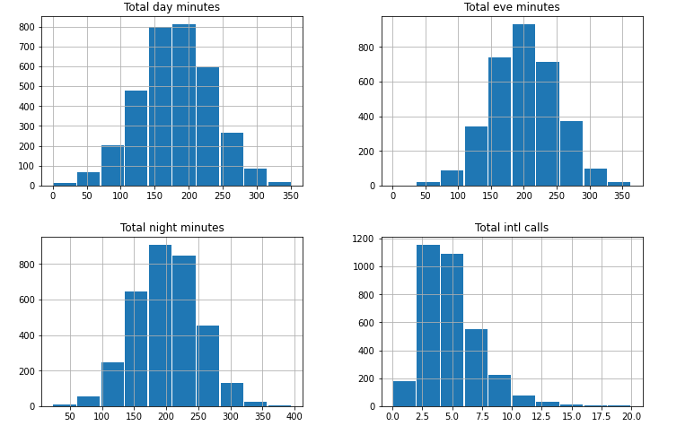
Histograms

Slide 8
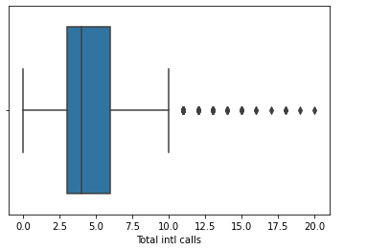
Boxplot

Slide 9
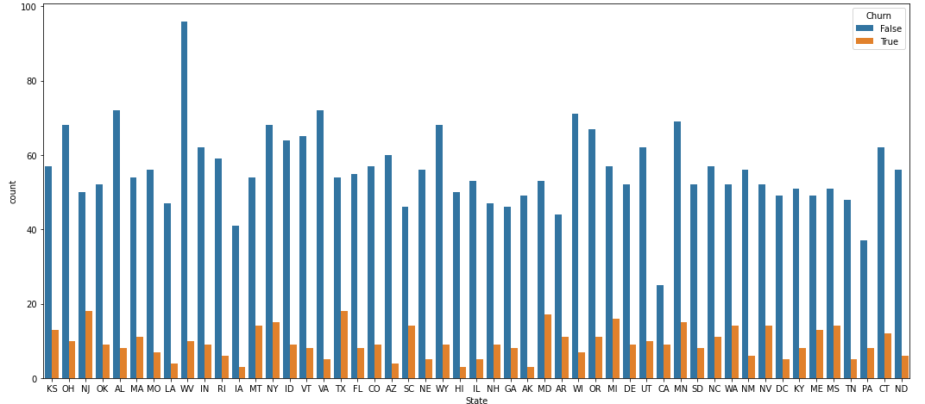
Churn and Not Churn For State

Slide 10
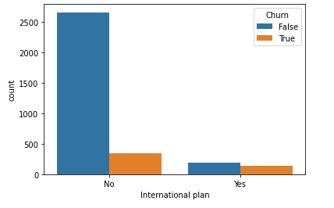
International Plan and churn

Slide 11
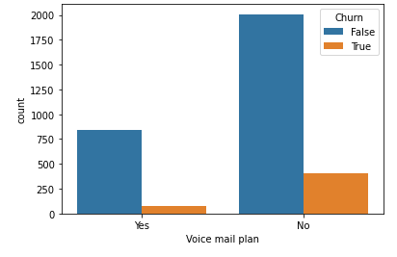
Voice mail plan and churn

Slide 12
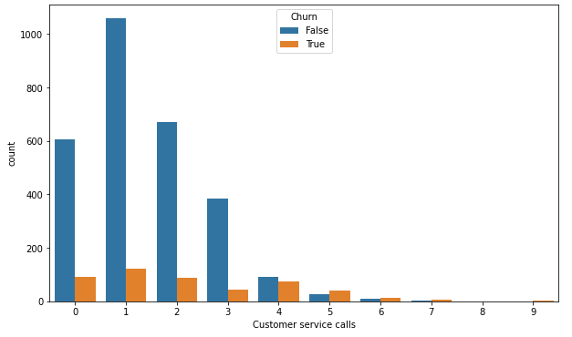
Customer service calls and churn

Slide 13
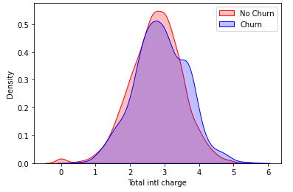
Total International charge and churn

Slide 14
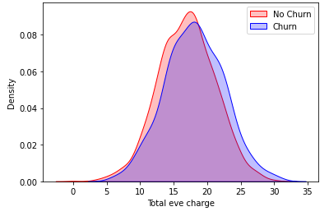
Total evening charge and churn

Slide 15
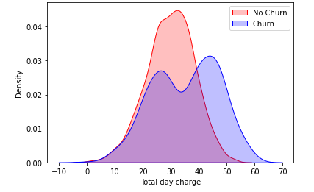
Total day charge and churn

Slide 16
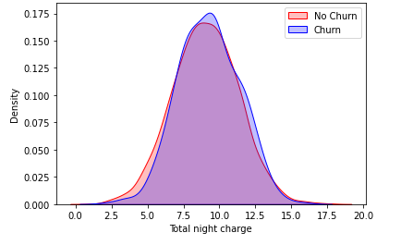
Total night charge and churn

Slide 17
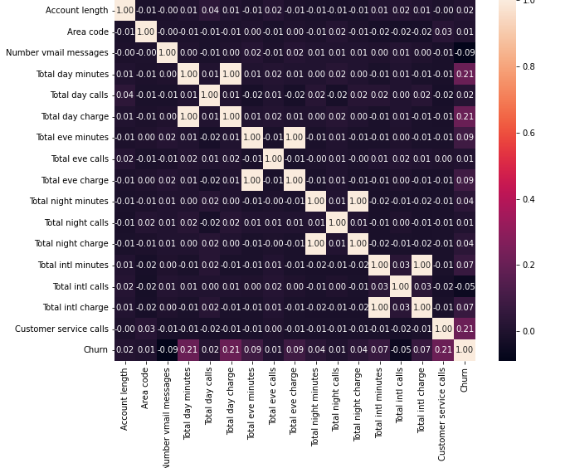
Heatmap

Slide 18
Conclusion
Data is highly biased 14% observations are churn and almost 51% not churn.
States where number of customers leaving higher are NJ, TX, MD , MI and NY
If the international plan is enabled, the churn rate is high.
Churn rate is also high after four or more customer service calls.
If total day/evening/international charge increase churn rate increases.

Slide 19
Challenges
Data set has many independent features selection important features from all independent features was the challenging part.
Plotting Kdeplot’s.
Computation time.

Slide 20
Q & A

