Slide 1
Welcome to OWASP Waterloo
Agenda:
15 min games and trivia (link - TBD)
5 min intro
30 min presentation and demo
10 min breakout (virtual drinks, Q&A and more)
15 min presentation wrap up
10 min retrospective/feedback (more virtual drinks, Q&A and more)

Slide 2
Container Security 101
Journey through the kubernetes threat matrix

Slide 3
TODO: Kubernetes 1000 foot view

Slide 4
Container Security 201
Journey through the kubernetes threat matrix

Slide 5
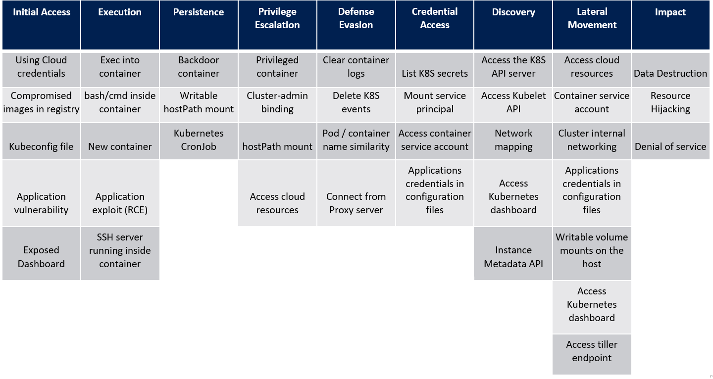
What is the Kubernetes Threat Matrix?
Why is this important?
Who does this apply to?
What can we do?
...
Source - https://www.microsoft.com/security/blog/2020/04/02/attack-matrix-kubernetes/

Slide 6
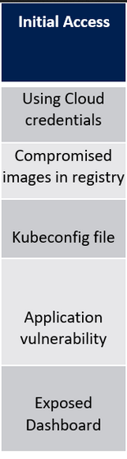

Initial Access:
Misuse Case [Application Vulnerability]
In our example, a malicious external user (Mallory) has discovered a vulnerability in our external facing service.
Mallory noticed that our service executes arbitrary commands passed as query parameters.
Mallory does not want to be identified so instead of directly exploiting, Mallory sets up a command and control server and creates a phishing email to send to Alice.

Slide 7
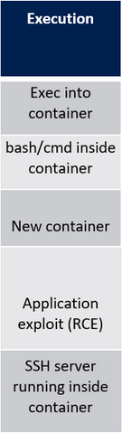
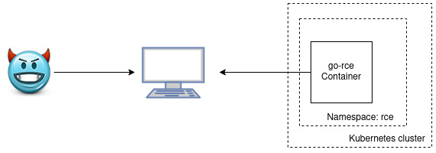
Execution
Alice clicks the link but is redirected to a benign website
Mallory checks the command and control server and notices that Alice has clicked the link in the phishing email. Mallory now has a reverse shell opened to the vulnerable container.

Slide 8
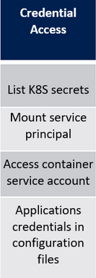
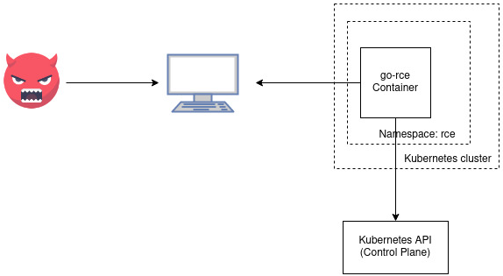
Credential Access
After some recon work, Mallory discovers the container has a service account token and Mallory uses the token to authenticate to the kubernetes api
Unfortunately for Mallory the service account permissions have been limited and can only be used to issue certificates

Slide 9
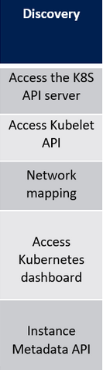
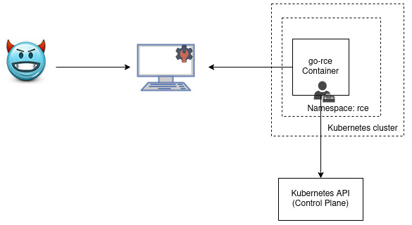
Discovery
Mallory generates a client certificate request with cluster admin permissions and uses the kubernetes api server to sign the certificate request
Mallory uses the client certificate to escalate permissions in the cluster and is now able to create, update, delete any resource in the cluster.

Slide 10
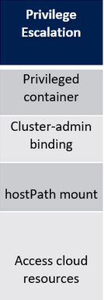
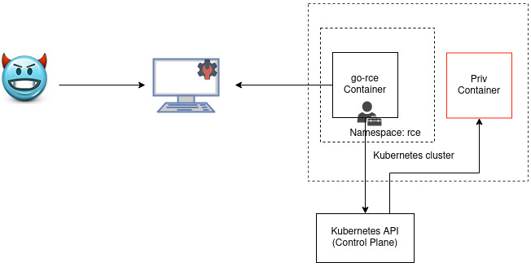
Privilege Escalation
Mallory creates a privileged container with a hostPath mount to run inside the cluster

Slide 11
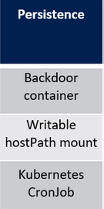
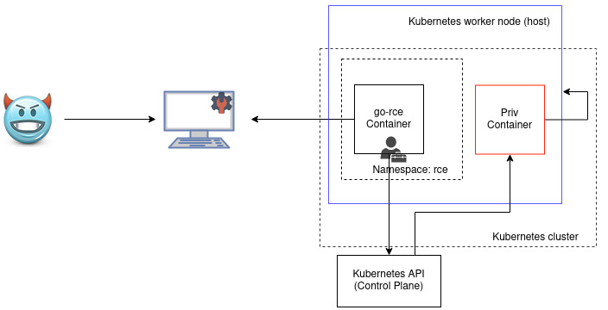
Persistence
Mallory uses the privileged container with hostPath to breakout of the container and access the kubernetes nodes (hosts)

Slide 12
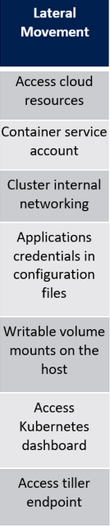
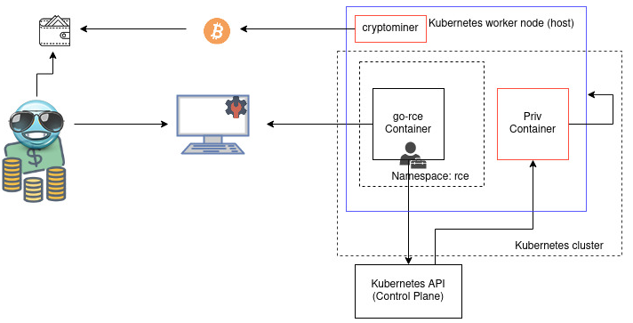
Lateral Movement
Mallory begins to deploy a series of cryptominers across the various kubernetes nodes (hosts) and uses the host network to further exploit internal assets for profit

Slide 13
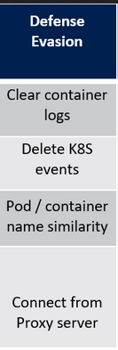
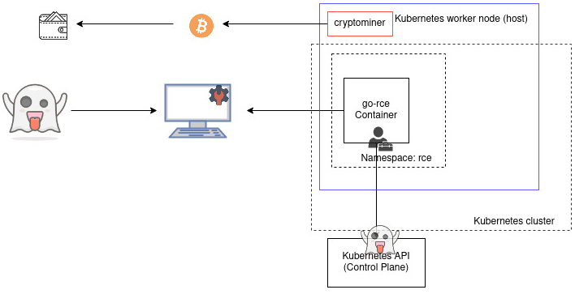
Defense Evasion
Mallory removes the privileged container and clears all events from the kubernetes cluster

Slide 14

Breakout:

Slide 15
How to address the threats
Build secure images
Use slim and minimal base images, where possible
Use multi-stage builds to avoid adding unnecessary binaries, libraries, files, etc.
Scan images and applications for security vulnerabilities
Ensure binary authorization
Restrict access to container registries and use only verified images (ie. Cryptographically signed images, OPA policies, etc. )
Remove unnecessary capabilities
Ensure securityContext is applied to ensure pods are running as non-root, with appropriate capabilities and read-only filesystems where possible.

Slide 16
How to address the threats
Apply least privilege access
Apply RBAC policy and limit access to service accounts
OPA policies
Take caution with sensitive mount points
Avoid mounting service account tokens and 'hostpath', especially for pods that are exposed to lower environments (ie. internet facing, accessible form uat, dev, etc..)
Segment, Segment and Segment
Namespaces
Use namespaces to logically group workloads but do not assume namespaces provide sufficient workload isolation.
Network policies
Service mesh
Secure control plane

Slide 17
Additional
Apply least privilege access
Apply RBAC policy and limit access to service accounts
OPA policies
Take caution with sensitive mount points
Avoid mounting service account tokens and 'hostpath', especially for pods that are exposed to lower environments (ie. internet facing, accessible form uat, dev, etc..)
Segment, Segment and Segment
Namespaces
Use namespaces to logically group workloads but do not assume namespaces provide sufficient workload isolation.
Network policies
Service mesh
Secure control plane
Don’t co-tenant with lower environments (ie. dev, uat, etc)

Slide 18
Feedback
OWASP Waterloo Chapter leads
Scott Handfield (scott.handfield@owasp.org)
Kristopher Jamieson (kristopher.jamieson@owasp.org)
Meetup
https://www.meetup.com/owasp-waterloo-meetup-group/
Github (Code from this presentation)
https://github.com/handfields/go-rce-kubernetes

Slide 19

Thank you!
Hope you Enjoyed this presentation.
(Please stick around for retrospective/feedback, Q&A, etc)

