Slide 1


Joeseph H. Pennycook
Closest thing to ecology within 800 metres
Jamie FitzGerald
jamie.fitzgerald@teagasc.ie
jamie.fitzgerald@ucc.ie
Vision 1 lab
Teagasc Moorpark
PI: Prof. Paul Cotter

Slide 2
Q1: is there signal in there?
Q1: is there signal in there?
Outline
Jamie’s question – how good can we get?
Joeseph’s question – is there anything usable in this sequence data? (prime dir)
A
Variable and strange assignments via mothur
Second tranche of sequencing ordered (GW)
Similar results
Is the ExpEr in the lab, or the sequencing?
Assess in F/MQC and see if issue with amplicons
Progress to DADA2 to see where assignments land
Is there seqeunce in there?

Slide 3
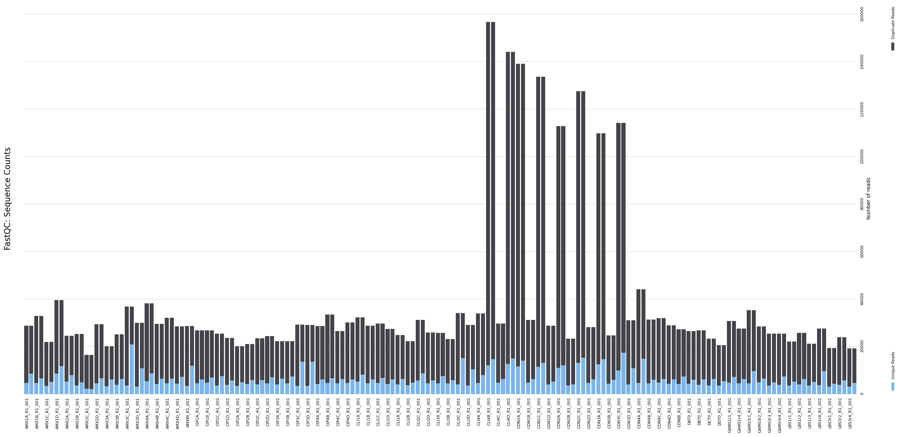
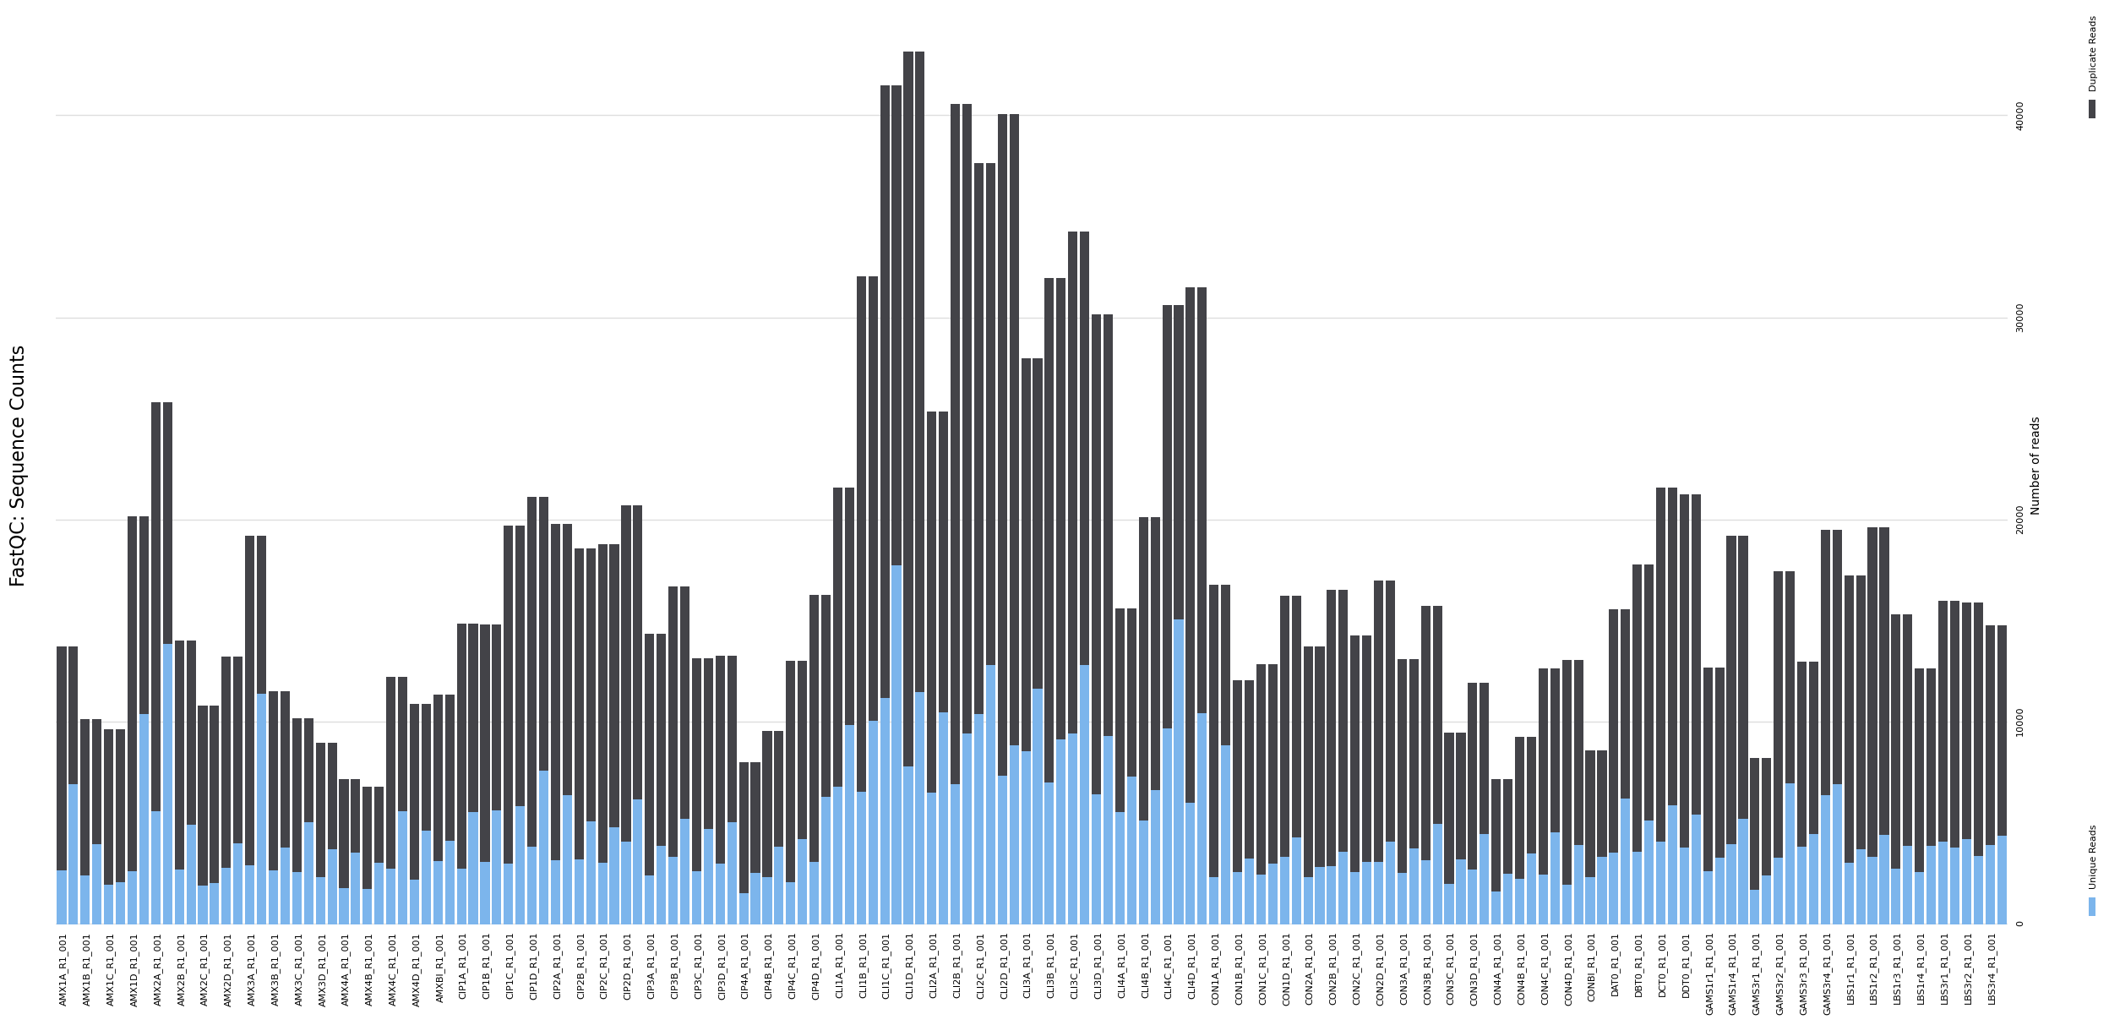
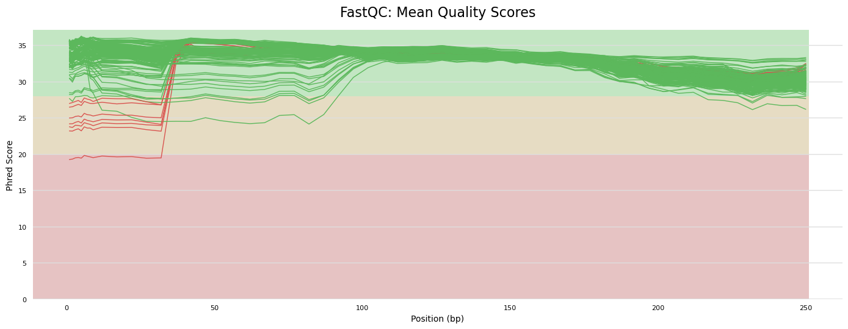
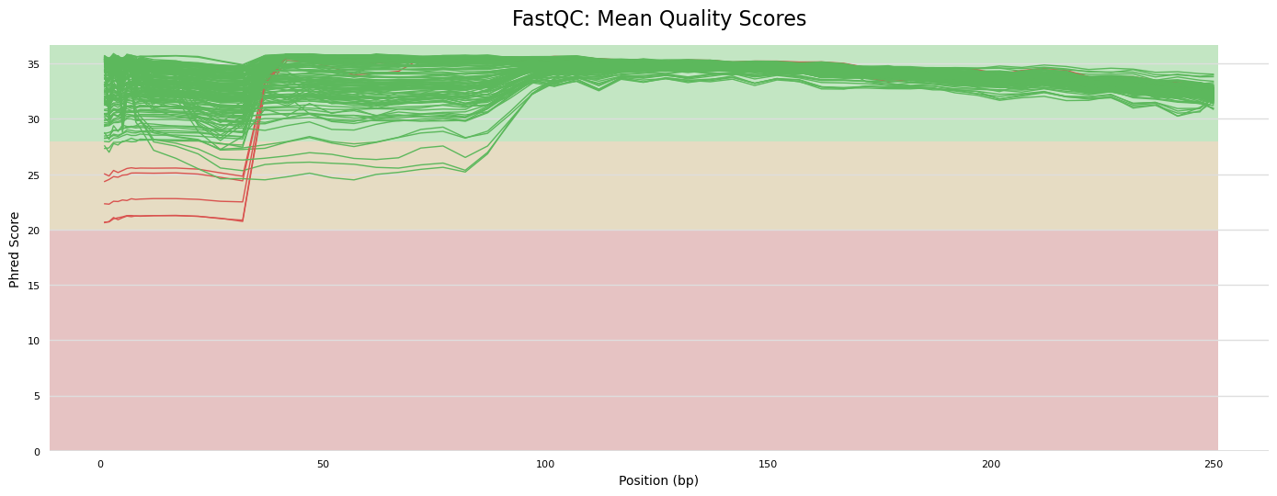
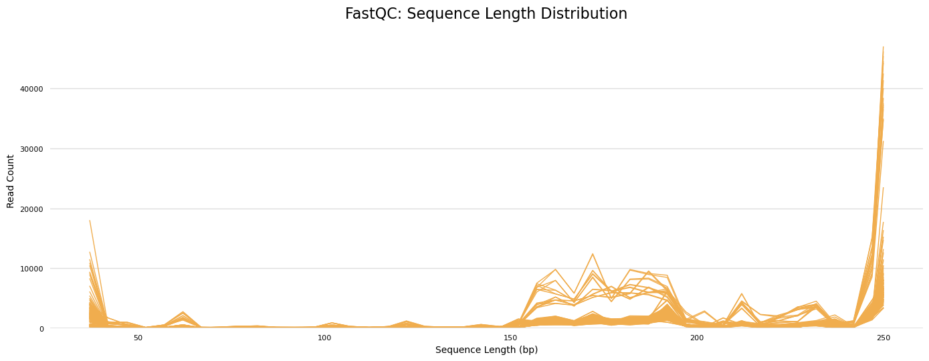
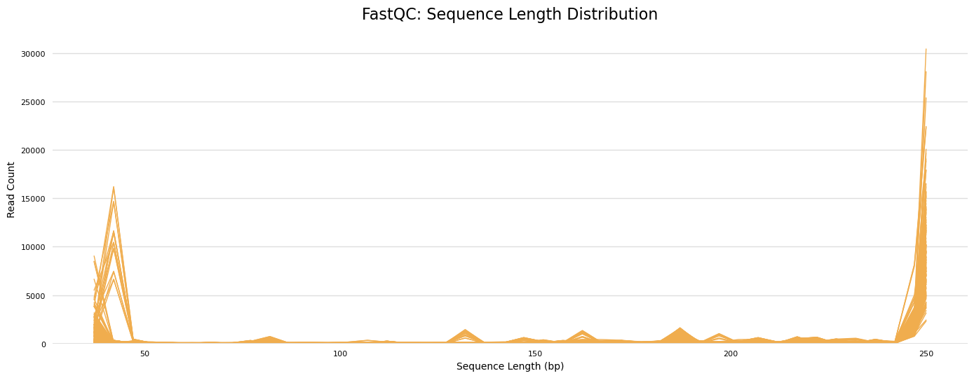
Q1: is there signal in there?
QC
Tranche 1 (nreads (y: 0-160K), qual, length) ;
Tranche 2 (nreads (y: 0-40K), qual, length)
A
Initial QC from both Tranche 1 & 2 appear similar: quality is very high, but length is low for GW (should be 301bp, is 0-250bp)
Quality suggests these are not raw sequences, but have been QC’d – too uniform too high
Additionally, lengths are all over the place
Variable lengths are problematic for FIGARO
Need to unify

Slide 4
Q1: is there signal in there?
QC - ameliorate
Sample 81 - 2958 reads in 1624 unique sequences.
Sample 82 - 4420 reads in 2464 unique sequences.
Sample 83 - 3282 reads in 1997 unique sequences.
> dadaRs <- dada(filtRs, err=errR, multithread=TRUE, pool = d_pool)
Sample 1 - 4010 reads in 2885 unique sequences.
Sample 2 - 4154 reads in 2948 unique sequences.
Sample 3 - 2968 reads in 1976 unique sequences.
[...]
Note unique reads are about half of total reads – can’t remember if this is the norm, but in any case it could simply be the result of sparse communities.
Note also the profile for the samples with “high” content:
Sample 47 - 32822 reads in 22323 unique sequences.
Sample 49 - 34650 reads in 24143 unique sequences.
Sample 50 - 37053 reads in 25604 unique sequences.
Sample 52 - 30280 reads in 19751 unique sequences
Same idea, but much larger quantities. Opposite of what we want (big seq with small uniqs) These probably the stool material
Looks much better when mergePairs’ d:
2349 paired-reads (in 84 unique pairings) successfully merged out of 3429 (in 163 pairings) input.
2203 paired-reads (in 102 unique pairings) successfully merged out of 3232 (in 170 pairings) input.
2240 paired-reads (in 73 unique pairings) successfully merged out of 3113 (in 129 pairings) input.
A
T1 seqs deadapted and trimmed to 245 (cutadapt)– this removes about 1/3 of all reads.
T2 seq length distrib could be better to work with?
However, keep moving with cutadapted T1 reads as processed – is there signal in there?

Slide 5
Q1: is there signal in there?
Taxa - check
Is it possibly because our Figaro settings are too permissive? Quite possibly. Worth plotting out what these parameters look like.
At overlap = 35...:
A
T1 – doing the fAT step manually does little to improve situation. If anything, inflates the sub-target reads (from reading histogram – could also be that it decreases spurious counts at the peak lenght, making off-peak seem higher..
At l=345, much of the data is attributed to the mitochondria via Alphaprot:...Ricketssia? Or similar. Nevertheless, there is a large cohort of gut assoc’s., but these assignments should be treated with caution, and most remain uncharacterised. DECIPHER is totally empty.

Slide 6
tasklists
Community Analysis
Alpha Diversity
Obs / Shan / ISimp / Faith’s / SeqDepth
Alpha div testing
Beta Diversity
Dissimilarity : BC, Jacc, Euc, ...
In/direct gradient analysis: cmdscale, metaMDS v. cca, rda
ADONIS / betadisper of dissims ; subsets as necess
Clustering: k-means as above, DMM
Abundances
Barchart
Heatmap
Differential abundance
Normalisation
Transformation
Lm engines
Lm + env_var testing
Association
Correlations
Proportionality
Summary
Findings (results)
Outcome (conclusions)
Correlations
A
Data types:
Taxonomy
Amplicon
Kraken / Kaiju / Other...
Phylogenetics?
Function
PICRUSt2
HUMAnN2/3
ARG / Vir
Direct
shortbred
Strain mapping
Wtf knows
ANI comparisons
Study Assessment
Outline / explanator
Sample characterisation
env_var and PCAs
Quality Control
Fast/MultiQC, rarefaction curves, amp/read length, ...

Slide 7
To Do
A
Do we even believe in results

