Slide 1
TBM with ANTs
Reorient from Sagittal to Axial
Image Crop/Trim [SMP8] (using cropimage.m)
Segment [SPM12]
Image Overlay [SPM12] – Realign Longitudinal data
3D to 4D transformation
Normalization [SPM12]
Apply Deformation [SPM12]
ANTs (using synbatchmake_maskfiles.m)
Apply Deformation – Jacobian [SPM12]
ROI Analysis [SPM12]

Slide 2
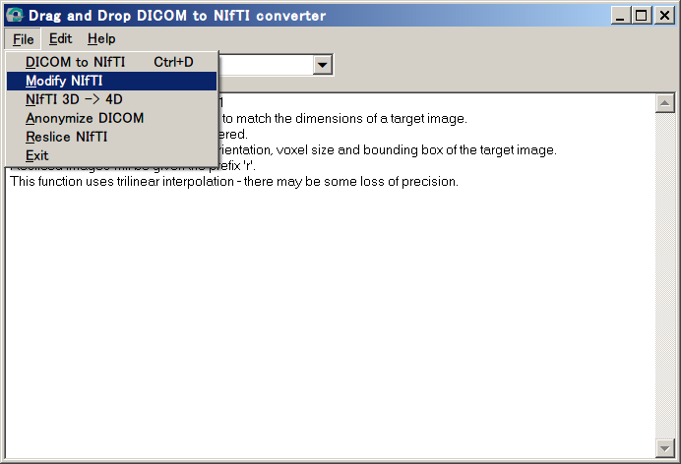
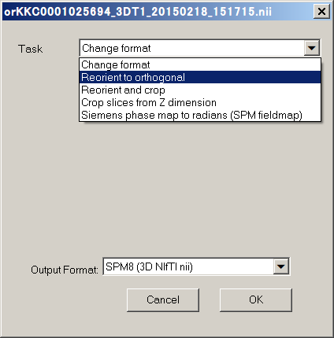
Reorient from Sagittal to Axial
This step can process multiple images simultaneously
RUN dcm2niigui.exe from mricron
File → Modify NIfTI → Select image(s) [*.nii]
Task: Reorient to Orthogonal
Output Format: SPM8 (3D NIfTI.nii)
[Output Files: o*.nii]

Slide 3
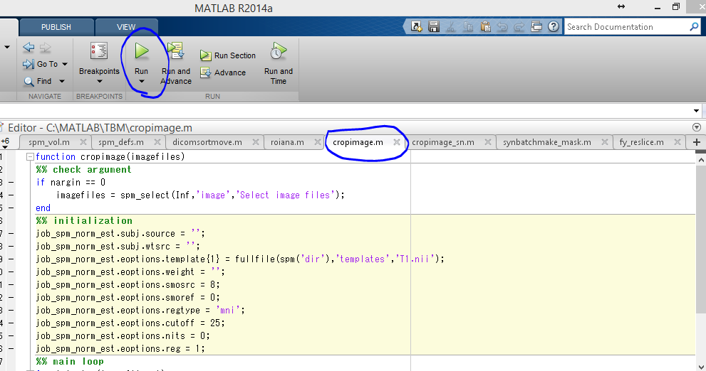
1. Image Crop/Trim (using cropimage.m) SPM8
[SPM8 only]
This step can process multiple images simultaneously
OPEN and RUN cropimage.m in MATLAB
Select files: select both BASELINE images (o*.nii) and new images (o*.nii)
[Output Files: o*_sn.mat, cropped*.nii]

Slide 4
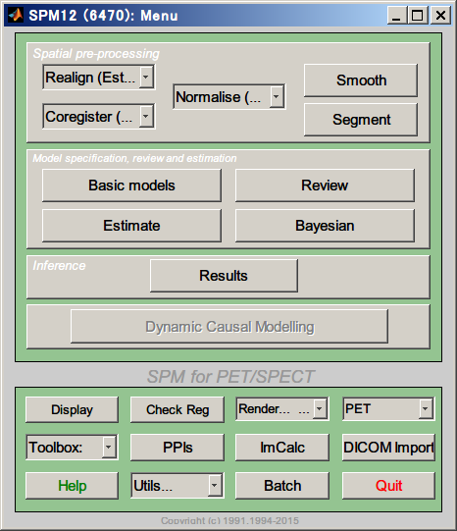
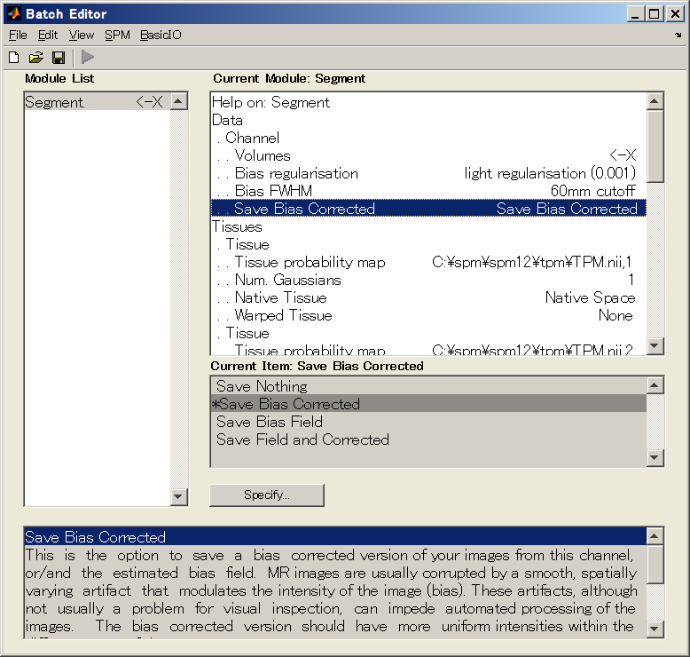
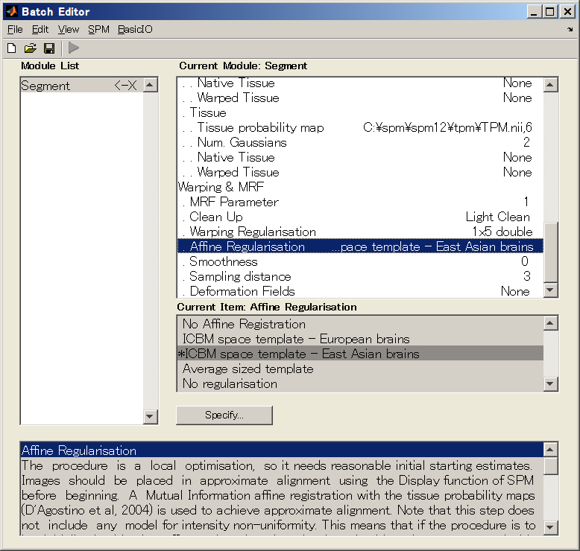
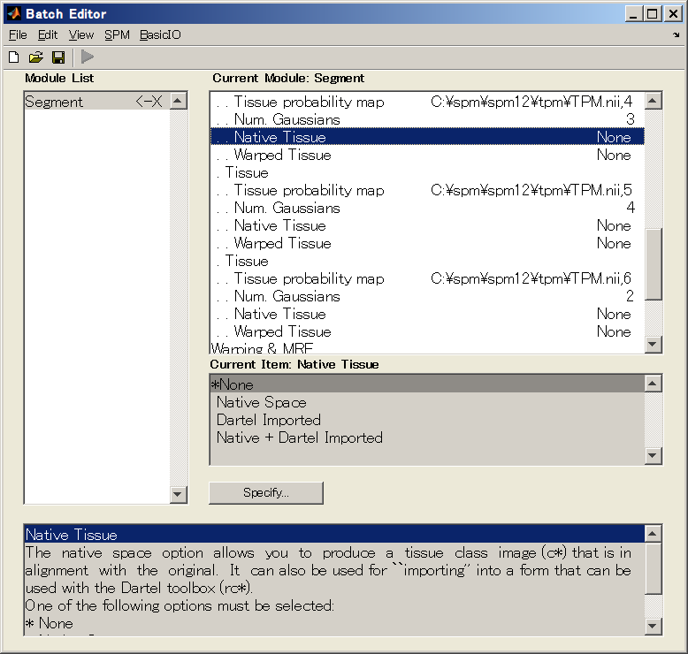
2. Segment [SPM12]
[SPM12]
This step can process multiple images simultaneously
OPEN “Segment” from SPM12 in MATLAB
Select files: select both BASELINE images (cropped *.nii) and new images (cropped *.nii) → VOLUMES
[Output Files: mcropped*.nii, c1crop*.nii, c2crop*.nii, c3crop*.nii]
Save Bias Corrected
None
None
ICBM space template - East Asian brains

Slide 5
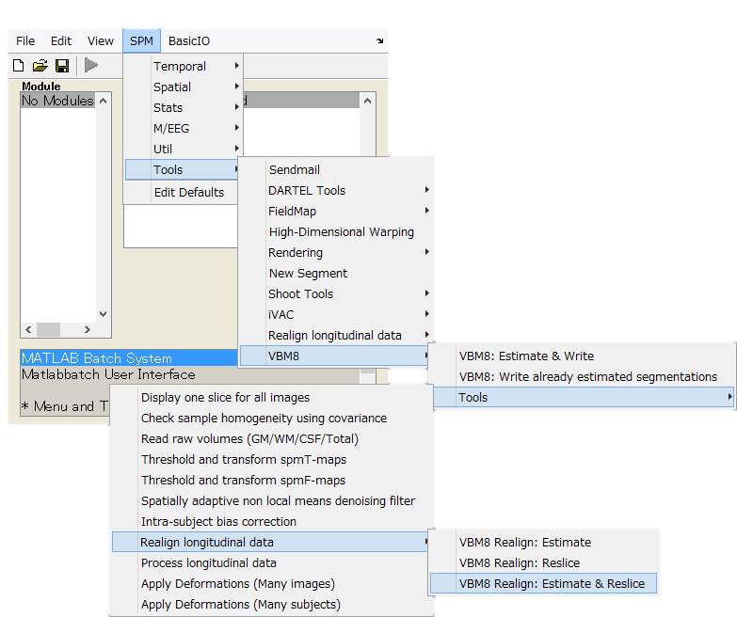
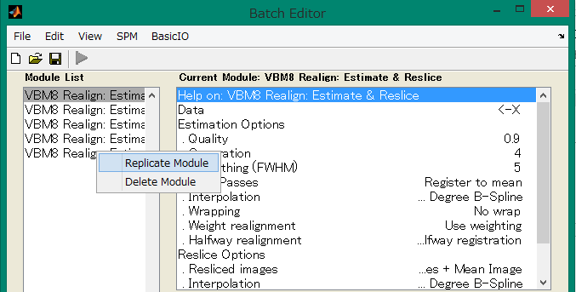
3. Image Overlay – Realign Longitudinal data
[SPM12, VBM8]
This step can process multiple set of data simultaneously
OPEN: Batch Editor → SPM → Tools → VBM8 → Realign longitudinal data → VBM8 Realign: Estimate & Reslice
Select: Data → Session, Put (mcropped*.nii) files, old first as baseline then new file.
Check meano*.nii files, since it is combined from 2 images, if there is a mistake (data from different persons) there will be big differences
Repeat for all pairs of data
[Output Files: rmcropped*.nii, rp_mcrop*.txt, meanmcrop*.nii]
×500人

Slide 6
3D to 4D transformation
[SPM12, VBM8]
This step can process multiple set of data simultaneously
OPEN: Batch Editor → SPM → Util→ 3D to 4D convertion
Select 3D volumes. Baseline and coregister images (rmcropped*.nii)
Change output file name if needed.
Do one pair at a time
The output image is used for quality check only
[Output Files:]

Slide 7
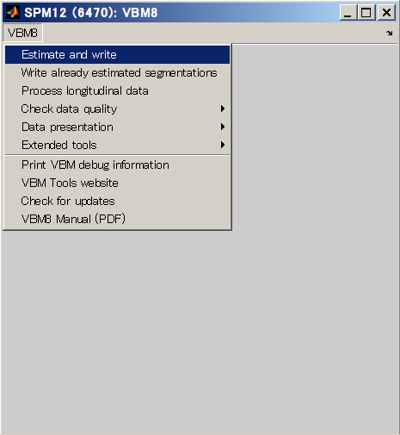
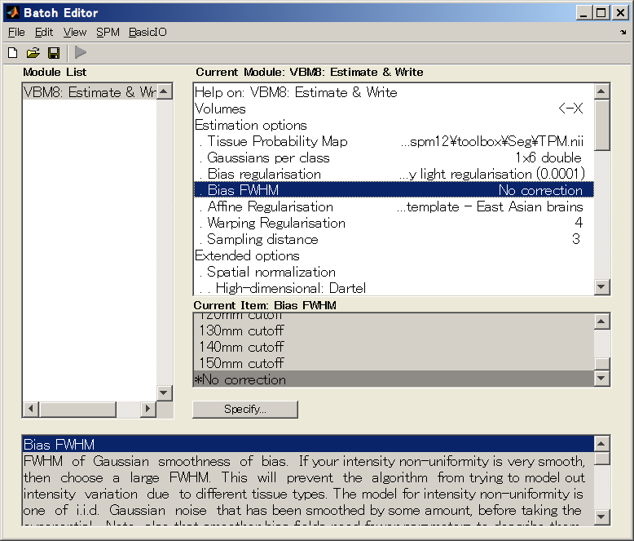
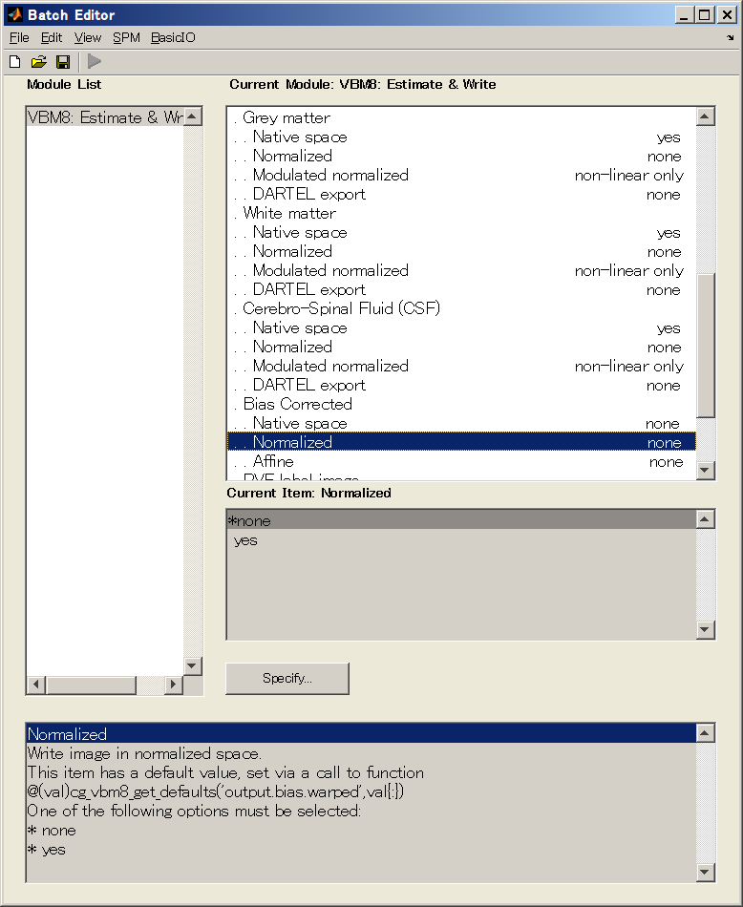
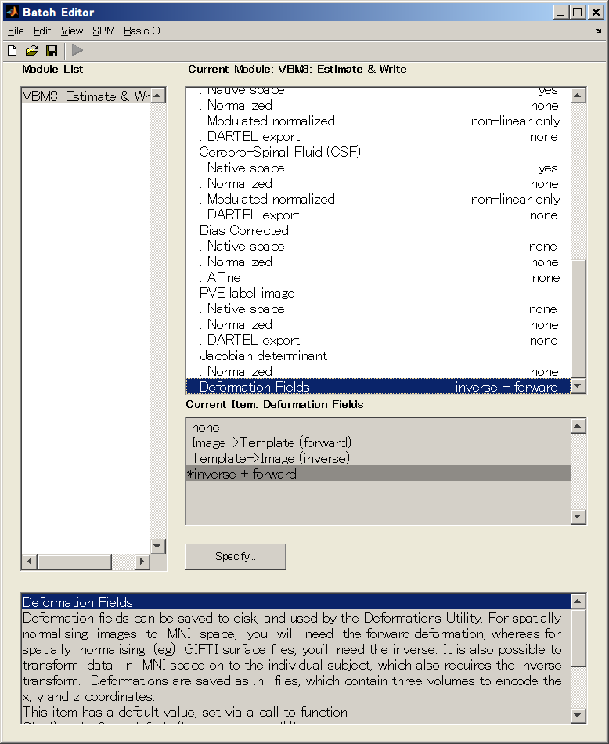
4. Normalization
[SPM12, VBM8]
This step can process multiple set of data simultaneously
Batch editor → SPM → Tools → VBM8 → VBM8: Estimate & Write
Select re-sliced data from step 3 (rmcropped*.nii) in the volumes (baseline only)
Affine Regularization: European → East Asian
[Output Files: iy_rrmcropped*.nii , y_rrmcropped*.nii, m0wrp3*.nii]
No correction
ICBM space template - East Asian brains
yes
yes
yes
non-linear only
none
Inverse + forward

Slide 8
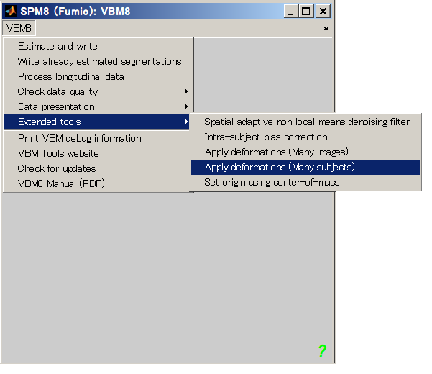
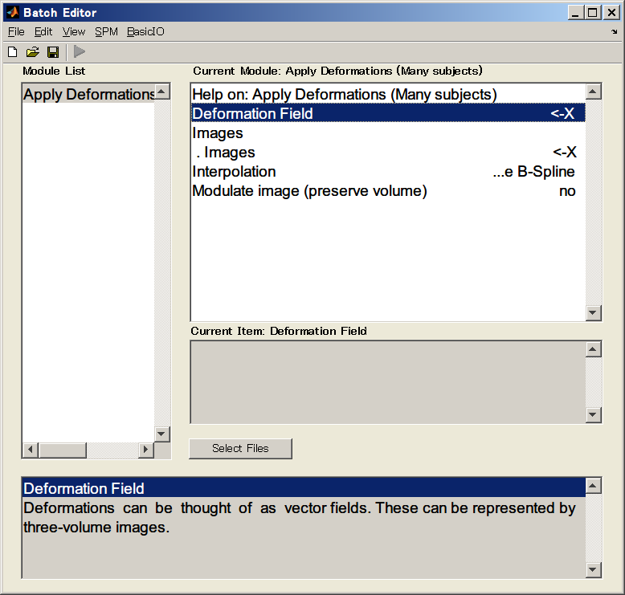
5. Apply Deformation
[SPM12, VBM8] – add path, /spm12/compat
This step can process multiple set of data simultaneously
Extended tools → Apply deformations (Many Subjects)
Select deformation field images from step 4: iy_rrmcropped*.nii
Select new images: mask_ICV.nii
Interpolation -> Trilinear
Mask_ICV can be found inside TPM folder inside SPM12 folder
Since for each repetition, the file output name wmask_ICV.nii will be produced inside TPM folder thus it is adviced to copy the mask_ICV.nii to each of the respective data’s folder. If not, after each process the file wmask_ICV need to be renamed and moved.
[Output Files: wmask_ICV.nii]

Slide 9
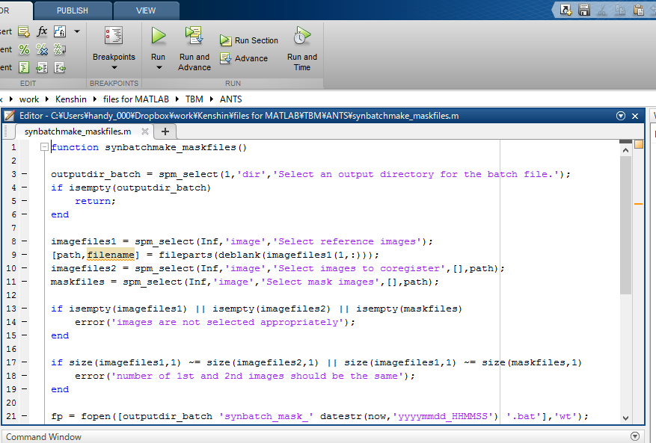
6. ANTs (using synbatchmake_maskfile.m)
[SPM12]
This step can process multiple set of data simultaneously
https://sourceforge.net/projects/advants/files/ANTS/ANTS_Latest/
Install ANTs ver 1.9 first
Open and Run the synbatchmake_maskfiles.m from TBM -> ANTS folder
Choose an output folder to put the batch file
First, select the cropped baseline from step 3 (rmcropped*.nii)
Second, select the cropped coregister image from step 3 (rmcropped*.nii)
Third, select the (wmask_ICV.nii) created from step 5
Open the selected output folder and RUN the batch file (roughly will take 18mins each)
[output files: j_1*logjacobian.nii.gz, j_1*grid.nii.gz, j_1*jacobian.nii.gz, 2n*.nii, 1s*InverseWarp.nii.gz, 1s*Warp.nii.gz, 1s*Affine.txt]
* Do not forget to unzip the j1*jacobian.nii.gz to get the *.nii file

Slide 10
7. Apply Deformation - Jacobian
[SPM12, VBM8]
This step can process multiple set of data simultaneously
Extended tools → Apply deformations (Many Subjects)
Select deformation field images from step 4: y_rrmcropped*.nii
Select new images: j*Jacobian.nii
Interpolation -> Trilinear
[Output Files: wj*jacobian.nii]

Slide 11
8. ROI Analysis [SPM12]
[SPM12]
This step can process multiple set of data simultaneously
Change the MATLAB path from SPM8 (delete) to SPM12 (add)
Open and Run: MATLAB>VBM> calcatlas_csfexc_jac.m
Select CSF: m0wrp3*.nii
Select Jacobian: wj_1st*Jacobian.nii
Select Atlas: spm12 > tpm > neuromorphometrics
Select Output Folder – recommend to separate folders for each repetition
Repeat 1 to 4 with: Select Atlas: spm12 > tpm > neuromorphometrics_lobes
Repeat 1 to 4 with: Select Atlas: spm12 > tpm > neuromorphometrics_ROI
[Output files: mwp3*csf0.nii, labelledbrainjac*.txt, labelledbrainjac_shrinkonly*.txt, labelledbrainvol.txt]

Slide 12
Quality Check
KKC*.nii
Rmcropped*.nii
P1*nii
P2*.nii
P3*.nii
M0w*p1*.nii
M0w*p2*.nii
M0w*p3*.nii
*_csf*.nii

