Slide 1
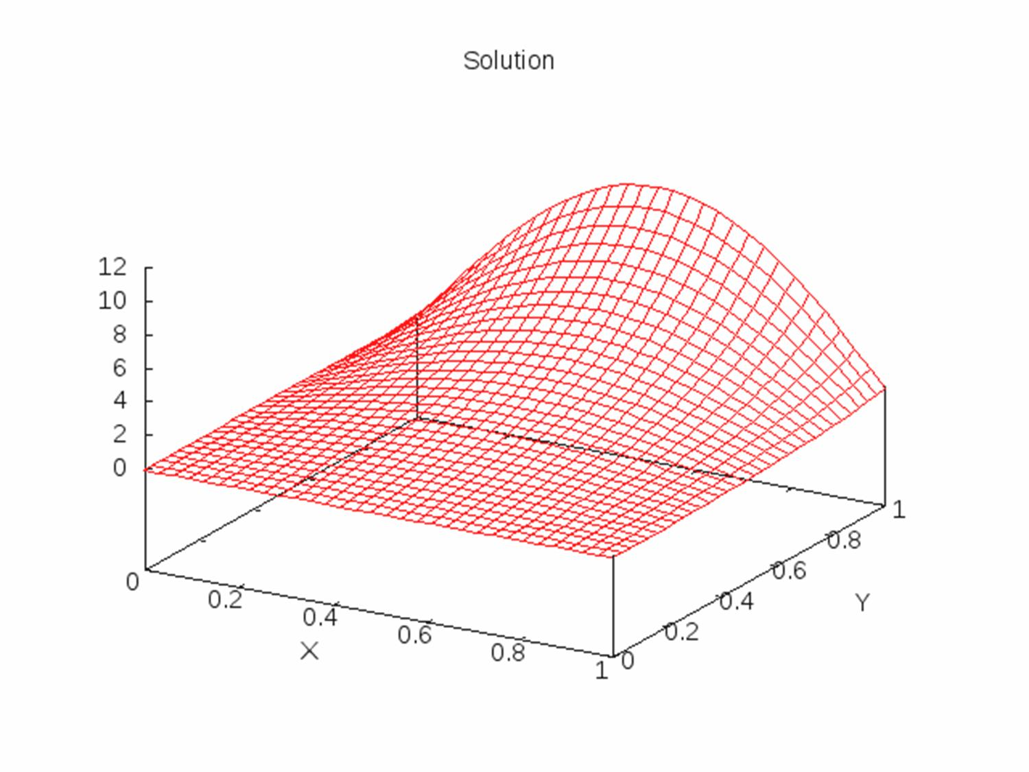
Full Multigrid
Sam Nees
Khoa Nguyen
Yigit Akgok

Slide 2
Full Multigrid (FMG)
v2
v1
Interpolation
Restriction
Level 4 (finest)
Level 3
Level 2
Level 1 (coarsest)

Slide 3
v2
v1
Interpolation
Restriction
Level 4 (finest)
Level 3
v_cycles
v_cycles
Level 2
Level 1 (coarsest)

Slide 4
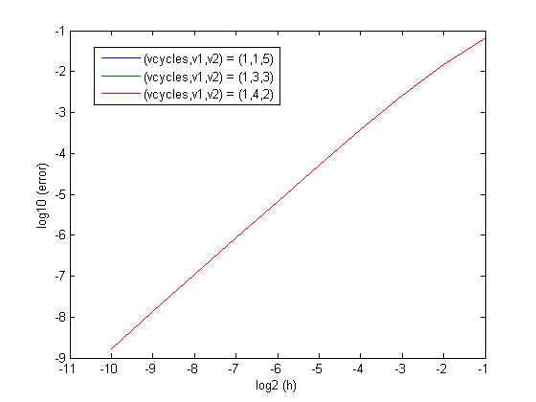
Error is the same when (v1+v2) = const

Slide 5
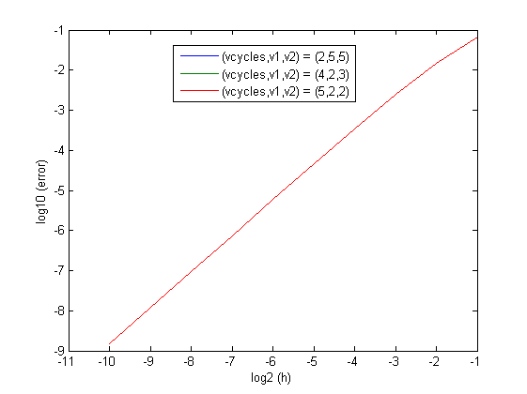
Error is the same when vcycles*(v1+v2) = const

Slide 6
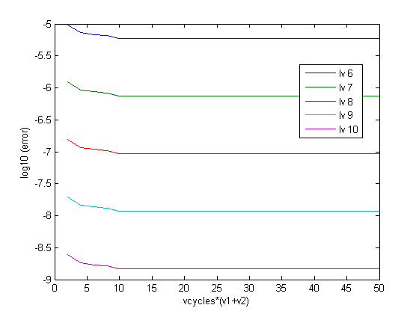
Errors for different vcycles*(v1+v2)
The error decreases by a factor of 10 for each level
Large vcycles*(v1+v2) does not improve the error significantly. Hence choosing big value of vcycles*(v1+v2) does not pay off
Discretisation error reached

Slide 7
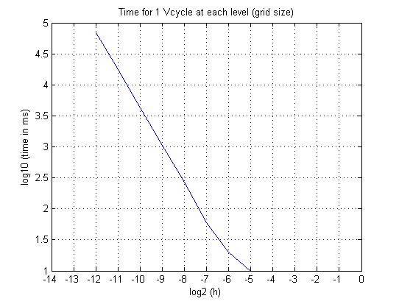
Time execution
The time spent on 1 Vcycle at a finer level is approx. 10^0.6 times greater than the coarser level
So important to do as much of the work as possible on the coarser levels

Slide 8
Observations
To achieve the error at 10^(–n) requires refining the grid to at least (n+1) level
One Vcycle at a finer grid cost a factor of 10^0.6 of time as much as at coarser level.

Slide 9
Parallelization
Identify hotspots
  Red black Gauss Seidel sweep
  Calculate residual
  Interpolation
Parallelization the hotspot (OPENMP)
Result

Slide 10
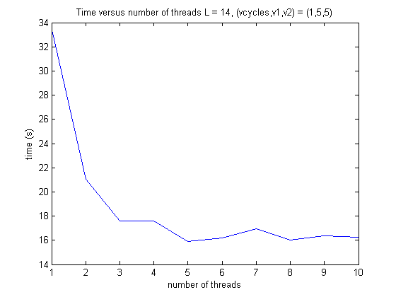
Result

Slide 11
Summary
Implementation of Full Multigrid
Optimization of the code
Parallelization of the code
Performance

Slide 12
Thank you

