Slide 1
Where do our ideas about the brain come from?
Major historical developments
Modern Approaches
Current Questions

Slide 2
Very Early Ideas
Aristotle (ca. 350 BC)
- brain was an organ of cooling
- heart was the source of our intellect
- he made decisions based on reason, not on experimentation
Herophilus (ca. 300 BC)
- brain is the organ of reason
- based on dissections: could see eyes connect to
brain; nerves connecting brain to muscle
- lived in Alexandria – dissection allowed there

Slide 3
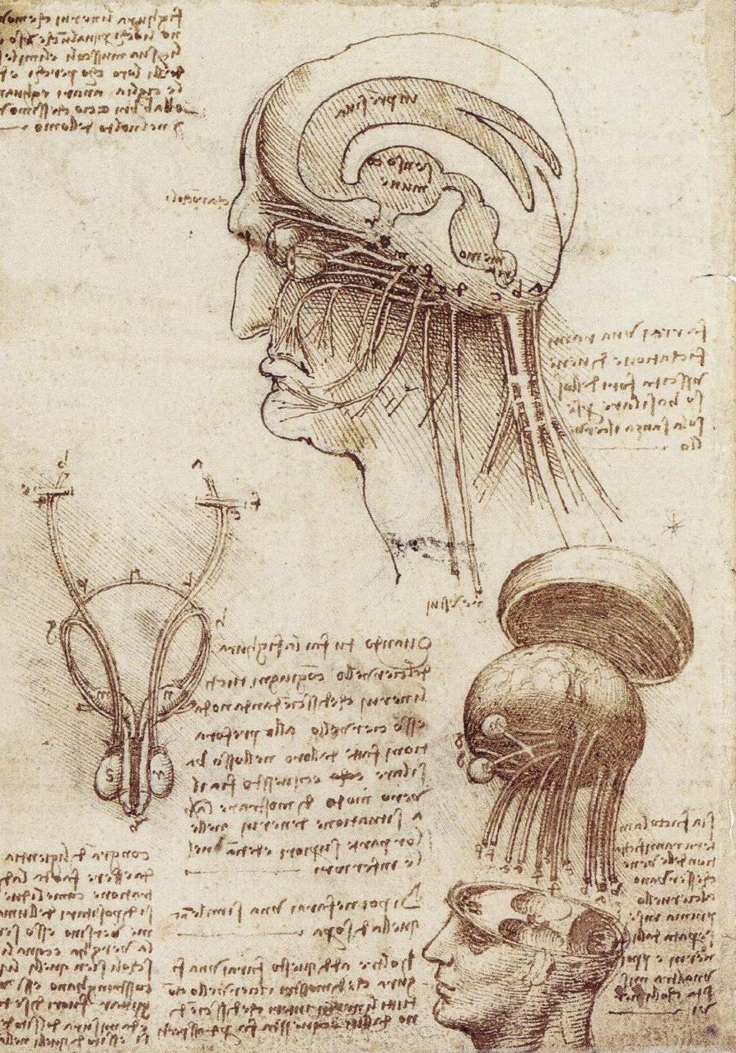
Renaissance
Leonardo da Vinci (ca. 1500)
- made dissections and drawings that improved
our knowledge of brain anatomy
- not all of it was totally accurate

Slide 4
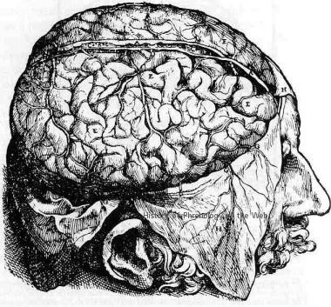
Renaissance
Andreas Vesalius (ca. 1550):
- made dissections and accurate drawing
(with other artists) of brain
- big advance in accuracy

Slide 5
Cell Theory
Antony van Leeuwenhoek (late 1600s) – the improved microscope
Theodor Schwann and Matthias Schleiden (early 1800’s)- Cell theory:
All living things are made of cells
Cells beget cells

Slide 6
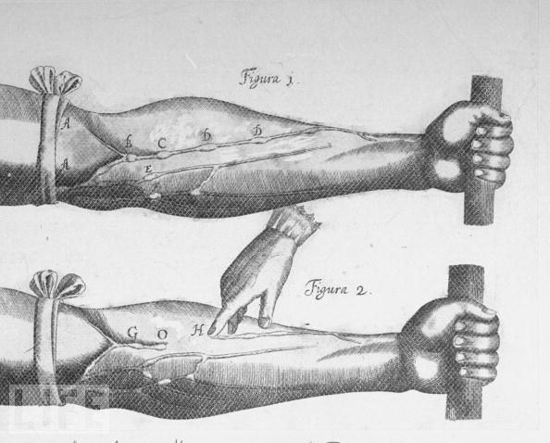
William Harvey (ca. 1620)
Not a brain guy, but his important contribution was the introduction of experimentation

Slide 7
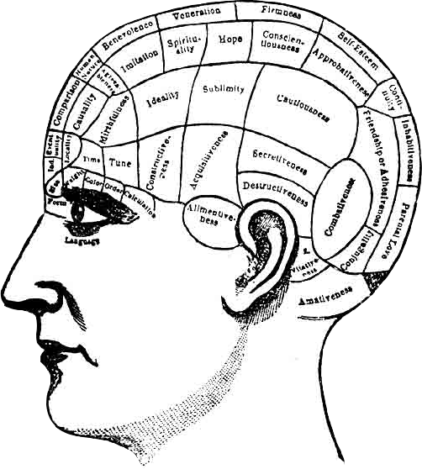
Franz Joseph Gall (early 1800’s): Phrenology
good: introduced the idea of
localization of function
bad:
-wrong/bizarre functions
- method doesn’t work

Slide 8
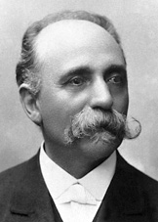
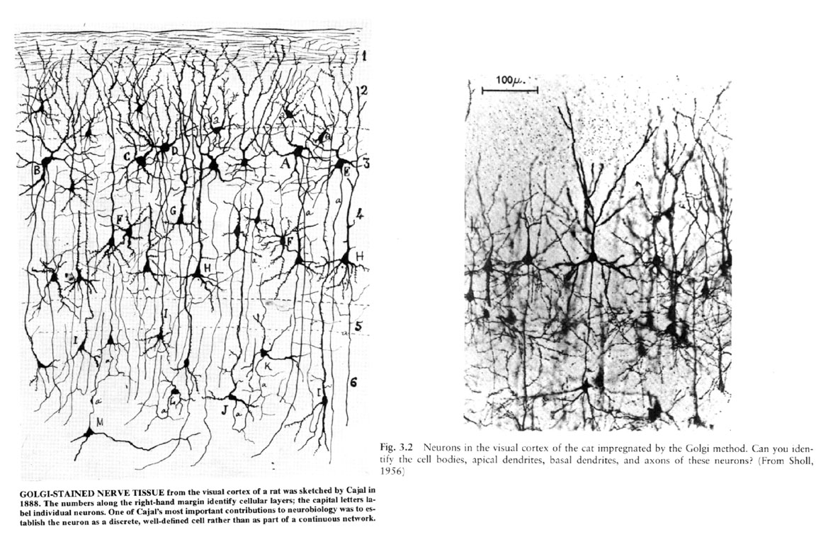
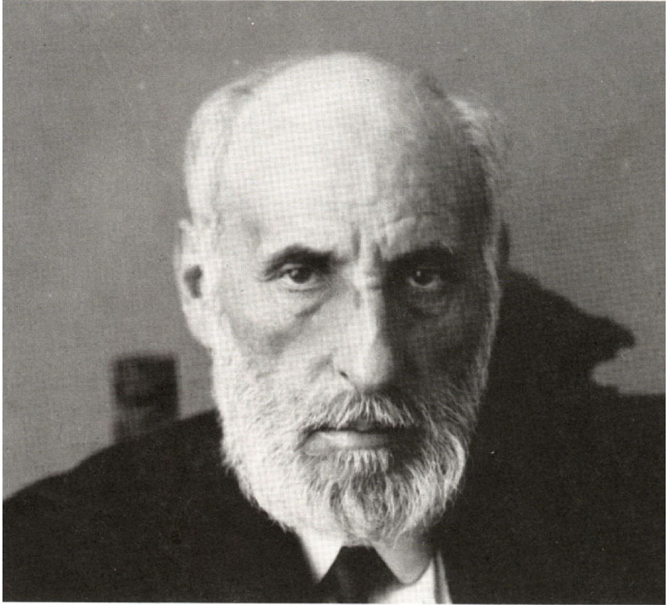
Is the brain made of cells?
Camillo Golgi and Santiago Ramón y Cajal (ca. 1900)
Golgi
drawing
photo
Cajal

Slide 9
Neuron Theory
The nervous system is made of cells called neurons
Information flow goes from dendrite to soma to axon

Slide 10
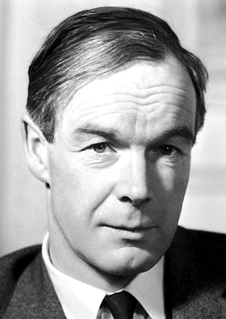
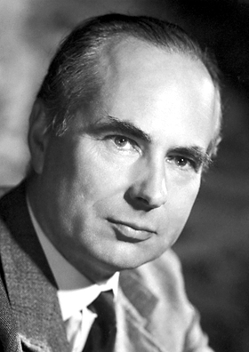
Hodgkin and Huxley (1930s-1950s)
The electrical basis of neuronal signaling
A.L. Hodgkin
A. F. Huxley

Slide 11
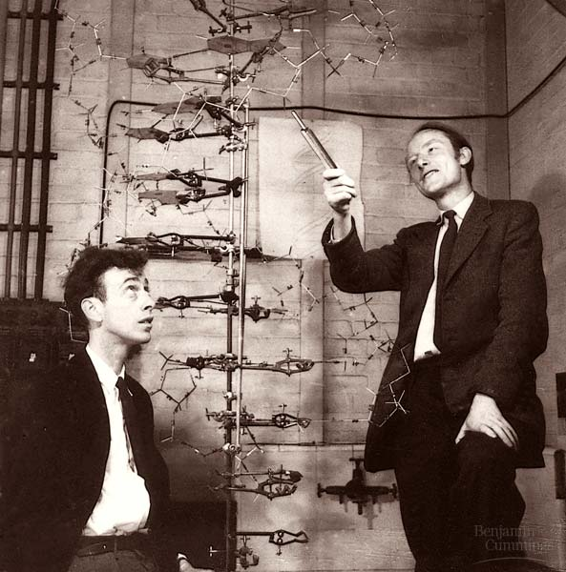
Watson and Crick (1953)
The structure of DNA

Slide 12
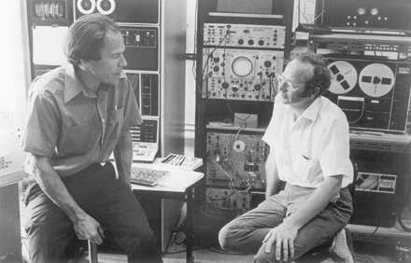
Hubel and Wiesel (1950’s-1970’s)
Signal processing in the visual system

Slide 13
Neuroscience is Interdisciplinary
Biology
- Cellular/Molecular
- Developmental
- Systems (anatomy and physiology)
- Behavioral
Psychology
- Behavioral
- Cognitive
Chemistry
Medicine
- Neurology
- Psychiatry
Philosophy
Physics

Slide 14
Current Questions in Neuroscience
Consciousness
Plasticity
Neurodegenerative diseases
Mental Illness
Neuroethics
Many more

Slide 15
Ways of Knowing in Neuroscience
1. Experimental Approaches
Manipulating the activity of the brain:
neurotransmitters, enzymes by drug administration
hormones
genes
gene expression
optogenetics
indwelling stimulating electrodes
controlling the subject’s behavior
controlling the subject’s environment and sensory input
Measuring brain function:
electrical field activity via extracellular electrodes and scalp surface electrodes
electrical activity of individual neurons via intracellular electrodes and patch
clamp electrodes
optical imaging: microscopy
non-invasive imaging: MRI, fMRI, PET
behavior
2. Correlational Studies

Slide 16
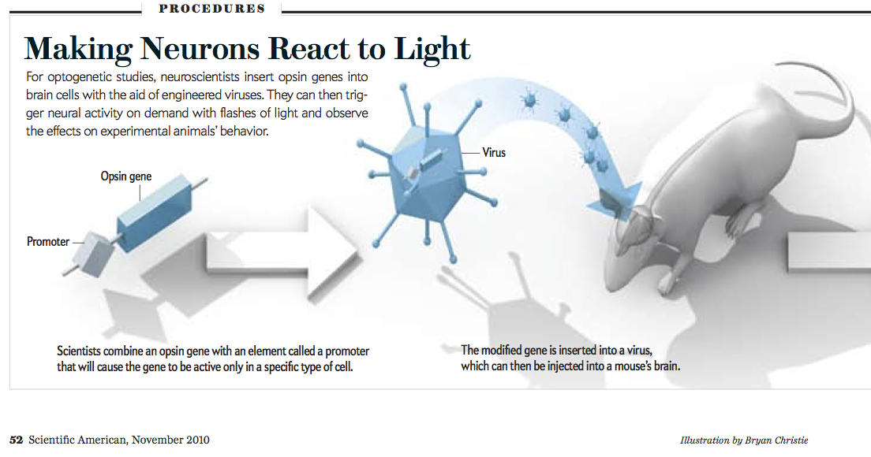
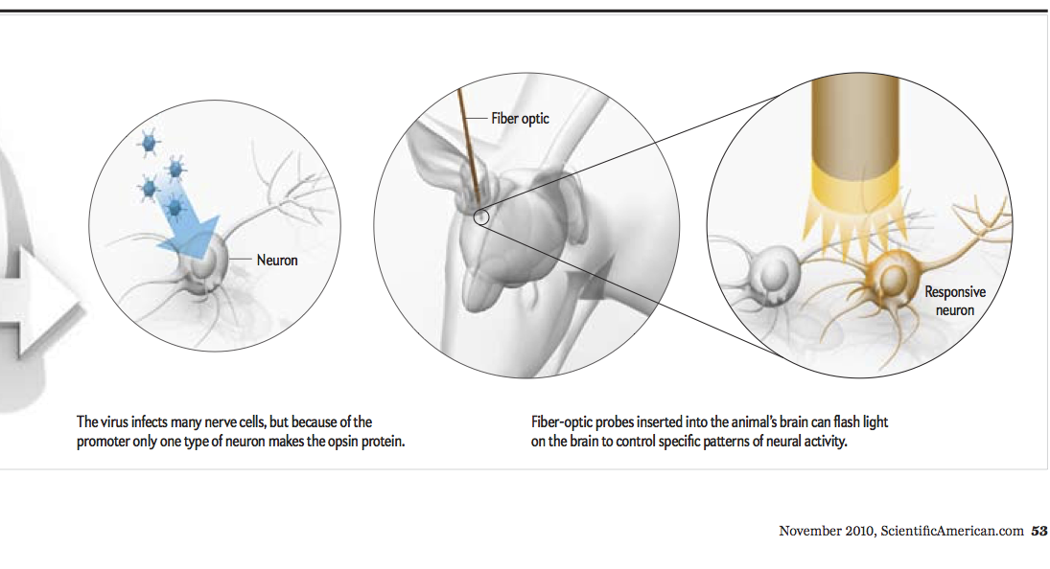
Optogenetics
A way of activating specific neurons at specific times

Slide 17
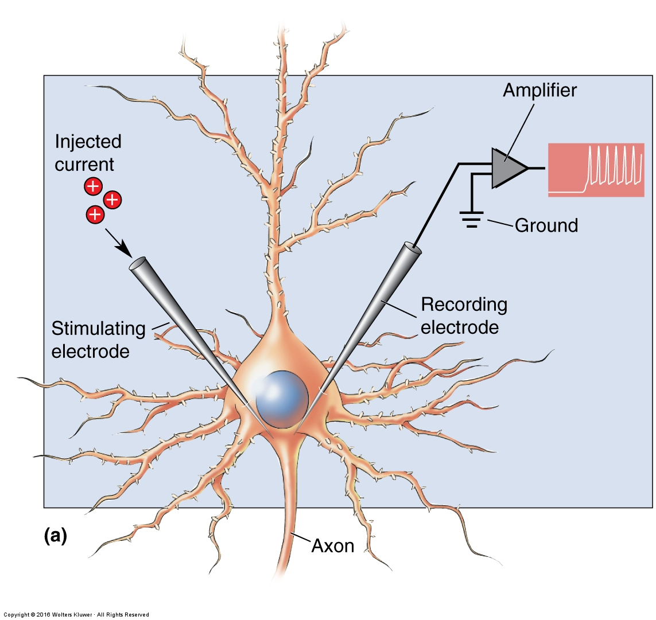
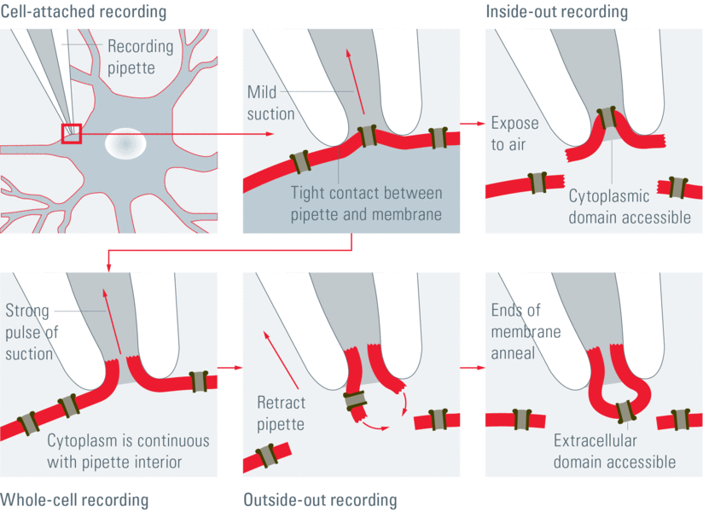
Intracellular Single Cell Recording
Used to record transmembrane potentials: one electrode is within the neuron and one electrode is outside the neuron.
Patch Clamp Recording
Used to record current flow across the cell membrane or through individual ion channels
Fig. 3: The four recording methods for patch-clamp: Cell-attached: When the pipette is in closest proximity to the cell membrane, mild suction is applied to gain a tight seal between the pipette and the membrane. Whole-cell: By applying another brief but strong suction, the cell membrane is ruptured and the pipette gains access to the cytoplasm. Inside-out: In the cell-attached mode, the pipette is retracted and the patch is separated from the rest of the membrane and exposed to air. The cytosolic surface of the membrane is exposed. Outside-out: In the whole-cell mode, the pipette is retracted resulting in two small pieces of membrane that reconnect and form a small vesicular structure with the cytosolic side facing the pipette solution. Source: Patch me if you can – What is the patch-Clamp Technique?, puzzledponderer.wordpress.com

Slide 18
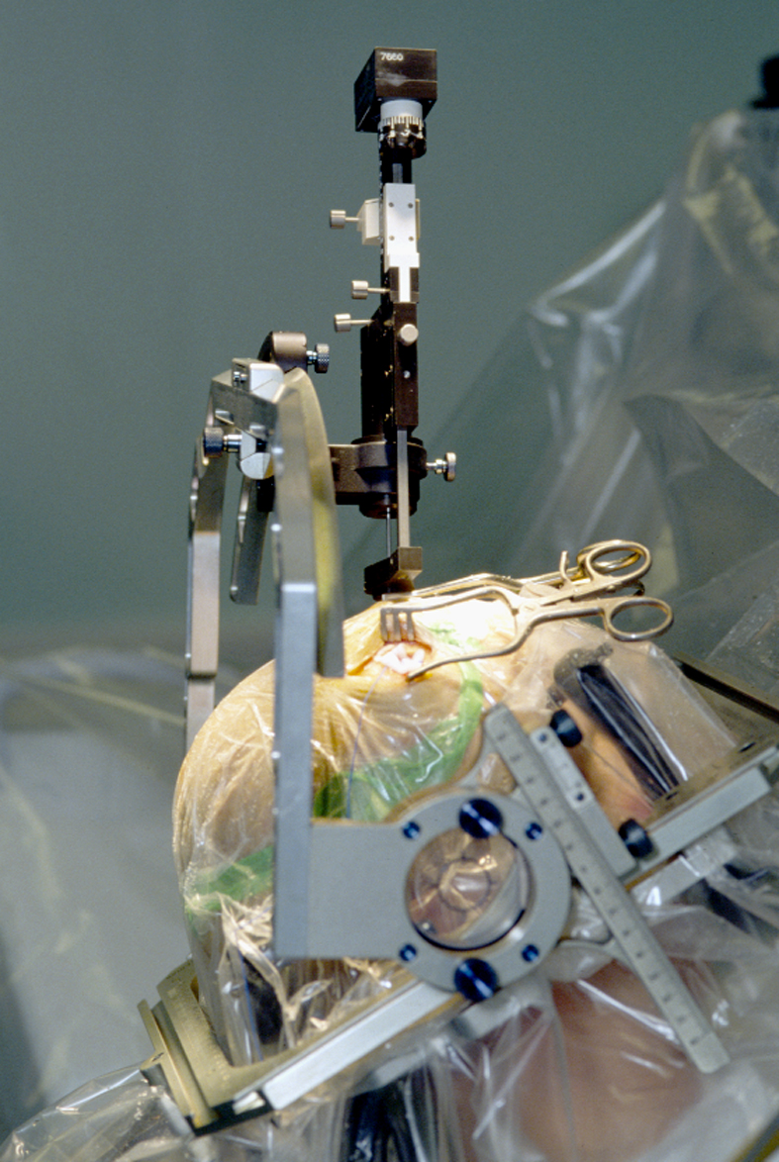
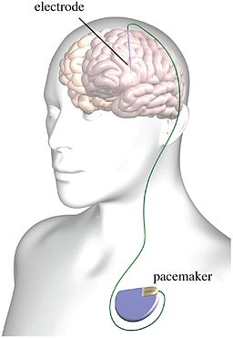
Indwelling Stimulating Electrodes
- In this case used to treat Parkinson’s disease
By Shamir R, Noecker A and McIntyre C [CC BY 3.0 (http://creativecommons.org/licenses/by/3.0)], via Wikimedia Commons

