Slide 1
Model-pre

Slide 2
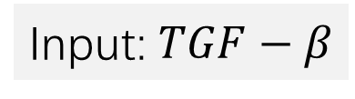
Basic View:
Input: $TGF−β$
Middle pathway
Output: RhoA
Key: ODE Model
Core code: Python – scipy.odeint

Slide 3
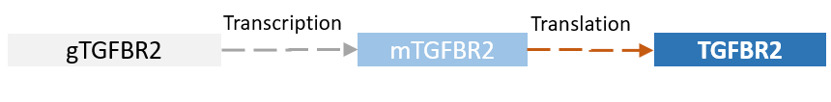
Submodels:
Transcription
Translation
Decomposition
Constant transcription/translation/decomposition rate

Slide 4
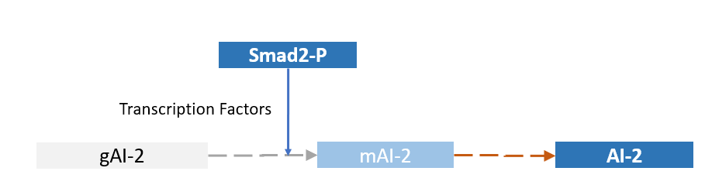
Submodels:
Transcription with transcription factor
Hill function:
Ref: 2015 igem KUL

Slide 5
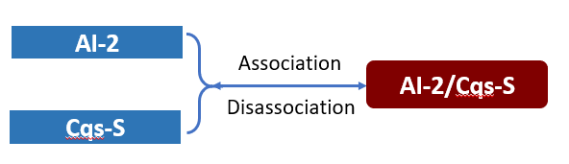

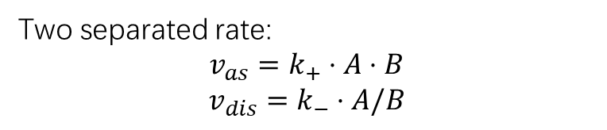
Submodels:
Protein:
Association and dis association
$$A+B \underset{↔}{association/disassociation} A/B$$
Two separated rate:
$$v_{as}=k_{+}⋅A⋅B$$
$$v_{dis}=k_{−}⋅A/B$$

Slide 6
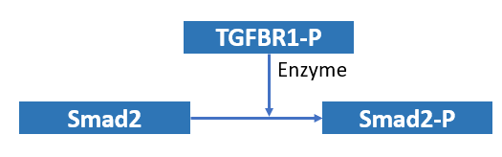
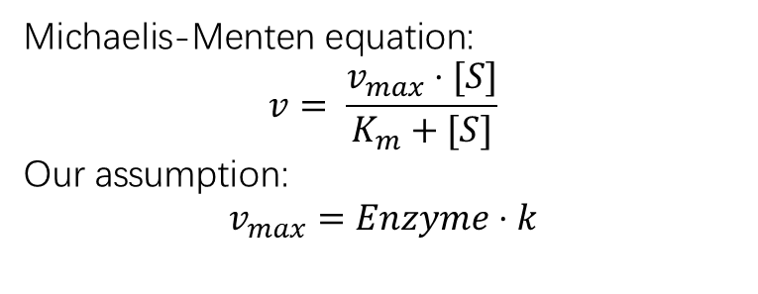

Submodels:
Enzymatic Reaction
$$A+P \underset{→}{Enzyme} (A−P)$$
Michaelis-Menten equation:
$$v= \frac{v_{max}⋅[S]}{K_{m}+[S]}$$
Our assumption:
$$v_{max}=Enzyme⋅k$$

