Slide 1
EECS 442 Discussion
09/20/2017
Siyuan Chen

Slide 2
Announcements
Homework2 out tomorrow, due in two weeks.
Quiz at the beginning of Thursday’s lecture. Also a mini quiz on Canvas at the end.

Slide 3
Topics
Examples of DoG and LoG
Geometric Transformation in practice

Slide 4
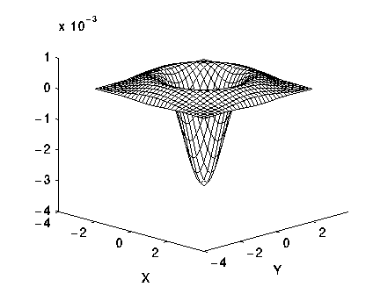
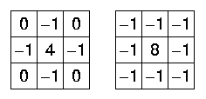
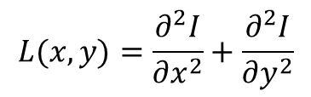
Review: DoG and LoG
Laplacian of Gaussian
$$L(x,y)=\frac{∂^{2}I}{∂x^{2}}+\frac{∂^{2}I}{∂y^{2}}$$
Difference of Gaussians
Mexican Hat

Slide 5
Matlab Tips
K = fspecial ('gaussian',HSIZE,SIGMA)
Usually, HSIZE = 2*SIGMA+1
K = fspecial ('laplacian',ALPHA)
conv2 (I, K, ‘valid’) or conv2(I, K, ‘same’)

Slide 6
Geometric Transformation in Practice

Slide 9
Matlab Tips
affine2d – create an object of affine transformation
Note that the matrix should be transposed before applying to the points.
interp2d – 2D interpolation
meshgrid – create a grid given x and y vectors

