Slide 1
EECS 442 Discussion
10/04/2017
Siyuan Chen

Slide 2
Announcement
HW1 grading
Grades have not been posted for all. Expected to see your grades by the end of this week.
Didn’t submit original .m files? Won’t lose points for this time (allow some time to make corrections). Will make the submission requirements more clear.
HW2 updated. Due date: Friday, Oct 6.
Gradescope registration
Still need to submit code to Canvas
Tomorrow’s quiz will be at the end of the lecture.
HW3 may be out by the end of Friday.

Slide 3
Today’s Topic
Two-minute Matlab Tip Sharing
SIFT
Matlab example: SIFT descriptor

Slide 4
Two-minute Matlab Tip Sharing
Share one or two useful or interesting Matlab functions or programming tips. at the beginning/end of the discussion.
Will keep this part if you feel it helpful.

Slide 5
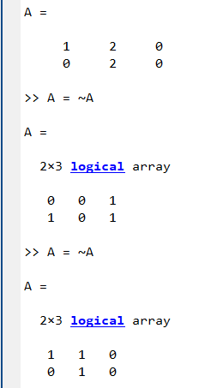
Two-minute Matlab Tip Sharing
Count the # non-zero elements in a matrix.
A = sum(sum(~~A))

Slide 6
SIFT: Scale-invariant feature transform
Detect and localize key points
DoG and Gaussian scale space
Assign dominant orientation
Histogram of orientated gradients
Compute descriptor

Slide 7
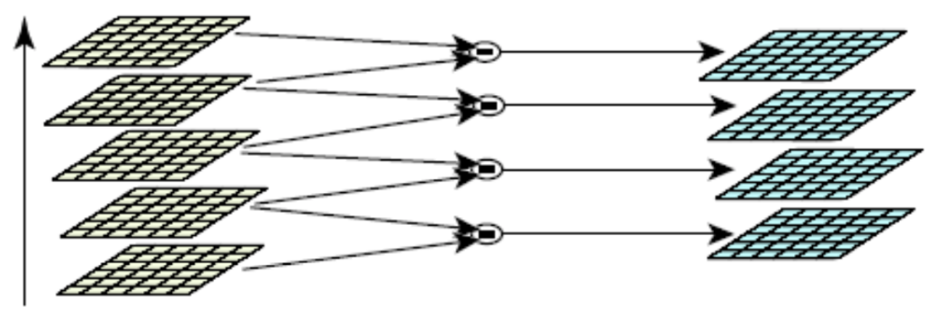
Detect and localize key points

Slide 8
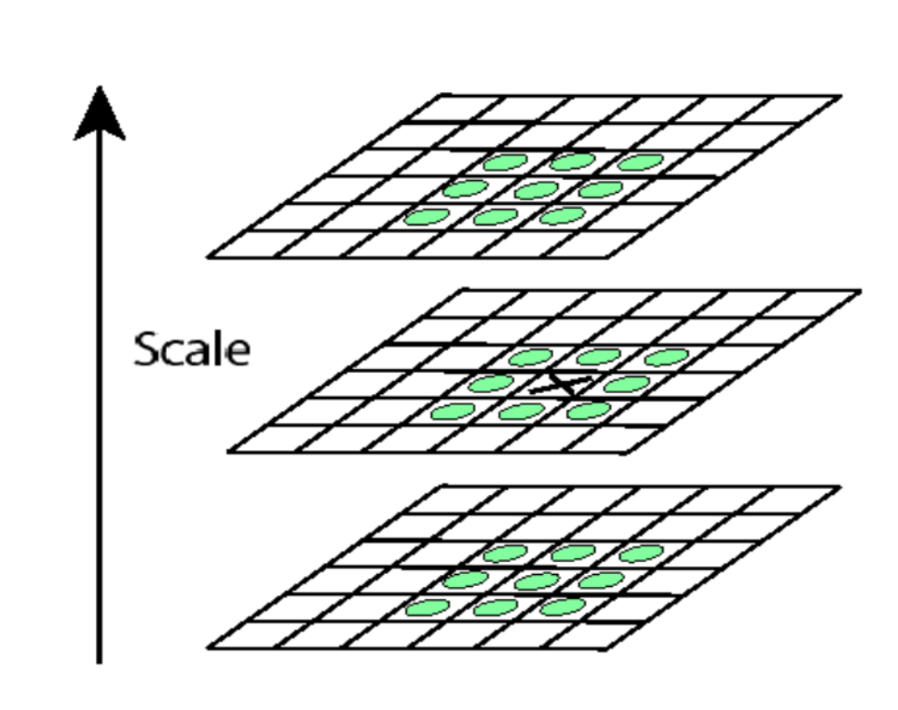
Detect and localize key points

Slide 9
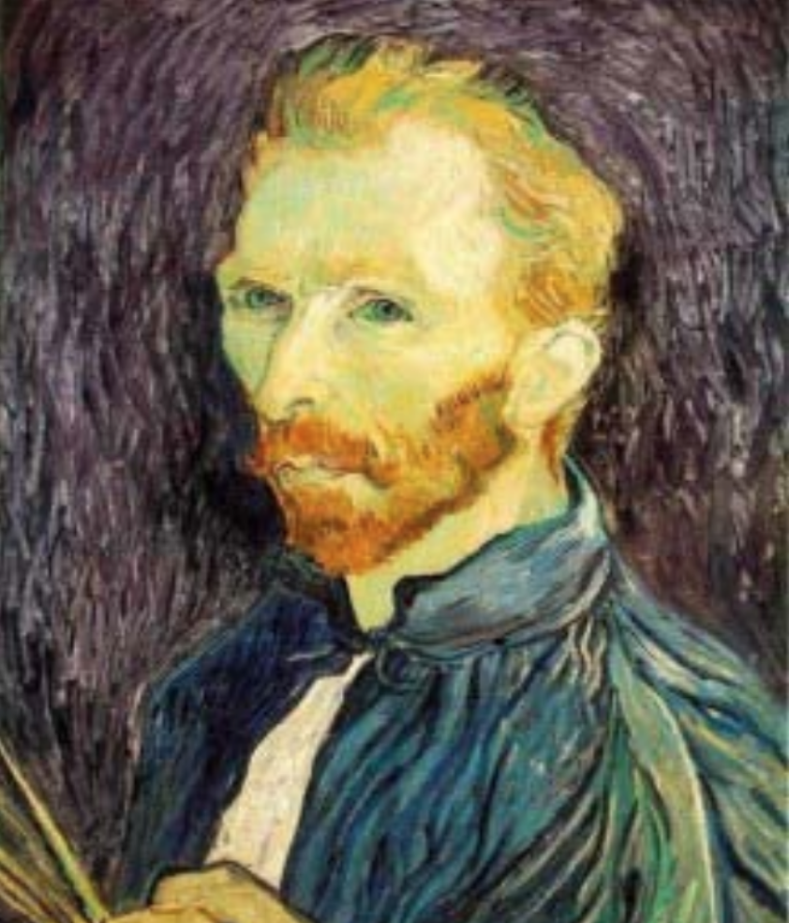
Detect and localize key points
For key points, we know
(x, y, scale)

Slide 10
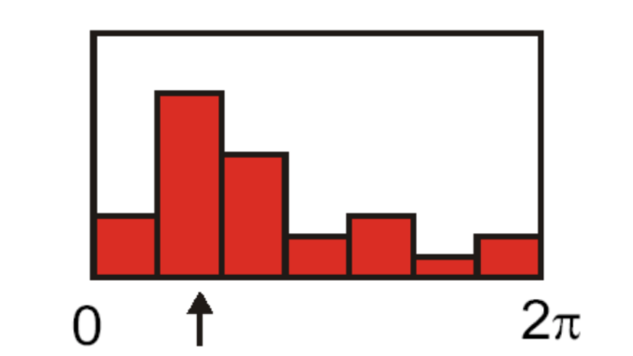
Assign dominant orientation

Slide 11
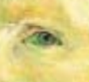
Assign dominant orientation
For key points, we know
(x, y, scale, rotation)

Slide 12
Key point descriptor

Slide 13
SIFT: Scale-invariant feature transform
Detect and localize key points
-> Scale invariance
Find dominant orientation
-> Rotation invariance
Compute descriptor
-> Robust to small variance in pose and intra-class (thanks to gradient histogram) and illumination (thanks to normalization)
SIFT & SIFT descriptor

