Slide 1
Some Examples for Background
EECS 442 Fall 2017
Computer Vision
Instructor: Jason Corso (jjcorso)
Readings:
Materials on these slides have come from many sources in addition to myself; individual slides reference specific sources.

Slide 2
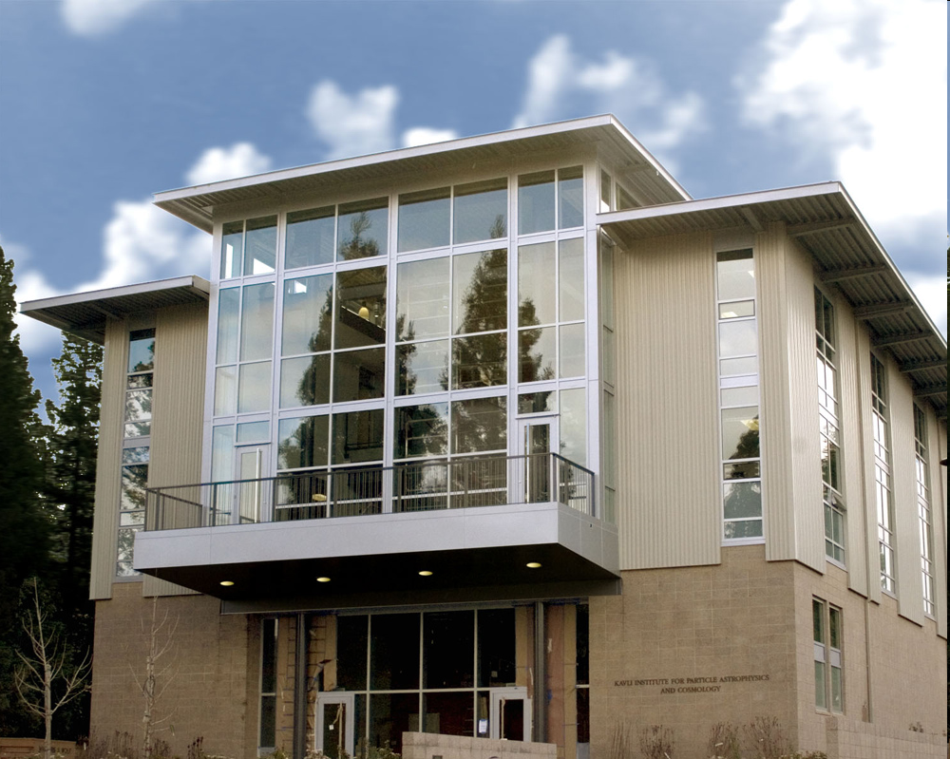
Example Fitting Lines
(for example: computing vanishing points)
Source: S. Savarese slides.

Slide 3
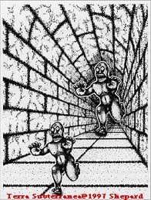
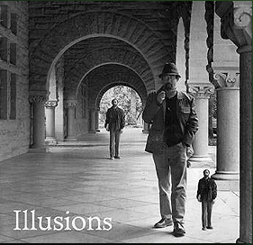
Fun with vanishing points
Source: S. Seitz

Slide 4
Perspective cues
Source: S. Seitz

Slide 5
Perspective cues
Source: S. Seitz

Slide 6
Perspective cues
Source: S. Seitz

Slide 7
Comparing heights
Vanishing
Point
Source: S. Seitz

Slide 8
Measuring height
5.4
5
Camera height
4
3.3
3
2.8
2
1
What is the height of the camera?
Source: S. Seitz

Slide 9
Example Fitting Lines
(for example: computing vanishing points)
Source: S. Savarese slides.

Slide 10
Can you think of challenges in this Line-Fitting?
Form small groups and spend a few minutes actively thinking about potential issues with least squares problems like this.

Slide 11
Estimation Critical Issues
Noisy data
Outliers
Missing data
Sampling density
Source: S. Savarese slides.

Slide 12
Critical issues: noisy data
Source: S. Savarese slides.

Slide 13
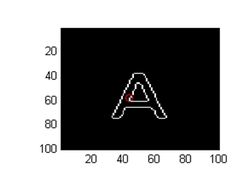
Critical issues: noisy data
(intra-class variability)
A
Source: S. Savarese slides.

Slide 14
Critical issues: outliers
H
Source: S. Savarese slides.

Slide 15
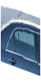
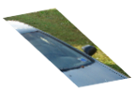
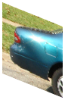
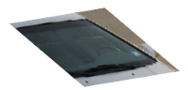
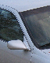
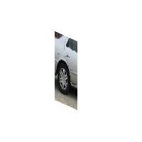

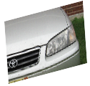
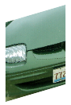
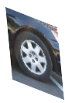

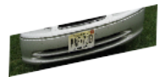

Critical issues: missing data
(occlusions)
Source: S. Savarese slides.
Notes:
As shown at the beginning, it interesting to visualize the geometrical relationship between canonical parts.
Notice that:
These 2 canonical parts share the same pose. All parts that share the same pose form a canonical pose.
These are other examples of canonical poses
Part belonging to different canonical poses are linked by a full homograhic transformation
Here we see examples of canonical poses mapped into object instances
%%
This plane collect canonical parts that share the same pose. All this canonical parts are related by a pure translation constraint.
- These canonical parts do not share the same pose and belong to different planes. This change of pose is described by the homographic transformation Aij.
- Canonical parts that are not visible at the same time are not linked.
Canonical parts that share the same pose forms a single-view submodel.
%Canonical parts that share the same pose form a single view sub-model of the object class. Canonical parts that do not belong to the same plane, correspond to different %poses of the 3d object. The linkage stucture quantifies this relative change of pose through the homographic transformations. Canonical parts that are not visible at the same %time are not linked.
Notice this representation is more flexible than a full 3d model yet, much richer than those where parts are linked by 'right to left', 'up to down‘ relationship, yet. . Also it is different from aspect graph: in that: aspect graphs are able to segment the object in stable regions across views

