Slide 1
声纹识别
李欣尧

Slide 2
情景
输入
Seller语音库
输出
Seller
过滤
Phase 1
电话录音
Customer
注册
Customer语音库
Music
Machine Sound
丢弃
匹配
Noise
打分
Third Person
不匹配
Phase 2
Customer录音

Slide 3
技术流程
VAD
(Voice Activity Detection)
语音端点检测
SCD
(Speaker Change Detection)
说话人改变检测
Speech Turn Clustering
说话人聚类
Speaker Recognition
说话人识别
Speaker Diarization
说话人差异化
Reference: https://pyannote.github.io/pyannote-metrics/reference.html

Slide 4
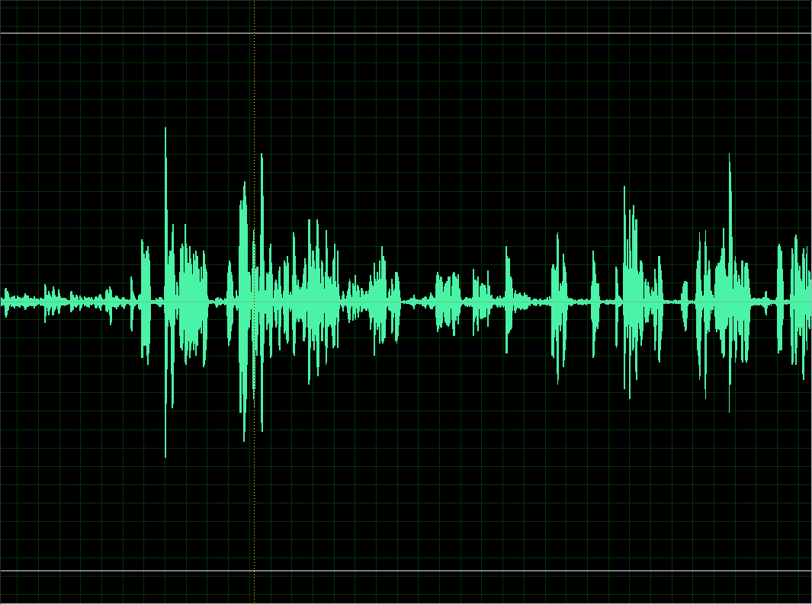
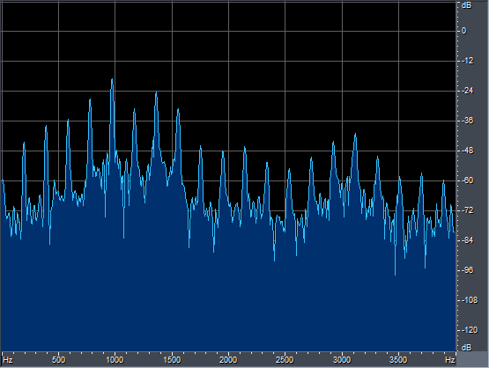
一些基础
测试你的音高

Slide 5
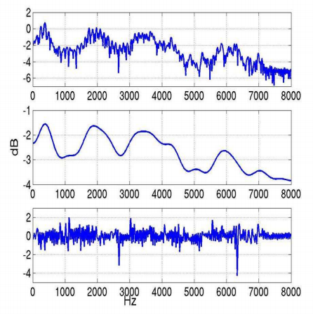
MFCC(Mel-frequency cepstral coefficients) 梅尔倒谱系数
Spectrum
Low-frequency
High-frequency
Image_source: http://www.speech.cs.cmu.edu/15-492/slides/03_mfcc.pdf

Slide 6
MFCC(Mel-frequency cepstral coefficients) 梅尔倒谱系数
Formants(共振峰)
共振峰是指在声音的频谱中能量相对集中的一些区域，共振峰不但是音质的决定因素，而且反映了声道（共振腔）的物理特征。
共振峰携带了声音的辨识属性, 声音的身份证
我们不仅要提炼出共振峰, 也需要提取共振峰转变的过程
共振峰 + 过度部分 = 包络
Reference: https://baike.baidu.com/item/%E5%85%B1%E6%8C%AF%E5%B3%B0

Slide 7
MFCC(Mel-frequency cepstral coefficients) 梅尔倒谱系数
Spectrum
Low-frequency
Envelop(包络)
High-frequency
Details
Image_source: http://www.speech.cs.cmu.edu/15-492/slides/03_mfcc.pdf

Slide 8






MFCC(Mel-frequency cepstral coefficients) 梅尔倒谱系数
时域信号
DFT
信号频谱
ln(x)
对数谱
DFT
倒谱
LowPass Filter
低频部分
$$X[k]=DFT(x[t])$$
$$X\left[k\right]=L\left[k\right]H[k]$$
$$log⁡(X\left[k\right])=log⁡(L\left[k\right])+log⁡(H\left[k\right])$$
$$x\left[k\right]=l\left[k\right]+h[k]$$
$$l\left[k\right]=lowpass(x[k])$$
$l\left[k\right]$: envelope

Slide 9
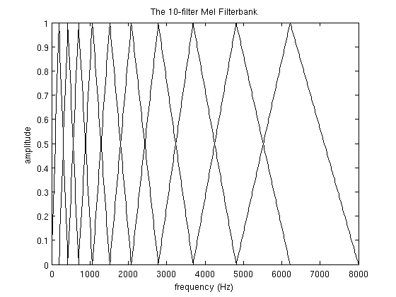
MFCC(Mel-frequency cepstral coefficients) 梅尔倒谱系数
Mel频率分析: 基于人类听觉感知实验, 人耳相当于一个滤波器组, 低频区域比较密集，高频区域较稀疏

Slide 10
MFCC(Mel-frequency cepstral coefficients) 梅尔倒谱系数
时域信号
预加重, 分帧, 加窗
FFT(Fast Fourier Transform)
每一帧的向量就是MFCC的特征向量
接下来可以根据这些向量进行训练和识别
Mel滤波
取对数
DCT(Discrete Cosine Transform)
特征提取部分通常是提取DCT的前13个系数,
并附加上这13个系数的一阶差分和二阶差分
动态特征
特征向量

Slide 11
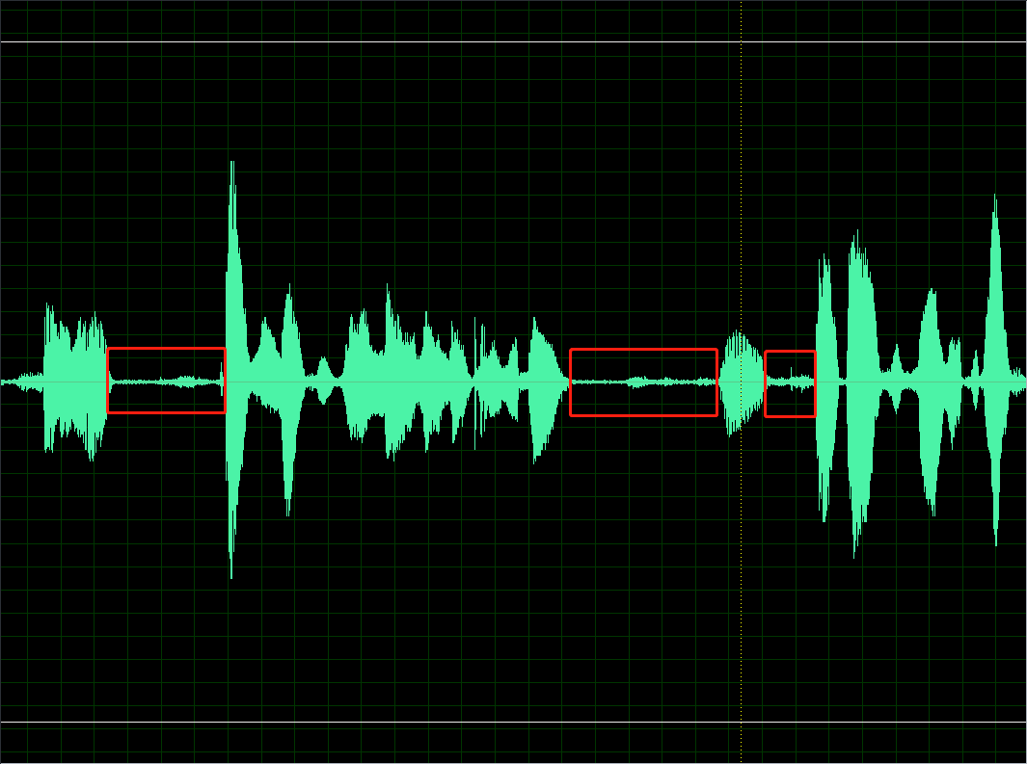
VAD/SAD (Voice/Speech Activity Detection)
语音活性检测(语音端点检测): 检测一段语音的是否是人说话的语音

Slide 12
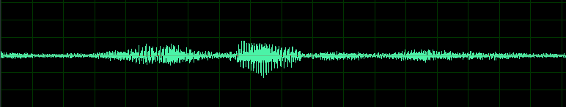
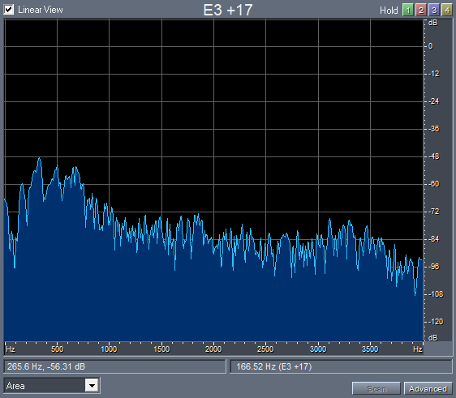
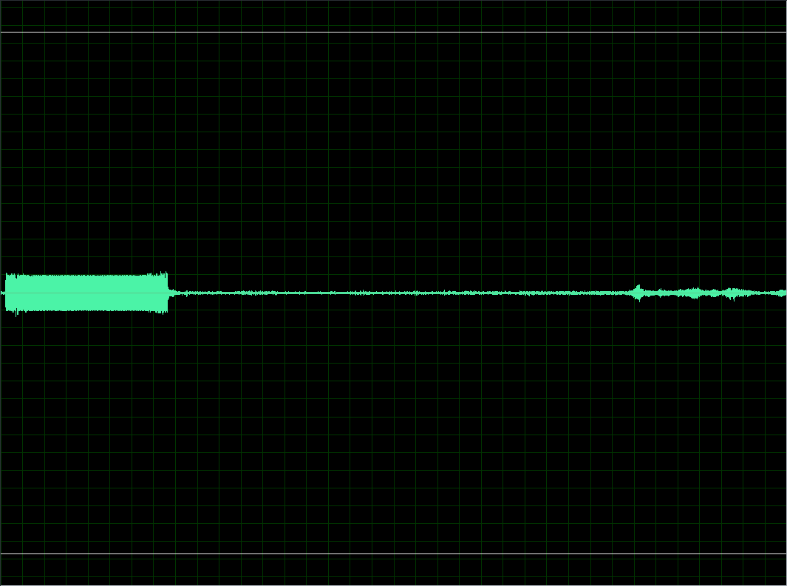
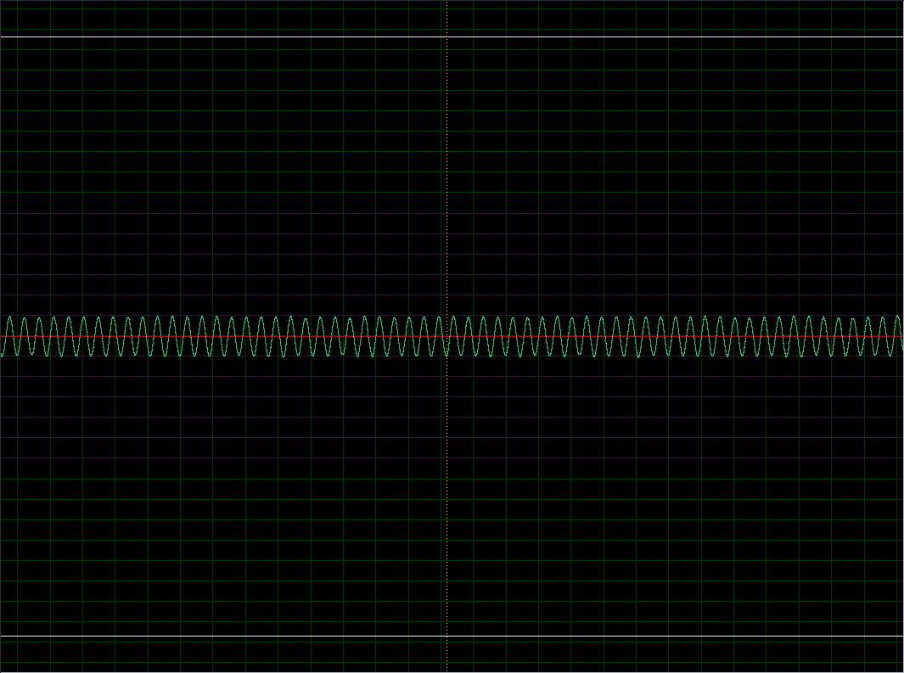
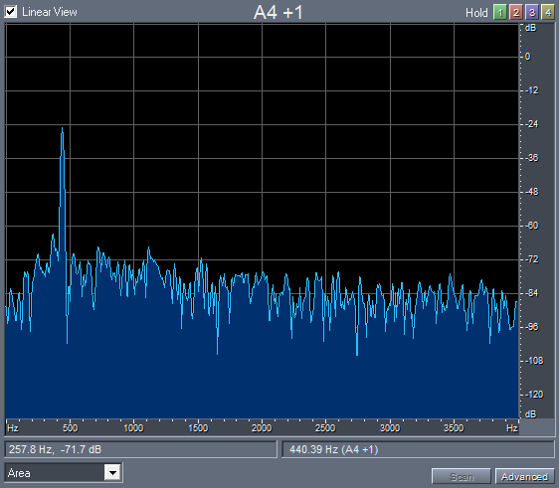
VAD/SAD (Voice/Speech Activity Detection)
时域
频域
远场噪音
封音

Slide 13
VAD/SAD (Voice/Speech Activity Detection)
Multi-parameter SAD
Statistical SAD
Energy Based SAD
Phoneme Recognizer Based SAD
Bi Gaussian Modeling of log-Energies Based SAD
Reference: https://arxiv.org/pdf/1210.0297.pdf

Slide 14
VAD/SAD (Voice/Speech Activity Detection)
Multi-parameter SAD
line spectral pairs
full-band energy
low-band energy
zero-crossing rate
Statistical SAD
Energy Based SAD
Phoneme Recognizer Based SAD
Bi Gaussian Modeling of log-Energies Based SAD

Slide 15
VAD/SAD (Voice/Speech Activity Detection)
Multi-parameter SAD
Statistical SAD
a statistical model is used where the decision are taken based on likelihood ratio test (LRT). In addition to that, a decision-directed (DD) method is used to estimate various parameters. Finally, it also introduces an improved hang-over scheme based on hidden Markov model (HMM)
Energy Based SAD
Phoneme Recognizer Based SAD
Bi Gaussian Modeling of log-Energies Based SAD

Slide 16
VAD/SAD (Voice/Speech Activity Detection)
Multi-parameter SAD
Statistical SAD
Energy Based SAD
First, energy of all the speech frames are computed for a given speech utterance. Then, an empirical threshold is selected from the frame energies. Kaldi
Phoneme Recognizer Based SAD
Bi Gaussian Modeling of log-Energies Based SAD

Slide 17
VAD/SAD (Voice/Speech Activity Detection)
Multi-parameter SAD
Statistical SAD
Energy Based SAD
Phoneme Recognizer Based SAD
non speech segments are of four kinds
pau: pause within speech signal 语音间的间隔
spk: speaker related noises 说话人相关的噪音
sta: stationary noise 一直都有的噪音
int: intermittent noise 断断续续的噪音
This tool uses a neural network and hidden Markov model based technique to identify phonemes.
Bi Gaussian Modeling of log-Energies Based SAD

Slide 18
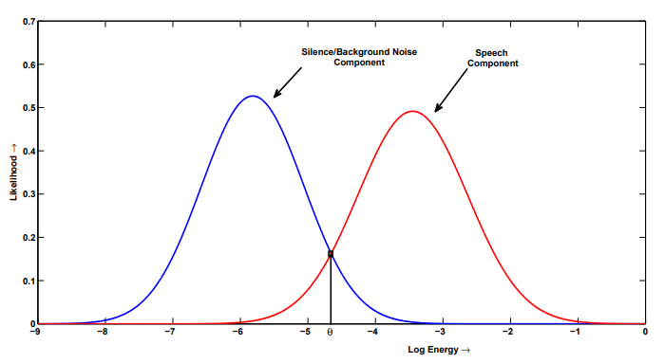
VAD/SAD (Voice/Speech Activity Detection)
Multi-parameter SAD
Statistical SAD
Energy Based SAD
Phoneme Recognizer Based SAD
Bi Gaussian Modeling of log-Energies Based SAD
log-energies of each speech frames of a speech utterance are computed
the distribution of log-energy coefficients is estimated using Gaussian mixture model of two mixtures
The cluster corresponding to smaller value of center is treated as noise or non-speech class, and the cluster corresponding to larger value of center is considered as speech
A threshold is computed to determine the decision making boundary between speech and non-speech class

Slide 19
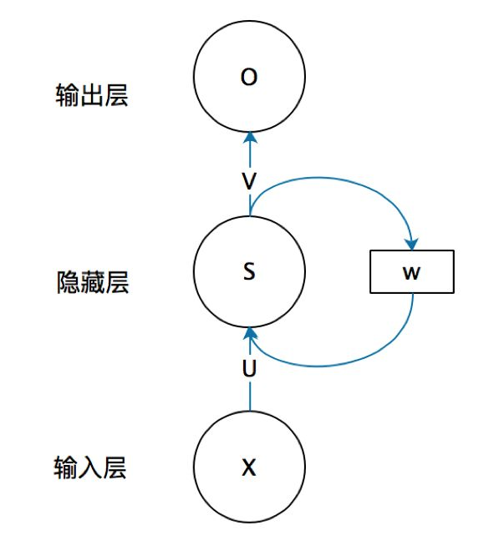
RNN(Recurrent Neural Network)循环神经网络
RNN: Recurrent Neural Network 循环神经网络
在NLP中至关重要
为什么需要RNN:
对于通常的神经网络模型, 他们只能单独的处理一个个输入, 前一个输入和后一个输入没关系, 但是某些任务需要能够处理序列的信息, 即前面的输入和后面的输入是有关系的
比如我们理解一句话的时候, 孤立的理解这句话是没有用的, 必须把整个句子作为序列连起来. 处理视频的时候, 我们要把视频的每一帧连起来分析
Reference: https://zhuanlan.zhihu.com/p/30844905

Slide 20
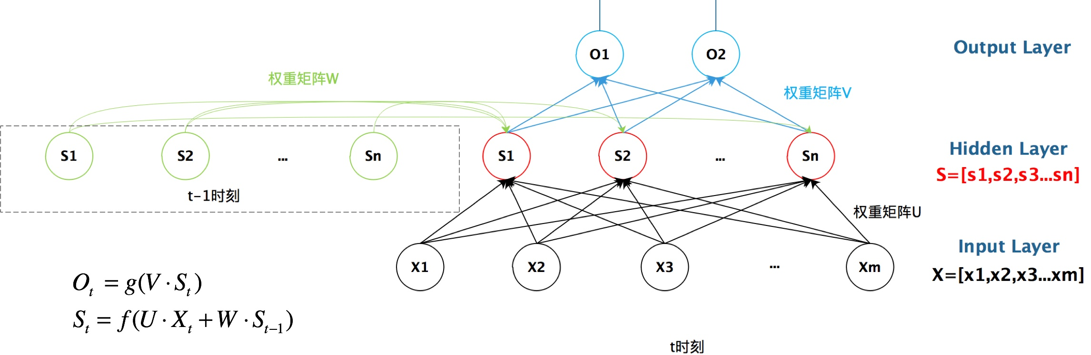
RNN(Recurrent Neural Network)循环神经网络
Image_source: https://zhuanlan.zhihu.com/p/30844905

Slide 21
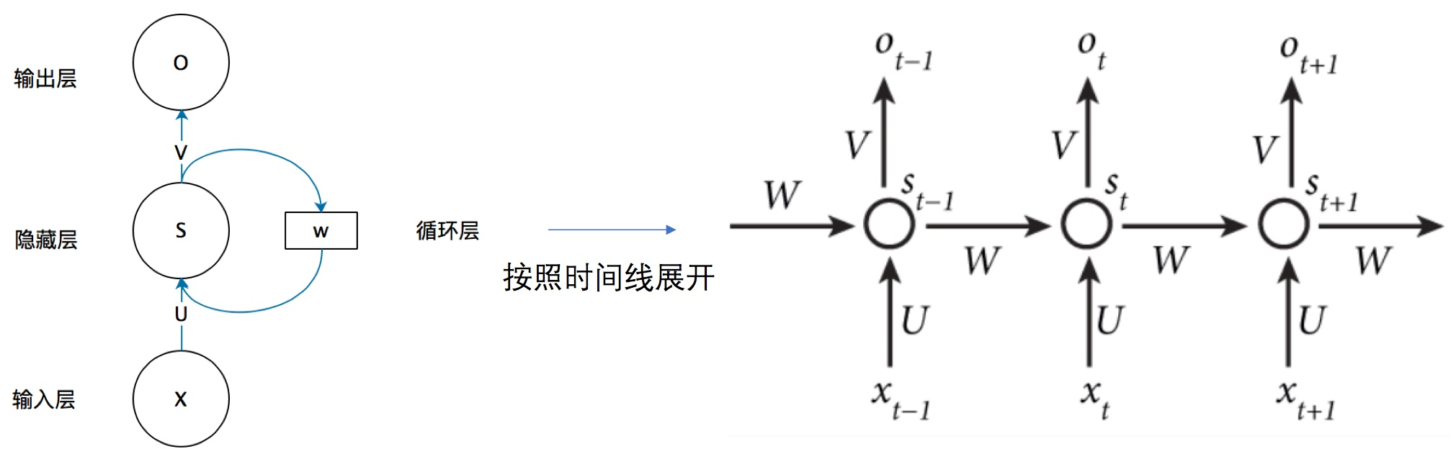
RNN(Recurrent Neural Network)循环神经网络
Image_source: https://zhuanlan.zhihu.com/p/30844905

Slide 22
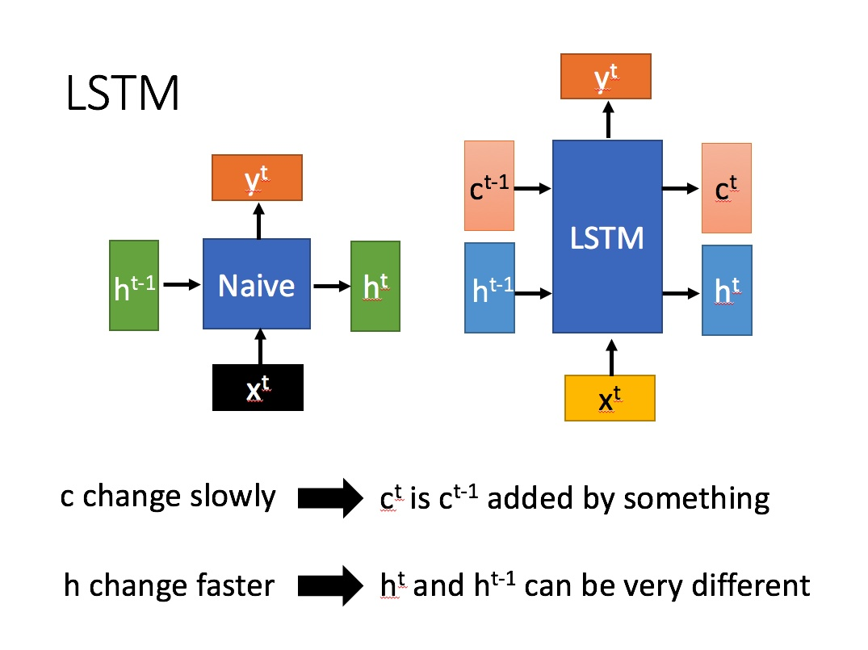
LSTM(long short-term memory)长短期记忆
Image_source: https://zhuanlan.zhihu.com/p/32085405

Slide 23
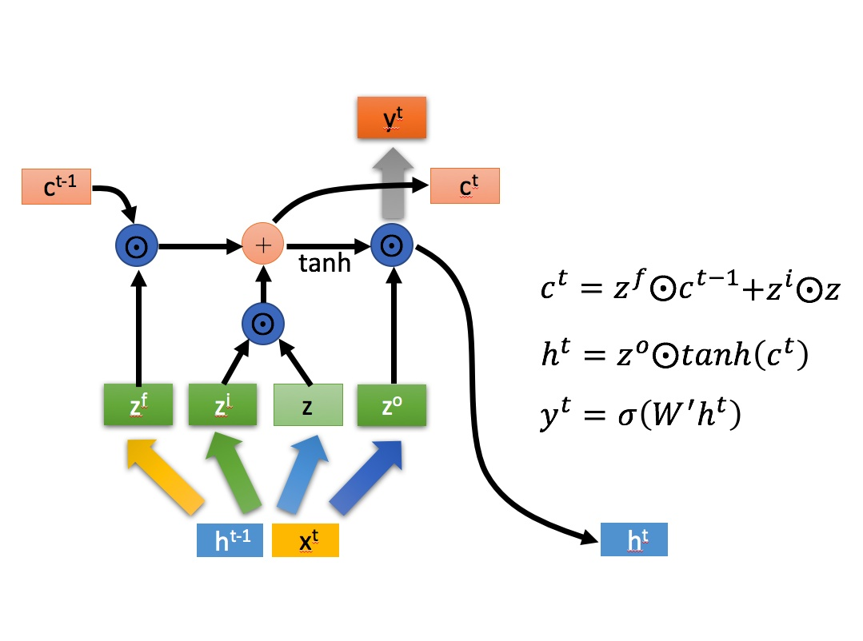
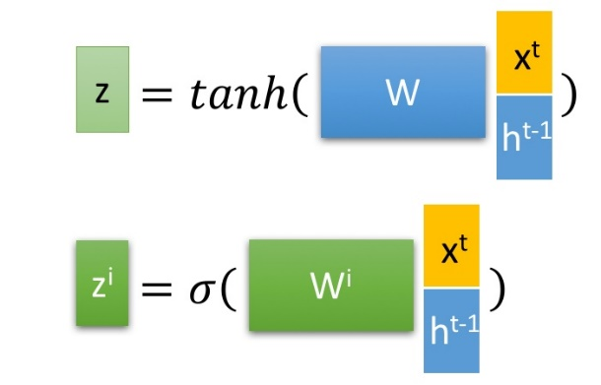
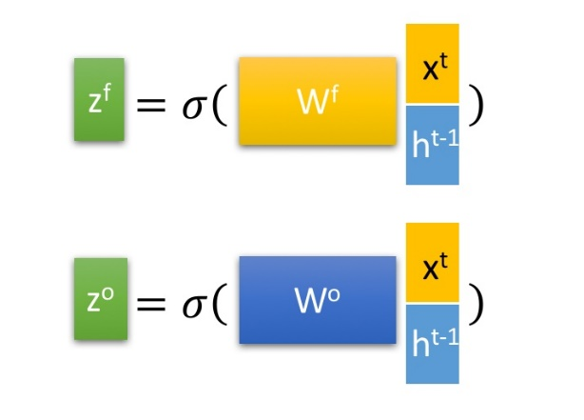
LSTM(long short-term memory)长短期记忆
Image_source: https://zhuanlan.zhihu.com/p/32085405

Slide 24
BRNN(Bidirectional RNN) 双向RNN
我十一假期来___玩了, 昨天去了艾弗尔铁塔, 今天去喝了左岸的咖啡, 真好喝.

Slide 25
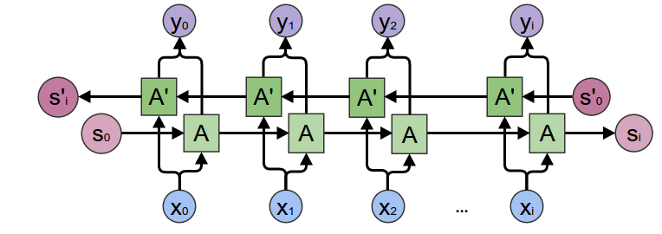
BRNN(Bidirectional RNN) 双向RNN
我十一假期来___玩了, 昨天去了艾弗尔铁塔, 今天去喝了左岸的咖啡, 真好喝.
当前时刻的输出不仅和之前的状态有关, 还可能和未来的状态有关, 真正做到基于上下文的判断
BRNN就是在RNN基础上加上一个反向的RNN, 两个RNN叠加一起组成的
同理Bidirectional LSTM也是由两条相反的LSTM叠加组成
Image_source: http://www.easy-tensorflow.com/tf-tutorials/recurrent-neural-networks/bidirectional-rnn-for-classification

Slide 26
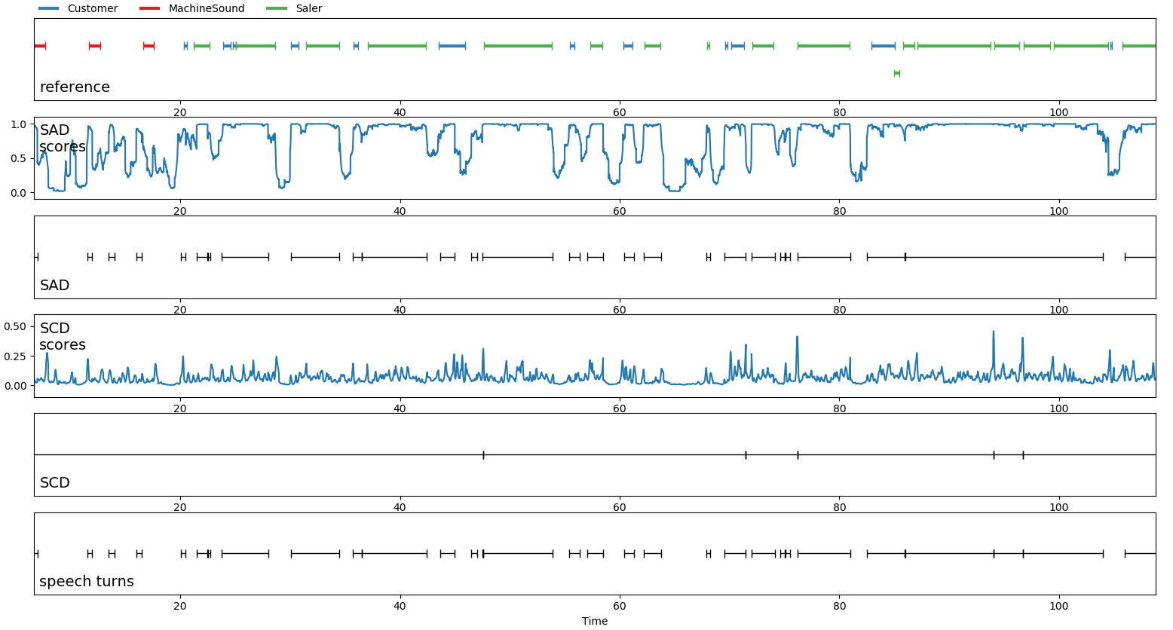
Pyannote
Pyannote是Github上的声纹识别的工具, 提供了SAD, SCD, Speaker Embedding, Overlapped Speak Detection工具, 包括训练和分类

Slide 27
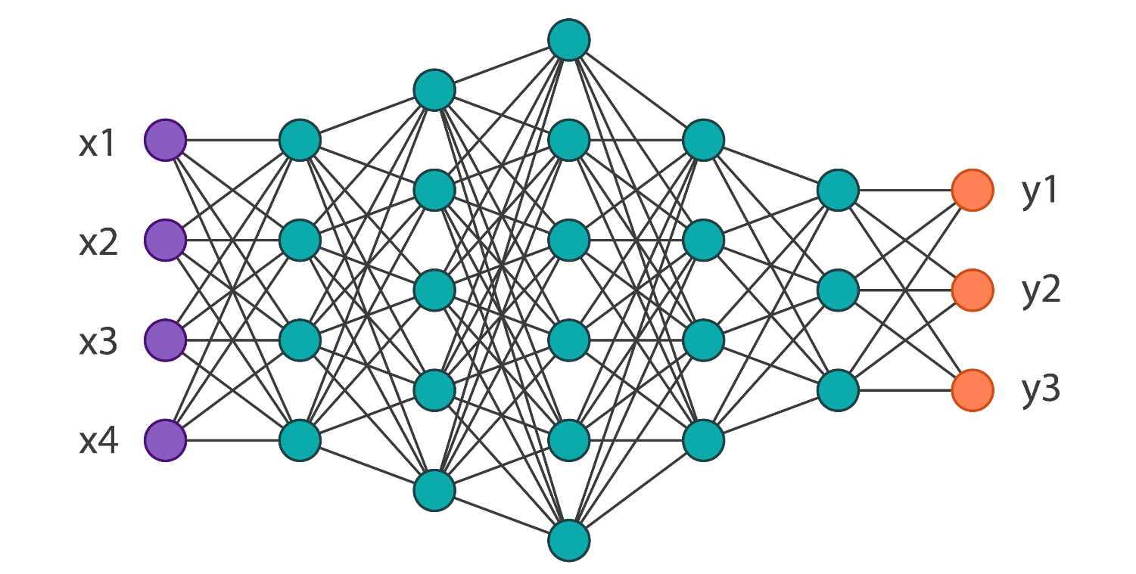
Pyannote
什么是Speaker Embeddings:
可以理解为分类器的线性层,
Embeddings的主要作用就是降维
BLSTM
Linear

Slide 28
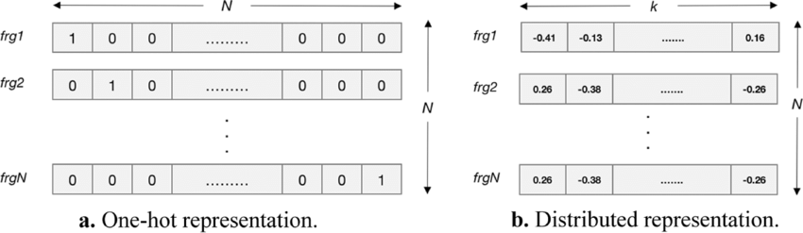
Pyannote
One-hot representation
Distributed representation

Slide 29
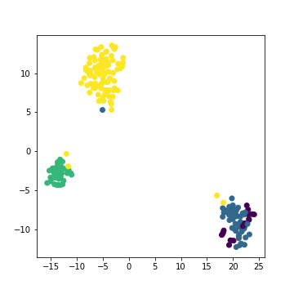
Pyannote
TSNE: 继续降维, 把高维度的Embedding投射至2维, 以便观察
Speaker Embeddings
A | B | C | D | …
1.234 | 0.264 | 6.6969 | 3.669 | …
32.1 | 3.225 | 9.6363 | 343.7 | …
52.66 | 25.21 | 43.4 | 413.4 | …
234.67 | 82.95 | 6.02 | 3.13 | …
… | … | … | … | …
556.2 | 5.3 | 22.001 | 56.655 | …
1.222 | 1.33 | 21.1 | 0.0001 | …
Image_source: https://github.com/pyannote/pyannote-audio

Slide 30
AISHELL
预处理
训练UBM
训练集
提取特征
提取ivector
训练plda
ivector 提取器
端点检测
数据集
预处理
注册集
提取特征
提取ivector
端点检测
测试集
打分
验证集
预处理
提取特征
提取ivector
端点检测

Slide 31
流程
销售语音库
客户验证语音
打分
匹配
电话录音
SAD&SCD
切分
清洗
聚类
过滤
筛选
注册
打分
高于阈值
低于阈值
不匹配
失败
失败
失败
调整参数
更新阈值?

Slide 32
我们的业务
1. 根据我们的情景, 基于DNN的SAD及SCD是基本确定了的
2. 根据SAD和SCD结果对录音进行切分, 得到销售和客户的各自的多段语音
3. 清洗: 过滤碎片片段, 如果整个音频太碎或太整, 都可能是不合格的, 回炉重造
4. 说话人聚类: 这一部分可以用两种方法做, 一是聚类的k-means, 二是基于DNN的embeddings, 还没搞清用哪种, 或者哪种可用
5. 然后根据销售的id找到对应的销售语音库的语音, 和聚类里的语音逐一对比, 如果有一个聚类匹配程度高, 可以确定这类是销售语音, 反之则失败, 回炉重造
6. 筛选: 这一步的目的是在剩下的客户聚类里找到最为合适的几个片段, 拿出来注册, top-n-similarity(距离销售cluster最远) 片段, 这里也会设置阈值, 如果聚类太过松散, 回炉重造
7. 阶段2根据客户id, 从客户语音库拿出对应客户语音, 进行打分, 高于阈值匹配, 否则不匹配, 可以根据需求更新阈值
8. 打分: speaker verification. 可以使用kaldi的基于ivector-plda, 或者DNN的embeddings打分, 目前试过kaldi的方法, 效果还可以, 还没试embeddings

Slide 33
参考文献
https://pyannote.github.io/pyannote-metrics/reference.html
http://www.speech.cs.cmu.edu/15-492/slides/03_mfcc.pdf
https://arxiv.org/pdf/1210.0297.pdf
https://bideyuanli.com/pp
https://github.com/pyannote/pyannote-audio
https://zhuanlan.zhihu.com/p/32085405
https://zhuanlan.zhihu.com/p/30844905
https://kaldi-asr.org/doc/about.html

