Slide 1
MPI implementation – collective communication
MPI_Bcast implementation

Slide 2
Collective routines
A collective communication involves a group of processes.
  Assumption:
    Collective operation is realized based on point-to-point communications.
  There are many ways (algorithms) to carry out a collective operation with point-to-point operations.
    How to choose the best algorithm?

Slide 3
Two phases design
Design collective algorithms under an abstract model:
  Ignore physical constraints such as topology, network contention, etc.
  Obtain a theoretically efficient algorithm under the model.
Effectively mapping the algorithm onto a physical system.
  Contention free communication.

Slide 4
Design collective algorithms under an abstract model
A typical system model
  All processes are connected by a network that provides the same capacity for all pairs of processes.
interconnect

Slide 5
Design collective algorithms under an abstract model
Models for point-to-point comm. cost(time):
  Linear model: T(m) = c * m
    Ok if m is very large.
  Honckey’s model: T(m) = a + c * m
    a – latency term, c – bandwidth term
  LogP family models
  Other more complex models.
Typical Cost (time) model for the whole operation:
  All processes start at the same time
  Time = the last completion time – start time

Slide 6
MPI_Bcast
A
A
MPI_Bcast
A
A
A

Slide 7
First try: the root sends to all receivers (flat tree algorithm)
If (myrank == root) {
  For (I=0; I<nprocs; I++) MPI_Send(…data,I,…)
} else MPI_Recv(…, data, root, …)
Flat tree algorithm

Slide 8
Broadcast time using the Honckey’s model?
  Communication time = (P-1) * (a + c * msize)
Can we do better than that?
What is the lower bound of communication time for this operation?
  In the latency term: how many communication steps does it take to complete the broadcast?
  In the bandwidth term: how much data each node must send to complete the operation?

Slide 9
Lower bound?
In the latency term (a):
  How many steps does it take to complete the broadcast?
  1, 2, 4, 8, 16, … ➔ log(P)
In the bandwidth term:
  How many data each process must send/receive to complete the operation?
    Each node must receive at least one message:
  Lower_bound (latency) = c*m
Combined lower bound = log(P)*a + c *m
  For small messages (m is small): we optimize logP * a
  For large messages (c*m >> P*a): we optimize c*m

Slide 10
Flat tree is not optimal both in a and c!
Binary broadcast tree:
  Much more concurrency
Communication time?
2*(a+c*m)*treeheight = 2*(a+c*m)*log(P)

Slide 11
A better broadcast tree: binomial tree
0
Step 1: 0→1
Step 2: 0→2, 1→3
Step 3: 0→4, 1→5, 2→6, 3→7
1
2
4
Number of steps needed: log(P)
Communication time?
(a+c*m)*log(P)
The latency term is optimal, this algorithm is widely used to broadcast small messages!!!!
3
5
6
7

Slide 12
Optimizing the bandwidth term
We don’t want to send the whole data in one shot – running out of budget right there
  Chop the data into small chunks
  Scatter-allgather algorithm.
P0
P1
P2
P3

Slide 13
Scatter-allgather algorithm
P0 send 2*P messges of size m/P
Time: 2*P * (a + c*m/P) = 2*P*a + 2*c*m
  The bandwidth term is close to optimal
  This algorithm is used in MPICH for broadcasting large messages.

Slide 14
How about chopping the message even further: linear tree pipelined broadcast (bcast-linear.c).
S segments, each m/S bytes
Total steps: S+P-1
Time:
(S+P-1)*(a + c*m/S)
When S>>P-1, (S+P-1)/S = 1
Time = (S+P-1)*a + c*m
near optimal.
P0
P1
P2
P3

Slide 15
Summary
Under the abstract models:
  For small messages: binomial tree
  For very large message: linear tree pipeline
  For medium sized message: ???

Slide 16
Second phase: mapping the theoretical good algorithms to the actual system
Algorithms for small messages can usually be applied directly.
  Small message usually do not cause networking issues.
Algorithms for large messages usually need attention.
  Large message can easily cause network problems.

Slide 17
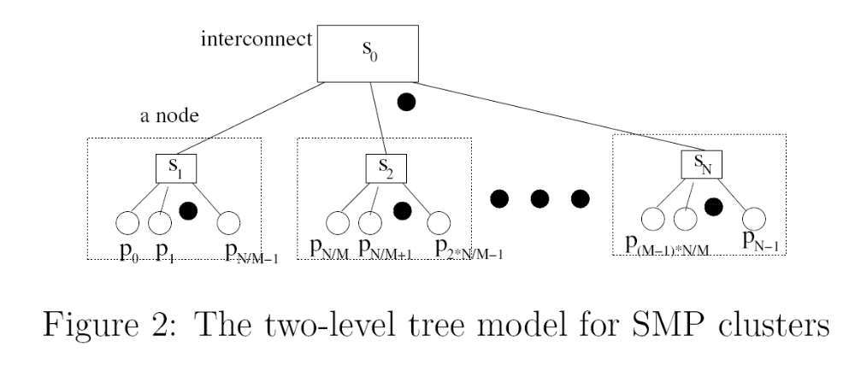
Realizing linear tree pipelined broadcast on a SMP/Multicore cluster (e.g. linprog1 + linprog2)
A SMP/multicore is roughly a tree topology

Slide 18
Linear pipelined broadcast on tree topology
Communication pattern in the linear pipelined algorithm:
  Let F:{0, 1, …, P-1} → {0, 1, …, P-1} be a one-to-one mapping function. The pattern can be F(0)→ F(1) → F(2) → ……→F(P-1)
  To achieve maximum performance, we need to find a mapping such that F(0)→ F(1) → F(2) → ……→F(P-1) does not have contention.

Slide 19
An example of bad mapping
0→1→2→3→4→5→6→7
  S0→S1 must carry traffic from 0→1, 2→3, 4→5, 6→
A good mapping: 0→2→4→6→1→3→5→7
  S0→S1 only carry traffic for 6→1
0
2
1
3
S0
S1
6
5
7
4

Slide 20
Algorithm for finding the contention free mapping of linear pipelined pattern on tree
Starting from the switch connected to the root, perform depth first search (DFS). Number the switches based on the DFS order
Group machines connected to each switch, order the group based on the DFS switch number.

Slide 21
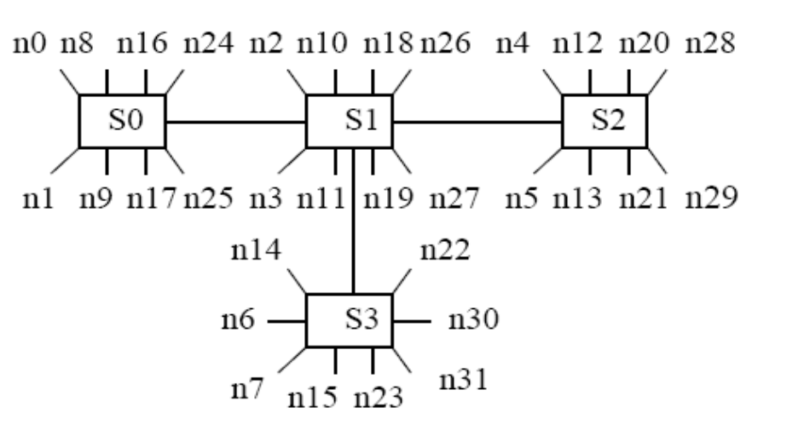
Example: the contention free linear pattern for the following topology is n0→n1→n8→n9→n16→n17→n24→n25→n2→n3→n10→n11→n18→n19→n26→n27→n4→n5→n12→n13→n20→n21→n28→n29→n6→n7→n14→n15→n22→n23→n30→n31

Slide 22
Some broadcast study can be found in our paper:
  P. Patarasu, A. Faraj, and X. Yuan, "Pipelined Broadcast on Ethernet Switched Clusters." Journal of Parallel and Distributed Computing, 68(6):809-824, June 2008. (http://www.cs.fsu.edu/~xyuan/paper/08jpdc.pdf)

