Slide 1
Language Learning Model for Context-based Sentence Generation
Kyounghan Park
Sungkyunkwan Univ.
Department of Digital Media and Communications Engineering
IISLab

Slide 2
Outline
Overview
Contribution
Related Work
Proposed Method
Experiment Result
Future Work
Reference

Slide 3
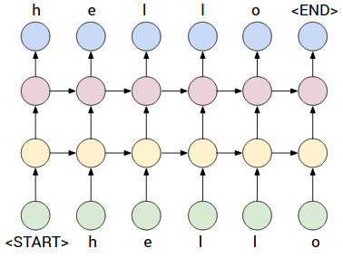
Overview
Language generation model using RNN
  Relation between words

Slide 4
Related Works
LSTM based Language Model for Topic-focused Sentence Generation
  Sentence generation with LSTM
  Additional document input vector
Deep visual-semantic alignments for generating image descriptions
  Image mapping vector using CNN
  Each image vector is used for initial value of RNN for generating language sentence

Slide 5
Proposed Method
Learning Context from Data
  Get Sentence Vector
  Clustering Sentence Vector
  Learning Document Model
Learning Sentence Generation with Document Model and Previous Sentence

Slide 6






Proposed Method (cont.)
Generate Sentence Vector through RNN Encoder-Decoder
Sentence
vector
Initial
value

Slide 7

















Proposed Method (cont.)
Clustering Sentence Vector
Clustering

Slide 8








Proposed Method (cont.)
Document Model
Initial
state
LSTM
LSTM
LSTM
LSTM

Slide 9






Proposed Method (cont.)
Learning how to generate sentence with Cluster information and previous sentence vector
Sentence Generation
RNN Layer
P
C
,
W
W
W

Slide 10
Experiments
Given sentence
How the Hubble Space Telescope Finally Got Into Orbit.
Generated sentence
Navy company said the investigation was reported to be the identified . The 12-ton telescope , a story taken on the issue , the media won the main army group , died in the federal system was announced by the state was criticized to pakistan gilbert . Not never meant in a movie miss called , UNK and the academy 's 13 leader group . Proceeds are more than six hours from the booker prize , " the base , several , and the navy explosion , in the past decade refused , was possible when it was not a full contact by current running to report the governor . The magazine is just after heart attacks , researchers said the drugs , though a UNK rating in system was 1988 's report .

Slide 11
Experiments
 | 요약문 A | 요약문 B | 요약문 C | 요약문 D | 요약문 E
생성 문 A | 0.36376 | 0.35227 | 0.13718 | 0.34936 | 0.21804
생성 문 B | 0.31807 | 0.37378 | 0.09575 | 0.34571 | 0.23522
생성 문 C | 0.32865 | 0.36656 | 0.14820 | 0.35060 | 0.18319
생성 문 D | 0.32348 | 0.35353 | 0.11500 | 0.37075 | 0.22827
생성 문 E | 0.30511 | 0.33138 | 0.10430 | 0.34816 | 0.19262

Slide 12
Conclusion
Understanding the context in given data through sentence vector
Design model for effective way for making context with RNN
Generate sentence based on context in data

