Slide 1
Automation Testing
Haneefa Abdulla
December 27th 2018

Slide 2
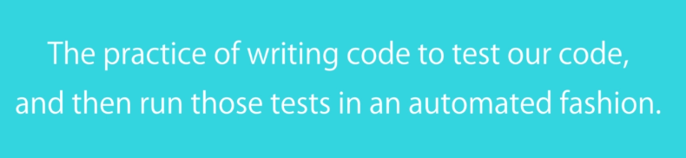
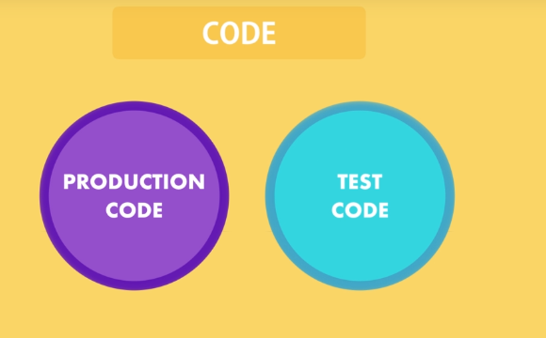

Slide 3
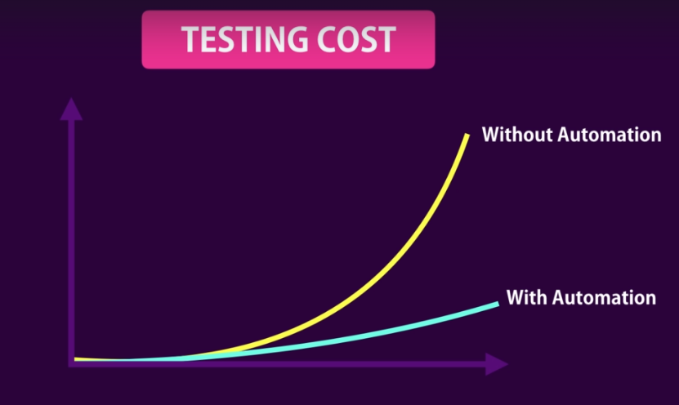

Slide 4



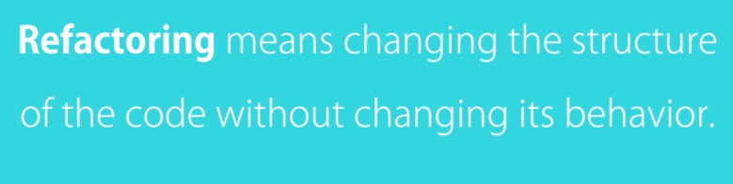


Benefits of automated testing?

Slide 5
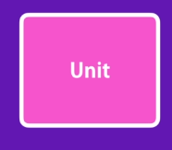

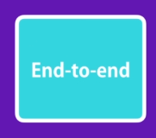
Types of TESTS

Slide 6

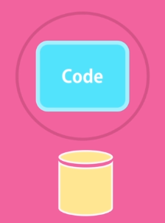
UNIT TEST
Files, Data bases,Message ques,weservices etc
Cheap to write.
Easy to execute.
Don’t give a lot of confidence.

Slide 7

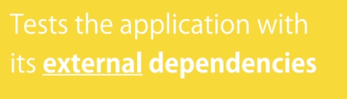

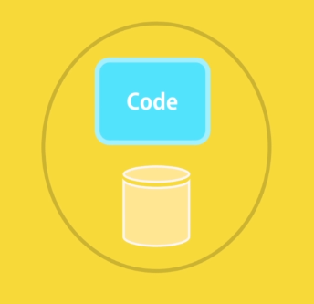
Integration Test
Longer to execute
Give more confidence

Slide 8
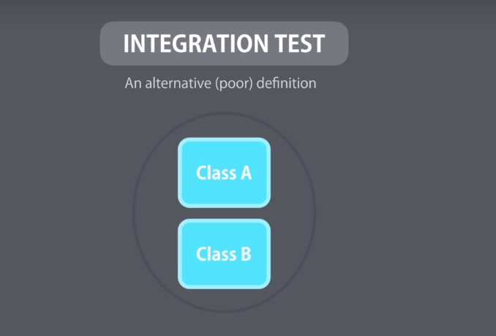
Traditionally Integration test defined as taking few classes and tests its behaviour as a whole

Slide 9


End to End Test
Tool Selenium
Give you great confidence
Very slow
Very brittle

Slide 10
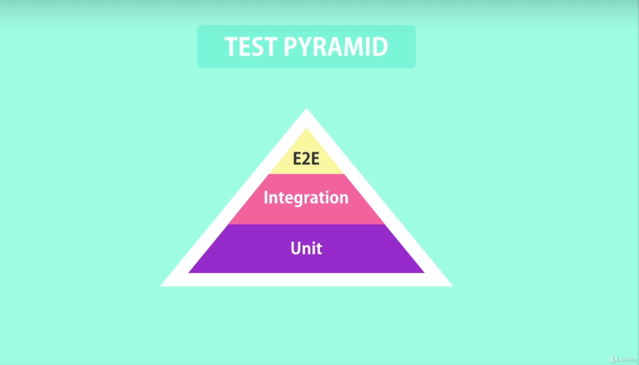
Test pyramid
Combining all types of tests such a way that Taking each ones advantages and avoiding disadvantages

Slide 11
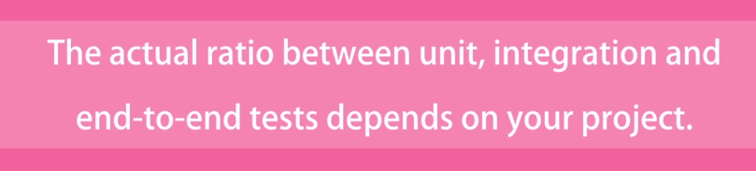
BUT….

Slide 12
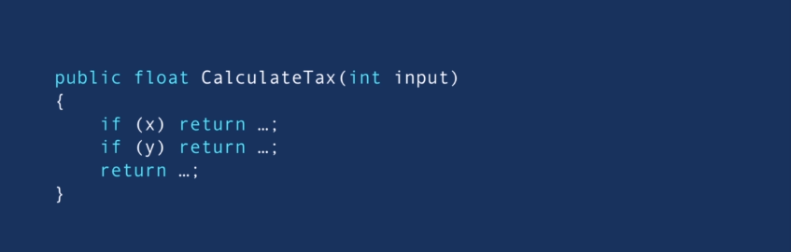
Methods with complex logic and calculation
UNIT TEST - Quick Test all the path.
Manual Testing- Time consuming, Prone to error.

Slide 13

Application simply read data from or write it to a data base Integration test

Slide 14
So, in brief...
Fastest
Prefer unit test to e2e tests .
Cover unit test gaps with integration tests.
Use e2e sparingly.
Cheapest to write
Very precise

Slide 15
Full Stack Application Development
Front-end
Unit Testing
E2E Testing
Back-end
Unit testing

Slide 16
Front-end
Unit Test
Karma-Test Runner
E2E
Protractor
Jasmin
Jasmin- Testing frame work.

Slide 17
Back-end
Unit Test
Mocha-Testing frame work
Chai- Assertion library
JEST – Wrapper over Jasmine
Super Test – Test HTTP module by using upper agent

Slide 18
Importance of unit testing.
Testing of a unit of code by considering its behaviour Not implementation.
Each function/Test should not be greater than 10 lines of code.

Slide 19
Why unit test?

Slide 20
Traditional/Manual Testing
Design
Implement
Test

Slide 21
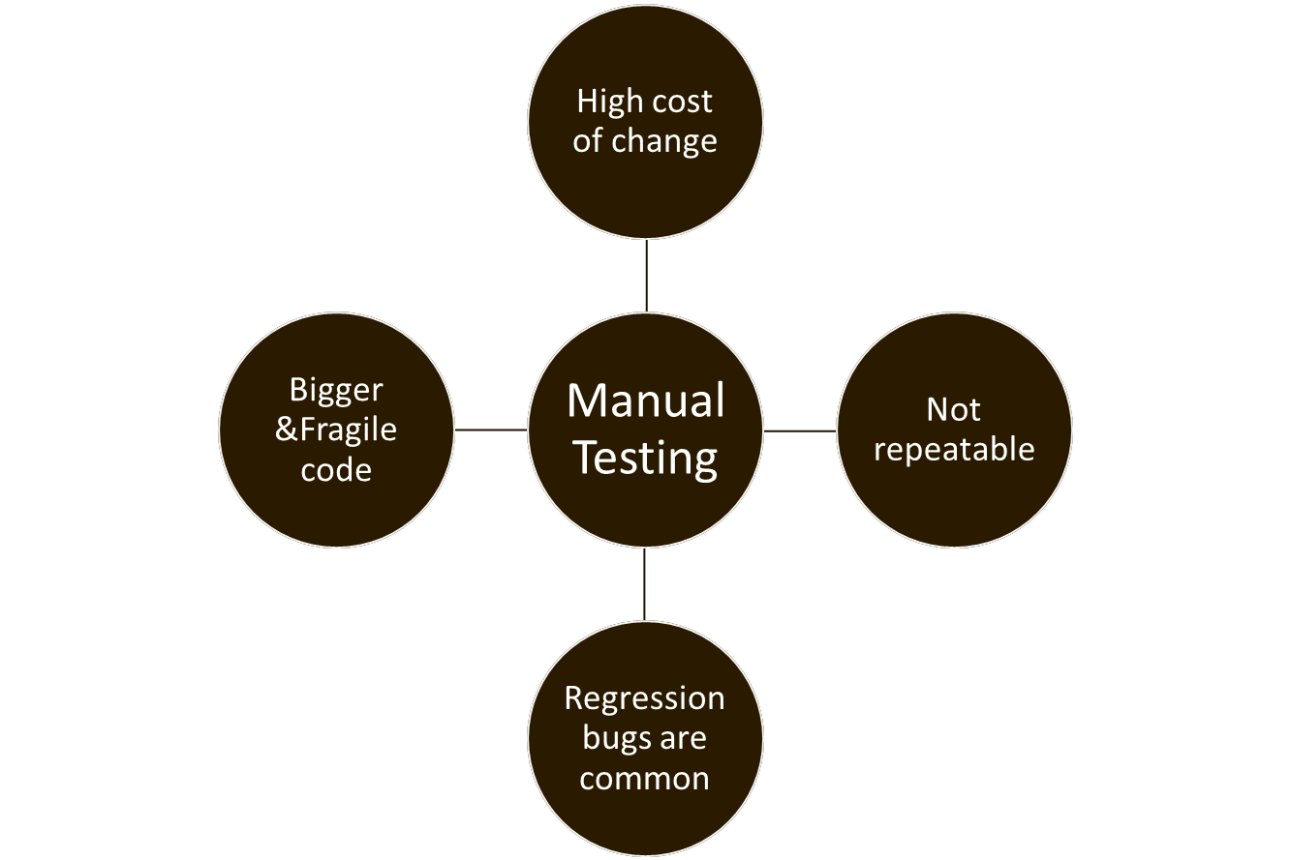
Manual testing-Lenghty

Slide 22
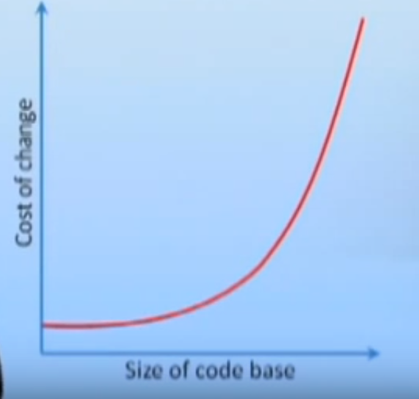

Slide 23
But developers usually do not prefer Unit test, WHY?

Slide 24
Unit Test
Development cost. Feature addition and
Delay in delivery. Bug fixing are easy to
be tested.
Quick HOT fix.

Slide 25
E2E Test
Development cost. Auto detect any DOME
Change.
Delay in delivery. Produce safe code.
Easy Regression Test or
sanity Test.

Slide 26
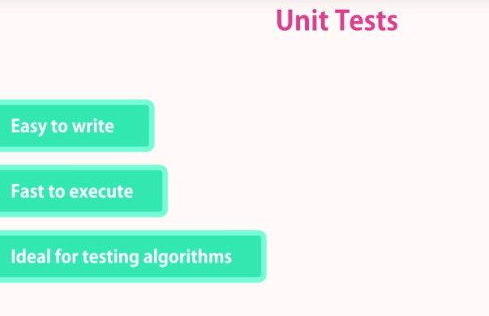
Integration Test
Unit tests are ideal for testing functions with 0 or minimal dependencies. But in real world application, we need to work with one or more external resources
SO integration Test!
We test our application code along with external resourses as a whole

Slide 27
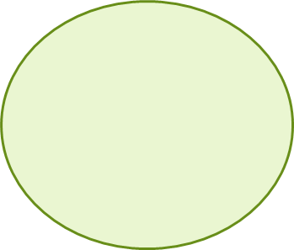
Integration Test
We need a real Data base
1:Populate DB
2: HTTP Request to
An end point we
want to test
TEST
SERVER
3:Assert(Inspecting the response or DB)

Slide 28
UNIT TEST

Slide 29
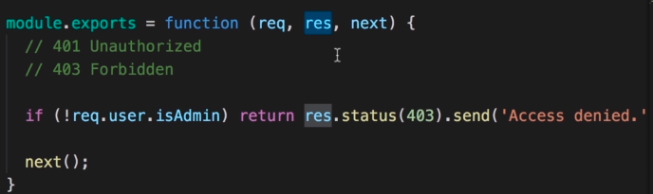
What to Unit Test
Use unit test to testing functions with algorithms that have 0 or minimum dependency to external resources.
Try to avoid creating too many mocks
It is better to write integration test if there are many mock method required.

Slide 30
TOOLING
A right test– Right frame work
LIBRARY – Gives bunch of utility function to write test.
TEST RUNNER-Programme that run from command line.

Slide 31

FRAME WORK
JASMINE- Comes with all testing features. No additional plug ins used
MOCHA- Popular Testing frame work in NPM.
Use alongwith some other plug in Like
Chai & Sinon as it doesnt have
some library features
JEST - Newer frame work- (Facebook to test
Re-act Application)
Basically a Wrapper around jasmine.

Slide 32
Your First Unit Test
Show Code Sample

Slide 33
Test a Number & a String
Show Code Sample

Slide 34
Grouping Test
Show Code Sample

Slide 35
Refactoring with Confidence
Show Code Sample

Slide 36
Test Array
Show Code Sample

Slide 37
Test Object
Show Code Sample

Slide 38
Test Exceptions
Show Code Sample

Slide 39

Continually Running Test
No Need of running npm test all the time
Set a flag inside your script in package.json

Slide 40
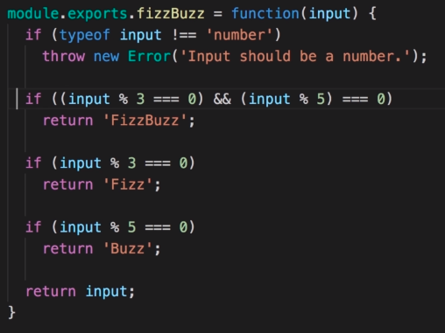
Excercise

Slide 41
Mock Function Testing
We don’t need to interact with another endpoint while writing unit test
Unit Test won’t be dependant to any external component.
Create mock function inside your test method to validate the output.

Slide 42
Interaction Testing
Test the interaction of objects
Write mock function as required

Slide 43
Jest Mock Functions
jest.fn();
It can return a value by calling jest.fn().mockReturnValue({});
It can also return promise resolved value jest.fn(). mockResolvedValue();

Slide 44


Slide 45
INTEGRATION TESTING

Slide 46
Setting Up Test DB
Integration test of real database can be done but we don’t want to mess the production data as we might be adding/ removing data while testing.
Add test database connection string(config/test.json)
Connect to db via node index.js to verify the connection is working
Import config to startup/db.js and modify tour connection string.
Set NODE_ENV=test
Connect to test db.
Write your test inside tests/genres.test.js

Slide 47
Your First Integration Test
npm install supertest –save-dev
Back to index.js and export the mongo db server to reuse it in the test
Add folder integration inside your test folder and your test file, say genres.test.js
Go to test file and add test suit for the genres end point. Also add suit for GET, GET/id, POST, PUT/id & DEL/id
Load the server before and close it after testing

Slide 48
Populating the Test DB
Import genre model
Inserting data to database
Always clear the data when you modified the database

Slide 49
Testing Route with Parameters
Populate genre collection
Create one genre and call the end point
Test the body with toMatchObject() and verify output
Test the bodt with toHaveProperty() and verify the output

Slide 50
Testing Route with Parameters
Populate genre collection to test valid output
Create one genre and call the end point
Test the body with toMatchObject() and verify output
Test the bodt with toHaveProperty() and verify the output
Test 404 case with next test
Test with some id which is not there in the db and verify output
Test it without validateObjectId and verify output

Slide 51
Testing the Authorization
No. of Test is equal to or greater than number of execution time.
Test return value, it should be 401

Slide 52
Testing Invalid Input
Import user model and call generateAuthToken() to do authorization
Call set method to set header
Test min and max length for genre

Slide 53
Testing Happy Path
Check genre with same name is already exists in the database
Genre should be there in the body of the response.

Slide 54
Write Clean Test
Shoe Sample Code

Slide 55
Test Auth Middleware
Create new file auth.test.js to test auth.js middleware
Start and close server on beforeEach() and afterEach() respectively.
Set valid token on beforeEach();
It will return 400 when the token=null as the header value will be string always.
We don’t have access to the request object, we only work on response. Hence decoded string to be tested with a Unit Test

Slide 56
Unit Test Auth Middleware
It should populate req.user with the payload of a valid JWT
Mock request object & next function
Create user object and create anew instance for testing

Slide 57
Code Coverage
Define the coverage flag in jest config
Find the report at /coverage/lcov-report/index.html
Code coverage tool will calculate the branches/excitation path based on the return statement.
Code Coverage missing area can be found at the report. Eg: /coverage/lcov-report/integration-testing/routes/genres.js.html
Check the line of code and update test to increase coverage
The report is having the number f function which are covered by test cases and the number of lines code which are covered in the test cases.
Update the ,ignore file with coverage folder as we don’t need to commit the coverage folder to the repository.

Slide 58
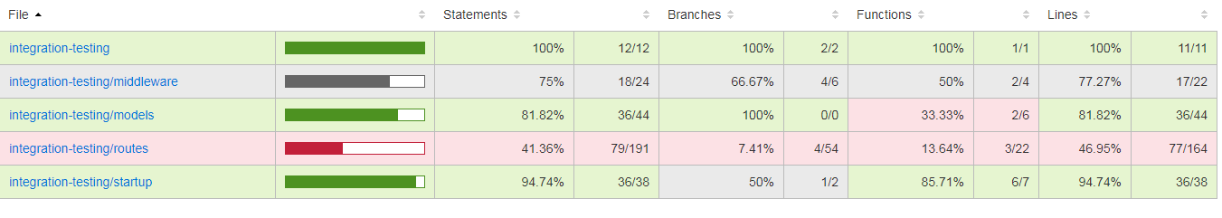
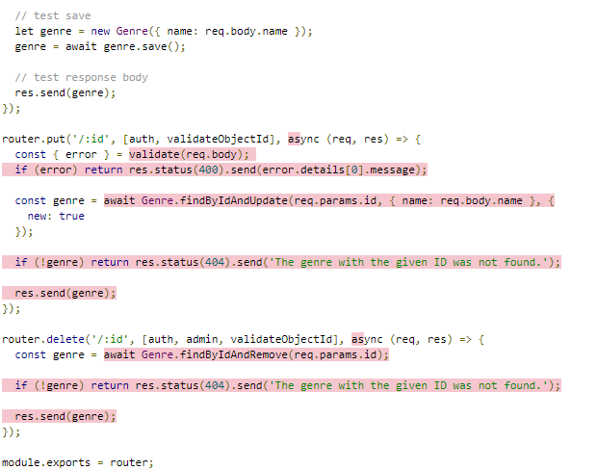

Slide 59
TEST DRIVEN DEVELOPMENT

Slide 60
Solution- Test driven development/ TEST FIRST DESIGN
TEST
DESIGN
IMPLEMENT

Slide 61


TEST-DESIGN-IMPLEMENT

Slide 62
Code First Development
AUTOMATED UNIT TEST
Easy and quick regression test the whole data
Verify that no code is broken
Can fix a bug straight away, with fewer minute
The longer the bug in a system, The harder is to fix it.why?

Slide 63
NOW YOU KNOW, TDD is a practice of writing an automated unit test to your code before you write your code.

Slide 64
HOW DO YOU DO TDD?

Slide 65



Fundamentals of TDD

Slide 66
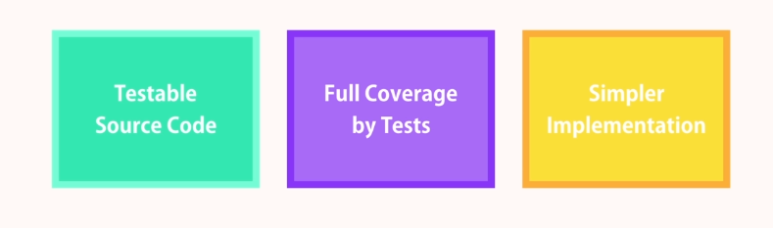
Benefits of TDD

Slide 67
Test First or Code First?
It depends whom you are ask☺
In

Slide 68
Code First
Test First
100% code coverage
Results clean code
Full-fill all requirement
Deploy with confidence
Sometimes it can get complex and slow down.
We will have something to view in a short period of time.
Easy to convince client

Slide 69
TDD PROCESS
THINK
WRITE A TEST
RUN TEST TO GET ALL YOUR TEST FAILED
WRITE CODE AND TEST YOUR CODE
FIX FAILURES
REFACTOR NEW CODE
RUN YOUR TESTS& FIX FAILURES
CHECK IN YOUR CODE

