Slide 1
Dukan

Slide 2
Table of contents
01
02
03
04
Business model
Our idea
Demo
Competitor and SWOT analysis

Slide 3

About us
Dukan is an e-commerce portal that connects artists, and handicraft producers across Jordan to new economic opportunities.

Slide 4
01
Our idea

Slide 5
A brief story
Dukan is an innovative e-commerce portal that connects artists, artisans, and handicraft producers across Jordan to new economic opportunities. It helps these vendors share their products and tell their stories, while also offering payment, delivery, and customer care services. Vendors can therefore sell more products online and increase their income.

Slide 6

Our Logo

Slide 7
Problems Addressed by Dukan
A large, diverse group of people in Jordan are active in arts and handicrafts. But despite a mastery of their craft, many small- and home-based artisans struggle to market and sell their products.
Simply put, buying high-quality handicrafts is hard. Boutiques suffer from small selection and high-prices; souvenir shops offer imported goods to tourists; bazaars appear and disappear without much notice. As a result, customers looking for an easy way to buy high- quality, locally made products have nowhere to go.

Slide 8
User Persona

Slide 9
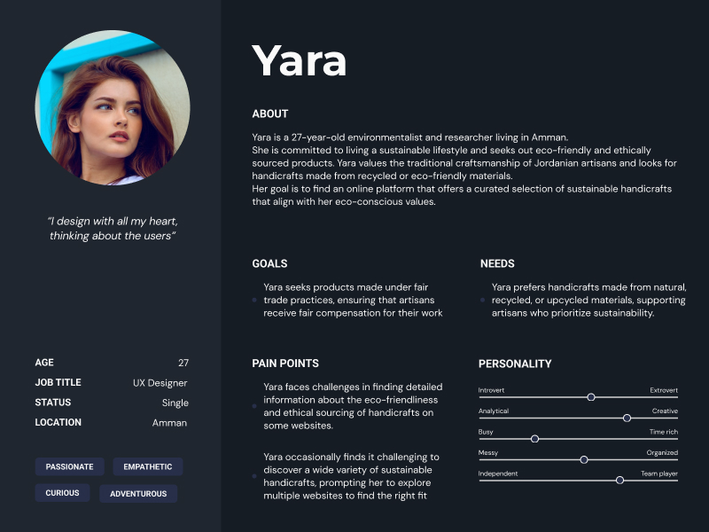

Slide 10
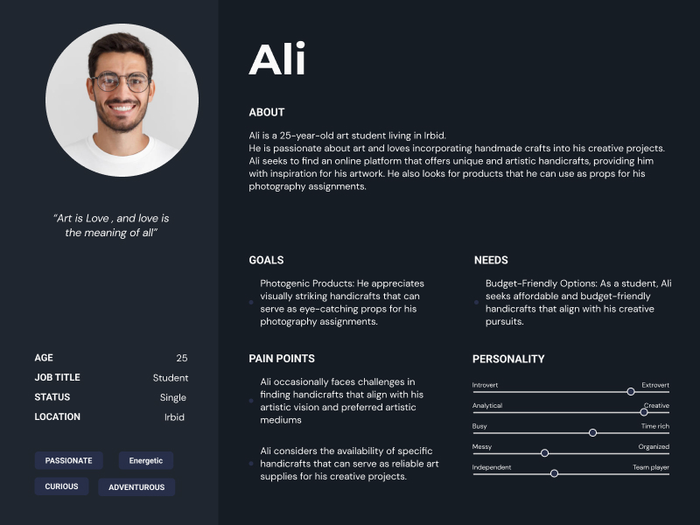

Slide 11
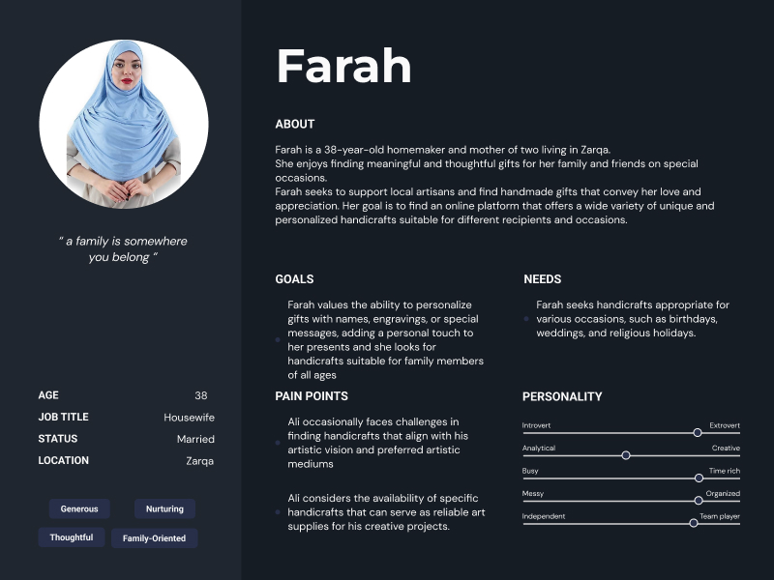

Slide 12
02
Business
Model

Slide 13
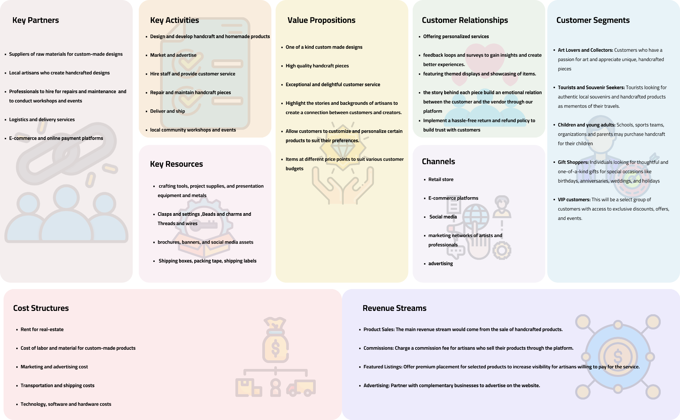

Slide 14
SWOT analysis
Weaknesses
Threats
Opportunities
Strengths
Challenges related to inventory management and shipping logistics to ensure consistent product availability and timely deliveries
Changing consumer preferences is another potential challenge and the trendy market is surely something we need to consider to stay in the business
A wide range of unique and authentic handmade products. Unlike mass-produced items, our products appeal to customers who are looking for personalized and distinctive items
There is a growing demand for handmade products as consumers seek unique and personalized items that support artisans. By continuously adding new products and highlighting the craftsmanship behind each piece, we can capitalize on this trend

Slide 15
03
Competitor analysis

Slide 16
competitor analysis: allform Jordan
Strengths
Specialized Product Range: allform jordan focuses on niche handmade products, such as artisanal leather goods, wooden carvings, and metalwork, catering to customers seeking exclusive and specialized crafts.
Unique Artistic Style: allform jordan website showcases a unique and contemporary artistic style, appealing to customers with modern and trendy preferences in handcrafted items.
Social Media Presence: allform jordan maintains an active social media presence, using platforms like Instagram and Facebook to showcase products and engage with customers effectively.

Slide 17
competitor analysis: allform Jordan
Weaknesses
Limited Product Diversity: allfromjordan specialized focus might lead to a limited range of product categories, potentially limiting choices for customers seeking a broader selection of crafts.
Shipping and Delivery Times:allfromjodan may face challenges in offering timely and cost-effective shipping options, potentially impacting customer satisfaction, especially for international orders.

Slide 18
competitor analysis: ALBURGAN
Strengths
Personalized Customer Service: ALBURGAN provides personalized customer service, assisting customers in finding the perfect handmade products that suit their preferences and needs.
Corporate Gifting Services: ALBURGAN offers specialized corporate gifting services, catering to businesses seeking unique and thoughtful gifts for clients, partners, and employees.

Slide 19
competitor analysis: ALBURGAN
Weaknesses
Limited Marketing Initiatives: ALBURGAN may lack extensive marketing efforts, which could impact its visibility and reach in a competitive market.
Limited Artisan Network: The website's limited network of artisans might restrict the diversity of products available, potentially reducing its appeal to customers seeking a broader range of crafts.

Slide 20
04
Demo

Slide 21
Links
https://www.figma.com/file/MchlB7EBwtzWywdnh1dK21/Dukan-StyleGuide?type=design&node-id=40-2732&mode=design&t=7iHSlANroi6CLXQE-0
https://www.figma.com/file/viW4ErkkItAJFhG6yQIgC1/Dukan?type=design&node-id=0-1&mode=design&t=4LCDdKLZGsvGAFhe-0

Slide 22
Thanks
Do you have any questions?

