Slide 1
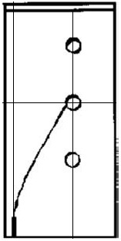
Experiment [1]
RVFT [2]
XFEM
y
x
[1] T. N Bittencourt, PA Wawrzynek, AR Ingraffea, and JL Sousa. Quasi-automatic simulation of crack propagation for 2d lefm problems. Engineering Fracture Mechanics, 55(2):321–334, 1996.
[2] C Miehe, M Hofacker, and F Welschinger. A phase ﬁeld model for rate-independent crack propagation: Robust algorithmic implementation based on operator splits. Computer Methods in Applied Mechanics and Engineering, 199(45):2765–2778, 2010.

Slide 3
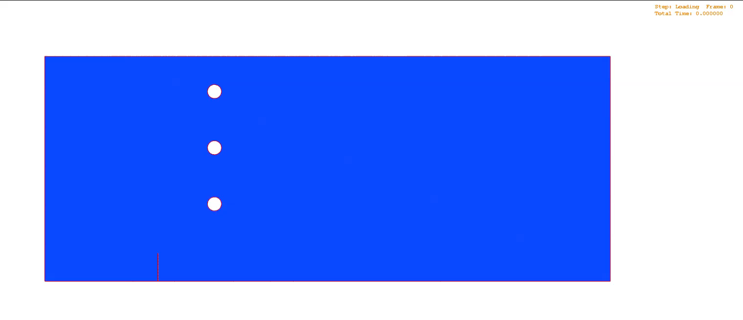
XFEM

Slide 4
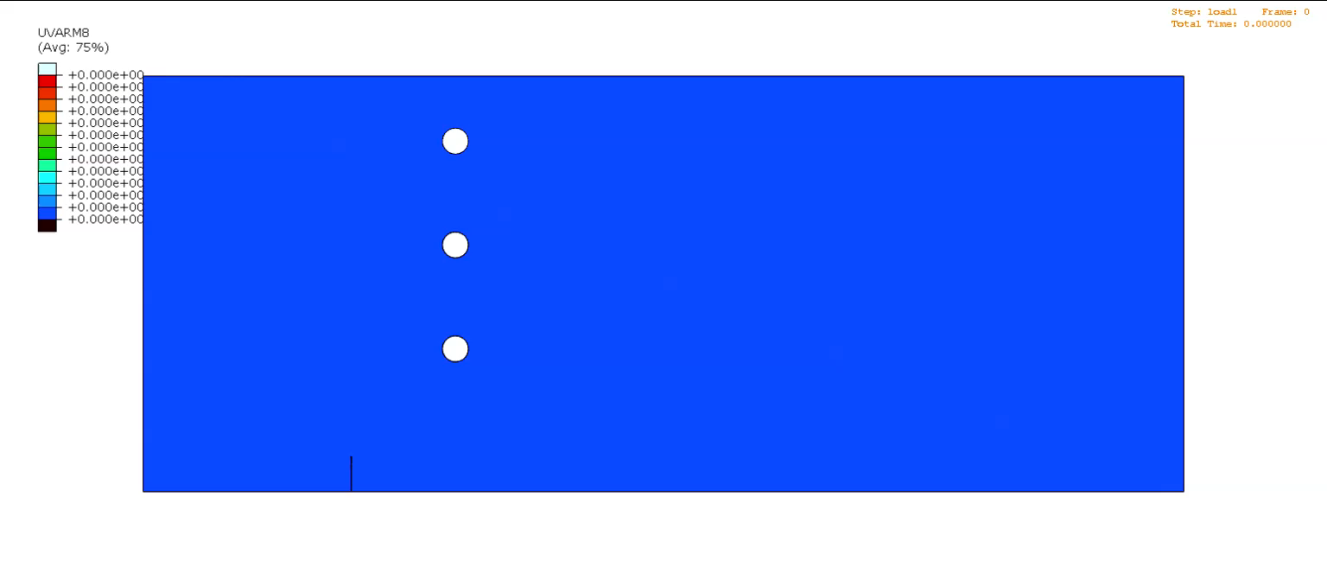

Regularized, Variational Fracture
$$d$$
1
0

